Slide 1
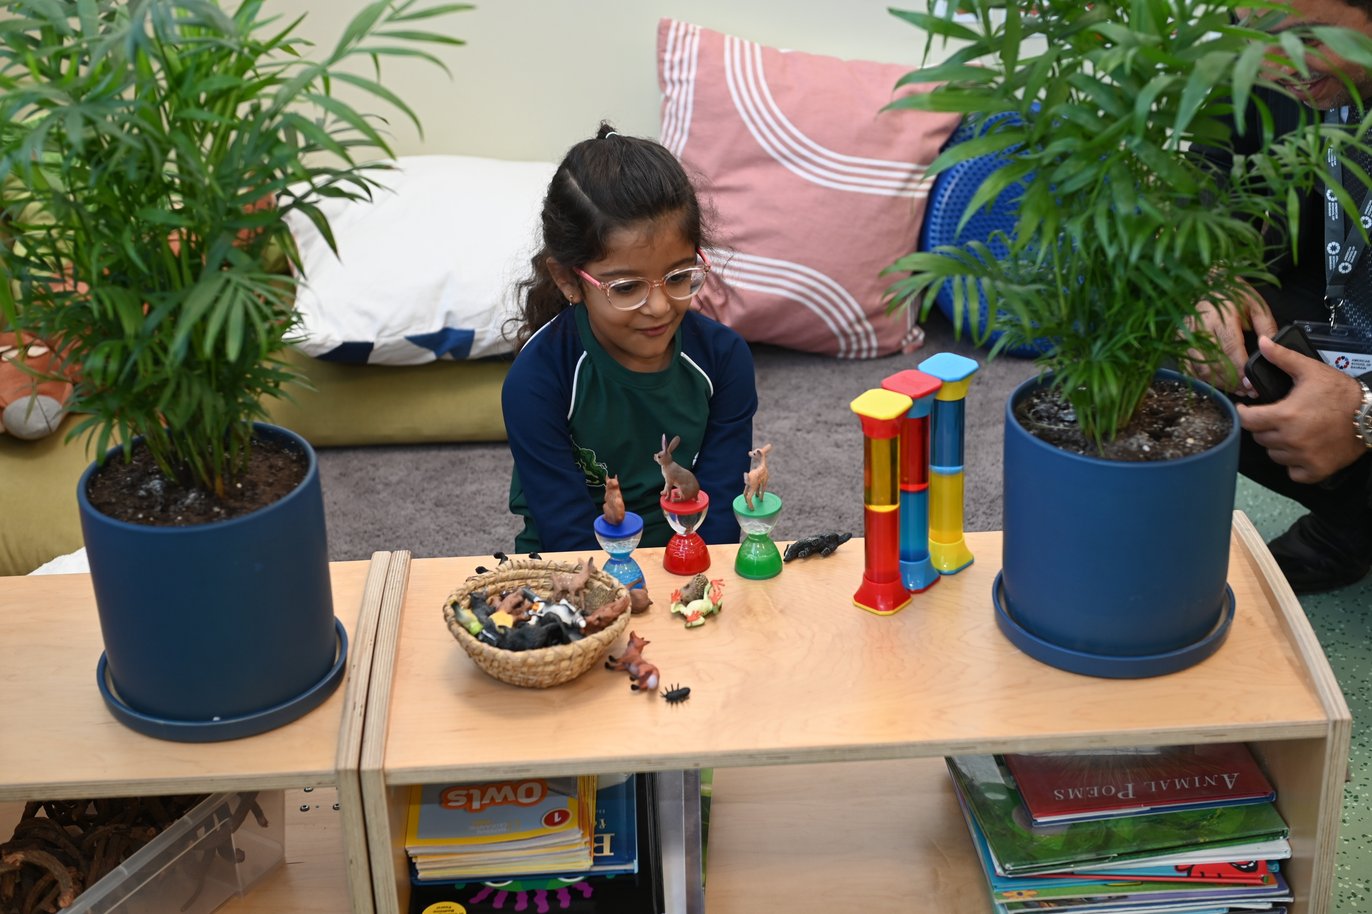
The Importance of Play in ECE
Presenter name: Dawn Larkin

Slide 2
Table of content
NSPCC Definition
The Power of Play
Introduction to Physical Play
Brain Development in the Early Years
Adapting Learning for Children with Additional Needs

Slide 3
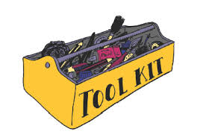
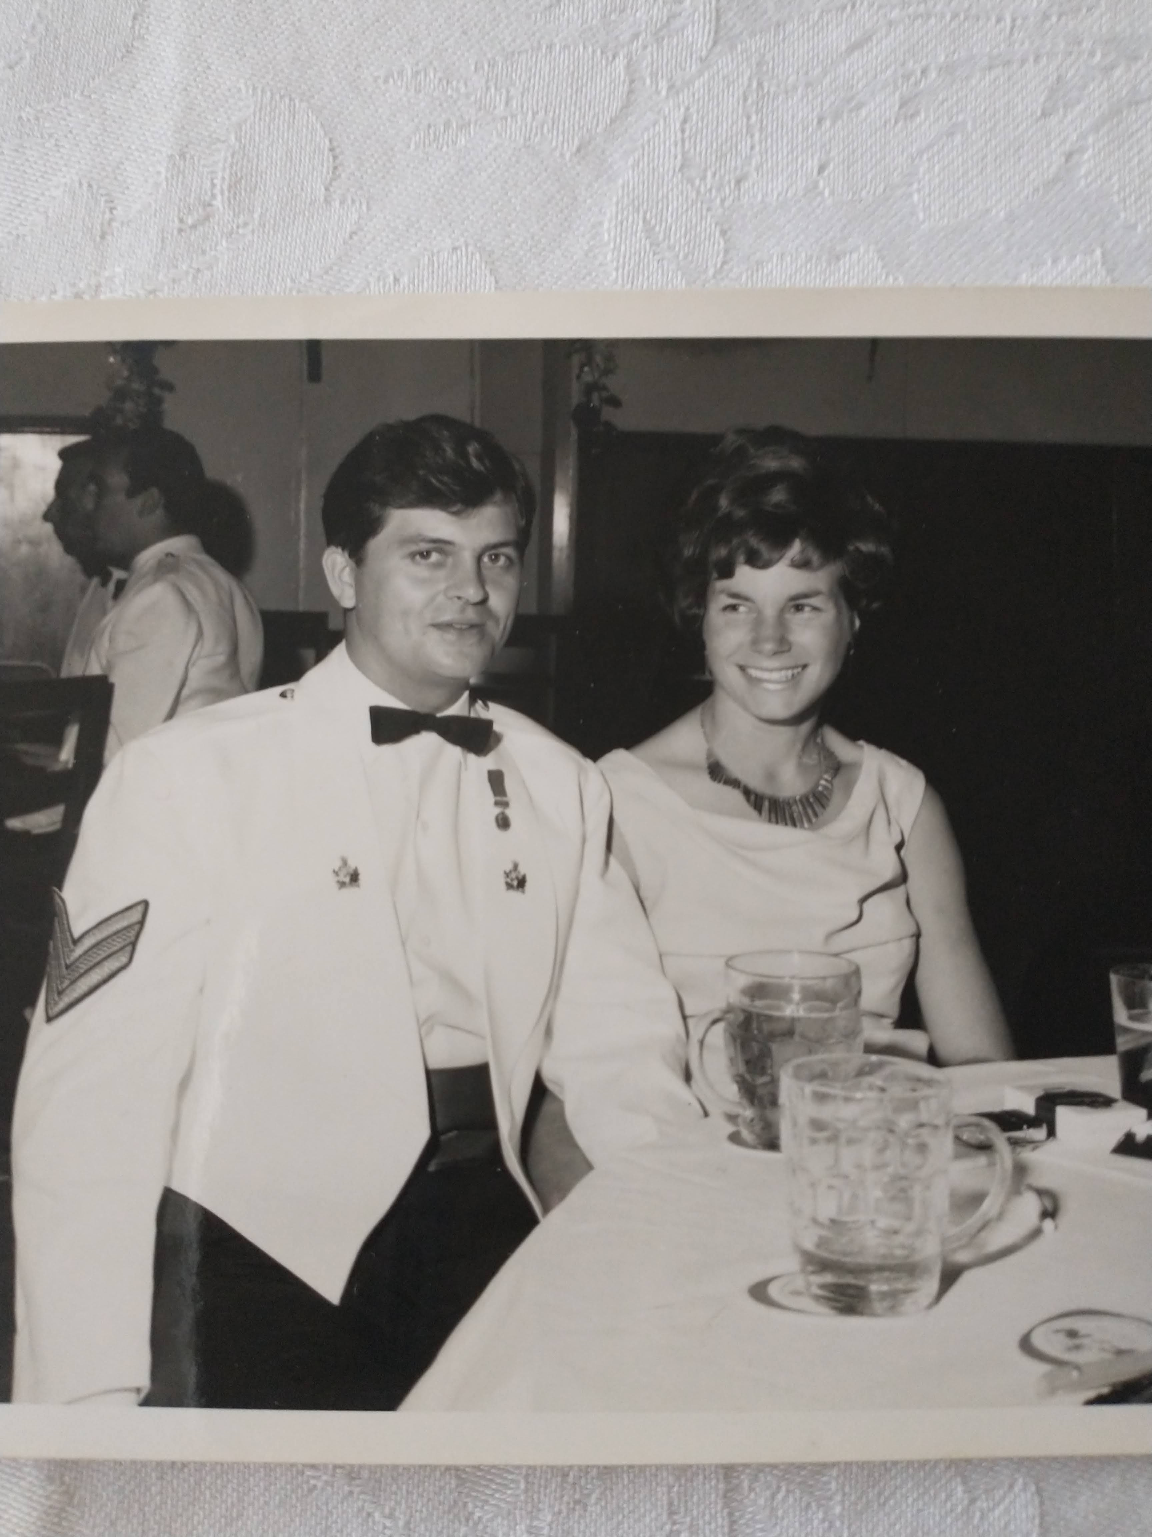
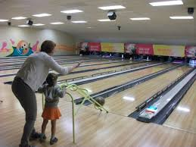
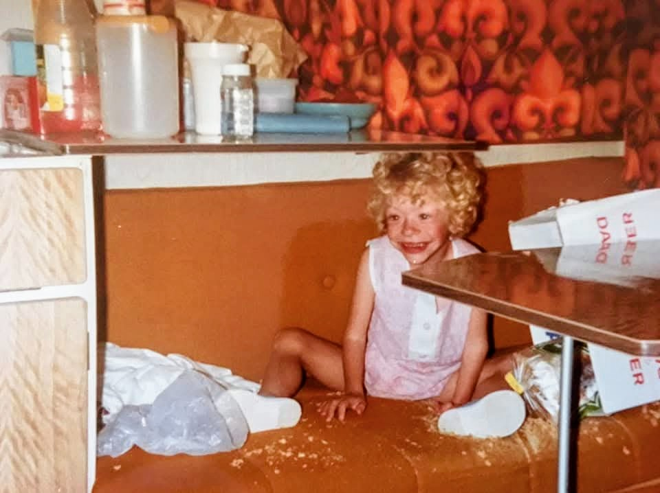
My Toolkit
Notes:
I grew up in London, my parents were in the Army so we travelled a lot. The area of London where we lived was very multi-cultural so both these experiences gave me an insight into other countries and cultures.
When I was 3, I met my best friend Megan who soon had a cousin called Olivia.
Olivia was born with a rare syndrome called William’s Syndrome. She loved music and was very loving and friendly but her understanding was very delayed and although she had quite good speech, it was on her terms, she found it difficult to answer a direct question. Olivia had some challenges and was delayed in a number areas of development. Most importantly, she was a very happy and fun loving person, always singing and dancing.
Rightly so Olivia’s mum wanted Olivia to access everything Megan and I did, so Olivia did! She came horse riding, ice skating and bowling with us. There were always adaptations to help Olivia to have as much fun as us. For example, when we went bowling the bumpers would be put up and a ramp was used to help Olivia with the weight of the bowling bowl.
Once again something was added to my toolkit that helps me to do my job today, I was learning and am still learning about how to make education and life inclusive.
I always knew I wanted to work with children, right from an early age, I would help look after the younger children at playtime at Primary School and when Megan and I were older enough we would volunteer at the holiday clubs for children with special needs where Olivia went for fun in the holidays.
I always knew that working with children was my vocation. I went to university and became a teacher always with the passion for early years education and special educational needs. After 10 years of teaching I went to work in Children’s centres, which was for families. Part of this role was to support families, schools and nurseries to understand how high quality education and care helped children to thrive. I then qualified as an Early Years Inspector, working for Ofsted, inspecting early years childminders and nurseries. For over 10 years now I have been an Early Years Consultant working in the U.K and internationally.
We all have different tools and experiences in our tool box and we add to our toll boxes all the time but it is really important never to assume it is full or tools do not need replacing or improving. We don’t know what we don’t know!
I wish the 21 old me knew what I now know about special needs, high quality teaching and education and children’s behaviour.
Today, I hope to add to your toolkit!

Slide 4
NSPCC Definition
Children's development and mental health are affected by factors such as the environments they're raised in, the relationships they build and the experiences they have.
Child development refers to the physical, cognitive, emotional and social growth that occurs throughout a child's life. Children's mental health – their cognitive, behavioural and social wellbeing.

Slide 5
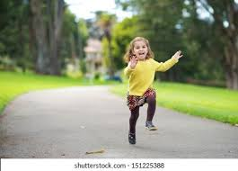
The Power of Play!
Why do children skip?
Notes:
Discuss with the person next to you, why do you think children skip?

Slide 6
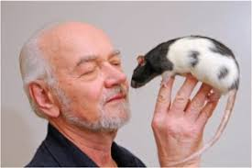
Jaak Panksepp – “The Rat Tickler” (neuroscientist)

Slide 7


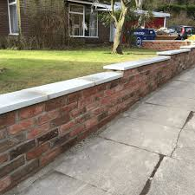
What does a child naturally do when they are in the following spaces?

Slide 8
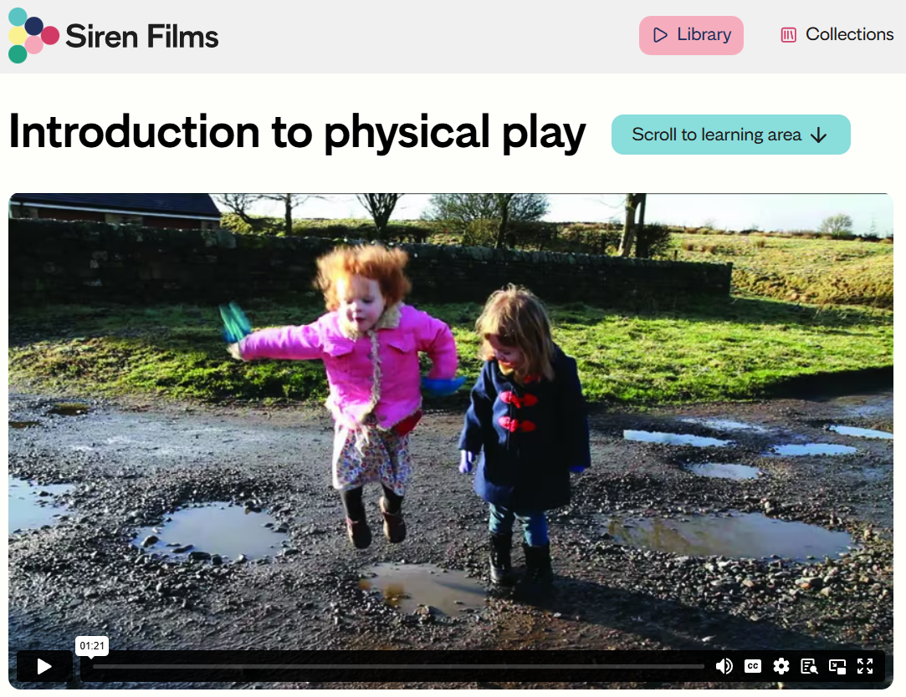
What does a child naturally do when they are in the following spaces?
https://www.sirenfilms.co.uk/library/introduction-to-physical-play/

Slide 9
Physical Play (Gross Motor) – Take Aways!
Gross motor play supports the development of…
Children’s confidence and mental health and well-being
Endurance and strength
Vestibular and proprioceptive senses (balance & body awareness)
Confidence control and use of body
Goss motor play/skills are needed for writing before fine motor skills
Notes:
Watch Physical play
Watch Why do children take risks in their play?

Slide 10
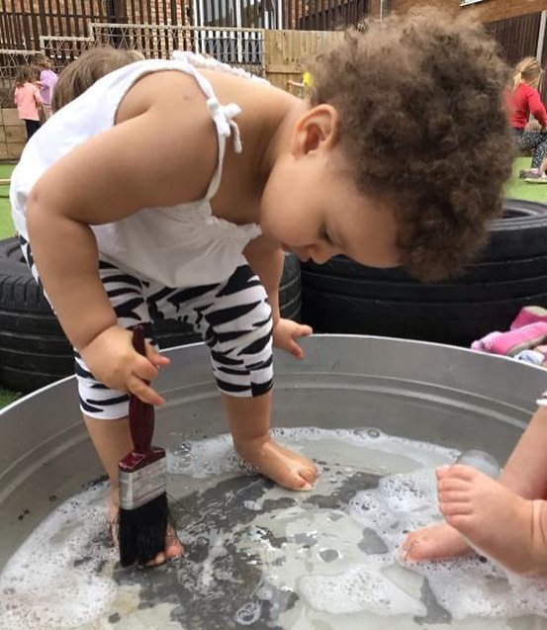
The Central Importance of Play
“Play is the highest level of child development. It is the spontaneous expression of thought and feeling. …It…constitutes the source of all that can benefit the child… At this age play is never trivial; it is serious and deeply significant.”
(Froebel in Lilley 1967:84)

Slide 11
Froebel created the first kindergarten, a place where children can grow and develop at their own pace, nurtured by knowledgeable and supportive adults.
Froebel saw children as active, curious, creative learners who learn best through activity, play, talk, and self-reflection.
They thrive when they are emotionally secure and in close relationships with others, including the family and wider community.

Slide 12
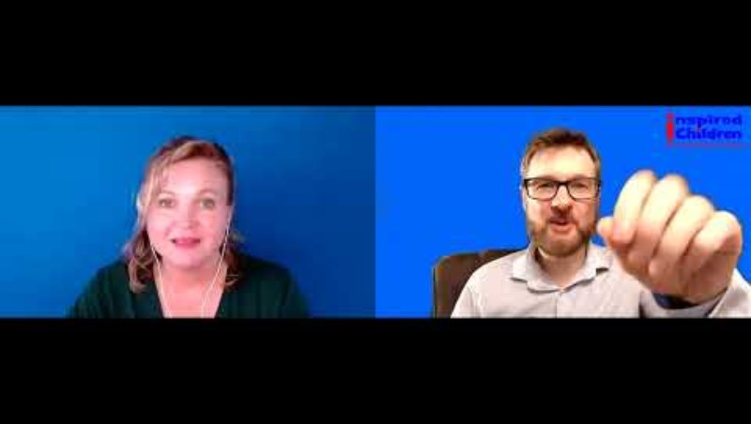

Slide 13
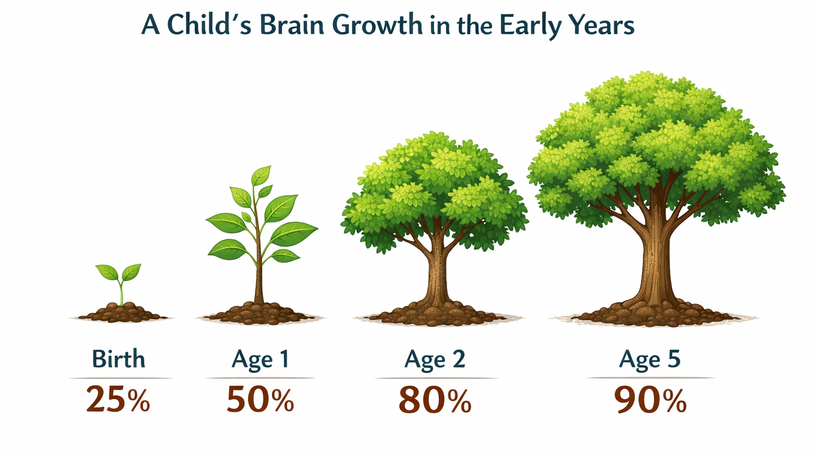
Brain Development in the Early Years
In the first years of life , a child’s brain forms more than 1 million new neural connections every second.

Slide 14
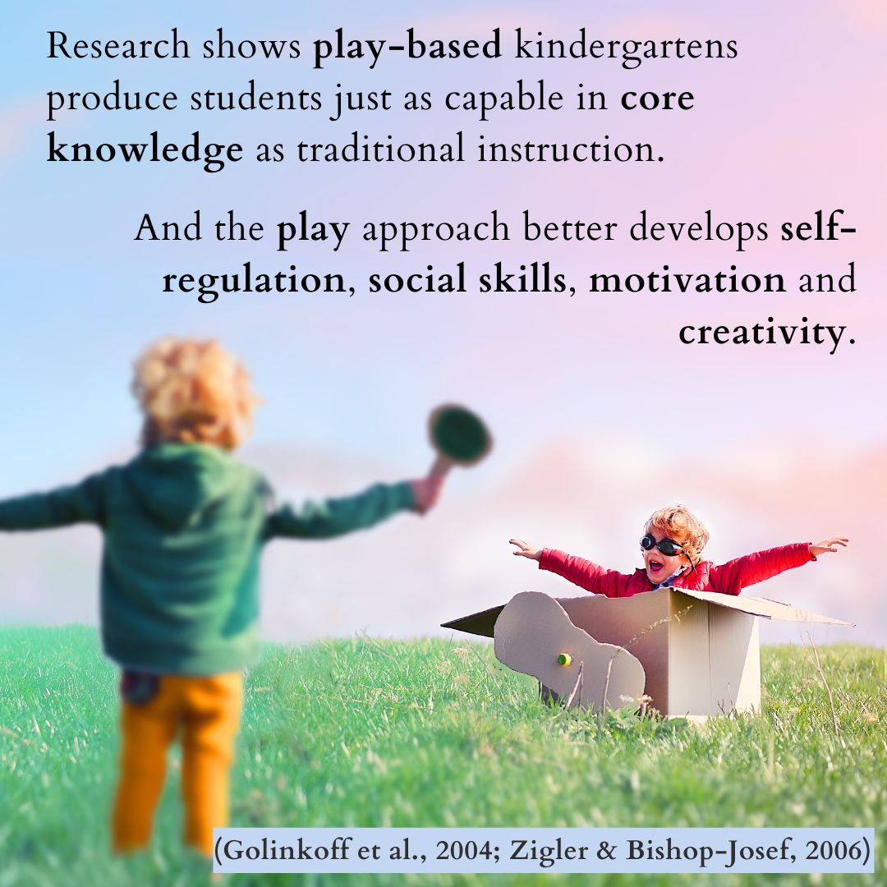

Slide 15
But how…?
The learning environment is often described as the third teacher. (Reggio Emilia approach)
A good learning environment encourages children to explore, be independent, curious and collaborative in their play and learning.
Resources are accessible and reflect the children’s needs.
Notes:
Give example of Ethan – painting and Oscar

Slide 16
But what might that look like?
Providing good quality continuous provision, allows children “to continue the provision for learning in the absence of an adult”
However, it is enhanced by high quality interactions from educators and resources that support children’s next stage in their development and reflects their interests. Interests allows children to be motivated learners.
Continuous provision should be available daily.

Slide 17
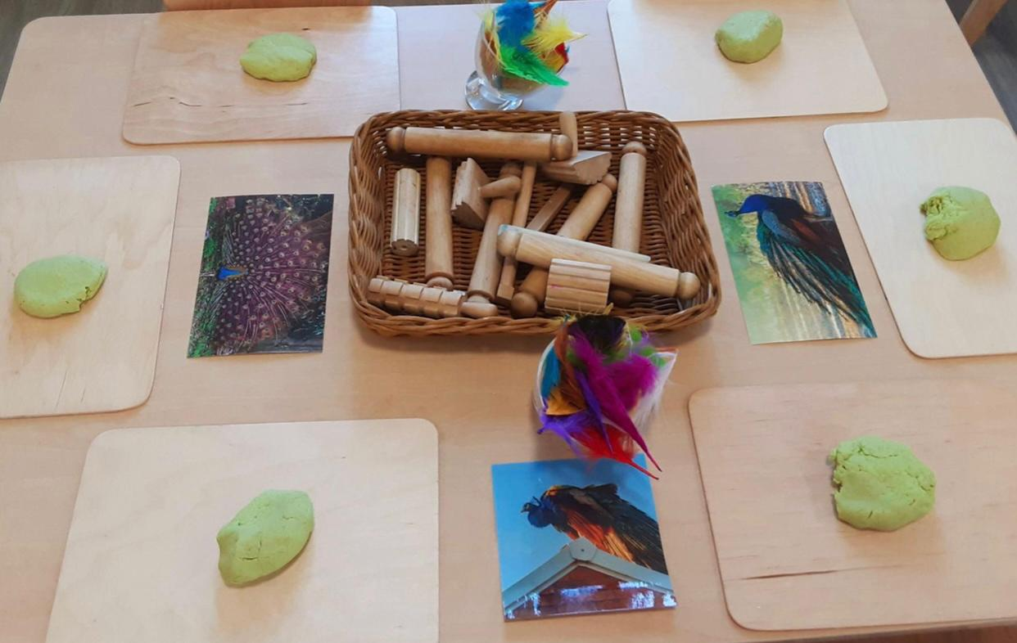
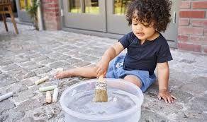
What are some of the areas of Continuous provision?
Notes:
Water, sand, small world, construction, painting, mark making, messy play, role play, playdough/malleable , books, maths is everywhere

Slide 18
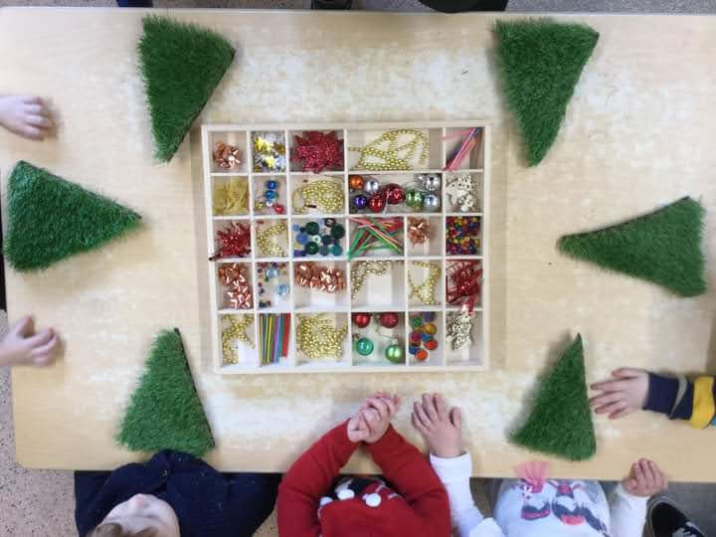
Adult led - and child-initiated learning

Slide 19
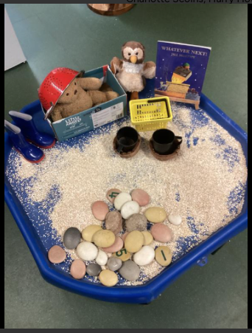
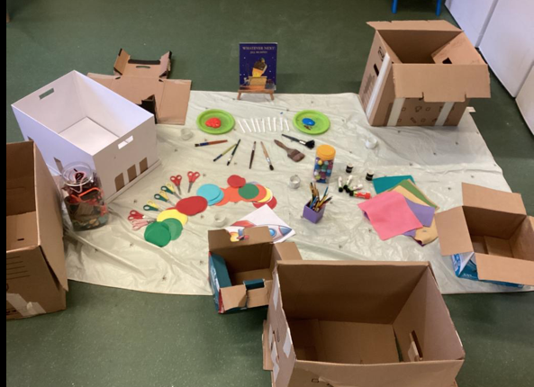
Adult led - and child-initiated learning

Slide 20
Adapting learning for children with additional needs
Meet the child where they are
Support understanding with objects of reference or visuals
Understand what helps children to co-regulate
Physical resources
Adapt language
Adapt environment
Consider the size of groups

Slide 21
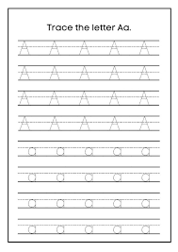
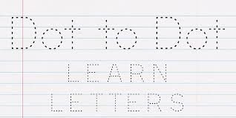
Handwriting – mistakes from the UK!

Slide 22
Better Alternatives
Instead of handwriting sheets and name cards, children need:
Large-scale mark making: Strengthening gross motor skills with paint, chalk, sand and water
Multi-sensory practice: Using dough, foam, or loose parts to form letters
Authentic purpose: Writing that matters to the child
Adult modelling: Shared writing and talk that link sound, movement and meaning
Developmental readiness: Waiting until children’s bodies and brains are prepared for fine handwriting

Slide 23

Created by Shonette Bason
Notes:
https://www.youtube.com/watch?v=i-IfzeG1aC4

Slide 24
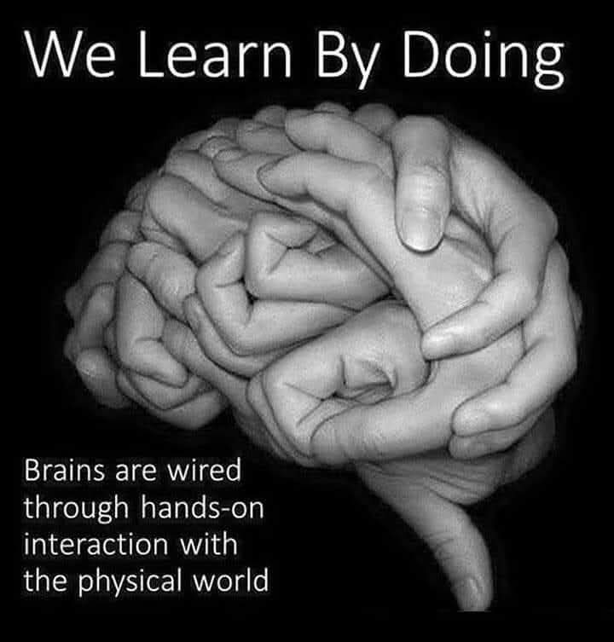
Take Aways
Play isn’t a reward for good behaviour or something that happens after the ‘real work’ is done.
It’s the infrastructure through which children process their experiences, build relationships, and develop the skills they need for life
Play supports brain growth and children to thrive!
‘Children’s right to play must be the anchor for all child development and mental health support.’
Dr Kate Renshaw

Slide 25
What will you add to your toolkit?

