Slide 1


The General Framework
of Higher Education Institutional Review
SER Training

Slide 2
Training Agenda
Time | Topic
08:45-09:00 | Registration
09:00-09:30 | Introduction: Review Processes & Outcomes Dr. Sh. Lobna Al Khalifa
09:30-10:15 | Review Standards & Indicators Standards (1-3) Dr. Sh. Lobna Al Khalifa
10:15-10:30 | Coffee Break
10:30-11:15 | Review Standards & Indicators Standards (4-6) Dr. Hala Obaid
11:15-12:00 | Review Standards & Indicators Standards (7-9) Dr. Salwa Elekyabi
12:00-12:30 | Prayer Break
12:30-1:00 | Self-Evaluation Report & Supporting Materials Ms. Sara Essam
1:00-1:45 | Activity Ms. Sara Essam
1:45-2:00 | Concluding Remarks & Guidelines Dr. Sh. Lobna Al Khalifa

Slide 3

Institutional Reviews, Processes & Outcomes

Slide 4
The Main Purposes of the Institutional Review
To enhance the quality of Higher Education in the Kingdom of Bahrain and ensuring public accountability of Higher Education Institutions (HEIs) through the provision of an objective assessment of the quality of each provider, which produces published reports and summative judgements that will be utilised by the Higher Education Council (HEC) for the purpose of accrediting these providers, as well as being made available to students, parents, and other relevant bodies.
To spread quality assurance culture across the higher education sector and enhancing the quality assurance arrangements of each HEI through (i) facilitating capacity development workshops and related activities; (ii) liaising with the relevant regulatory bodies; and (iii) disseminating good practices throughout the Bahraini higher education sector.

Slide 5
The Main Documents
The General Framework of Higher Education Institutional Review
https://online.fliphtml5.com/mghkl/jscq/
The Institutional Review Handbook
https://online.fliphtml5.com/mghkl/wcpj/
Institutional Review Standards
1
Review Judgments
1
Glossary of Terms
Required evidence
4
4
Institutional Review Indicators
BQA & HEC Coordination Mechanism
Selection & Appointment of Review Panels
2
5
2
5
Site Visit Arrangements
Institutional Review Expectations
Key features of good self-evaluation
3
6
General Review Policies
3
6
Preparation of Review Reports

Slide 6

What do we need from the HEI?
Nominating a contact person
Conducting a thorough self-evaluation following BQA guidelines
Uploading the Self-Evaluation Report (SER) and Supporting Materials (SMs)
Informing the Institution’s community about what is happening
Planning and providing the logistics needed for the site visit’s interviews and tour
Meeting the deadlines specified in the review handbook for each review step and ethical guidelines

Slide 7
The Main Milestones in the Institutional Review
BQA
informs
HEIs about review requirements & visit dates
HEIs
submit SERs & SMs to BQA
External Review Panels joined by BQA & HEC staff conduct HEIs’ site visits
BQA
publishes HEIs’ Review
Reports
Eligible HEIs
apply for HEC Accreditation
HEC & BQA
conduct joint Interim Visits to Accredited HEIs

Slide 8
The Outcomes of the Institutional Review
Compliant with the General Framework Standards
The judgement will be final, and the institutional review report will be published on the BQA website.
The institution will be listed or remain listed in the NQF Register.
Partially Compliant with the General Framework Standards
The judgement will not be final, and the institution will be subject to an extension visit in less than two years after the institution and the concerned entities are notified with the initial review judgement.
Not Compliant with the General Framework Standards
The judgement will be final, and the institutional review report will be published on the BQA website.
The institution will be eligible to apply to HEC Accreditation
Based on the extension visit, the overall judgement may change to ‘Compliant’ or ‘Not Compliant’ with the General Framework Standards, and the institutional review report will be published on the BQA website.
The institution will be re-reviewed after one year from the publication date of the institutional review report.
Based on the institutional re-review, the overall judgement may change to ‘Compliant’ or ‘Not Compliant’ with the General Framework Standards.
The HEC will take the necessary actions in line with its policies & regulations.
The listed institution in the NQF Register will be archived.

Slide 9
Institutional Review Standards & Indicators

Slide 10
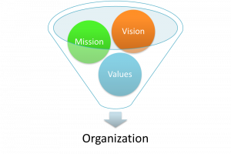
Standard 1
Governance and Management
The institution has an appropriate mission statement and values, which are derived from its vision and translated into strategic and operational plans, and has well-established, effective governance and management systems that enable the HEI to discharge its full range of responsibilities, achieve its mission, and sustain its values.
Indicator 1 – Vision, Mission and Values
The institution has a clearly stated vision, mission and values that are appropriate for the institutional type and the programmes offered; and these align with the national priorities of the Kingdom of Bahrain.
1.1
Publicly displayed, well-communicated & approved by the governing body
1.2
Appropriate to the institution Type & aligned with national priorities
1.3
Developed in consultation with internal & external stakeholders
1.4
Regularly reviewed considering trends in higher education

Slide 11

Standard 1
Governance and Management
The institution has an appropriate mission statement and values, which are derived from its vision and translated into strategic and operational plans, and has well-established, effective governance and management systems that enable the HEI to discharge its full range of responsibilities, achieve its mission, and sustain its values.
Indicator 2 - Strategic and Operational Planning
There is an effective strategic plan with clear objectives and key performance indicators, showing how the mission and vision will be achieved, which is translated into implemented and monitored operational plans that include key performance indicators and targets with respect to the core functions of the institution.
2.1
Strategic Plan developed in consultation with internal & External Stakeholders
2.2
Aligned with Vision & Mission and include KPIs and Targets
2.3
Allocated Responsibilities at Senior Management Level
2.4
Operational Plans supporting the Strategic Plan
2.5
Annual monitoring of KPIs against Targets
2.6
Strategic & Operational Risk Management

Slide 12

Indicator 3 - Governance and Management Practices
The institution exhibits sound governance and management practices, and financial management that are linked with institutional planning in respect of its operations and core functions.
Standard 1
Governance and Management
The institution has an appropriate mission statement and values, which are derived from its vision and translated into strategic and operational plans, and has well-established, effective governance and management systems that enable the HEI to discharge its full range of responsibilities, achieve its mission, and sustain its values.
3.1
Governing Body TORs
3.2
Governing Body Role in Maintaining Academic Standards
3.3
Separation of Duties between Government Body & Management
3.4
Appointment & Induction of Governing Body
3.5
Performance Evaluation of Governing Body
3.6
Appointment & Performance Evaluation of Senior Management
3.7
Conducting & Recording Meetings
3.8
Planning & Allocation of Resources
3.9
Approved Delegations of Authority to Senior Management
3.10
Sound Financial & Accounting Management
(Including Audits)
3.11
Accuracy of Published Information

Slide 13
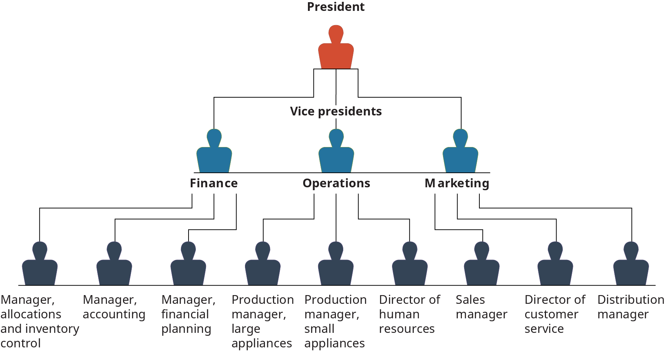
Indicator 4 - Organisational Structure
The institution has a clear organisational and management structure and there is stakeholder participation in decision-making, where appropriate
Standard 1
Governance and Management
The institution has an appropriate mission statement and values, which are derived from its vision and translated into strategic and operational plans, and has well-established, effective governance and management systems that enable the HEI to discharge its full range of responsibilities, achieve its mission, and sustain its values.
4.1
Accurate, Accessible and up-to-date Organisational Structure
4.2
Clear Stakeholders Participation in the Organisational Structure
4.3
Effective Leadership & Coordination
4.4
Clear Staff Job Descriptions
4.4
Clear Channels of Communications
(All Stakeholders & Levels)
4.5
Clear TORs, Reporting Lines & Evaluation Mechanism for all Committees
4.6
Proper Circulation of the Decisions and Recommendations

Slide 14

Indicator 5 – Partnerships, Memoranda with other Institutions (where applicable)
The relationship between the institution operating in the kingdom of Bahrain and other HEIs is formalised, monitored and clearly explained, so that there is no possibility of students or other stakeholders being misled.
Standard 1
Governance and Management
The institution has an appropriate mission statement and values, which are derived from its vision and translated into strategic and operational plans, and has well-established, effective governance and management systems that enable the HEI to discharge its full range of responsibilities, achieve its mission, and sustain its values.
5.4
Mechanisms
for ensuring compliance of other HEI(s) with their obligations
5.5
Mechanisms
for monitoring & improving operations where they take place
5.1
Active Binding Agreement between the HEIs clarifying:
Programme(s) Recognition Status
Roles & responsibilities
5.2
Clear & Publish Information on:
The name of HEI(s) on the certificates
The relevant policies & procedures
5.3
Clear & Publish Information on:
The HEIs providing teaching and conducting assessments
Capacity building for local Staff
Risk management strategy

Slide 15

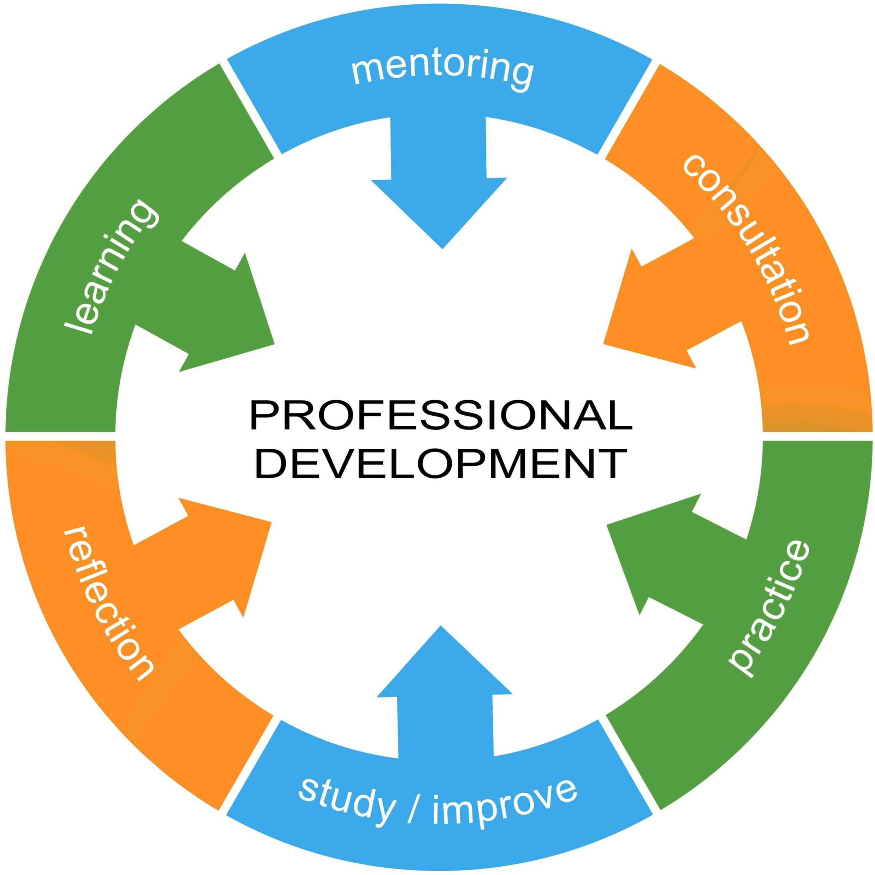
  Standard 2 Human Resources Management
The institution has appropriate human resource policies and procedures in place, including staff development, that demonstrably support and enhance the various operational activities of the institution.
Indicator 6 - Human Resources
The institution has an articulated human resources management strategy which ensures that academic and non-academic staff are employed on an equal basis, in a sufficient number and are appropriately qualified, so as to achieve the institution's mission and provide good quality higher education.
Indicator 7 - Staff Development
The institution has a systematic approach to staff development and provides opportunities for all staff to remain up-to-date in their areas of teaching, research and administration.

Slide 16
  Standard 2 Human Resources Management
The institution has appropriate human resource policies and procedures in place, including staff development, that demonstrably support and enhance the various operational activities of the institution.
Planning
Strategy & Operation Plans
Policies &
Procedures
Selecting, Recruiting, and Retaining Staff
Implementation
Minutes of Meetings
Equality & Diversity
Handling of Legal Issues
Staff Complaints and Grievances
Promotion or Financial Incentives.
Staff Records
Staff Satisfaction and Exit Surveys
Staff Professional Development (PD)
Performance Evaluation
Professional Development Plans
Filled Forms
Staff Lists & CVs
Survey Reports
Lists of Workshops/Capacity Buildings Programmes
Improvement Plans

Slide 17


  Standard 3 Quality Assurance and Enhancement
There are robust quality assurance and quality enhancement systems that ensure the effectiveness of the quality assurance arrangements for reviewing the institution’s performance and for driving continuous improvement in all aspects of its academic and administrative operations.
Indicator 8 - Quality Assurance System
The institution has defined its approach to quality assurance and how its effectiveness is ascertained; and has quality assurance arrangements in place for managing the quality of all aspects of education provision and administration across the institution.
Indicator 9 – Quality Enhancement
There are clear, well-articulated and documented quality enhancement arrangements, including benchmarking exercises, surveys and the gathering of appropriate and relevant feedback from all stakeholders on a regular basis, the results of which inform planning, decision-making and quality enhancement.

Slide 18
Policies, Procedures
Mechanisms &
Arrangements
Quality Manual
Implementation
QA Workshops
Improvements
Periodic Audit Reports (core operations)
Monitoring Compliance & Improving Performance (core operations)
A plan or a schedule for revising policies & procedures
Action taken and improvement plans based on audit, feedback, benchmarking and cohort analysis reports
Minutes of Meetings
Benchmarking Reports (core operations)
Cohort Analysis Reports
Developing, Updating and Disseminating Policies & Procedures
Benchmarking (core operations)
Collecting feedback (core operations)
Survey Reports (core operations)
  Standard 3 Quality Assurance and Enhancement
There are robust quality assurance and quality enhancement systems that ensure the effectiveness of the quality assurance arrangements for reviewing the institution’s performance and for driving continuous improvement in all aspects of its academic and administrative operations.

Slide 19
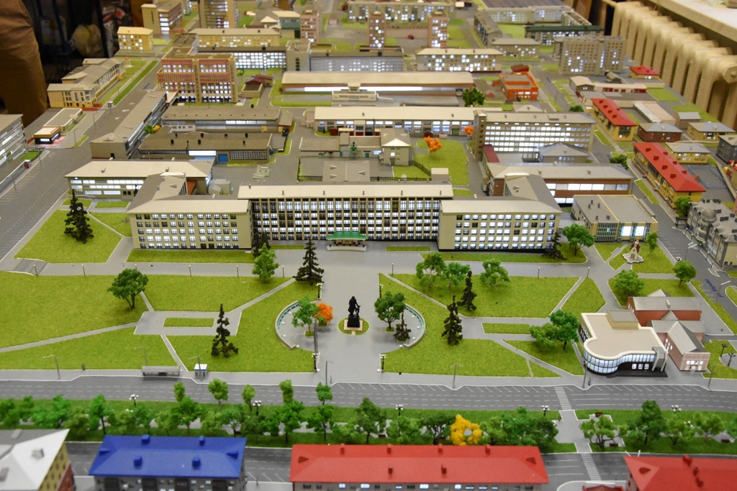
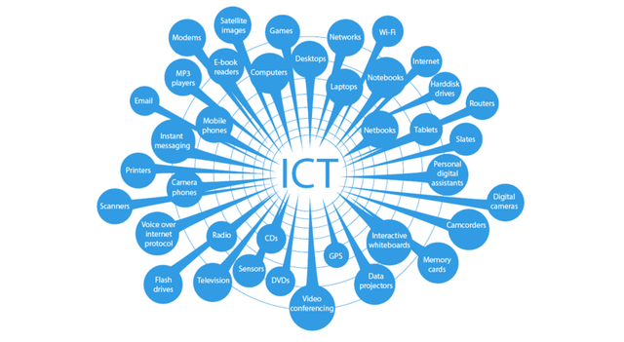

  Standard 4 Infrastructure, Information and Communications Technology and Learning Resources
The institution has appropriate and sufficient physical infrastructure, ICT and learning resources to support the academic programmes and administrative operations of the institution.
Indicator 10 - Infrastructure
The institution provides physical infrastructure that is safe and demonstrably adequate for its type and core functions.
Indicator 11 – Information and Communications Technology
The institution provides coordinated ICT resources for the effective support of its academic and administrative operations, and safeguards against copyright infringements of print and digital resources.
Indicator 12 - Learning Resources
The institution provides sustained access to sufficient information and learning resources to fully support effective delivery of its academic programmes.

Slide 20
Infrastructure
All physical resources including labs, classrooms and offices are suitably equipped and sufficient.
All physical resources are regularly reviewed to ensure compliance with HEC requirements.
Records for cleaning, maintenance & upgrade
Formal, appropriate and implemented action plans for expansion, if needed
Secure Access to Premises
Safe & supervised students’ accommodations, if applicable
ICT Resources
ICT Operational Plans
Learning Resources
Minutes of Meetings
3. Use of Website and Social Media Account
4. Copyright Infringements
Filled Forms
Staff Lists & CVs
Survey Reports
Lists of Workshops/ Capacity Buildings Programmes
Improvement Plans
Registers for ICT Systems & Services
Management Information Systems
Accessible ICT
Policies & procedures dealing with:
1. Occupational Health and Safety
2. Unauthorized Access to, and Inappropriate Use of, ICT Resources
  Standard 4 Infrastructure, Information and Communications Technology and Learning Resources
The institution has appropriate and sufficient physical infrastructure, ICT and learning resources to support the academic programmes and administrative operations of the institution.

Slide 21

  Standard 5 Management of Academic Affairs
The institution has a comprehensive academic management system with a clear management structure and processes in place, to ensure that all academic affairs are effectively planned and managed.
Indicator 13 – Academic Management and Integrity
The institution upholds and maintains academic standards and protects academic integrity throughout its teaching and research activities.

Slide 22
13.1
Academic plans built on the HEI mission & strategic goals
(implemented, monitored & evaluated)
13.2
Academic Leadership & Responsibilities
(clear roles, responsibilities & adequate workload)
13.3
Academic Staff Diversity
(background/ qualifications/ experience/ seniority/ ranks)
13.4
Mentoring System for junior academic staff
(appropriate & effective)
  Standard 5 Management of Academic Affairs
The institution has a comprehensive academic management system with a clear management structure and processes in place, to ensure that all academic affairs are effectively planned and managed.
13.5 & 13.6
Ethical & Legal Regulations, Intellectual Property, and Academic Misconduct Policies & Procedures
(clear, published, implemented & regularly reviewed)
13.7
Policies & Procedures dealing with Staff & Students unacceptable Behavior and Discrimination
(Clear, published, implemented & regularly reviewed)
13.8
Clear Process for Monitoring & Enforcing Student Attendance & Punctuality
13.9
Published Process dealing with Student Complaints and Grievances

Slide 23


  Standard 5 Management of Academic Affairs
The institution has a comprehensive academic management system with a clear management structure and processes in place, to ensure that all academic affairs are effectively planned and managed.
Indicator 14 – Design and Approval of New Academic Programmes
The institution has rigorous systems and processes for the design and approval of new programmes to ensure sound academic standards are met.
Indicator 15 – Academic Programme Reviews
The institution has rigorous systems and processes for the review of existing/running programmes to ensure sound academic standards are met. These are consistently applied, regularly monitored, and reviewed.

Slide 24
Policies,
Procedures
Mechanisms &
Arrangements
Proposal, Design and Approval of New Programmes
Implementation
Minutes of Meetings (Relevant Committees)
Improvements
Considering Benchmarking Results & Stakeholders’ Feedback (New & Current Programmes)
Improvement Plans
Benchmarking & Market Study Reports
Ensuring Compliance with NQF Qualification Design Requirements (New & Current Programmes)
Review of Existing/Running Programmes (Annual & Periodic Reviews)
Consulting External Experts (New & Current Programmes)
Approved Proposal Forms (New Programmes)
Annual and Periodic Review Reports (Current Programmes)
Survey Reports
  Standard 5 Management of Academic Affairs
The institution has a comprehensive academic management system with a clear management structure and processes in place, to ensure that all academic affairs are effectively planned and managed.

Slide 25

  Standard 5 Management of Academic Affairs
The institution has a comprehensive academic management system with a clear management structure and processes in place, to ensure that all academic affairs are effectively planned and managed.
Indicator 16 – Admission and Certification
The institution has appropriate and rigorously enforced admission criteria for all its programmes and formal arrangements for ensuring the accuracy and authenticity of student records and certification.

Slide 26
Up-to –date & Accurate Information
Programme Specifications
Admission Criteria
Policies, Procedures & Arrangements
Admissions, Recognition of Prior Learning (RPL), Transfer of Credits & Exit Points (Certificate/Diploma Exit)
Implementation
Published Materials (Programmes)
Benchmarking & Review Reports (Admission Criteria)
Benchmarking & Review of Foundation Programme & Remedial Courses
Minutes of Meetings (Relevant Committees)
Accurate Transcripts & Certificates
Staff Satisfaction and Exit Surveys
Students’ Records
Responding to Applicants’ Enquiries
Appeals against Admission and Transfer Decisions
Collection and Refund of Student Fees
Foundation Programme & Remedial Courses
integrity and confidentiality of Student Records
Safety and Integrity of Certificate Issuance
Language(s) of Teaching and Learning
Staff Records
  Standard 5 Management of Academic Affairs
The institution has a comprehensive academic management system with a clear management structure and processes in place, to ensure that all academic affairs are effectively planned and managed.

Slide 27



Indicator 17 - Management of Teaching and Learning
There are effective mechanisms to ensure the quality of teaching and learning provision across the institution.
  Standard 6 Teaching, Learning and Assessment
The institution has effective mechanisms and clear processes in place to ensure the quality of the teaching, learning and assessment.
Indicator 18 – Graduate Attributes and Learning Outcomes
The institution ensures that graduate attributes at the institutional level and learning outcomes for all programmes and courses are clearly formulated reflecting employability skills and there are effective mechanisms to ensure that graduates achieve the graduate attributes and the learning outcomes of the programmes.
Indicator 19 - Assessment and Moderation
There are implemented transparent assessment policies and procedures including moderation, which ensure that the assessment of student learning is appropriate and accurately reflects the academic standards and the learning outcomes achieved by students.

Slide 28
Teaching & Learning
Teaching and Learning Policies and Procedures
Mechanisms for Ensuring Updated, Accurate and Complete Course Syllabi
Policies and Procedures for Establishing Work-Based Learning Agreements With Companies
Clear Assessment Strategy, Roles & Responsibilities of all Stakeholders Involved in Work-Based Learning
Mechanisms Used to Monitor Student Learning Experience Progression
Mechanisms Used to Monitor the Quality of Teaching & Learning
Graduate Attributes & Learning Outcomes
Mechanisms to ensure that Graduate Attributes & Learning Outcome are:
1. clearly written and measurable
2. incorporate employability skills
3. developed and revised in light of benchmarks and information generated from tracking graduate destinations
4. measured to verify the level of their achievement.
Assessment & Moderation
Policies and procedures ensuring the following:
1. appropriate formative and summative assessment design
2. alignment of assessments with learning outcomes
3. fairness & transparency of marking
4. timely feedback
5. effective pre and post internal and external moderation of assessment
6. grade appeal process
7. security and retention of assessment documents and records.
  Standard 6 Teaching, Learning and Assessment
The institution has effective mechanisms and clear processes in place to ensure the quality of the teaching, learning and assessment.

Slide 29


  Standard 7 Research and Postgraduate Studies
The institution has a research operational plan appropriate for its type, mission and strategic goals that is well-resourced, implemented, monitored and reviewed for enhancement.
Indicator 20 – Research Management and Support
The institution has an operational research plan appropriate for its institutional type, which includes monitoring its research output, together with policies and processes to ensure the ethical and effective conduct of research.
Indicator - 21 Postgraduate Studies (where applicable)
Where the institution offers postgraduate studies, it provides effective resources, supervision and assessment for research students.

Slide 30
Policies,
Procedures
Mechanisms &
Arrangements
Research Strategy (Priorities & Goals)
Implementation
KPIs Achievement Reports
Improvements
Improvement Plans
Allocated Budget to Achieve Strategic Goals
Course Syllabi
Mechanisms Linking Research to Teaching & Learning
Research Operational Plans (KPIs & Targets)
Research Ethics Policies
Mechanisms to Ensure Alignment Between the Programme and Research Learning Outcomes
Thesis Assessment Arrangements (Internal & External Examiners)
Policies & Procedures Related to Supervision and Support of Research Students
Meeting Minutes of Relevant Committees
Approvals of External Examiners
Lists of Published Research (3 Years)
Arrangements for Disseminating Research Plans & Output
Survey Reports (Supervision & Resources)
  Standard 7 Research and Postgraduate Studies
The institution has a research operational plan appropriate for its type, mission and strategic goals that is well-resourced, implemented, monitored and reviewed for enhancement.

Slide 31

  Standard 8 Community Engagement
The institution has a clear community engagement operational plan that is aligned with its mission and strategic goals.
Indicator 22 - Community Engagement
The institution has a clear, well-conceptualised and regularly reviewed approach for serving and engaging with local communities in order to fulfill its social responsibilities.

Slide 32
Policies,
Procedures
Mechanisms &
Arrangements
Community Engagement (CE) Strategy (Definition Statement, Priorities & Goals)
Implementation
KPIs achievement reports
Improvements
Improvement Plans
Survey reports
CE Operational Plans (KPIs & Targets)
Arrangements for strengthening links with industry
Mechanism for collecting feedback on CE
Meeting minutes of relevant committees
Lists of CE activities (previous 3 years)
Arrangements for involving students, alumni, professional bodies & other HEIs in CE
Arrangements for supporting and encouraging staff and students to engage in CE
Community engagement database
  Standard 8 Community Engagement
The institution has a clear community engagement operational plan that is aligned with its mission and strategic goals.

Slide 33


  Standard 9 Student Support Services
The institution provides efficient and effective student academic and non-academic support services from admission to post graduation and encourages the personal development of students.
Indicator 23 - Student Academic Support
Students receive efficient and effective academic support, which enhances their learning experience.
Indicator 24 - Student Non-Academic Support
Students receive non-academic support and guidance, which are appropriate for their needs and encourage their personal development.

Slide 34
Policies,
Procedures
Mechanisms &
Arrangements
Implementation
List of Students’ Social, Cultural & Sport Activities (3 years)
Improvements
Improvement Plans
Survey Reports
Published Information for Current & Prospective Students on Academic Programmes
Induction Policy & Procedure
Arrangements for Students with Special Needs
Academic Advising Arrangements
Career Information, Advice and Guidance Arrangements
Access to Academic Staff Outside Teaching Hours
Arrangements for Identifying & Supporting At-Risk Students
Arrangements for Promoting the Concept of Lifelong Learning Among Students
Arrangement for Ensuring that Prospective National & International Students Are Well-Informed (Scholarships, Support Services & Living Expenses)
Counseling, Health and Welfare Arrangements
Arrangements for Supporting & Encouraging Students’ Activities and their Interactions with Alumni
Arrangements for Selecting, Monitoring and Evaluating Student Recruitment Agents, If Applicable
  Standard 9 Student Support Services
The institution provides efficient and effective student academic and non-academic support services from admission to post graduation and encourages the personal development of students.

Slide 35
Tips on Developing a Critical and Informative Self Evaluation Report
Supported with Evidence

Slide 36
Best Practices in Self Evaluation
Assigning a senior staff to Lead a working group in planning and monitoring the self evaluation process.
Consideration should be given to involving students in the process.
Assigning the review standards and indicators to the relevant academic and administrative units.
Sufficient time should be allocated for analysis, critical reflection, and identifying areas of strength and areas that require improvements.
Each unit examines the indicators’ expectations and considers what types of evidence are needed.
Developing a plan for the identified areas that require improvements to implement changes gradually.

Slide 37
Formal, Objective & Bias Free
Covering all Applicable Expectations
Concise Supported by Evidence
Referring to ‘What Is’ and not to ‘What Should Be’
Single Tone & Checked For Consistency
Critical & Analytical
SER Writing Style

Slide 38
Evidence files must be clearly numbered with concise names
If the evidence document is in Arabic, include a brief summary in English outlining the document's contents.
All PDF files must be searchable.
Hyperlink the evidence within the self-evaluation report.
When dealing with a large evidence document, refer to the specific relevant pages.
Minimize the use of “On Site’ and ‘Upon Request’ evidence reserving them to the site visit.
Supporting Material [SM]
Supporting Material

Slide 39

Supporting Material [SM]
Don’t provide already provided evidence with a new code
Don’t provide blank templates only, add filled samples
Don’t use long names for evidence files
Don’t use “refer to” instead of the coded evidence
Don’t provide old version of policies, procedures and handbooks
Supporting Material

Slide 40
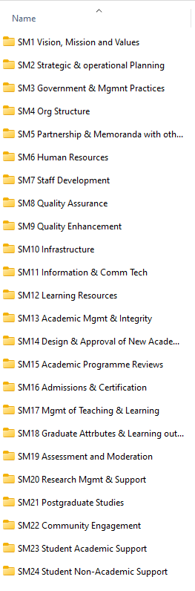


How to Submit Evidence?
SM1.1 Strategic Plan
SM1.45 Minutes of Meetings
Evidence files must be saved in folders organized by Indicator
SM1.1 Strategic Plan
SM22.10 List of activities (2022-24)

Slide 41
Evidence and Its Journey
Index
Availability
Accuracy
SM List
Extra Evidence List
Site Visit Evidence List
Condition
During the Site Visit
You provide the evidence, what’s next ?
Before the Site Visit

Slide 42
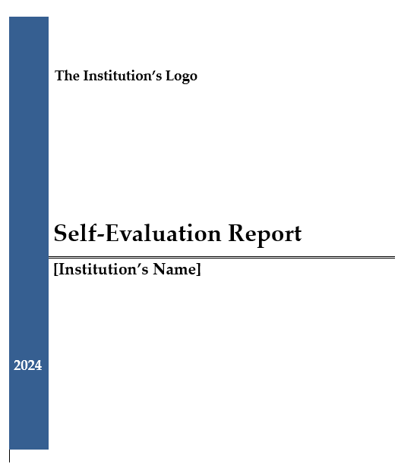
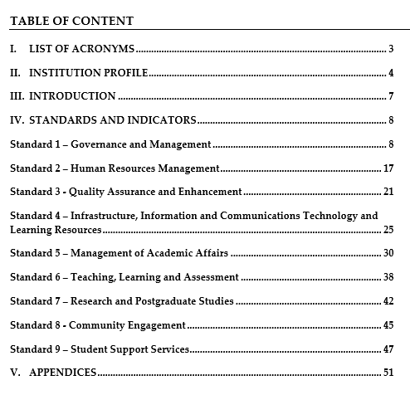
Self Evaluation
Report Template

Slide 43
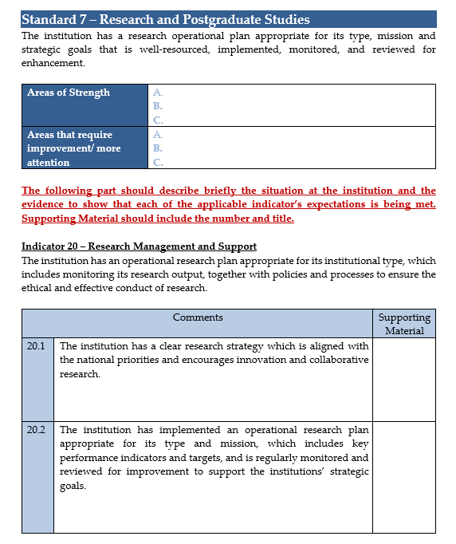
Self Evaluation
Report Template
SM20.1
Research Strategy
SM20.9
Research Plan

Slide 44
Short Exercise

Slide 45
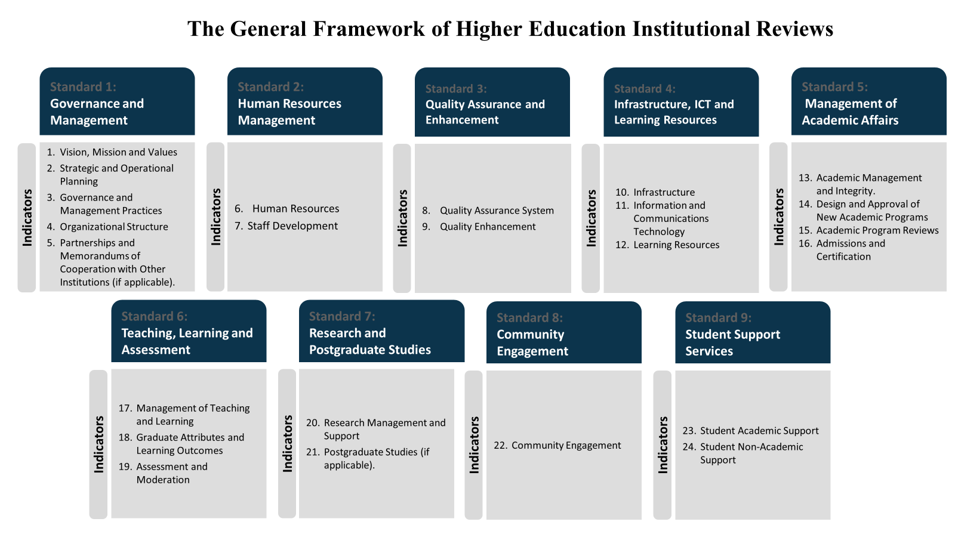
PART II
A Short Exercise
Step (1)
Select one of the Indicators that are listed under the (9) Standards of the General Framework of Higher Education Reviews
https://online.fliphtml5.com/mghkl/jscq/

Slide 46


Fully Met
100%
All the Indicator’s applicable expectations are addressed.
Judgements
Substantially Met
Criteria for Indicators’ Judgements
75%
At least 75% of all the Indicator’s applicable expectations are addressed.
Partially Met
<50%
>75%
More than 50% and less than 75% of the Indicator’s applicable expectations are addressed.
Not Met
50%
50% or less of the Indicator’s applicable expectations are addressed.

Slide 47
Step (2)
Check if your institution addressing (✓)
or not addressing (x) the expectations listed under the Indicator, as shown in Example (1)
Example (1) Indicator 1 – Vision, Mission and Values The institution has clearly stated vision, mission and values that are appropriate for the institutional type and the programmes offered; and these align with the national priorities of the Kingdom of Bahrain.
Expectations | Status
1.1 The institution has a publicly displayed vision, mission and values that are approved at the governing body level, guide its activities, and well communicated to stakeholders. | ✓
1.2 The vision and mission are appropriate for the institutional type and programmes on offer; are aligned with the national priorities and strategies of the Kingdom of Bahrain; and reflect the core functions of the institution and its values. | ✓
1.3 The institution involves internal and external stakeholders in the development of the vision, mission, and values of the institution. |  | X
1.4 There is a process which ensures, a regular review of the vision and mission that takes into account the national, regional and international context with respect to trends in higher education and programme offerings. | ✓

Slide 48
Example (1) Indicator 1 – Vision, Mission and Values The institution has clearly stated vision, mission and values that are appropriate for the institutional type and the programmes offered; and these align with the national priorities of the Kingdom of Bahrain.
Step (3)
Check if your institution has sufficient evidence to support your claims.
Appendix B in the Institutional Review Handbook can assist you in identifying the types of evidence required.
Appendix B: Supporting Material https://online.fliphtml5.com/mghkl/wcpj/

Slide 49
Step (4)
Write a short paragraph evaluating the performance of the institution. The narrative should be:
Concise and relevant to the Expectation
Covering all the listed expectations under each Indicator
Critical/Analytical Description
Based on Evidence
Provides constructive Information that is useful to the improvement of the Institution
Example (1) Indicator 1 – Vision, Mission and Values The institution has clearly stated vision, mission and values that are appropriate for the institutional type and the programmes offered; and these align with the national priorities of the Kingdom of Bahrain.
Narrative | Evidence Code & No.
1.1 1.2 1.3 1.4

Slide 50




Judgements per Standard
Fully Met
Substantially Met
Partially Met
Not Met
At least one of all the applicable Indicators is ‘Substantially
Met’, whereas the remaining are ‘Fully Met’
At least one of all the applicable Indicators is ‘Partially Met’,
whereas the remaining are either ‘Fully Met’, or ‘Substantially
Met’
All applicable Indicators are ‘Fully Met’
At least one applicable Indicator is ‘Not Met’

Slide 51
Overall Judgements
Compliant with the General Framework Standards
All the standards of the General Framework of Higher Education Institutional Review are ‘Fully Met’ or ‘Substantially Met’.
Partially Compliant with the General Framework Standards
Less than four standards of the General Framework of Higher Education Institutional Review are ‘Partially Met’, and the remaining standards are either ‘Fully Met’ or ‘Substantially Met’.
Not Compliant with the General Framework Standards
Four standards or more of the General Framework of Higher Education Institutional Review are ‘Partially Met’, or one of the standards is ‘Not Met’, or the institution did not successfully pass the extension visit review.

Slide 52
Concluding Remarks & General Tips

Slide 53
Success of the Site Visit
Coordination, preparation, time management & quality of dialogue
Interviewees should be informed about the purposes of interviews (validate claims made in SER & obtain more information and evidence)
Interviewees should be informed that they can ask for the question to be repeated in English or in Arabic if they do not understand it.
Interviewees should be informed that Interviews are held in confidence and that they should not reveal their or their colleagues’ specific responses to others.
Interviewees should be informed that they should respond directly and briefly to the questions and that one person should not dominate the responses.
Interviewees should be informed that the Panel is collecting information from many different sources, so the words of one specific individual do not carry undue weight.
Interviewees should be informed that the site visit is not a forum for debates or hearing individual complaints or grievances.

Slide 54
Ethical Guidelines
HEIs must not make direct contact with Review Panel members; all issues related to the review should be communicated through the designated Review Director.
HEIs must not present any gifts to the Review Panel members during, before or after the site visit.
HEIs must not make offers to Review Panel members (consultancy, jobs) for at least one year after the publication of the Review Report.
HEIs must not record interview sessions or taking notes during interviews.
HEIs must not ‘coach’ staff or students about answers to questions or censoring them.
HEIs must ascertain that all information submitted to the Review Panel is accurate and that no relevant information is withheld from the Panel.

Slide 55
Thank you
For more information
Kindly visit our website:
www.bqa.gov.bh

