Slide 1
The Training presentation for ‘Kindergartens Reviews’ in the Kingdom of Bahrain For Kindergartens Teachers and Practitioners

Slide 2
What is Early Childhood Education (ECE)?
Watch the Video on What is Early Childhood Education
Notes:
A video introducing ECE

Slide 3
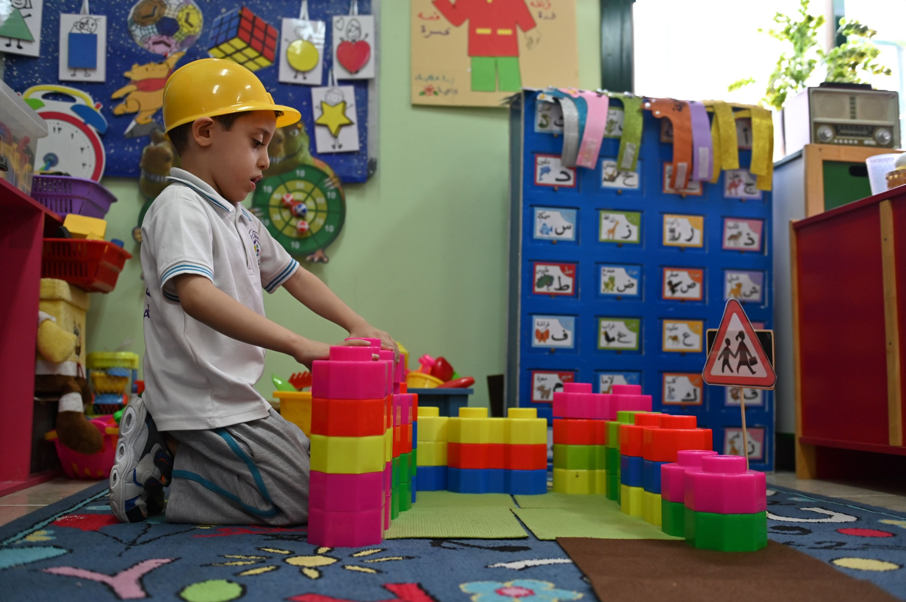
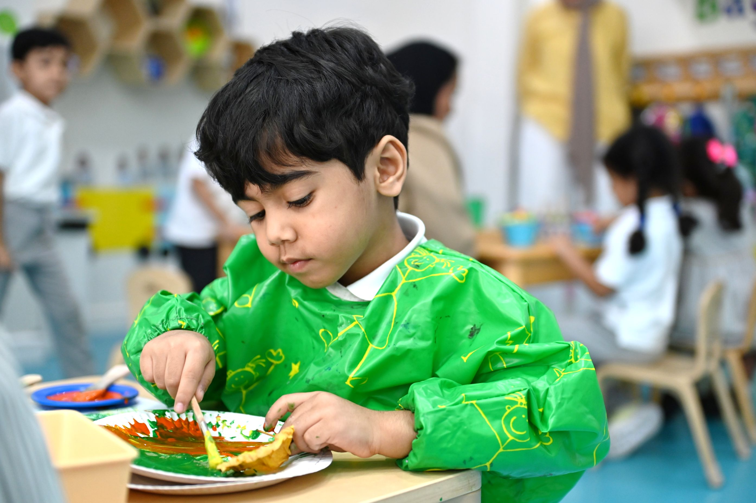
Benchmarks
Learning through PLAY
Focus on social and emotional growth
It’s all about the child
Inclusion and partnerships
Notes:
Explain: Leading countries in quality education share similar core approaches to early years education, all centred on children and their holistic development. These approaches prioritise learning through play, exploration, and meaningful interactions. Fundamental to this is a strong focus on children’s social and emotional development, supported by a collaborative partnership with families and communities. Such systems actively promote inclusive practices, ensuring all children are valued and supported, regardless of their diverse needs and backgrounds.

Slide 4
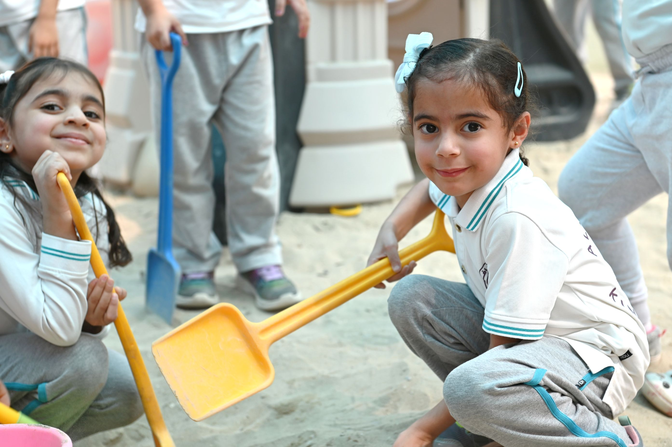
Pillars of Early Childhood Education
Centrality of Play
Notes:
Share, explain and discuss:
From the video, we understand these are the pillars of ECE:
Centrality of play:
Supports cognitive, physical, social, and emotional development.
Allows children to explore their world and learn problem-solving.
Promotes critical thinking skills.
Encourages creativity, imagination and resilience.
Central to effective early childhood education and a key method of learning.

Slide 5
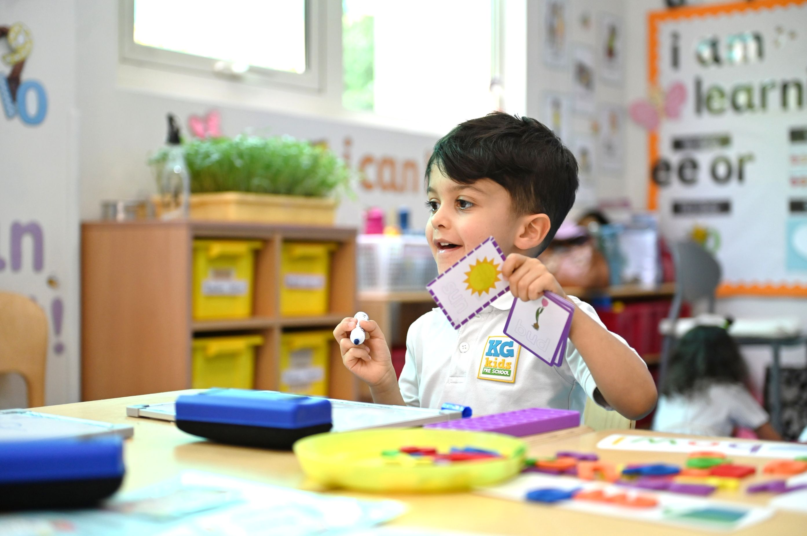
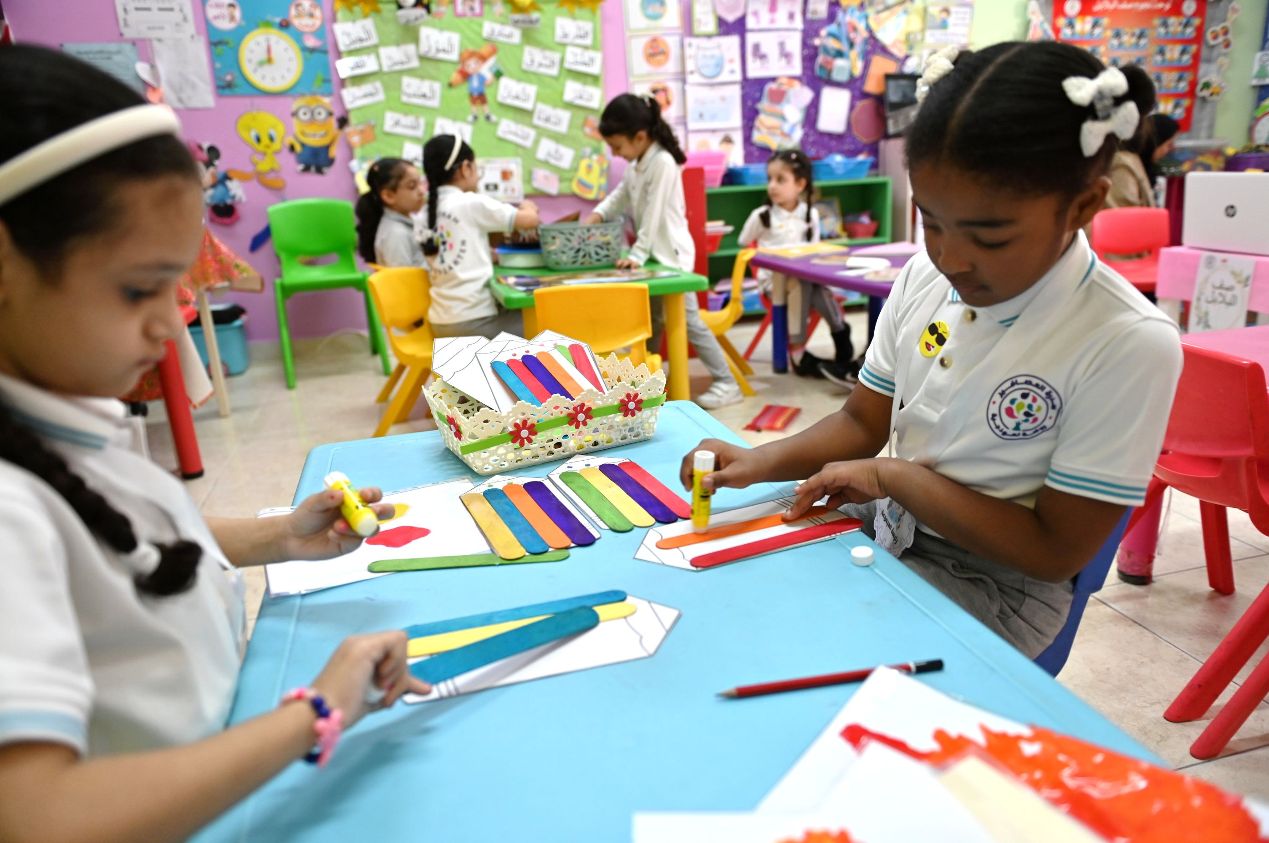
Pillars of Early Childhood Education
Holistic Development
Notes:
Share, explain and discuss:
Holistic development:
Focus on nurturing overall development of children.
Recognises each child as unique, with individual needs and interests.
Personalised learning experiences tailored to developmental levels.
Supportive environment that allows children to thrive.
Encourages growth at their own pace, based on ability and interests.

Slide 6
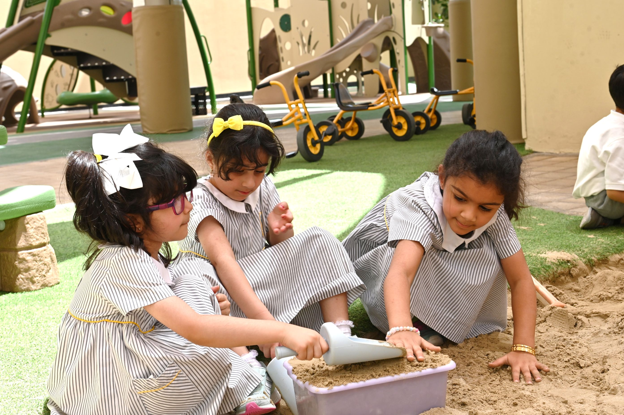
Pillars of Early Childhood Education
Nurturing and Inclusive Environment
Notes:
Share, explain and discuss:
Nurturing and Inclusive Environment:
Enriched by family and community involvement in activities and learning experiences.
All children are engaged and involved regardless of needs, conditions and backgrounds.
Fundamental for holistic development.
Safe, inclusive, and supportive atmosphere helps children feel valued and secure.
Enhances cognitive, emotional, and social growth through play, exploration, and learning.

Slide 7
Activity 1
Centrality of Play
2
Holistic Development
Nurturing and Inclusive
Environment
1
3
Reflect on your practices in the kindergarten, what types of activities foster the three pillars of ECE?
Notes:
Give the teachers 15 minutes to reflect on their practices and discuss what types of activities that foster the three pillars?
They will need flipcharts , A3 papers, markers.

Slide 8
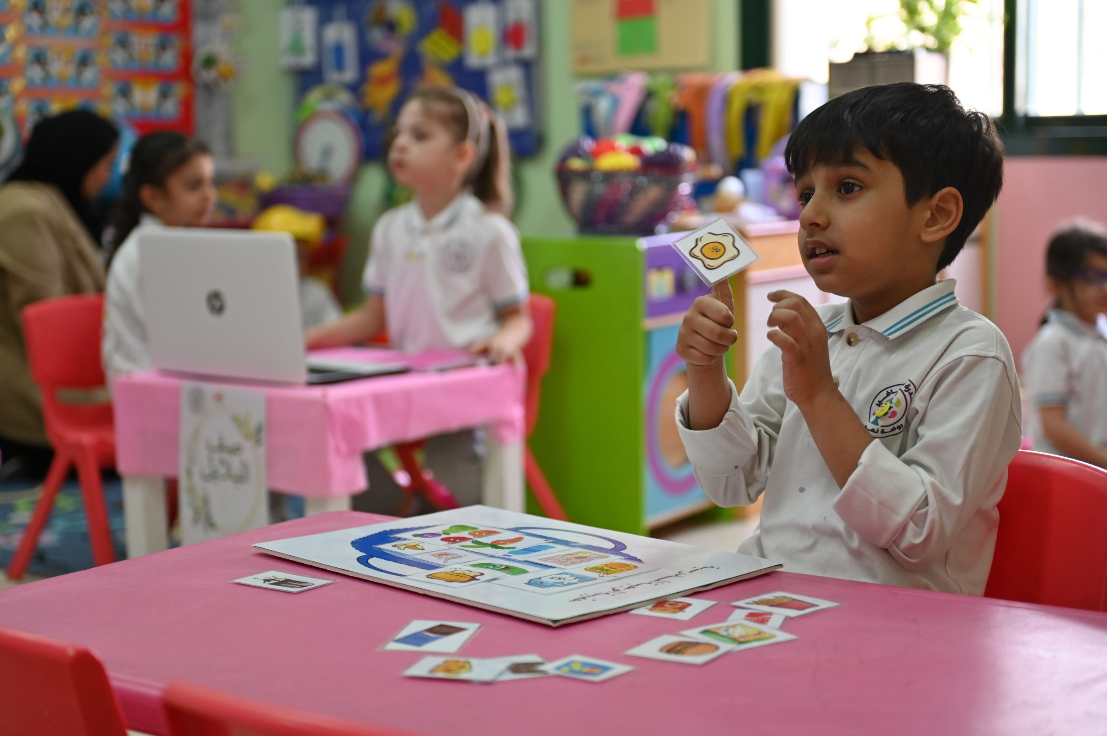
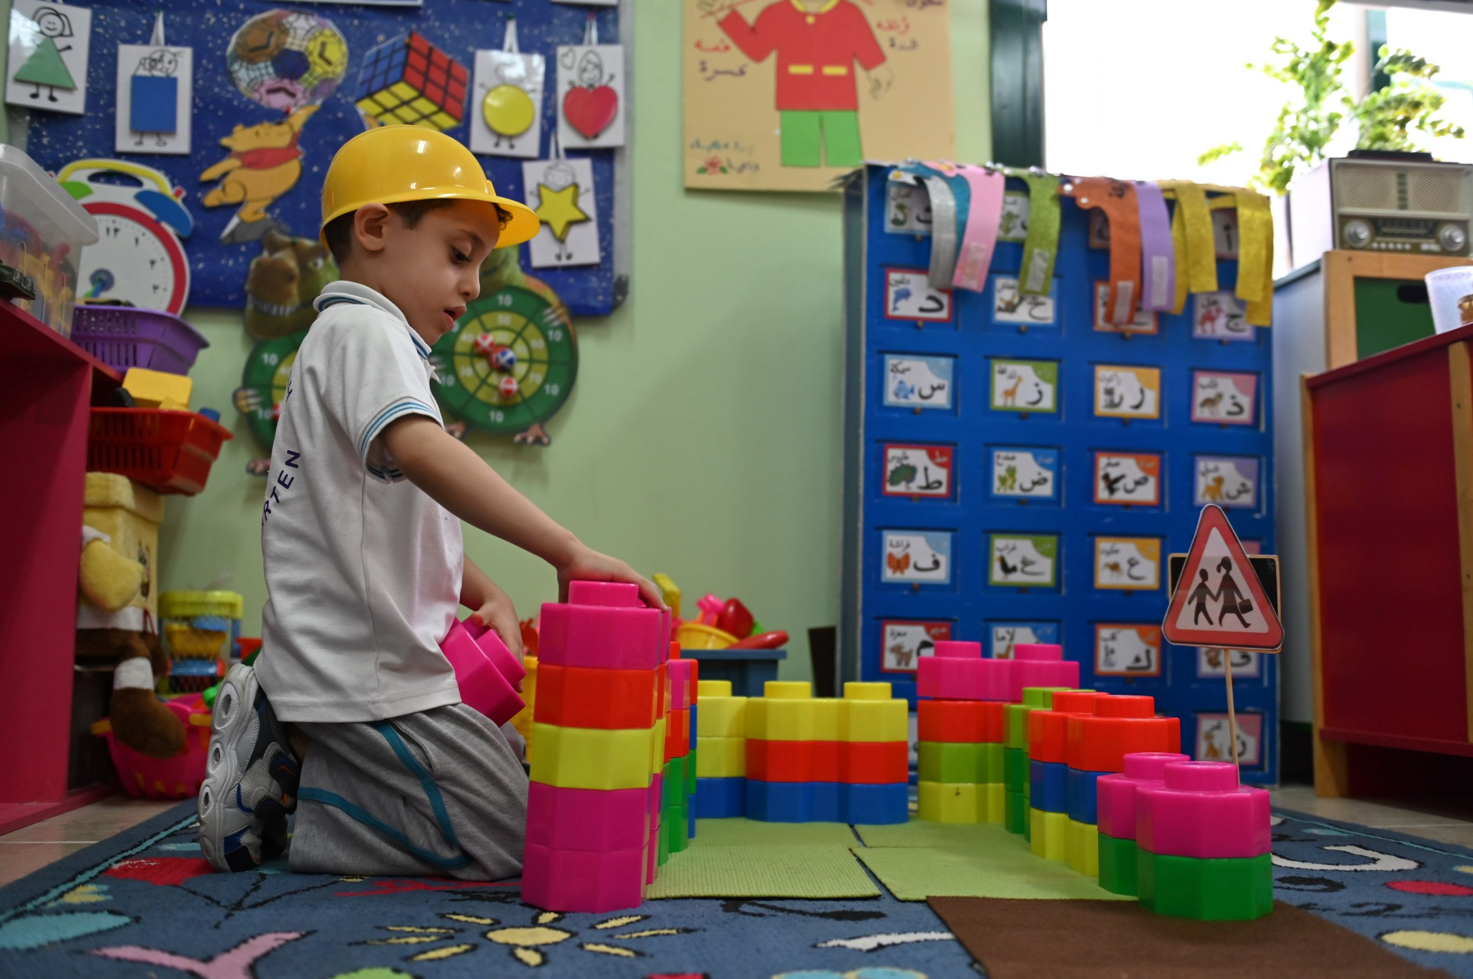
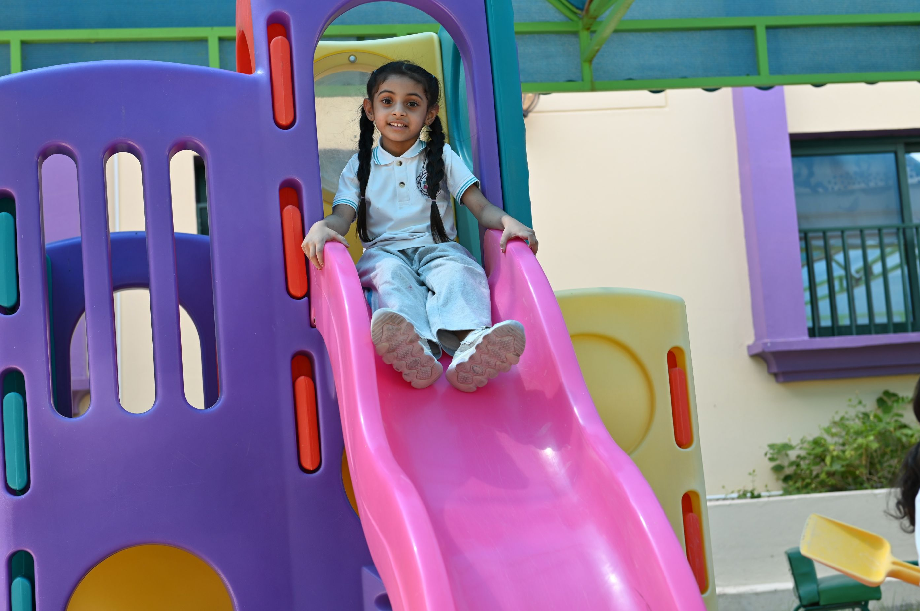
Activity 1
Sample of activities covering pillars of ECE
Matching pictures to sounds
Creating shapes with sand
1
Centrality of Play
Building blocks
Free outdoor play
Notes:
Sample answer – please note many other examples (that include children learning and growing through play) are correct.
Please provide the teachers chances to present their examples before showing the answer.
Discuss the examples – how do they cover the pillar?

Slide 9
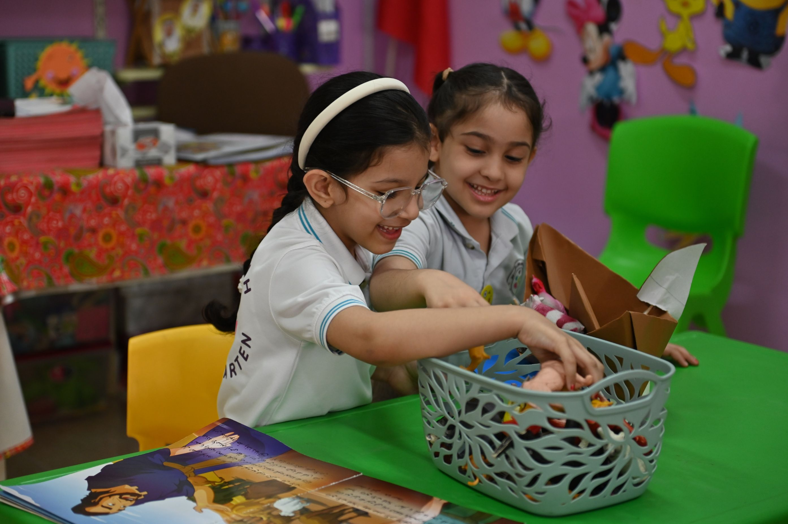
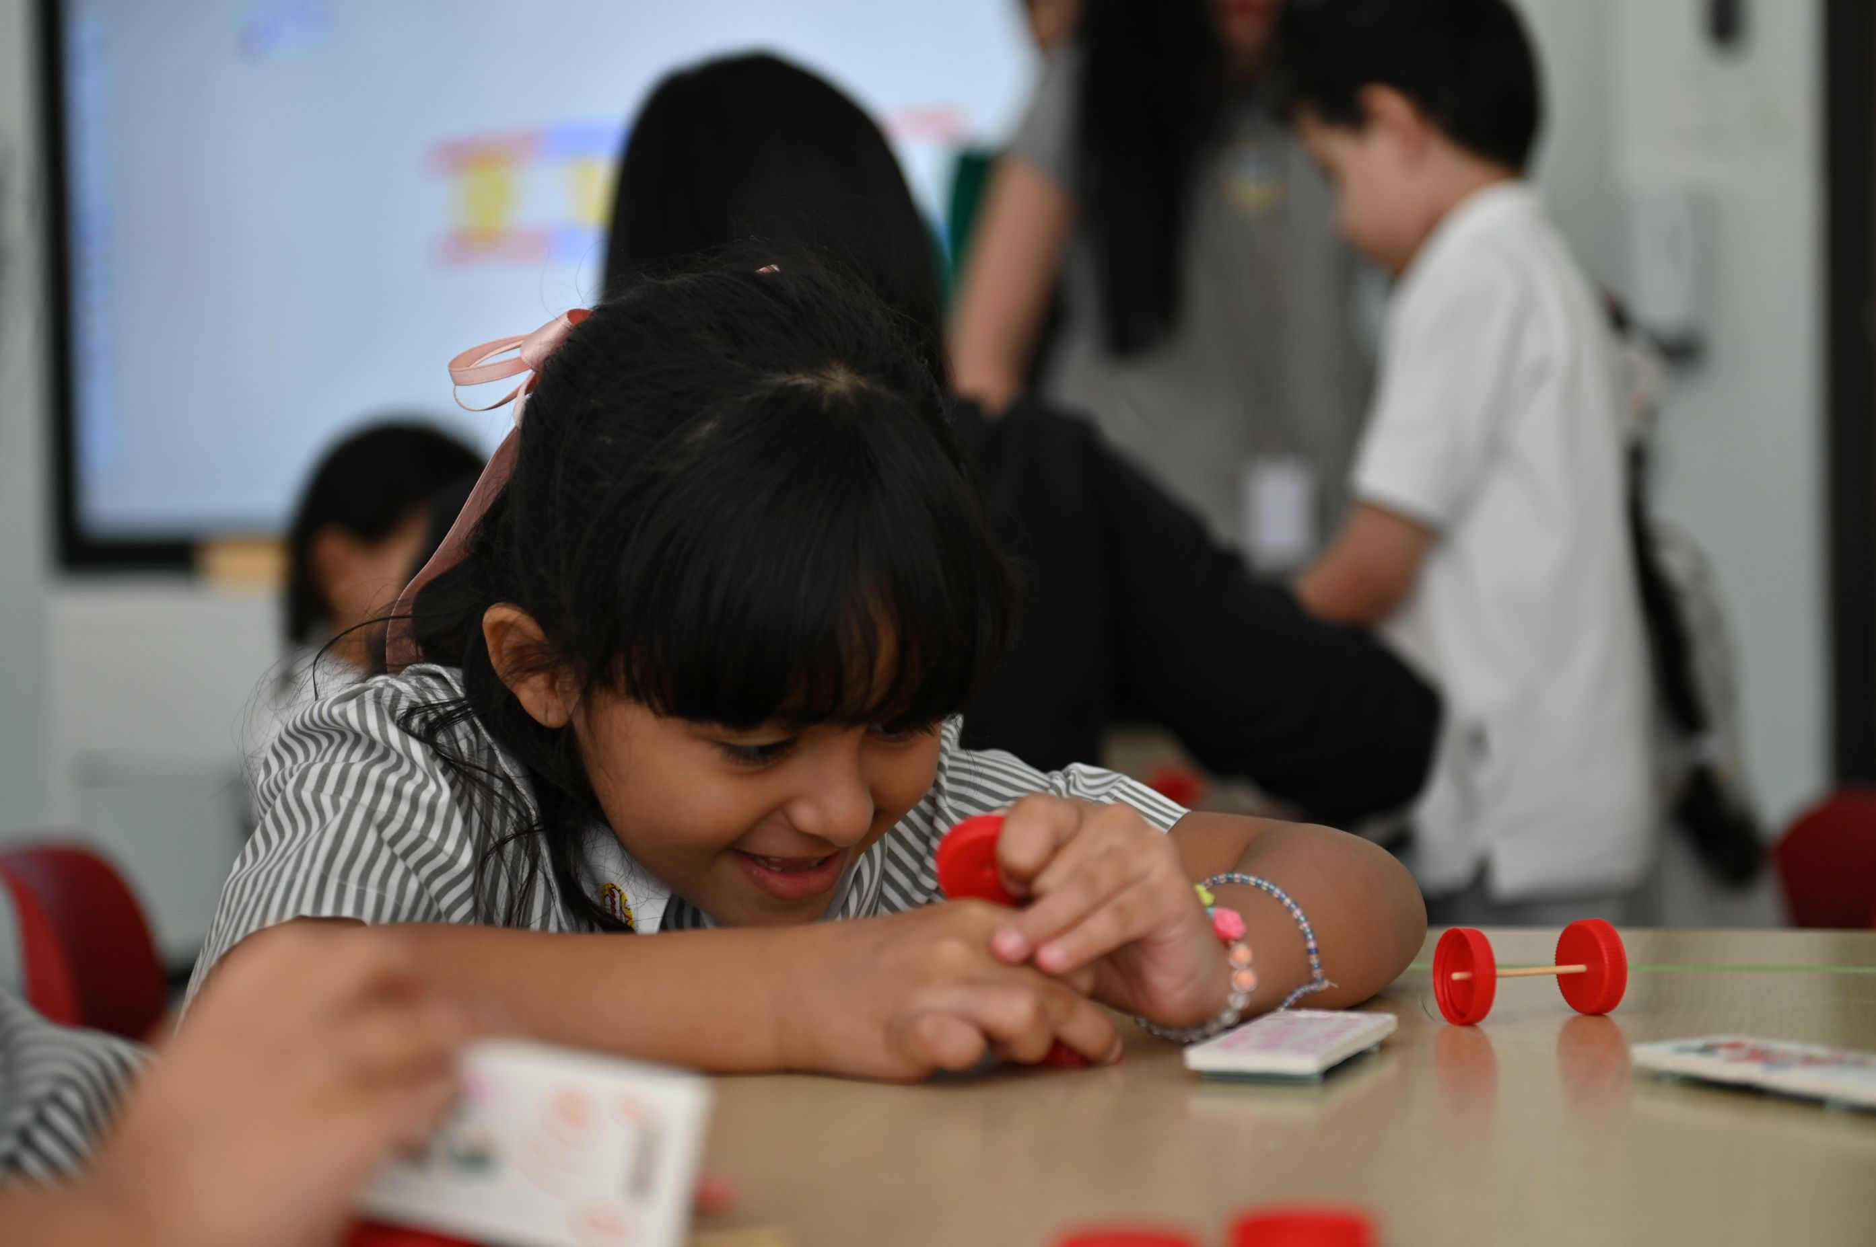
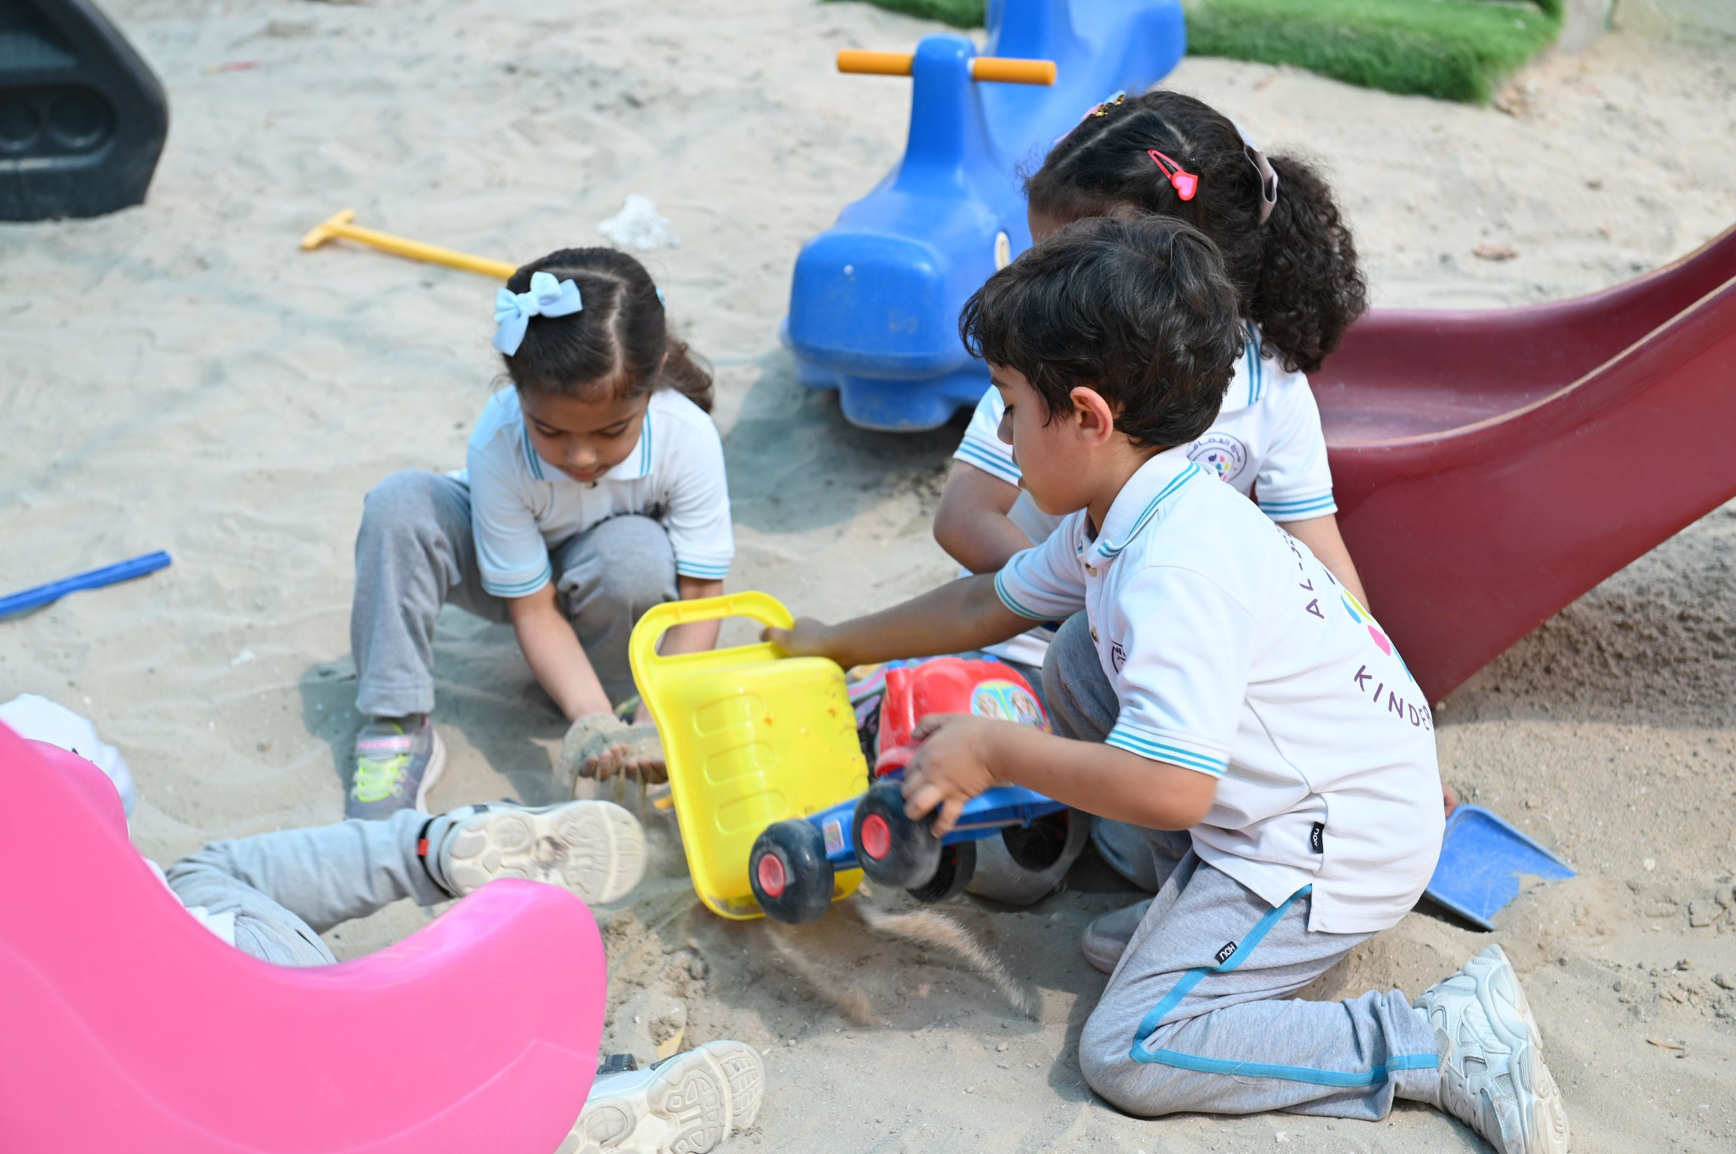
Activity 1
Sample of activities covering pillars of ECE
Pair activity
Assembling pieces to create shapes
2
Holistic Development
Outdoor group play
Express opinions and feelings
Notes:
Sample answer – please note many other examples of activities (that include children growing and progressing in skills and concepts) are correct.
Please provide the teachers chances to present their examples before showing the answer.
After showing the answer click on the next slide.

Slide 10
Activity 1
Reflect: How do these sample activities lead to ‘Holistic Development’?
Outdoor group play
Pair activity
Assembling pieces to
create shapes
Express opinions
and feelings
These sample activities all foster the development and progress of children in different aspects. While doing so, they are developing fine and gross motor skills, they’re developing their social and communication skills while interacting with others, they’re learning how to regulate their feelings and actions, they’re using their imagination through exploring and developing their creativity, etc.
That is how these activities foster
Holistic Development
Notes:
Give the teachers few minutes to reflect and think about the term “Holistic Development”.
Then show and discuss the answer.

Slide 11
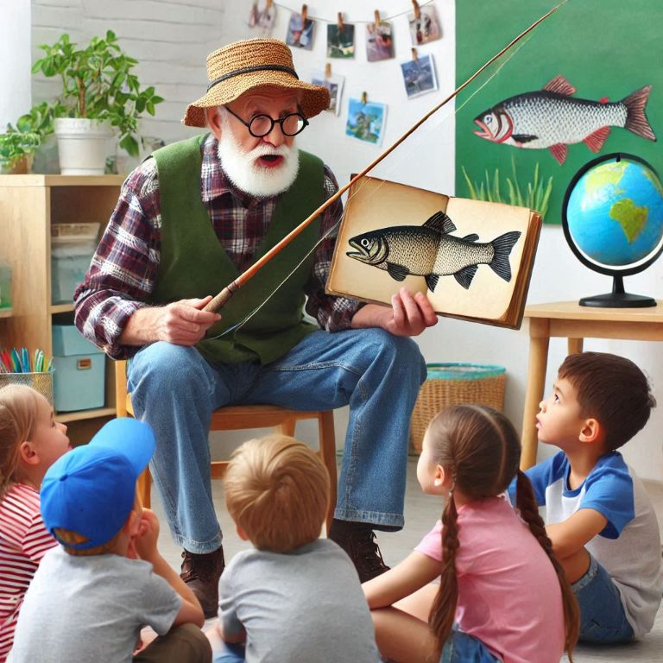
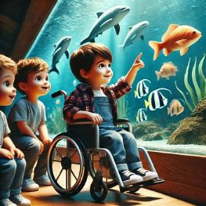
Activity 1
Sample of activities covering pillars of ECE
Story with mom
Grandad adventures
3
Nurturing and Inclusive
Environment
Dentist visit
A trip to the aquarium
Notes:
Sample answer – please note many other examples of activities (that include family and community members participation – trips and inclusivity) are correct.
Please provide the teachers chances to present their examples before showing the answer.
Discuss the examples – how do they cover the pillar?

Slide 12
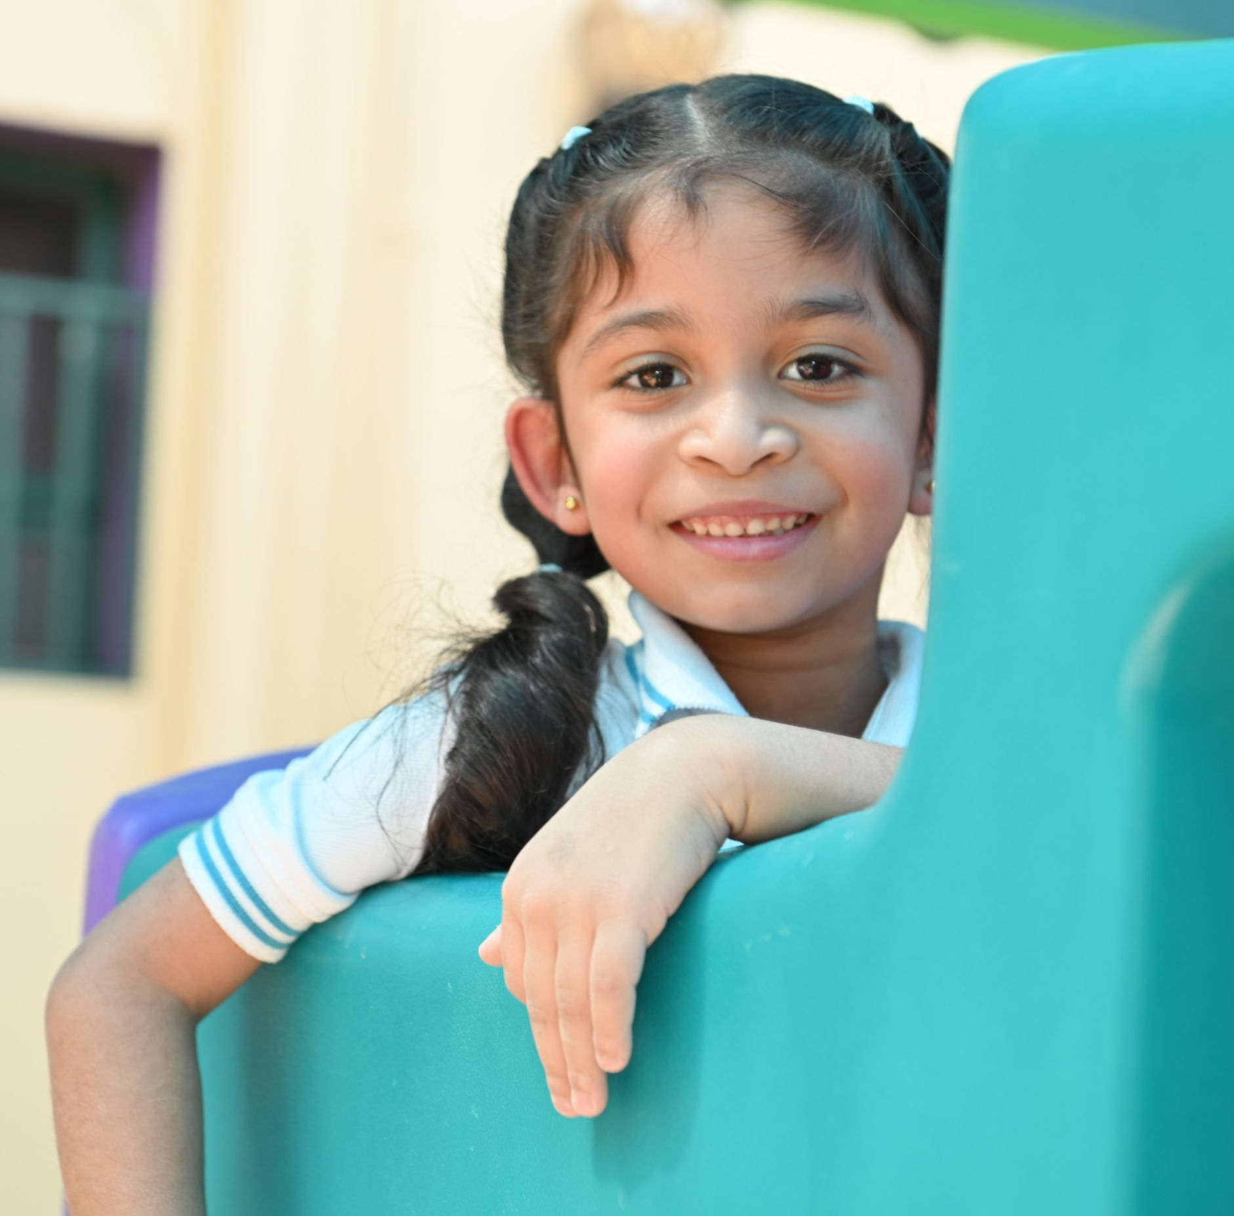
‘Kindergartens Reviews Framework’ components
Aspects
=
Evaluation
Criteria
Indicators
Notes:
Explain:
Aspect: Representing the core areas of Kindergartens’ practices.
- Criteria: Representing the focus areas in each aspect and upon which the aspect is evaluated.
- Indicator: Explaining the key elements that the criteria focus on.

Slide 13
Kindergartens Reviews Framework
Aspect 1:
Children’s Growth and Development
1.1 Children's Social and Emotional Development
1.2 Children's Physical Development
Aspect 2:
Child Initiated Learning
2.1 Areas of Learning
2.2 Curriculum Experiences
Aspect3:
Leadership and Management
3.1 Leadership Effectiveness
3.2 Family and Community Engagement
1.3 Meeting Special Needs *
Notes:
Share, explain and discuss

Slide 14
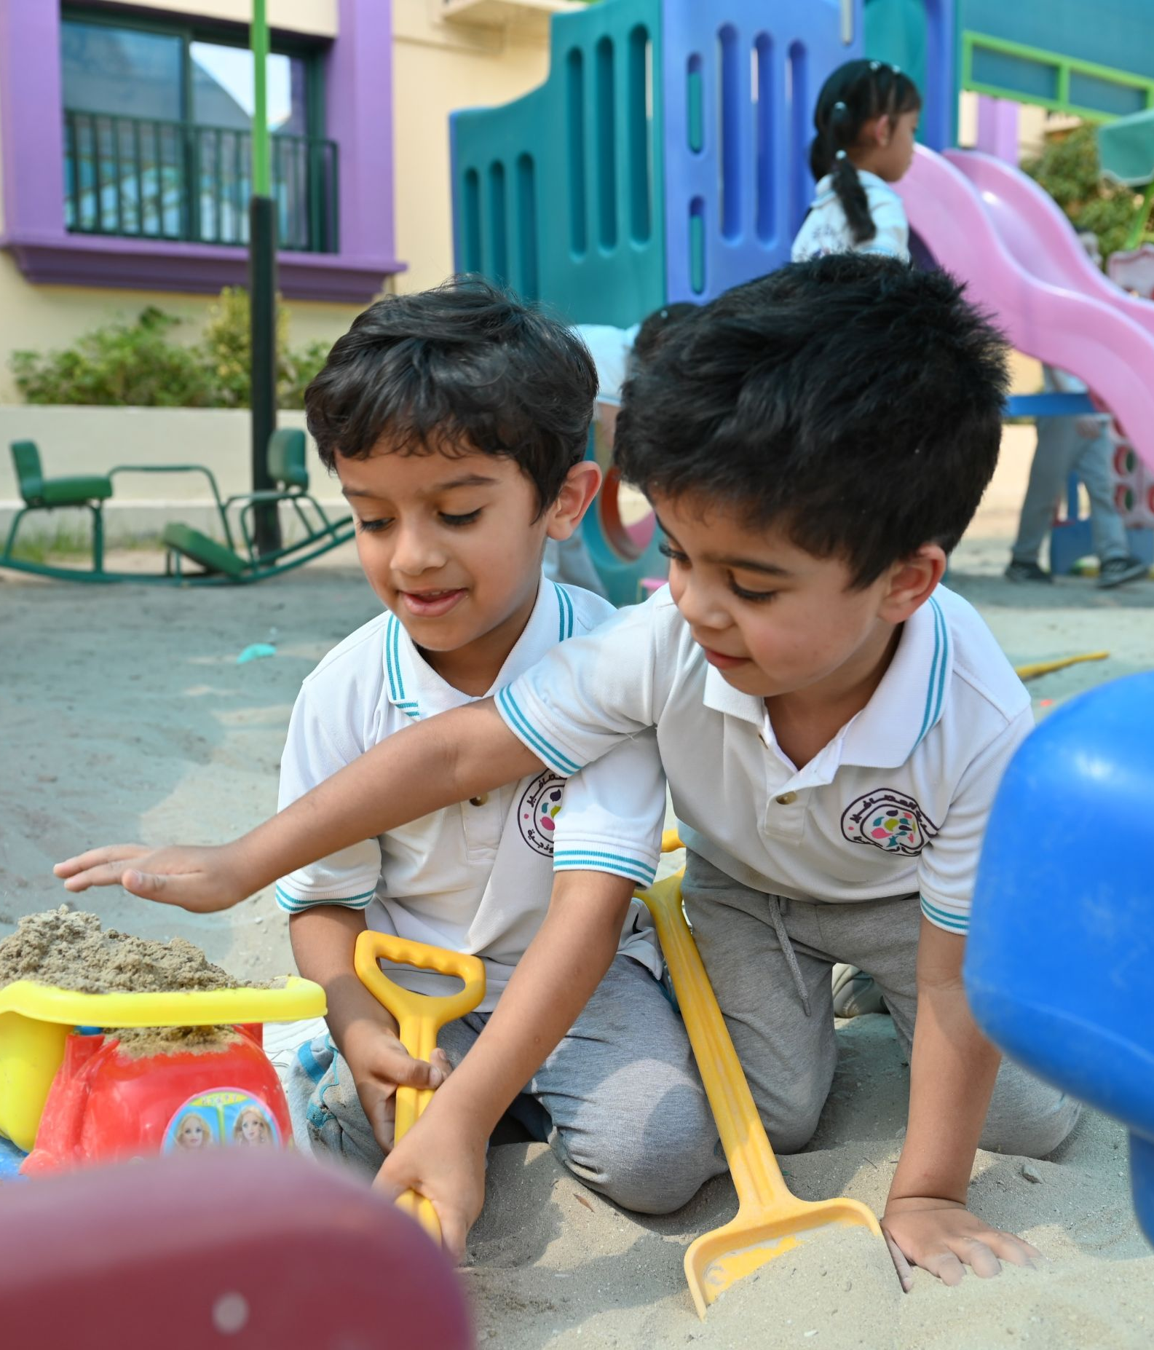
Aspect 1: Children's Growth and Development
1.1 Children’s Social and Emotional Development
1.1.2
Behavior and
Wellbeing
1.1.3
Communication Skills
1.1.1
Social Skills
1.2 Children’s Physical Development
1.2.1
Motor Skills
1.2.2
Health and Selfcare
1.3 Meeting Special Needs *
1.3.1 Special Personal Support
Notes:
Share, explain and discuss:
1.1.1 Social Skills (Engagement in activities, interaction with others, showing confidence, cooperating and building friendships).
1.1.2 Behavior and Wellbeing (Sense of self and identity, Self regulation, resolve conflicts and show positive values, develop empathy, sense of safety).
1.1.3 Communication Skills (Self expression thoughts and feelings, active listening, follow instructions, and engage in conversations).
1.2.1 Motor Skills (Development of Fine and Gross Motor skills, that includes developing hand/feet and eye coordination).
1.2.2 Health and selfcare (How children take care of themselves and make healthy choices, such as good hygiene practices, healthy eating habits and physical activity).
1.3.1 Special personal support (Identifying potential special needs and supporting children with special needs, children with health conditions and disabilities, providing needed accommodation and engagement in KG activities).

Slide 15
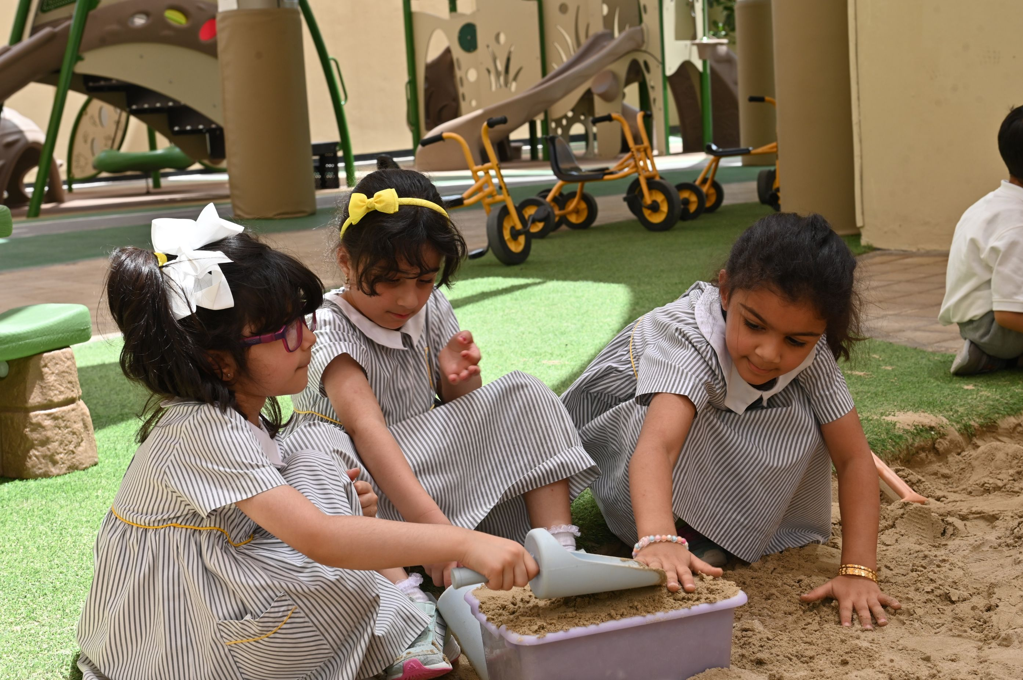
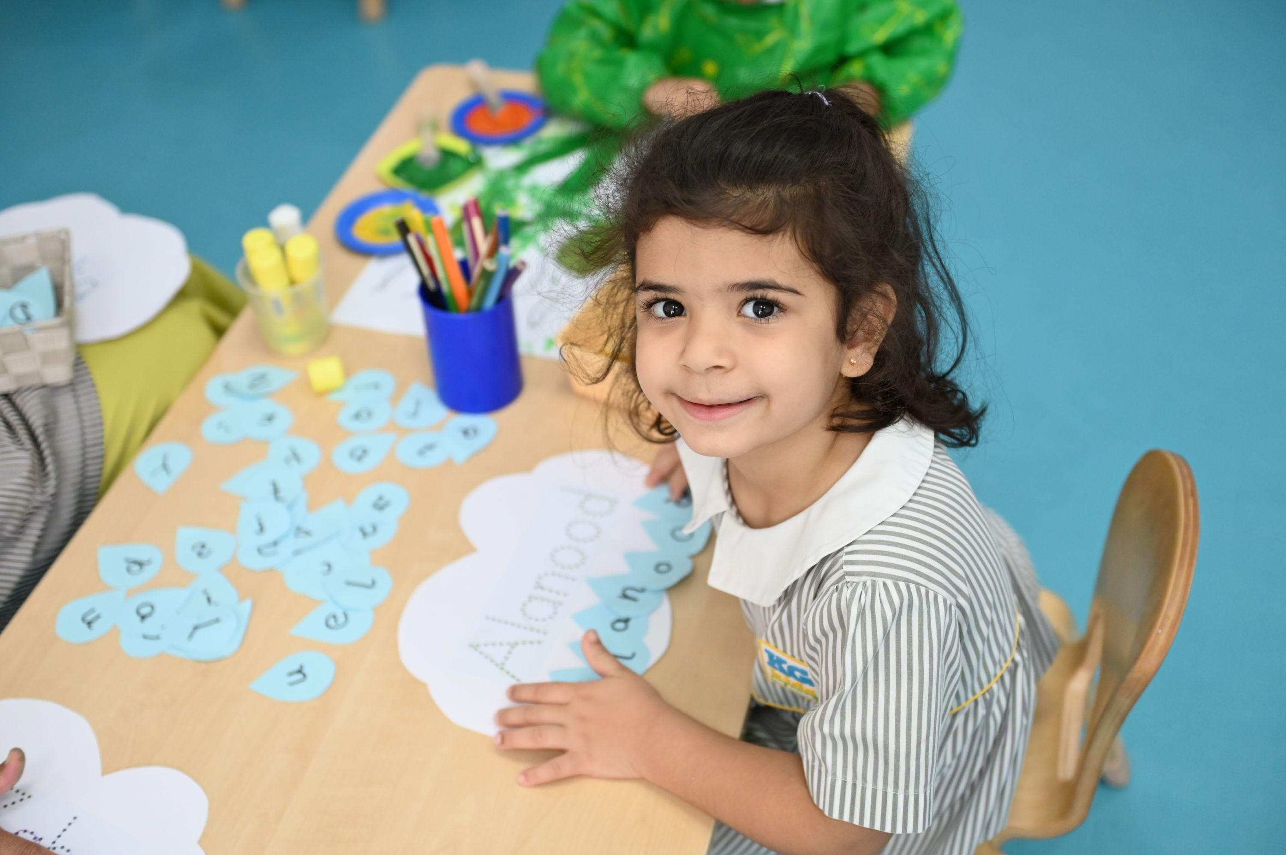
How do children grow?
Self awareness and confidence
Building friendships and playing together
Managing feelings and showing positive behaviour
Social and Emotional Development
Notes:
Share, explain and discuss

Slide 16
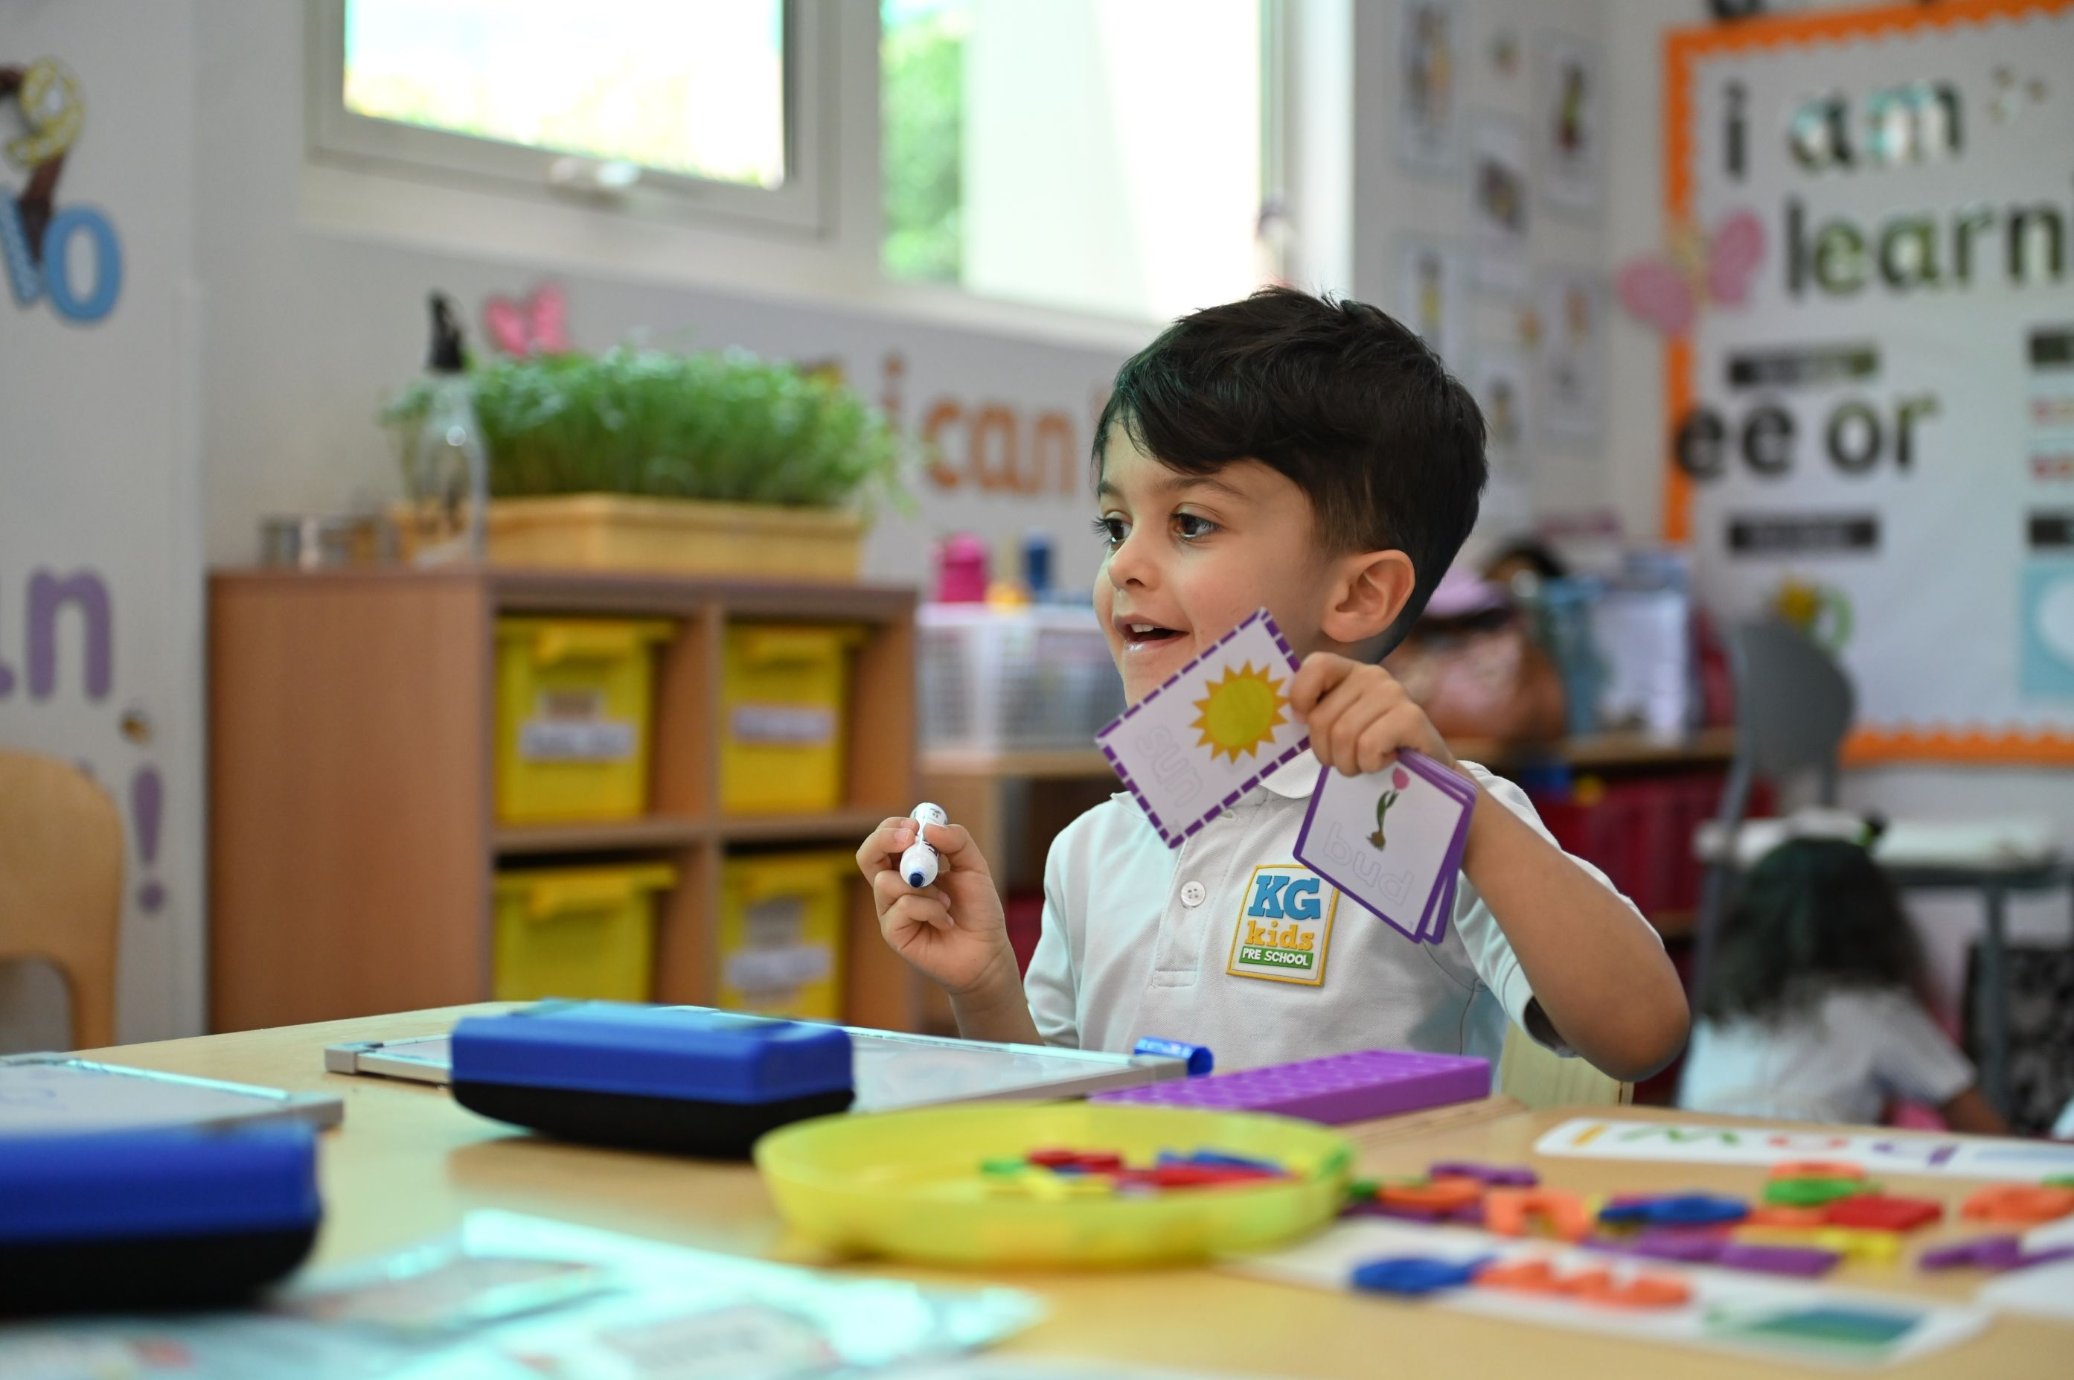
How do children grow?
Participating and engaging with others
Expressing opinion and listening actively
Expressing feelings and thoughts
Language and Communication
Notes:
Share, explain and discuss

Slide 17
Quality communication and interactions
Watch the video on High quality interactions in the Early Years
Notes:
A video explaining Quality Communication and Interactions

Slide 18
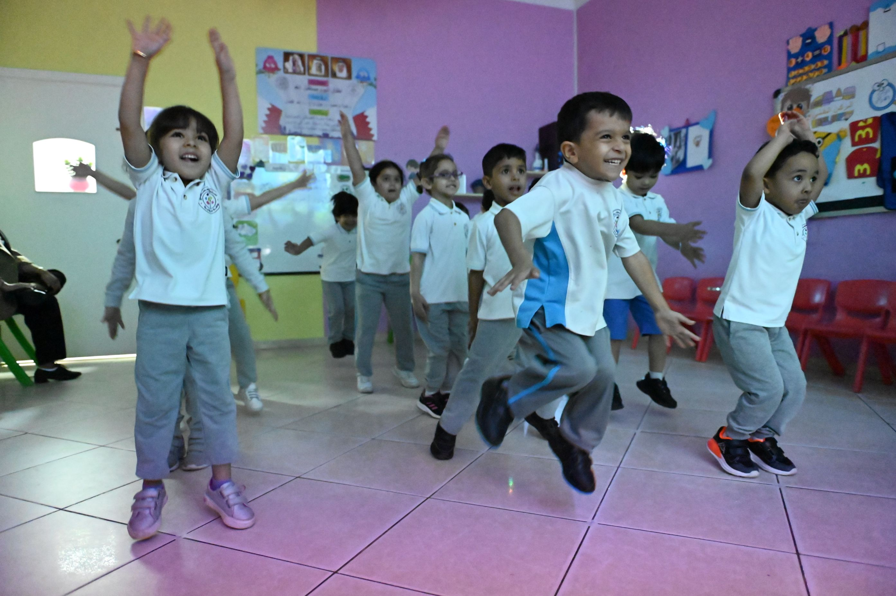
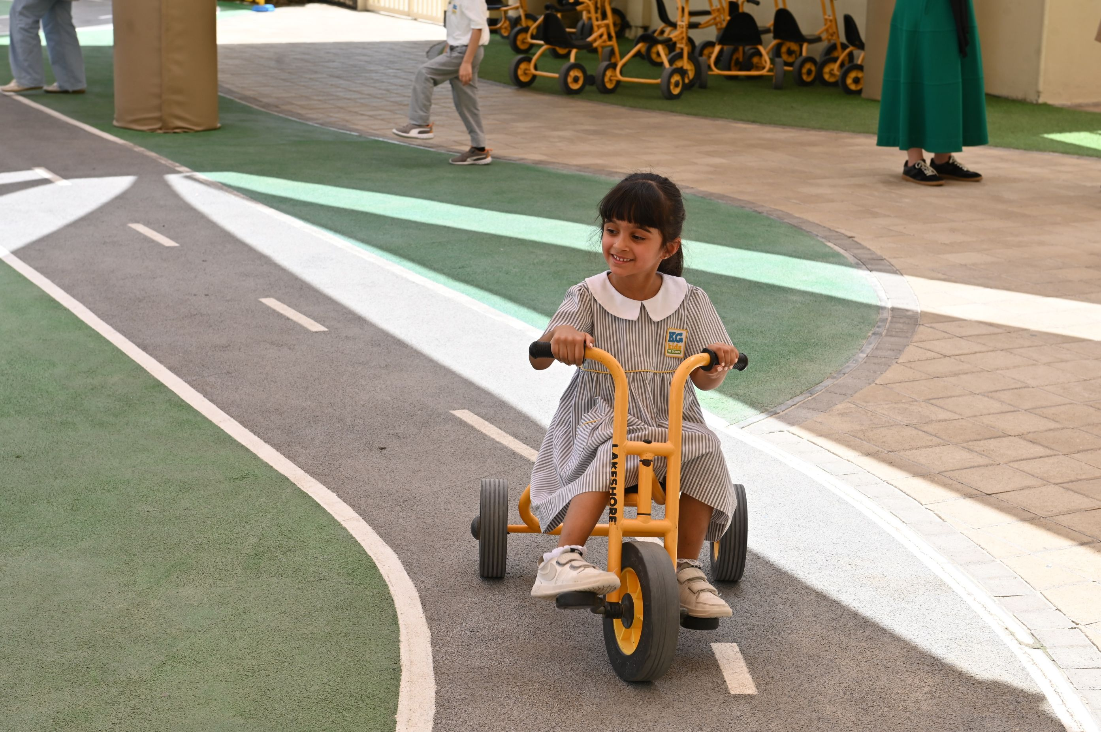
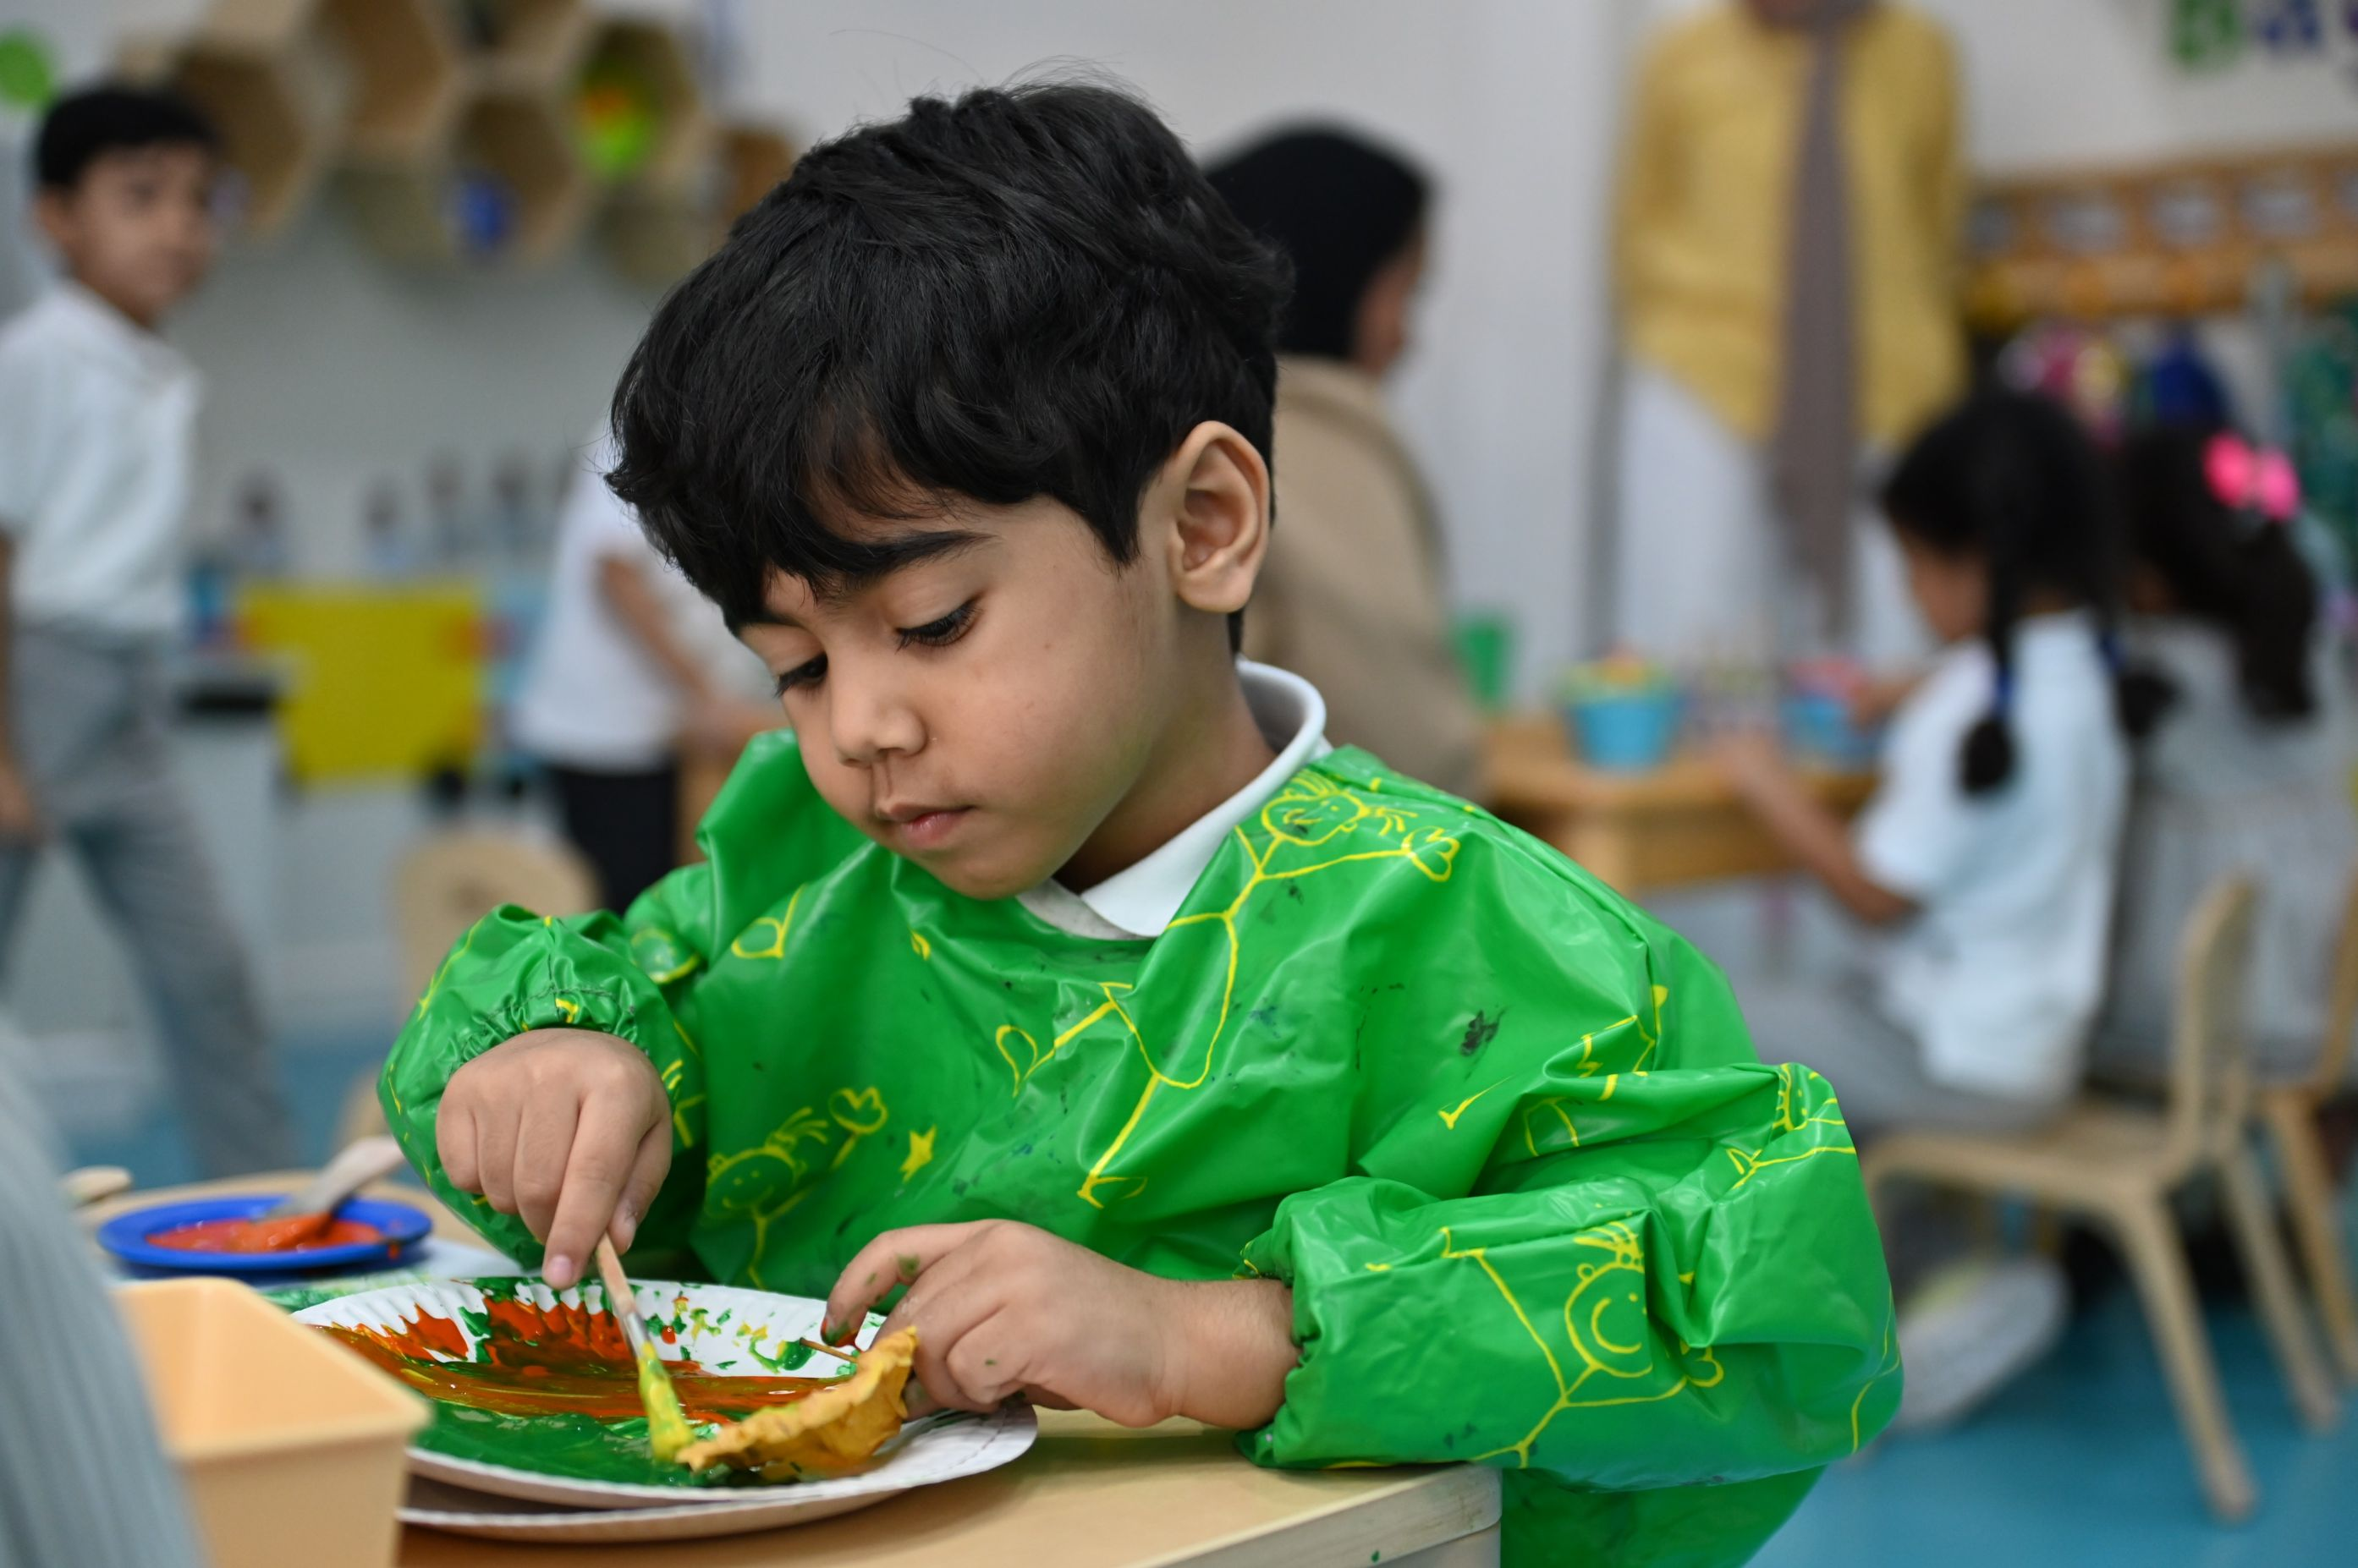
How do children grow?
Balance and coordination in movement
Development of gross motor skills
Development of fine motor skills
Physical Development
Notes:
Share, explain and discuss

Slide 19
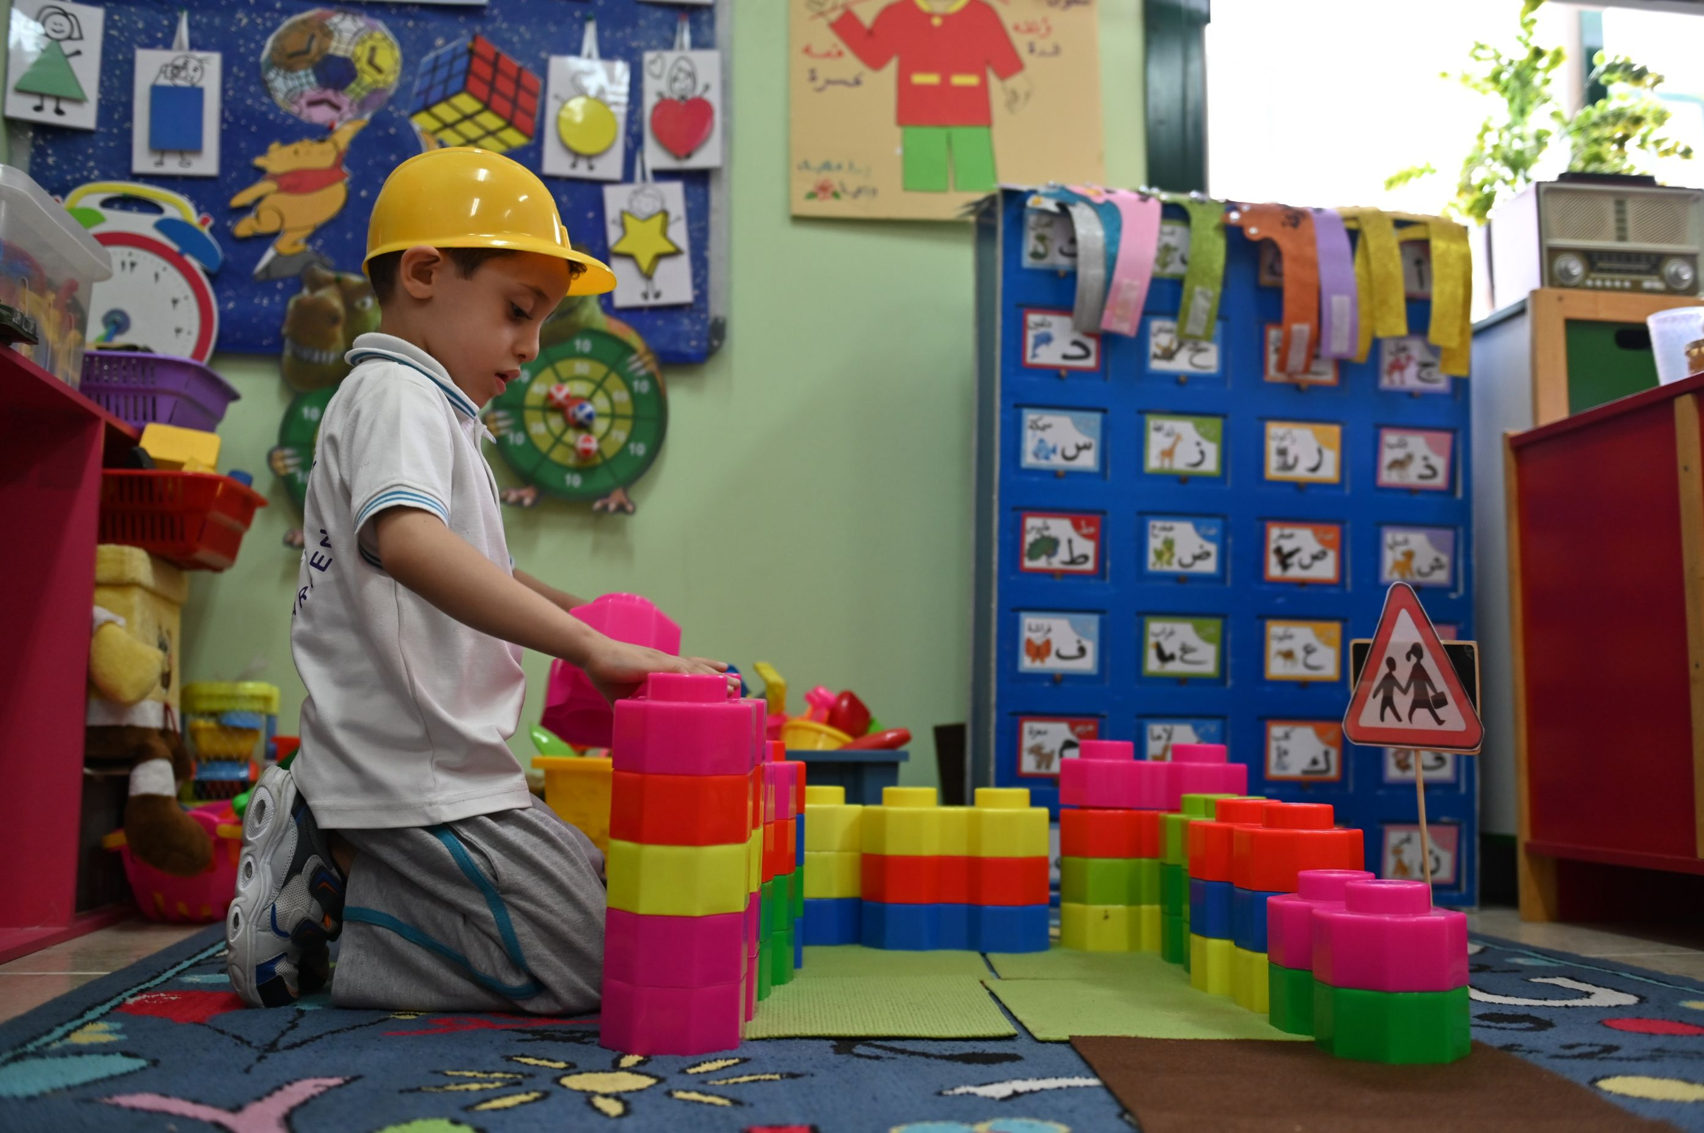
How do children grow?
Exploring and solving problems
Imagination and creativity
Learning different skills and knowledge
Cognitive Development
Notes:
Share, explain and discuss

Slide 20
Children grow through play
Watch the video on Children grow through play
Notes:
Share, explain and discuss
A video explaining how children grow holistically through play

Slide 21
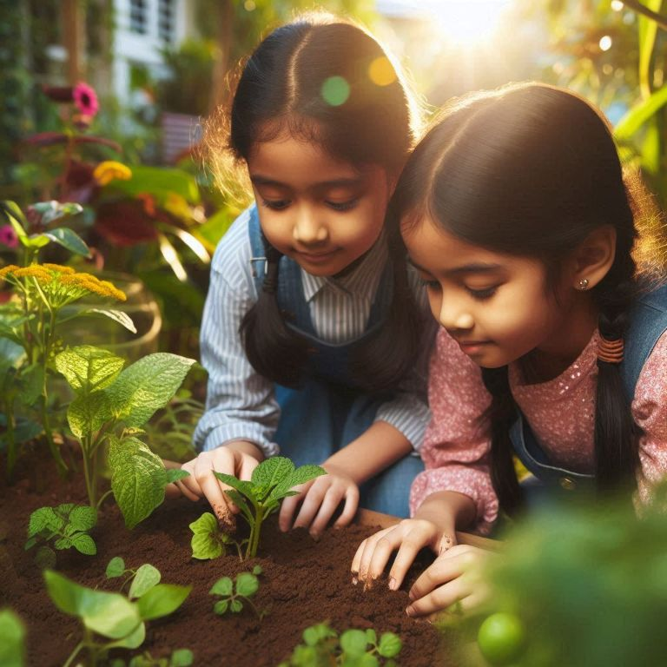
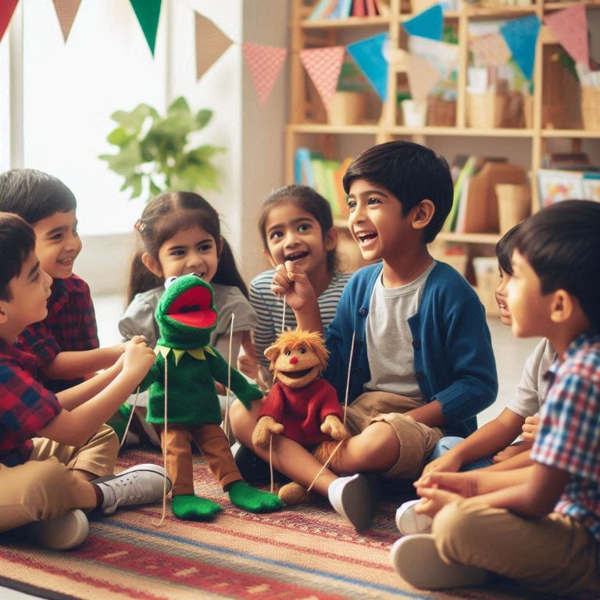
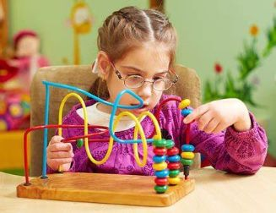
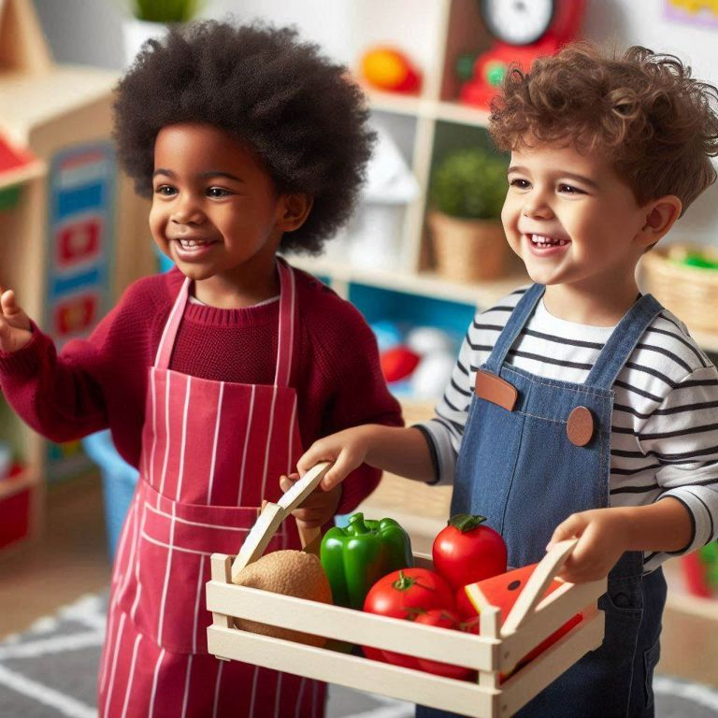
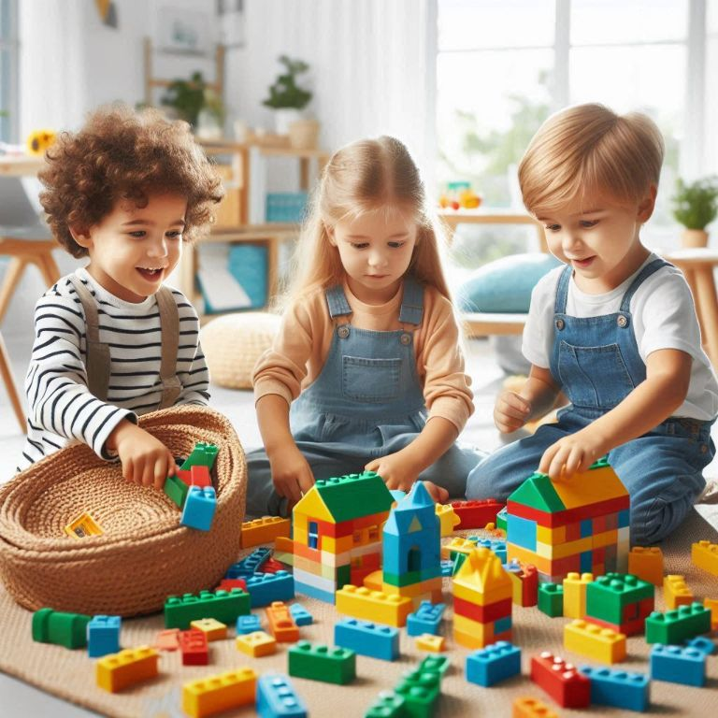
Children grow through play
Explore and discover
Express emotions
Solve problems
Build confidence
Develop social skills
Enhance creativity
Notes:
Share, explain and discuss:
Explore and Discover: Play allows children to explore the world around them, ask questions, and satisfy their natural curiosity.
Solve Problems: Whether building with blocks or solving a puzzle, play helps children think critically and figure things out on their own.
Develop Social Skills: Playing with others teaches sharing, cooperation, and how to take turns, helping children build friendships.
Express Emotions: Through pretend play, art, or role-playing, children can express how they feel and make sense of their experiences.
Build Confidence: When children try new things and succeed, they feel proud, which builds their self-esteem and independence.
Enhance Creativity: Play encourages imagination, from creating stories to building their own worlds with toys, helping them think creatively.

Slide 22
Aspect 1: Children's Growth and Development
Where to obtain data and evidence?
1
Observing & evaluating children’s participation & interaction
2
Analysing documents and procedures
3
Conducting interviews and surveys
4
Reviewing sample of children’s outcomes.
Notes:
Share, explain and discuss

Slide 23
Aspect 2: Child Initiated Learning
2.1 Areas of Learning
2.1.1 Age-appropriate Experiences
2.1.2
Managing Learning Environment
2.2 Curriculum experiences
2.2.1
Acquiring Skills
2.2.2
Tracking Progress
Notes:
Share, explain and discuss:
2.1.1 Age-appropriate experiences (Active Play Based Learning – sensory learning - Investigative Learning - cooperative Learning - fostering creativity, problem solving and imagination through open ended activities and regular access to outdoor learning time).
2.1.2 Managing learning environment (Management of participation and engagement – utilization of learning time and resources – clarity of instructions – children’s motivation and love for learning – Teacher- child positive rapport).
2.2.1 Acquiring skills (Progress in language acquisition, numeracy skills, ICT skills and general knowledge, understanding the world to (life skills – citizenship – inclusivity), based on curriculum experiences).
2.2.2 Tracking progress (Holistic curriculum approach - Continuous evaluation – child observations and photos documentation - Progress Portfolios - support and feedback provided).

Slide 24
Aspect 2: Child Initiated Learning
Play Based Learning
Sensory Learning
Creativity and imagination
Exploring
Outdoor learning time
2.1.1
Age-appropriate Experiences
Managing engagement
Utilising learning time
Clarity of instructions
Motivation and love of learning
Teacher- Child rapport
2.1.2
Managing Learning Environment
2.1 Areas of Learning
Notes:
Share, explain and discuss:
2.1.1 Age-Appropriate Experiences
Evaluates the provision of an age-appropriate curriculum.
Focus on child-led, targeted play-based learning, sensory exploration, and concrete materials.
Encourages cognitive development individually and cooperatively.
Offers open-ended activities that respect children's individuality.
Provides regular outdoor learning opportunities for discovery, problem-solving, and creativity.
Ensures diverse and stimulating learning activities to support overall development.
2.1.2 Managing Learning Environment
Evaluates effective management of the learning environment.
Assesses curriculum time, play spaces, and resource utilisation.
Focus on maintaining active participation in play-based learning.
Reviews clarity of instructions from practitioners and their ability to build positive rapport.
Ensures a safe and motivating environment where children feel loved and excited to learn.

Slide 25
What do we mean when we say
Play Based Learning?
Notes:
Give teachers few minutes to discuss the term

Slide 26
Play Based Learning
Watch the video on Play Based Learning
Notes:
A video explaining play-based learning

Slide 27
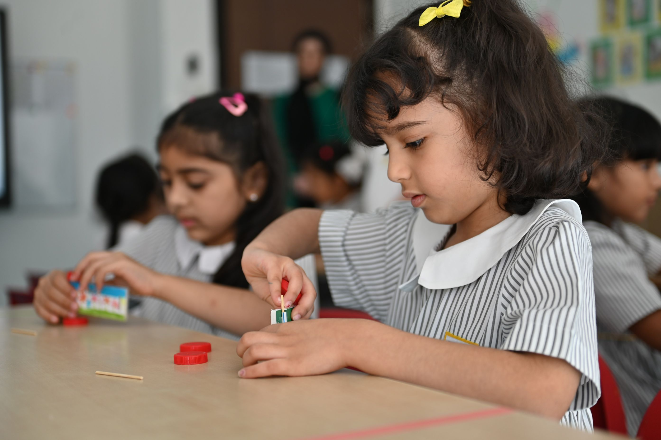
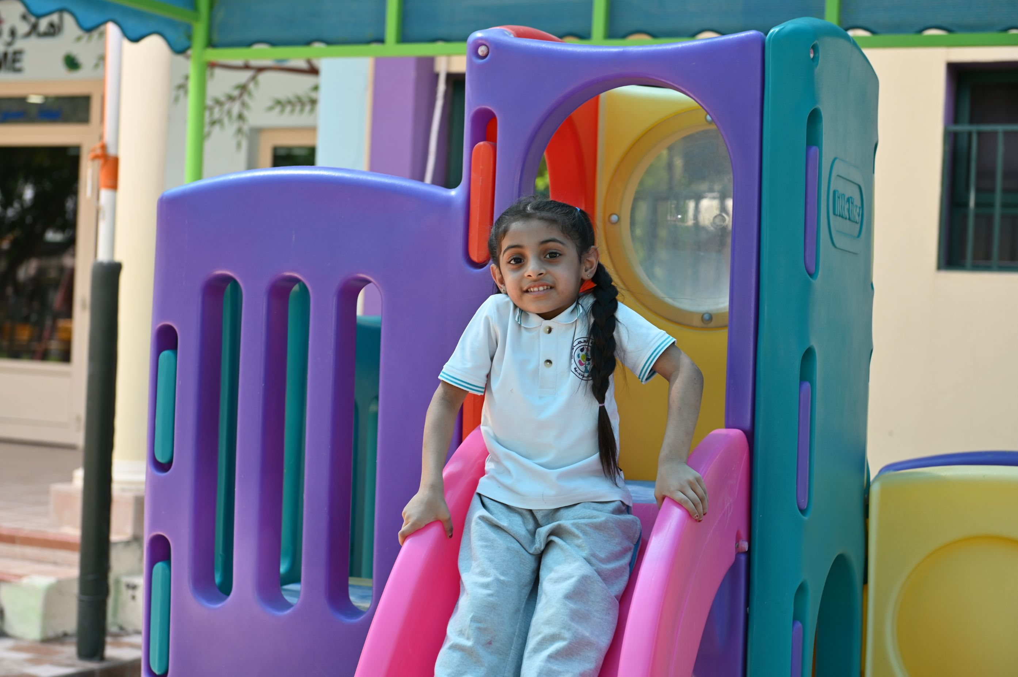
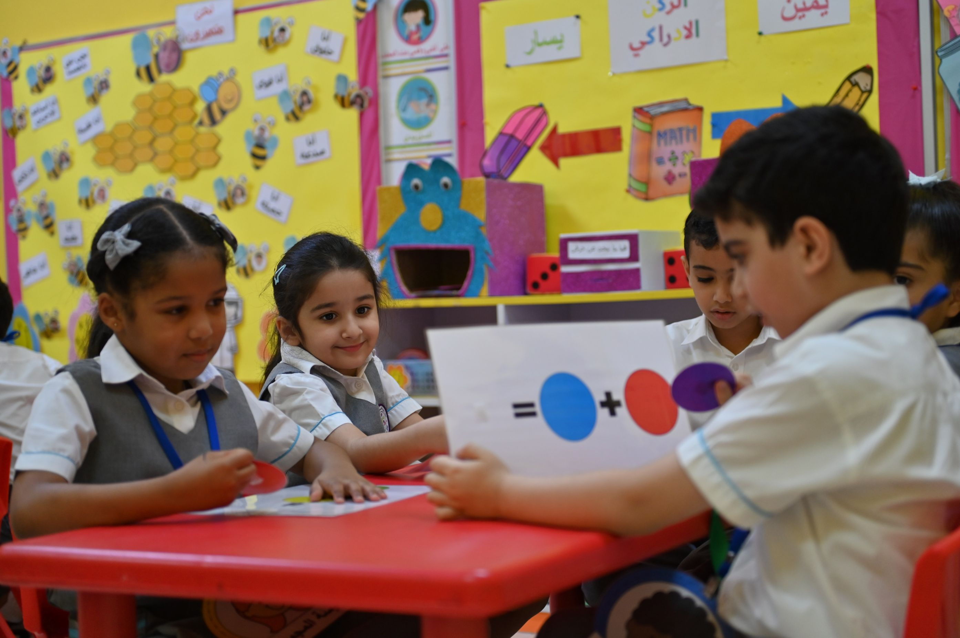
What is Play Based Learning?
Learning through play means that the child learns new things - knowledge and skills - while playing.
Through play, children discover the world around them and learn important life skills in a fun and relaxing way, including problem-solving and communication skills.
It does not mean free play without purpose or planning, but rather refers to educational play activities carefully planned by the teacher to support the child’s growth and development through diverse experiences, matching their abilities and interests.
Notes:
Share, explain and discuss

Slide 28
Types of play
Watch the Video on Play Types
Notes:
A video on types of play

Slide 29
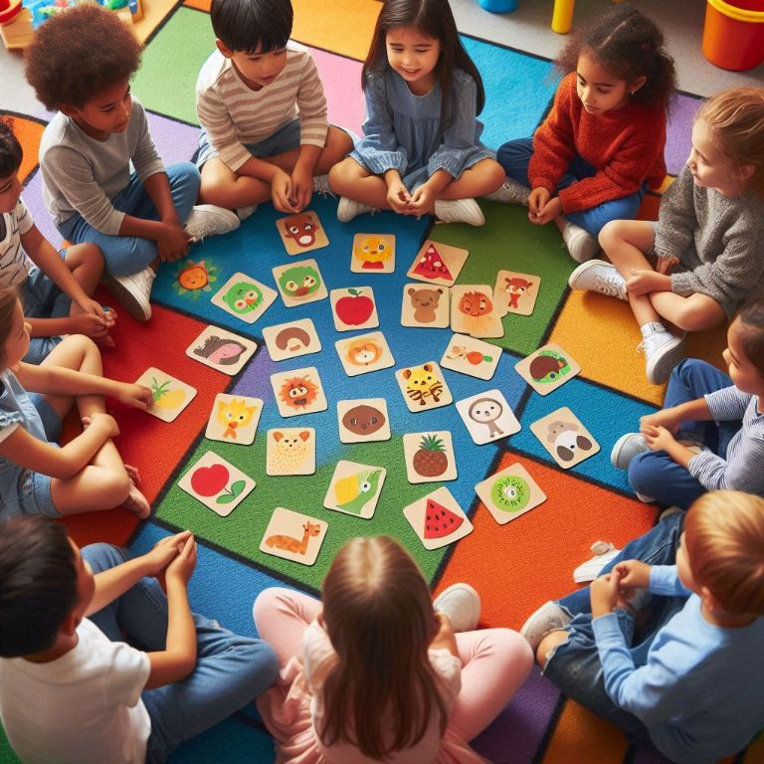
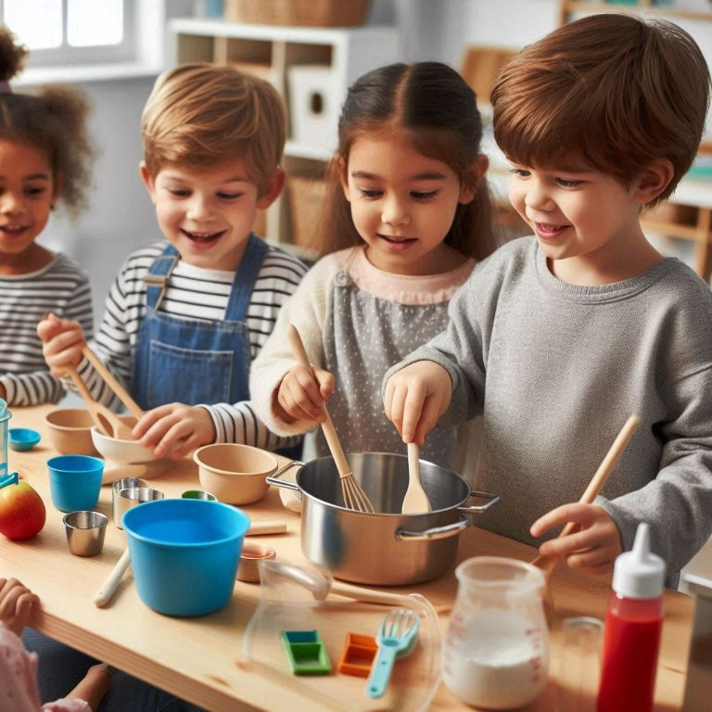
Types of play
Examples of acquiring numeracy skills through play-based learning
Building blocks
Match numbers to pictures
Pretend cooking
What are we trying to develop ?
Notes:
Give the teachers few minutes to discuss the question.
Answer: Numbers, colour, size, practicing counting, sorting, and understanding basic addition or subtraction, measuring, sequencing concepts as they play.

Slide 30
Types of play
Examples of acquiring language skills through play-based learning
Story telling with puppets
Phonics treasure hunt
Role play scenarios
What are we trying to develop ?
Notes:
Give the teachers few minutes to discuss the question.
Answer: Creativity – imagination – sentence structure – listening and speaking skills – vocabulary – alphabets and phonics - communication – behavior – social skills – motor skills (holistic development).

Slide 31
Play in scientific research
Data from studies comparing the effect of play on children’s learning compared to children who learned in a traditional setting:
34% Development of cognitive skills such as memory and critical thinking
75% Show higher empathy and ability to resolve conflicts
30% language development and learned vocabulary
45% More likely to excel in reading, writing and math at school
40% Development in gross and fine motor skill
Notes:
References:
(Pediatrics Journal, 2018)
(Journal of Child Psychology and Psychiatry, 2020)
(NAEYC Research, 2019)
(Early Childhood Research Quarterly, 2017)
(Journal of Pediatrics, 2021).

Slide 32
Aspect 2: Child Initiated Learning
Language acquisition
Numeracy skills
General knowledge
Understanding the world
Curriculum experiences
2.2.1
Acquiring Skills
Holistic approach
Continuous evaluation
Observation and documentation
Portfolios
Support and feedback
2.2.2
Tracking Progress
2.2 Curriculum experiences
Notes:
Share, explain and discuss:
2.2.1 Acquiring Skills
Assesses children's progress in essential early skills.
Focus on language development, basic numeracy, and general knowledge (e.g., understanding the world, ICT, citizenship).
Evaluates how the curriculum supports holistic learning in these areas.
Reviews how effectively practitioners facilitate progress in fundamental skills for future success.
2.2.2 Tracking Progress
Examines kindergarten's methods for monitoring and documenting children's learning.
Focus on continuous evaluation methods (e.g., observations, photographs, development portfolios).
Ensures learning progress is tracked with quality support and feedback to enhance development.

Slide 33
Aspect 2: Child Initiated Learning
Where to obtain data and evidence?
Observation of learning experiences
Interaction with the children
Evaluation of learning plans
Assessing children’s outcomes.
Notes:
Share, explain and discuss

Slide 34
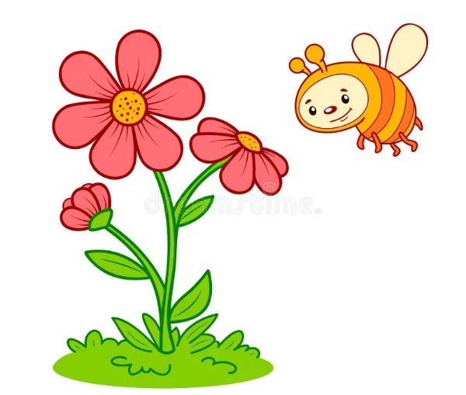
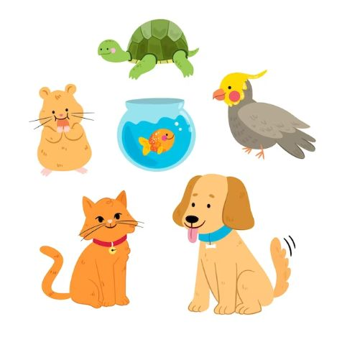
Activity 2
Create play-based activities to help children progress in these knowledge/ skills ..
The letter h
Types of flowers
5
Number 5
Home pets
Notes:
Give the teachers 20 minutes to think, discuss and write down an activity for each concept/ knowledge/ skill (in groups)
They will need flipcharts , A3 papers, markers
Give each group 10 minutes to present their idea and discuss it with the other groups
Ask about how these ideas cover the three pillars of ECE
Show sample answer

Slide 35
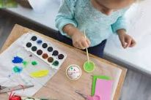
Activity 2
Create play-based activities to help children progress in these knowledge/ skills ..
The letter h
Tips
Crafts
Treasure hunt
Always focus on the SOUND of the letter, not its name
Start with all lowercase letters.
Introduce high-frequency letters first, such as s, a, t, p, i, n, rather than the regular sequence of a, b, c, d.
Chalk, paint, playdough or sand
Songs
Notes:
Discuss sample answer (please note these are examples, many others can be applicable)
Discuss the Tips of teaching letters with teachers. Research for more tips - examples
Ask about how these ideas cover the three pillars of ECE

Slide 36
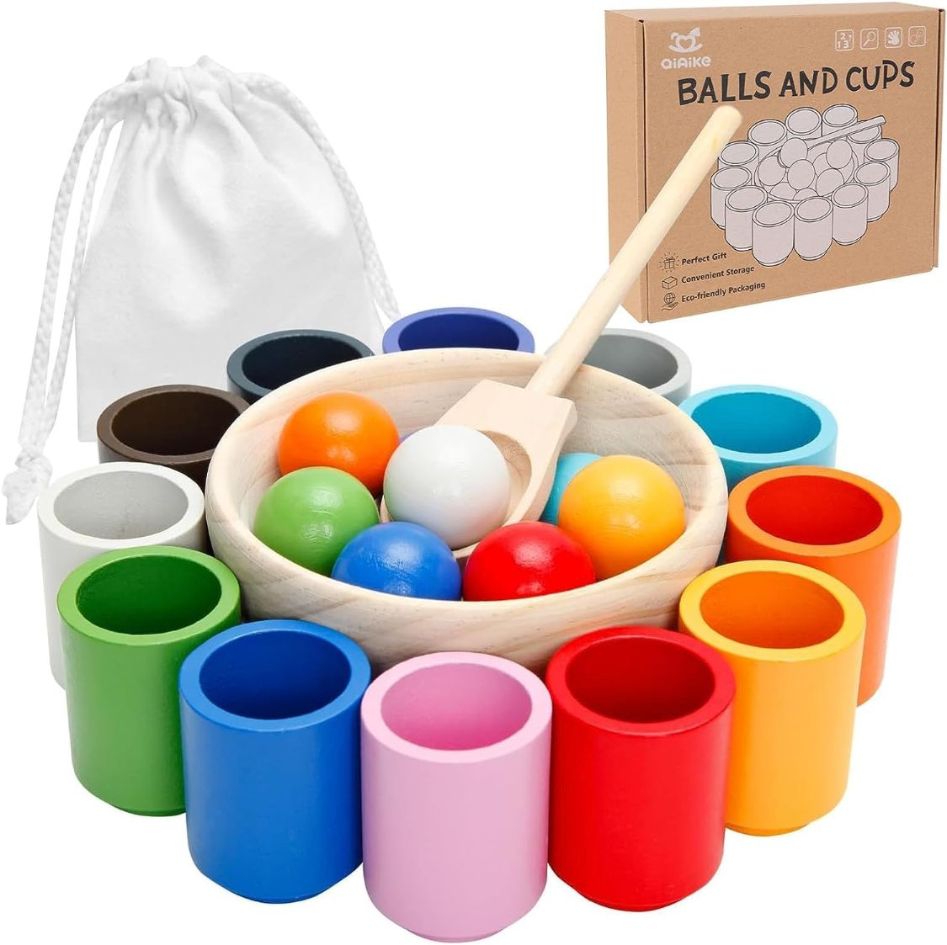
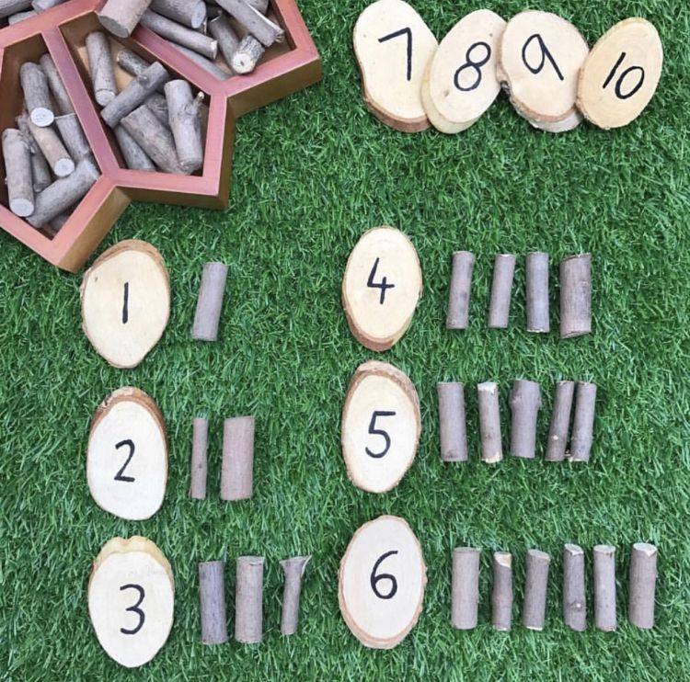
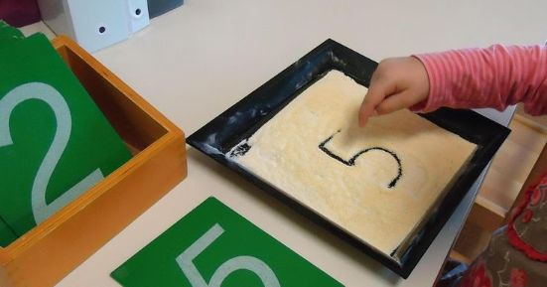
Activity 2
Create play-based activities to help children progress in these knowledge/ skills ..
5
Number 5
Tips
It’s important to start with concrete materials showing the concept of the number (for example: 5 cups, 5 balls, 5 blocks)
Connect to Daily Life: Relate numbers to everyday tasks like setting the table or counting steps.
Balls in cups
Building blocks
Outdoor learning: counting jumps, hoops, twigs
Chalk, paint, playdough or sand
Notes:
Discuss sample answer (please note these are examples, many others can be applicable)
Discuss the Tips with teachers. Research for more tips - examples
Ask about how these ideas cover the three pillars of ECE

Slide 37
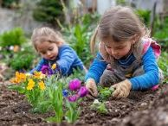
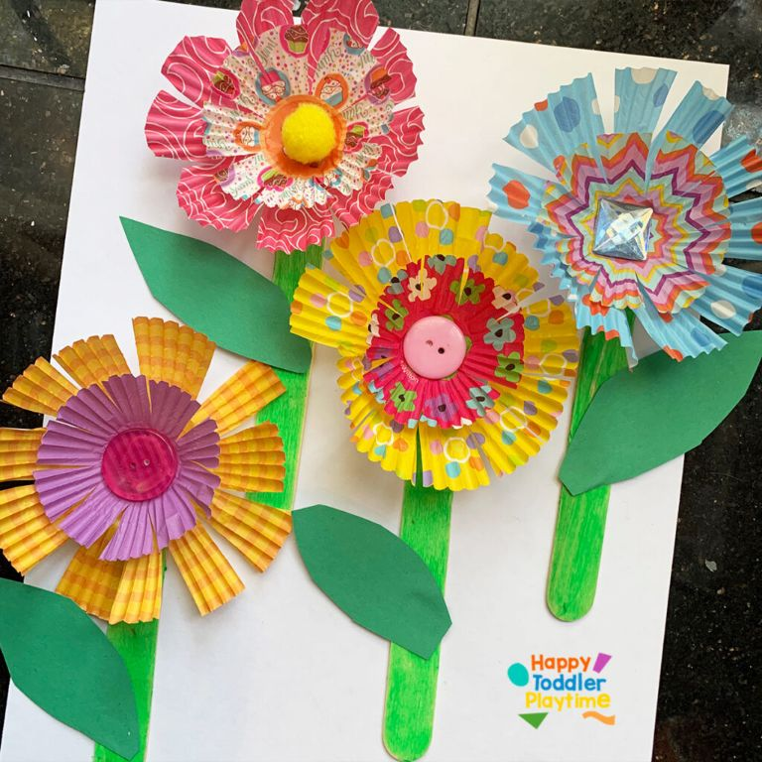
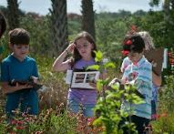
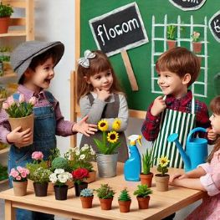
Activity 2
Create play-based activities to help children progress in these knowledge/ skills ..
Types of flowers
Tips
Make it interactive: take the children outside to explore the different types of flowers and discover facts about them.
Involve children in every step, from planting to watering their own flowers.
Use simple language and easy-to-understand terms.
Planting
Crafts
Trip to a garden
Role play / story
Notes:
Discuss sample answer (please note these are examples, many others can be applicable)
Discuss the Tips with teachers. Research for more tips - examples
Ask about how these ideas cover the three pillars of ECE

Slide 38
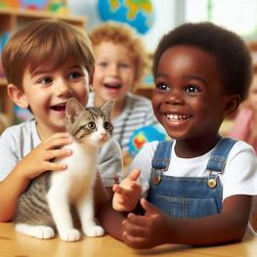
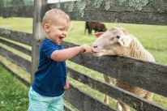
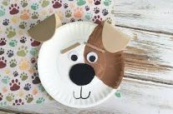
Activity 2
Create play-based activities to help children progress in these knowledge/ skills ..
Home pets
Tips
Relate to Real Experiences: Discuss pets children may have or know about to create connections, develop language and enrich vocabulary.
Teach Responsibility: Emphasise simple tasks like feeding or cleaning to care for pets.
Check the possibility of bringing some of children’s pets in class.
Show and tell
Create imaginary pet
Visit a farm
Crafts
Notes:
Discuss sample answer (please note these are examples, many others can be applicable)
Discuss the Tips with teachers. Research for more tips - examples
Ask about how these ideas cover the three pillars of ECE

Slide 39
Aspect 3: Leadership and Management
3.1 Leadership effectiveness
3.1.1
Improvement Planning
3.1.2
Managing Resources
3.2 Family and Community Engagement
3.2.2
Engagement with the Community
3.2.1
Family Involvement
Notes:
Share, explain and discuss
3.1.1 Improvement Planning (Work with clear vision - self evaluation to identify priorities - improvement planning – implementation of the curriculum- impact of governance).
3.1.2 managing resources (Suitability of human resources - staff development – availability and suitability of learning resources and facilities).
3.2.1 Family involvement (parents’ communication – informing progress – Family’s engagement in KG activities).
3.2.2 Engagement with the community (to prepare for next stage of education and enrich children’s experiences and sense of inclusion).

Slide 40
Aspect 3: Leadership and Management
Where to obtain data and evidence?
Assess leadership awareness
Analysis of plans
Evaluate resources and facilities
Interviews and document analysis.
Notes:
Share, explain and discuss
((for more information on Aspect 3, you may refer to Kindergartens Principals Training ppt))

Slide 41
Thank you
bqa Bahrain
@bqa_bh
www.bqa.gov.bh

