Slide 1
Introduction to Early Childhood Education and Child Development
For Parents

Slide 2
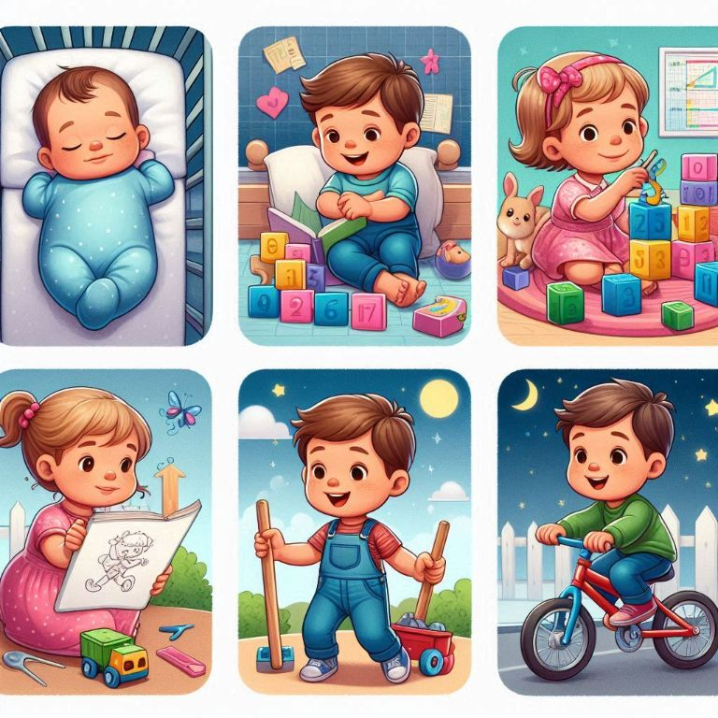
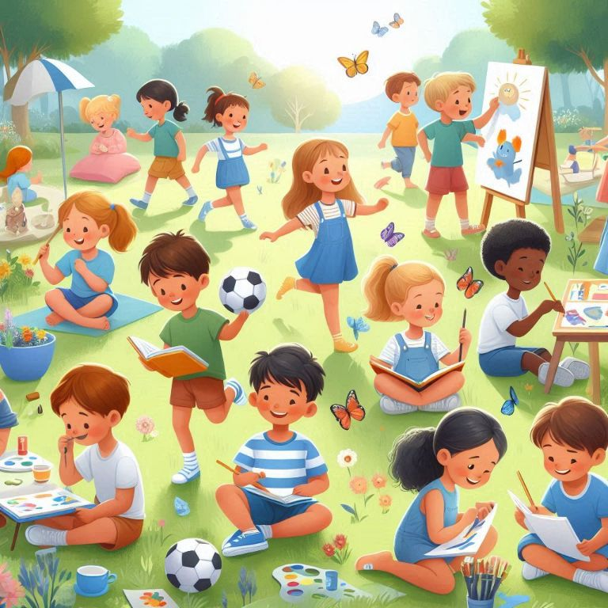
Early Childhood Education (ECE)
What?
Why?
The learning and development that happens from birth to around the age of 6.
It focuses on building strong foundationsfor children's future learning.
To support children in growing into confident, capable and curious learners, by focusing on their needs during these early important years.

Slide 3
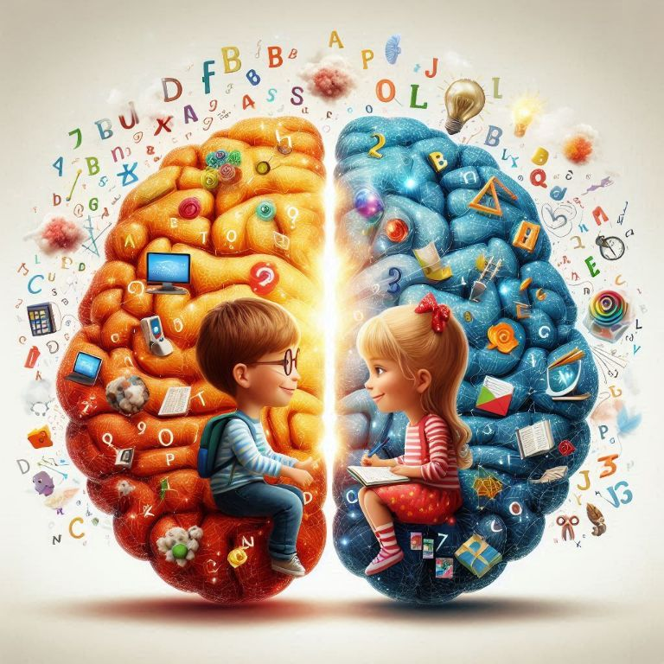
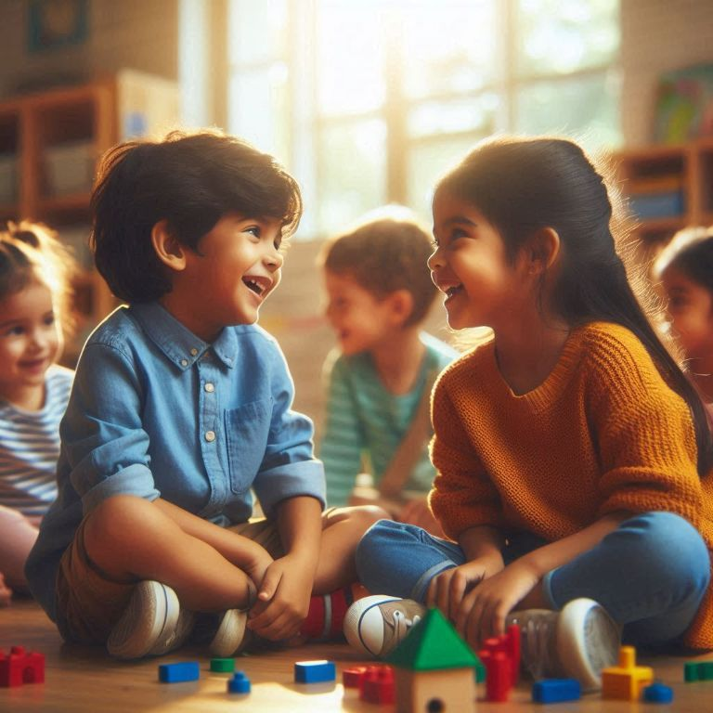
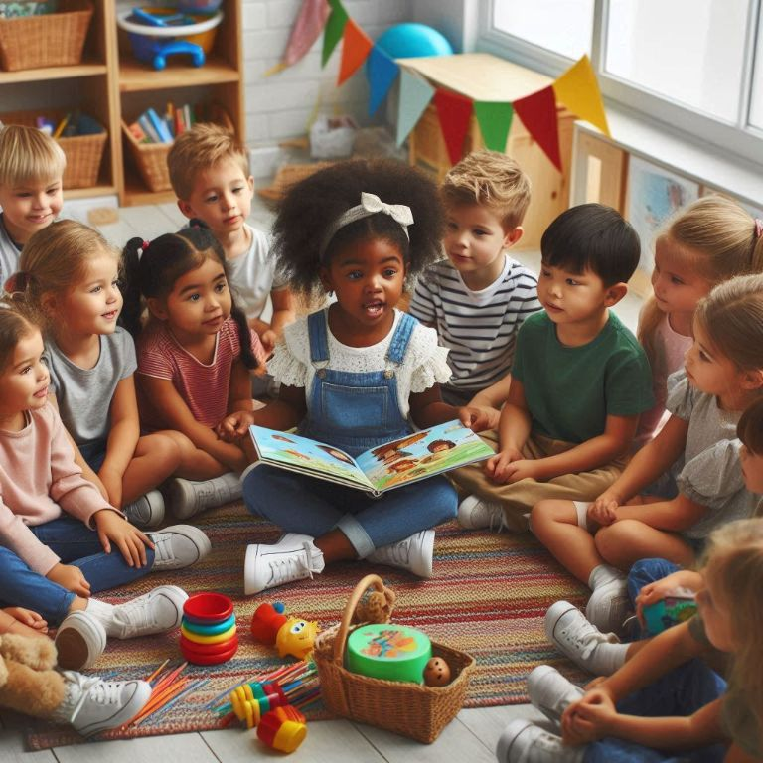
Why is ECE important?
Brain Development
Social Skills
Building Blocks for School
The first five years are when children's brains grow the fastest. What they learn now shapes their future thinking, skills, and social behaviours.
It helps children learn to communicate, share, make friends, and get along with others, which are important for their overall happiness and success.
ECE helps children develop early skills and concepts, such as problem-solving and language acquisition, so they are ready to succeed when they start school.

Slide 4
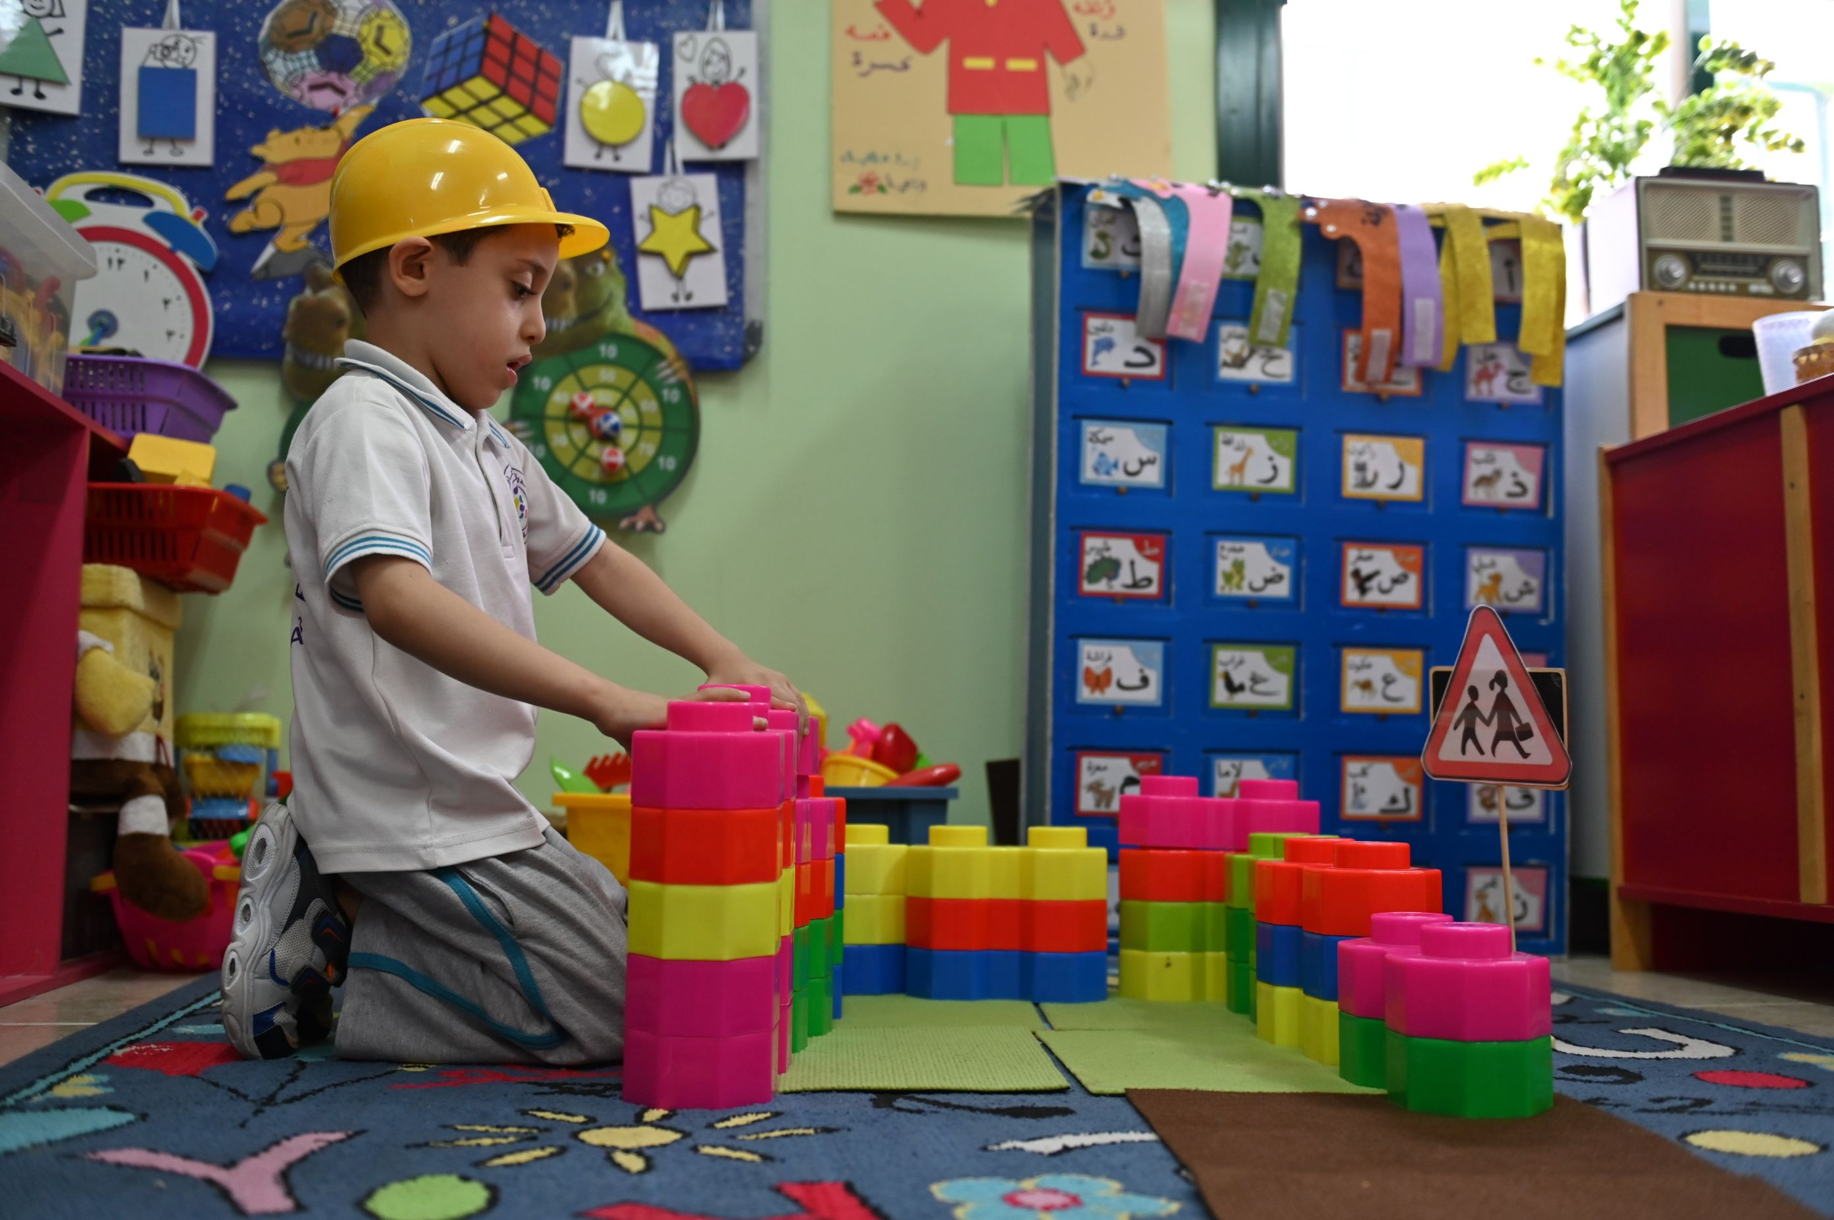







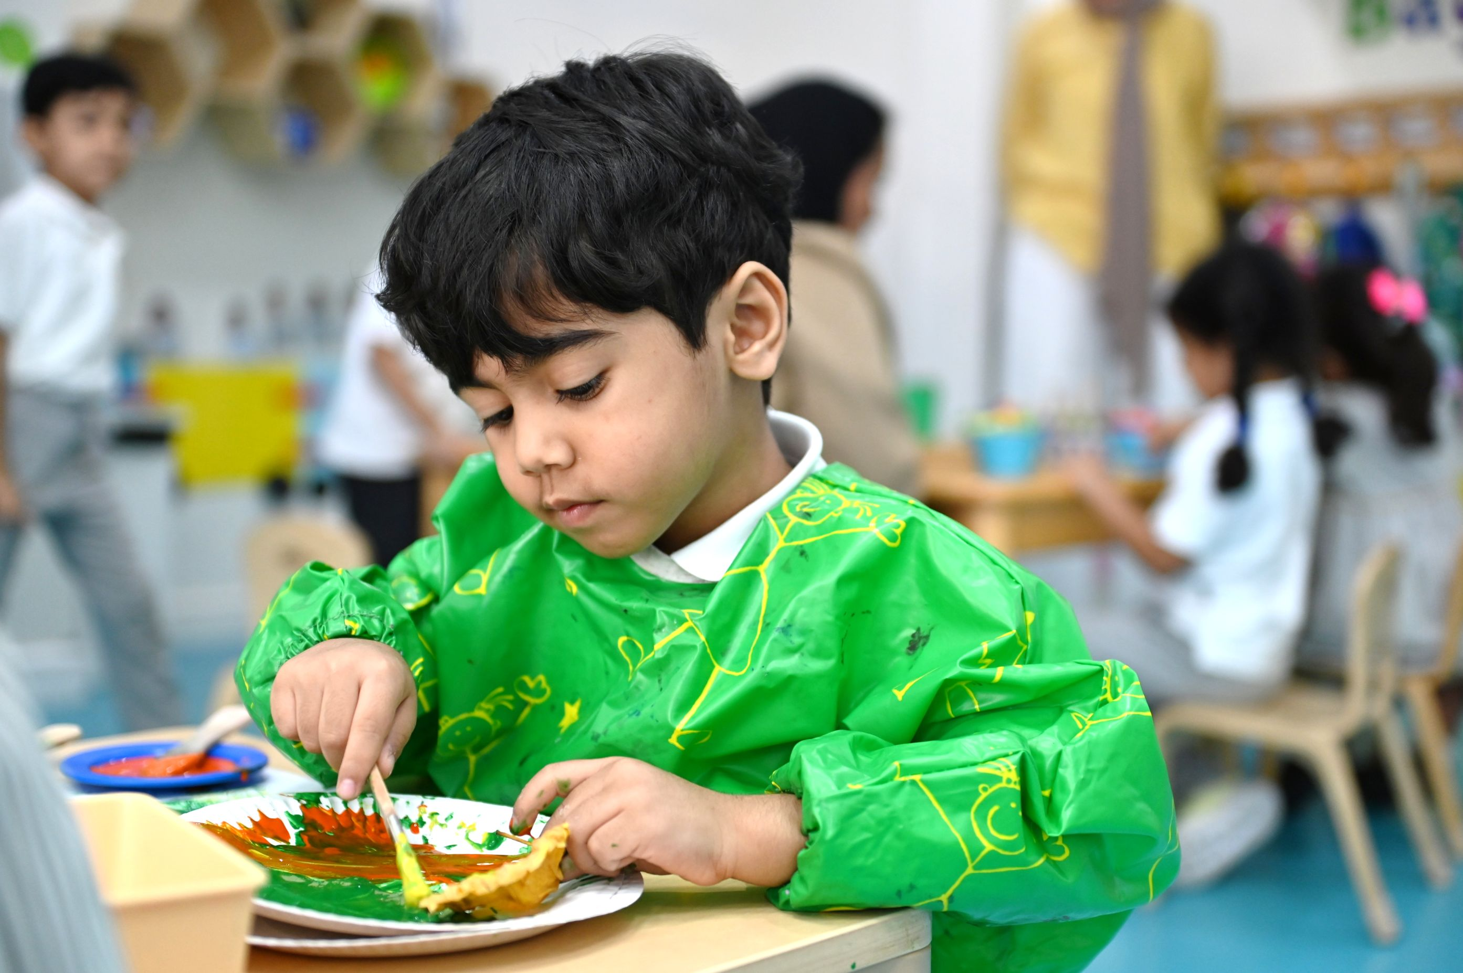
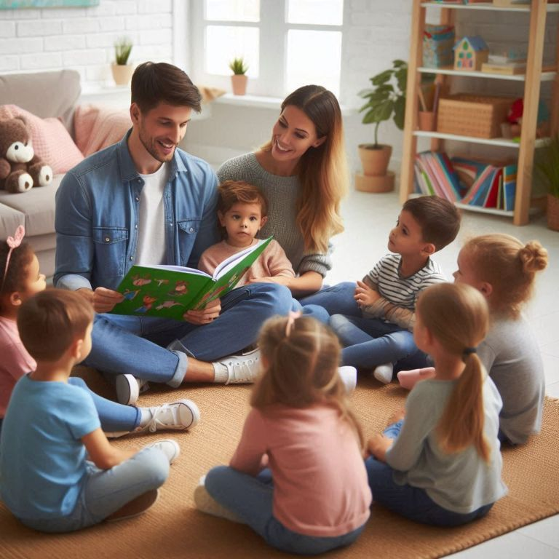


What the world is doing in ECE
Learning through PLAY
Focus on social and emotional growth
It’s all about the child
Inclusion and partnerships

Slide 5

How do children grow?
Watch the video on How do children grow
Notes:
A video

Slide 6

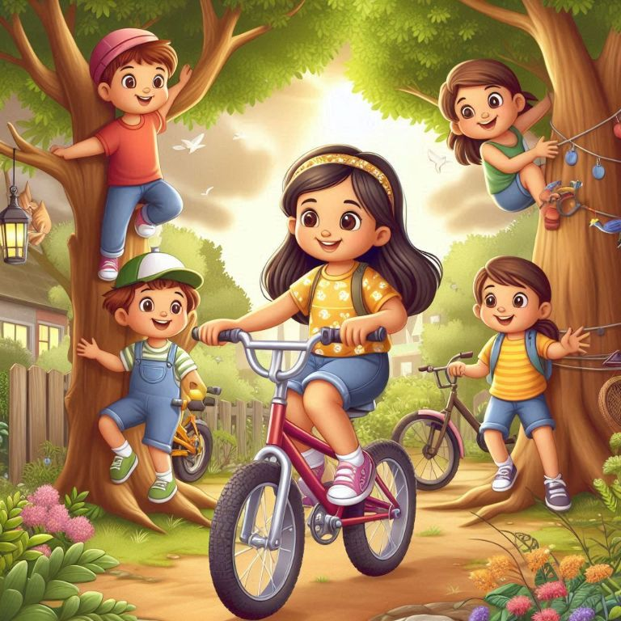
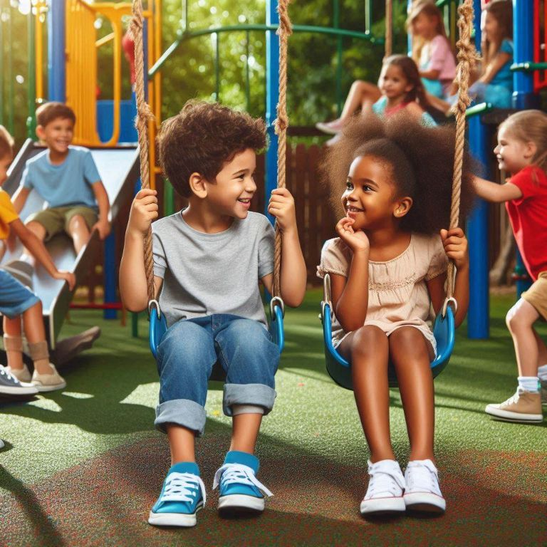
How do children grow?
Cognitive Development
Physical Development
Language and Communication
Social and Emotional Development
Notes:
Cognitive Development: Thinking, learning, Creativity, Imaginative and problem-solving skills (e.g., curiosity, exploring, asking questions).
Physical Development: Strengthening muscles through movement, balance, and coordination (e.g., running, jumping, drawing, building blocks).
Language and Communication: Understanding and using language (e.g., talking, listening, understanding stories).
Social and Emotional Development: Learning to manage feelings, build relationships, and develop self identity and self-confidence.

Slide 7
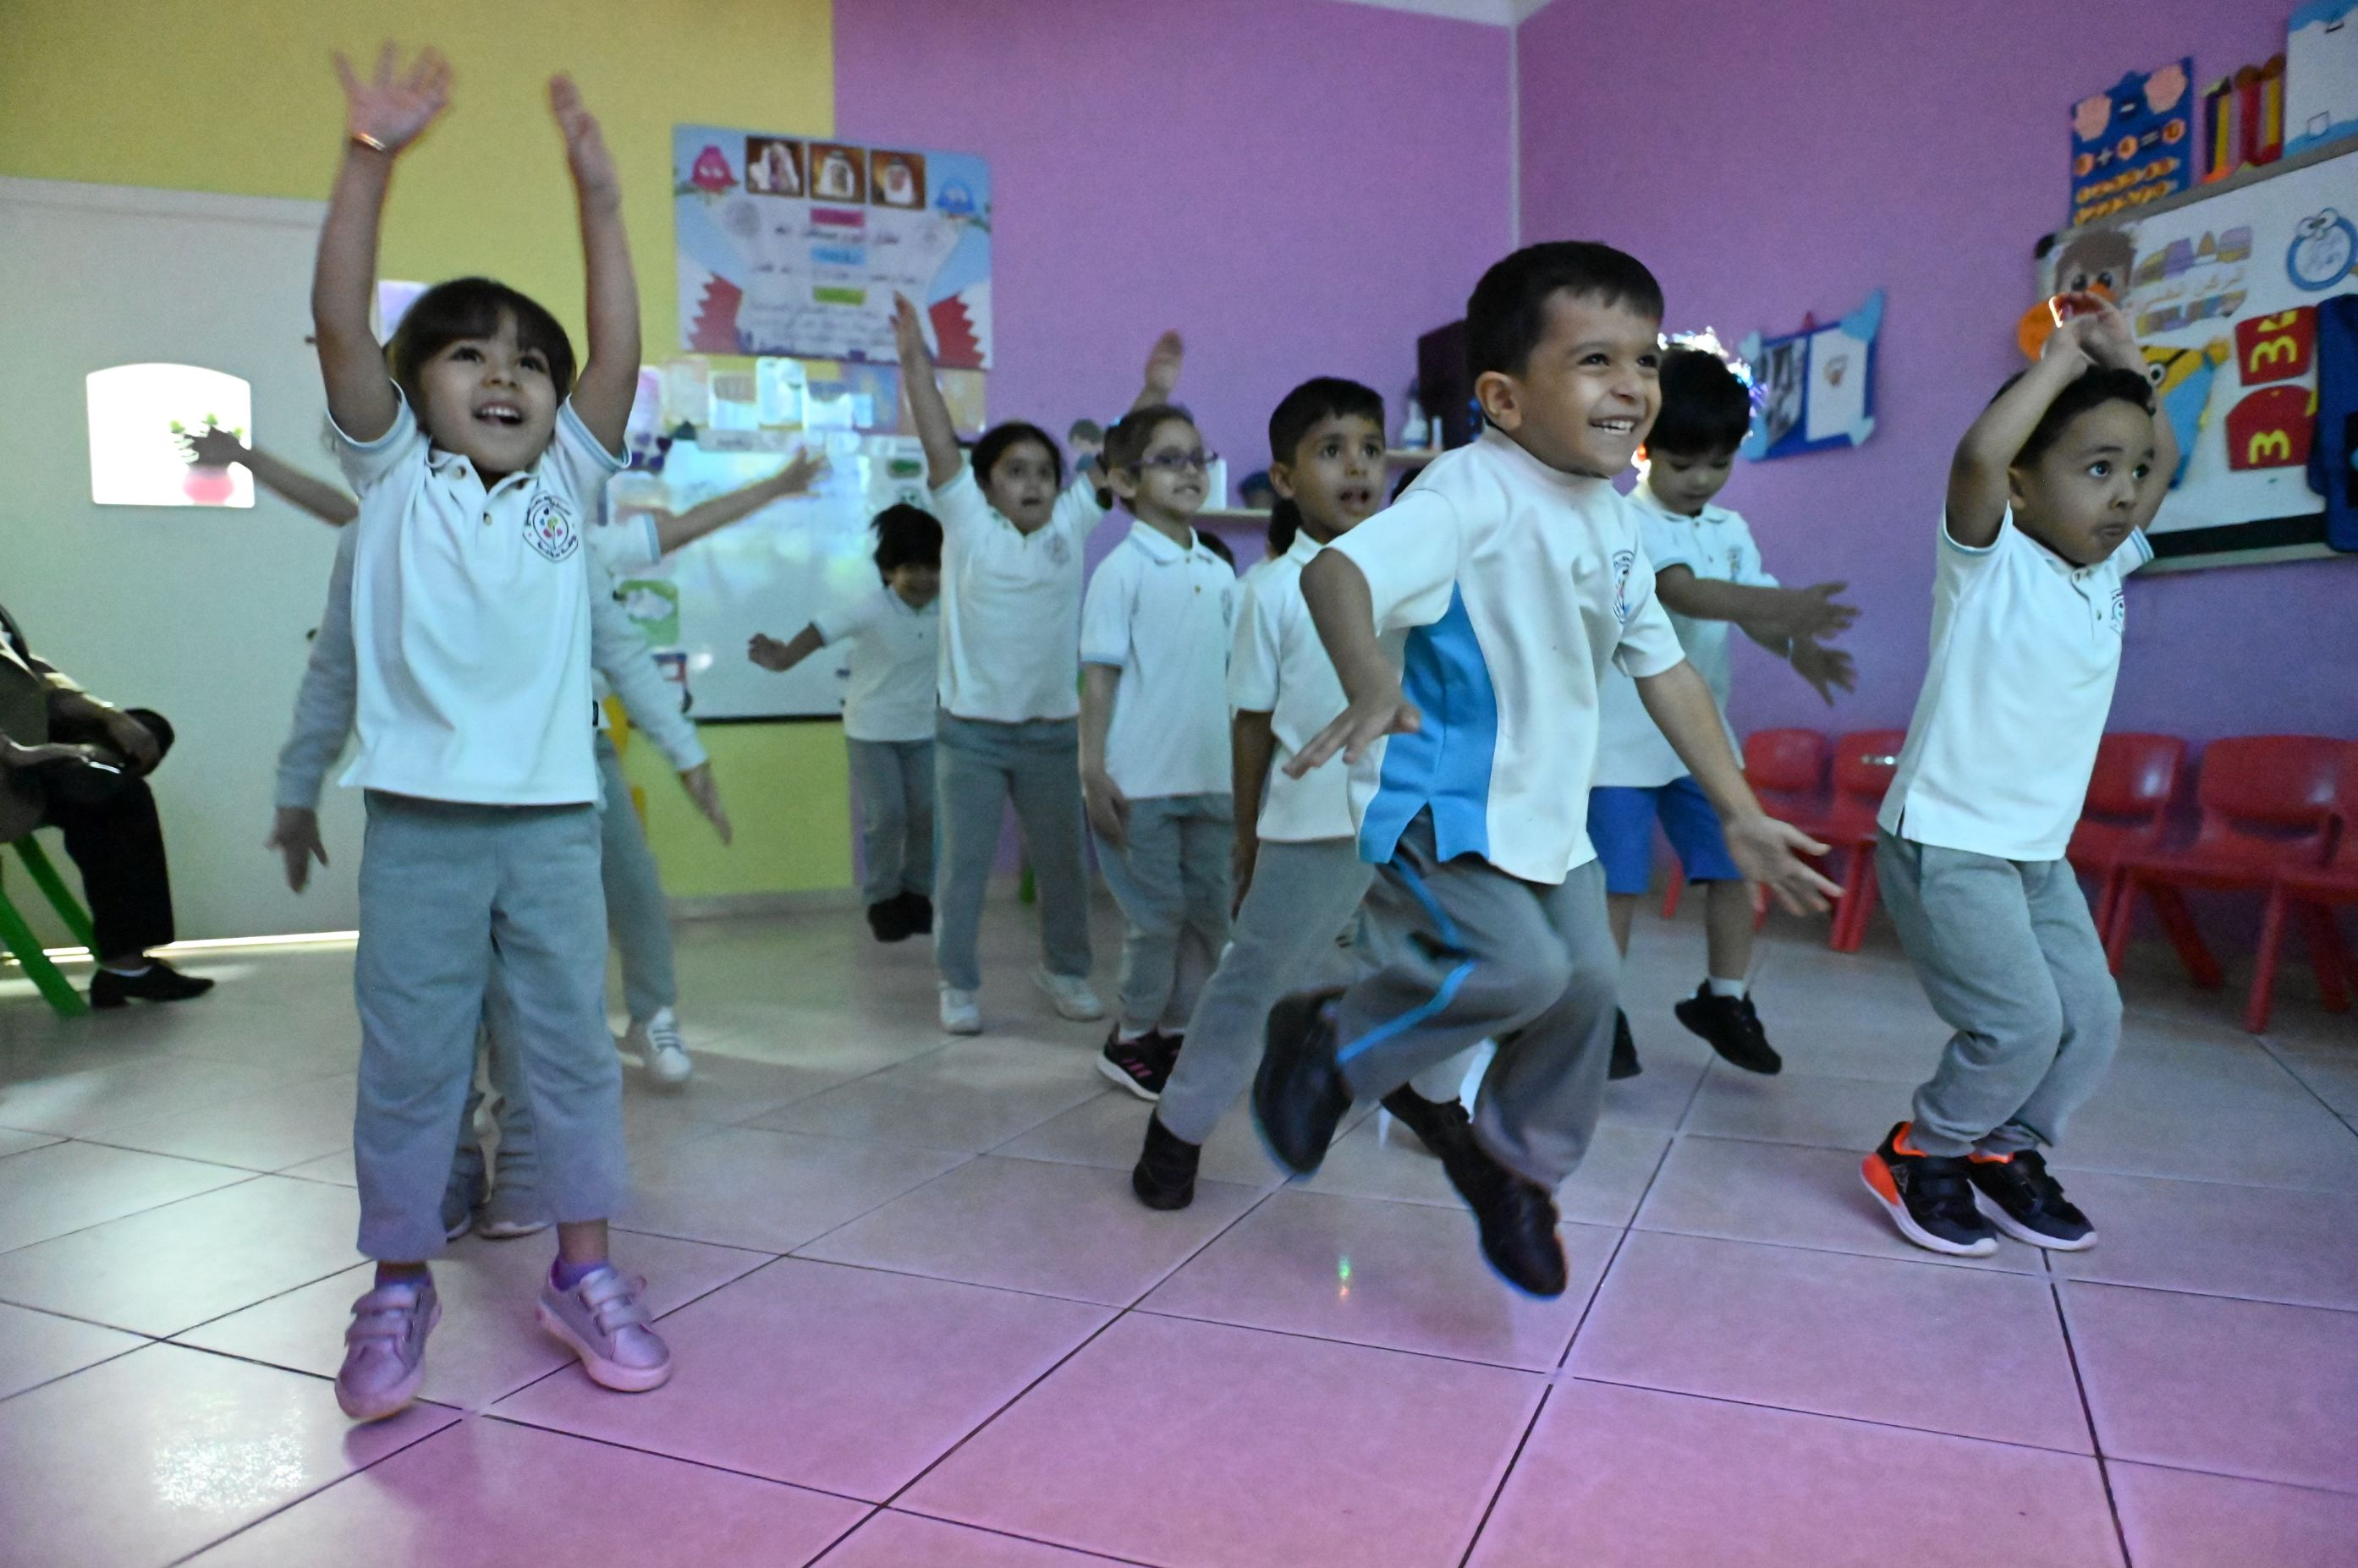
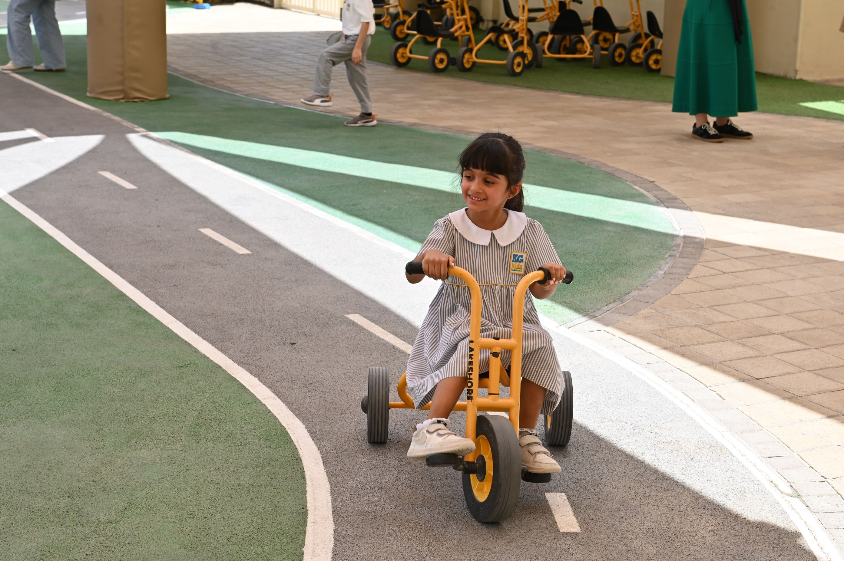
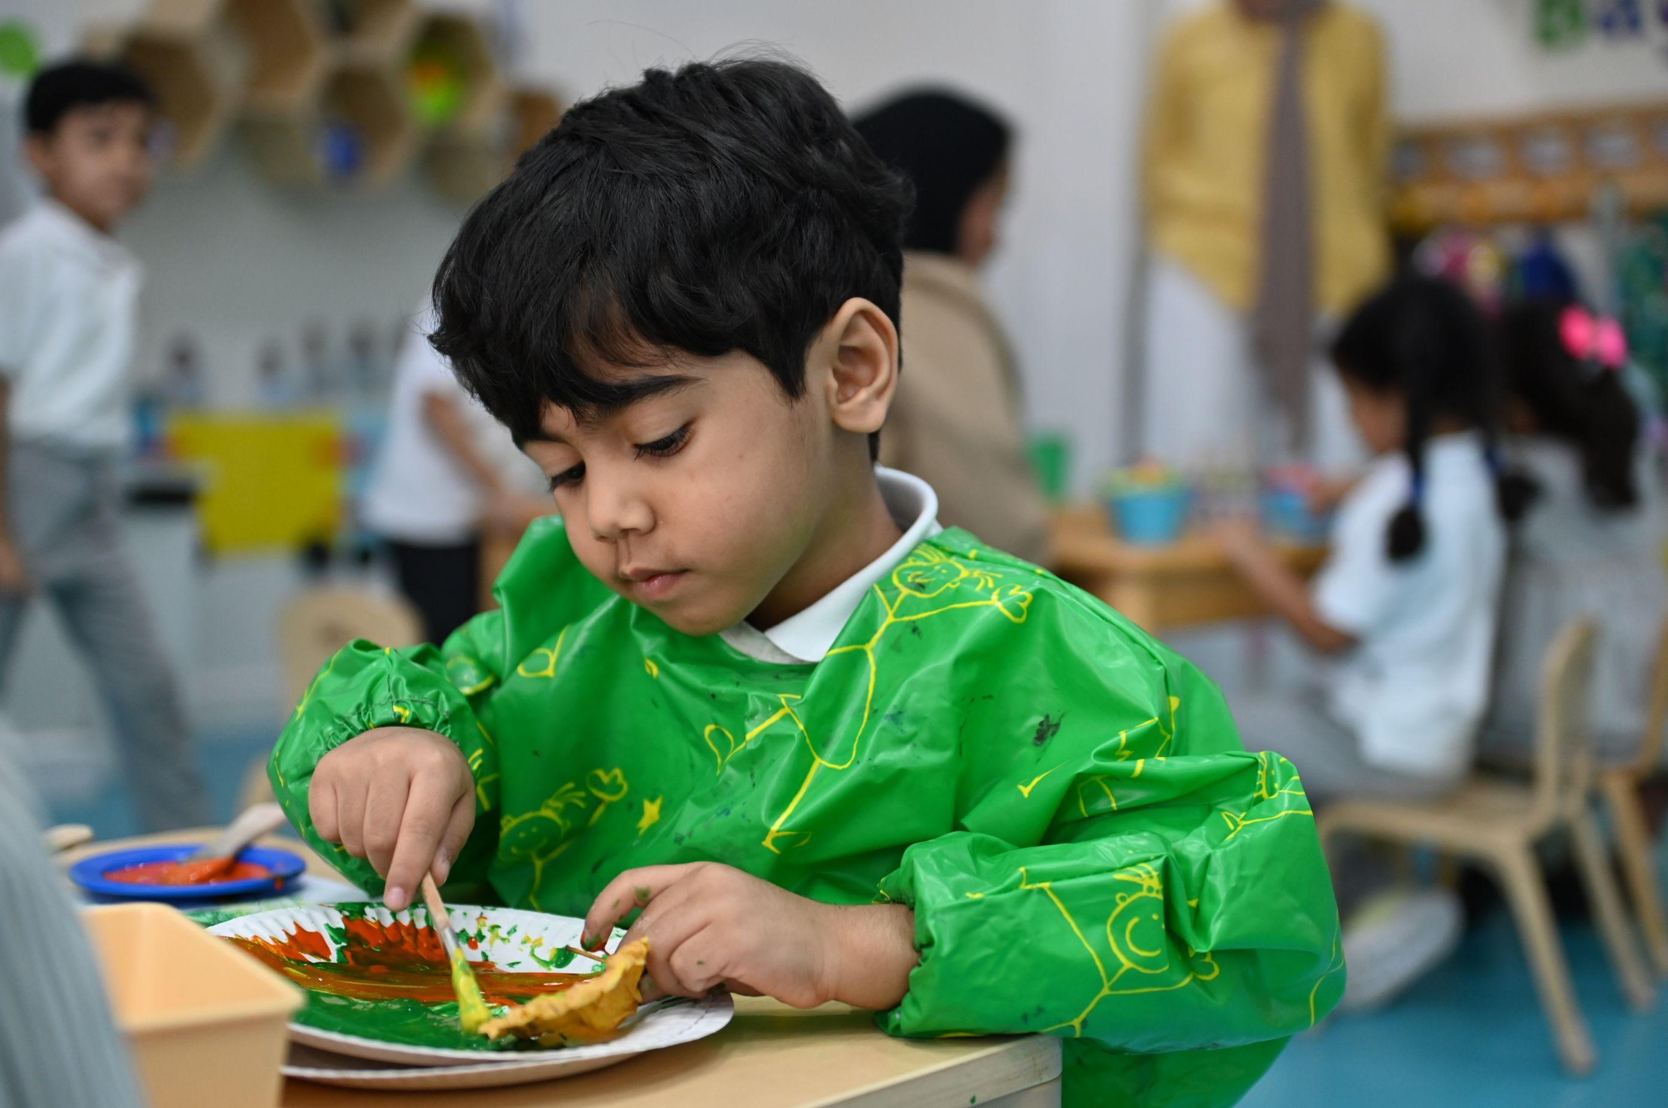
How do children grow?
Balance and coordination in movement
Development of gross motor skills
Development of fine motor skills
Physical Development

Slide 8
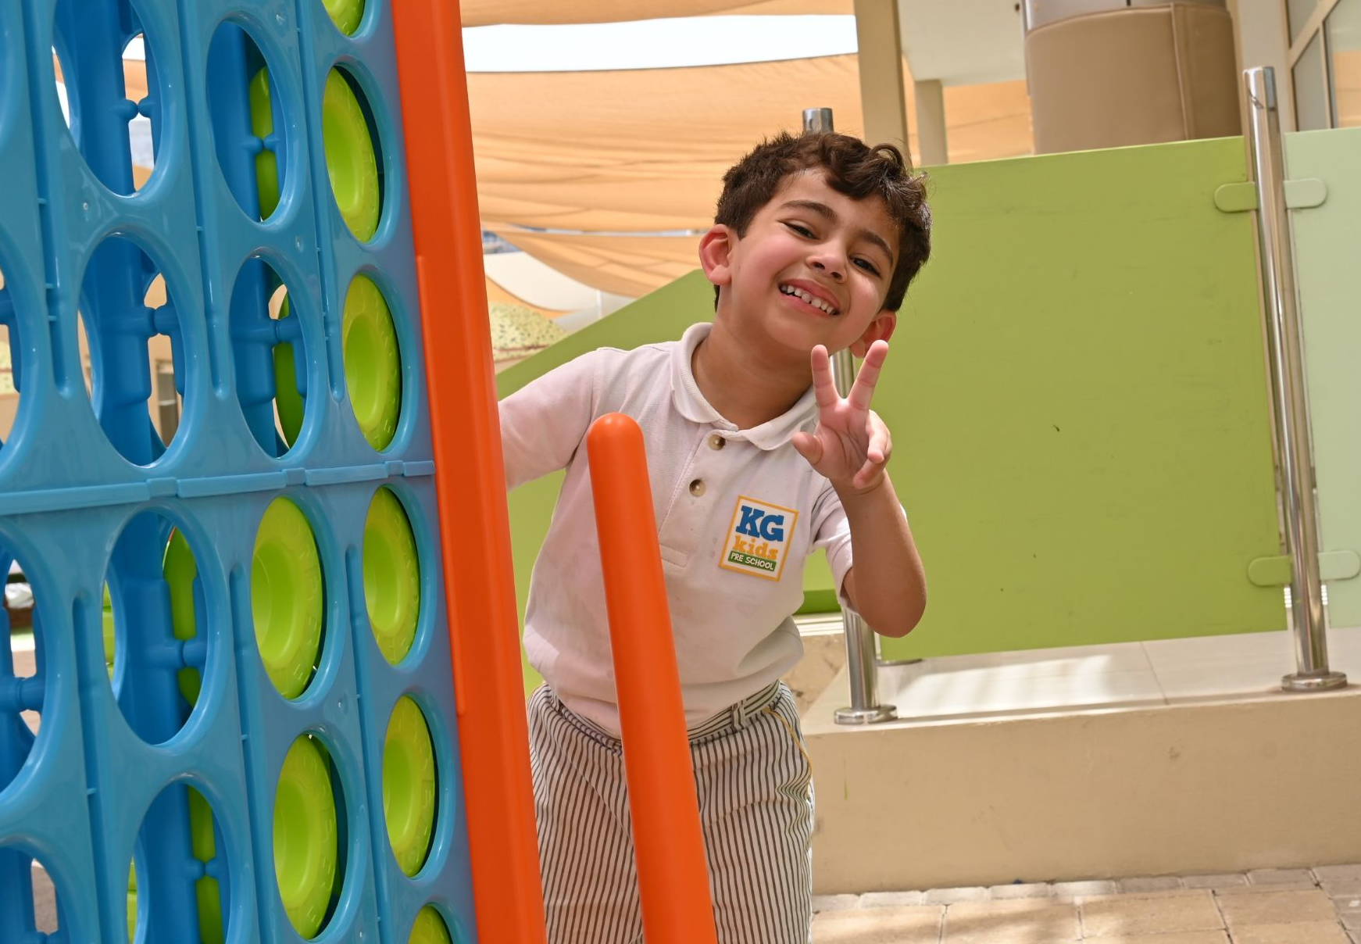
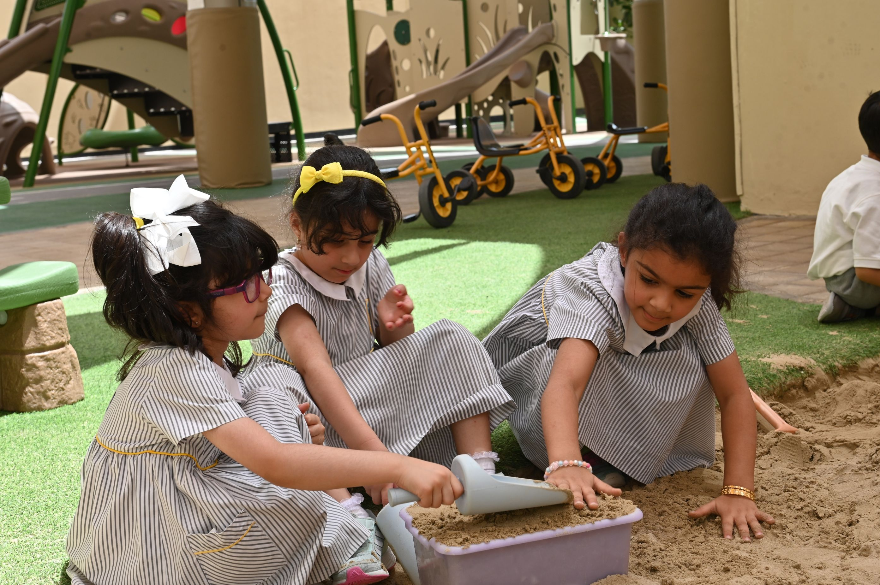
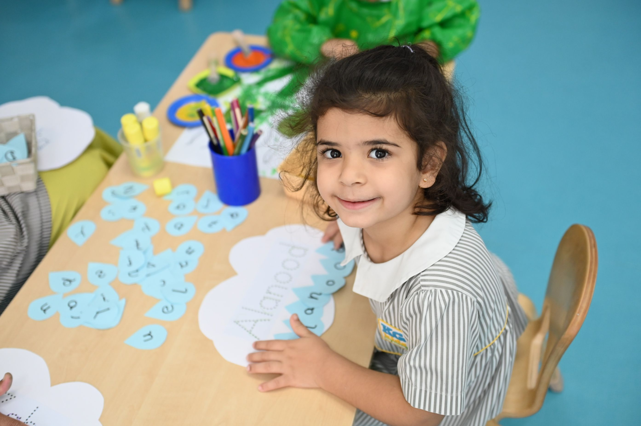
How do children grow?
Self awareness and confidence
Building friendships and playing together
Managing feelings and showing positive behaviour
Social and Emotional Development

Slide 9
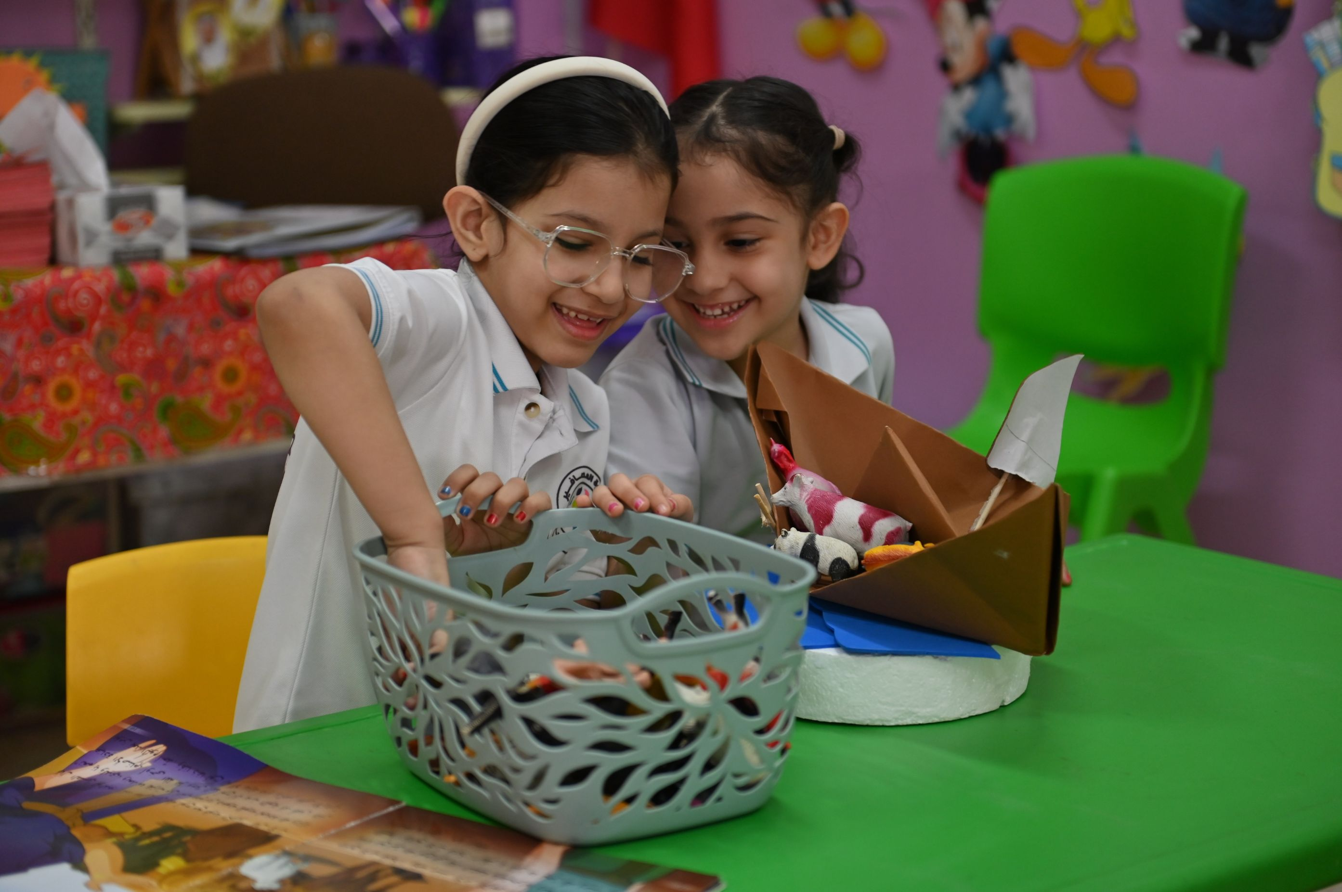
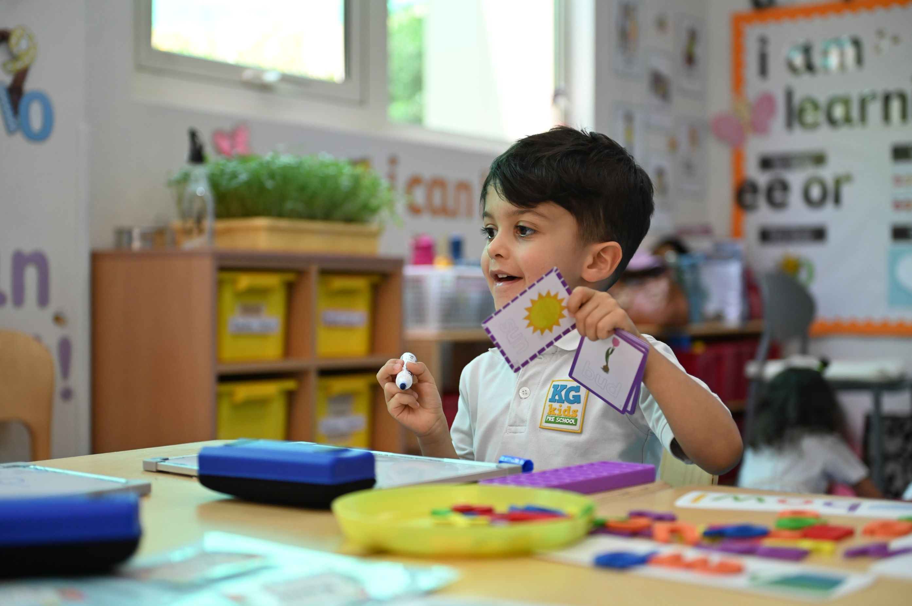
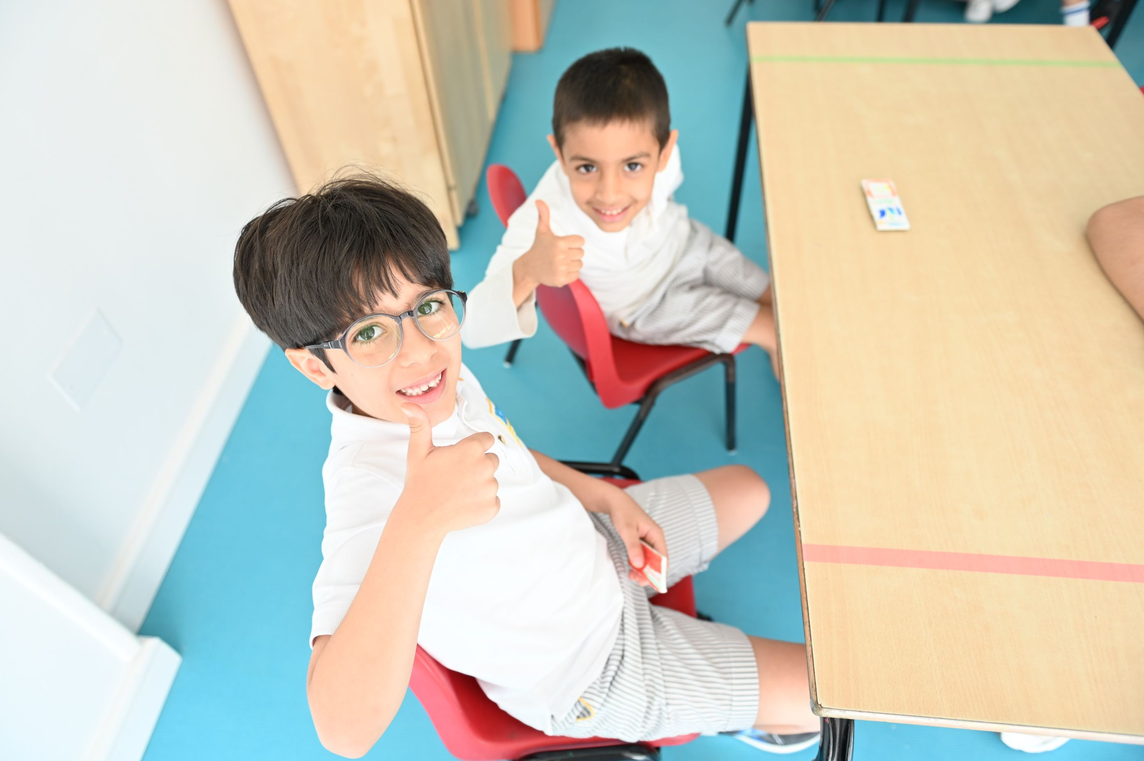
How do children grow?
Participating and engaging with others
Expressing opinion and listening actively
Expressing feelings and thoughts
Language and Communication

Slide 10
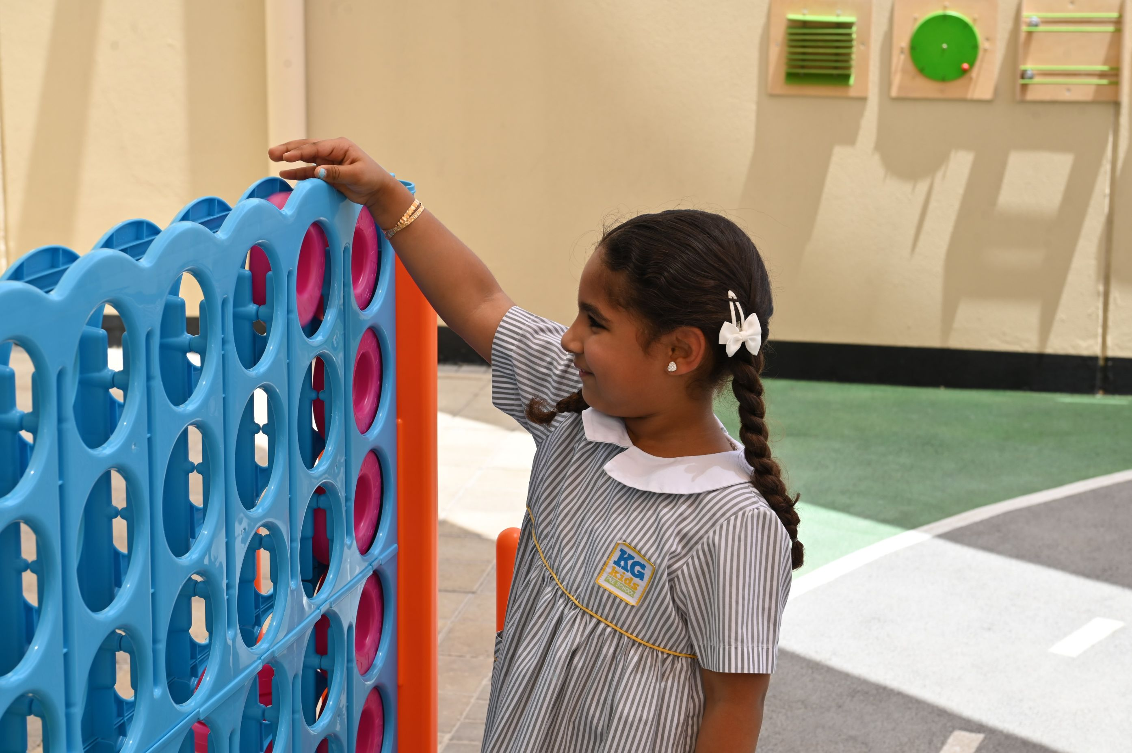
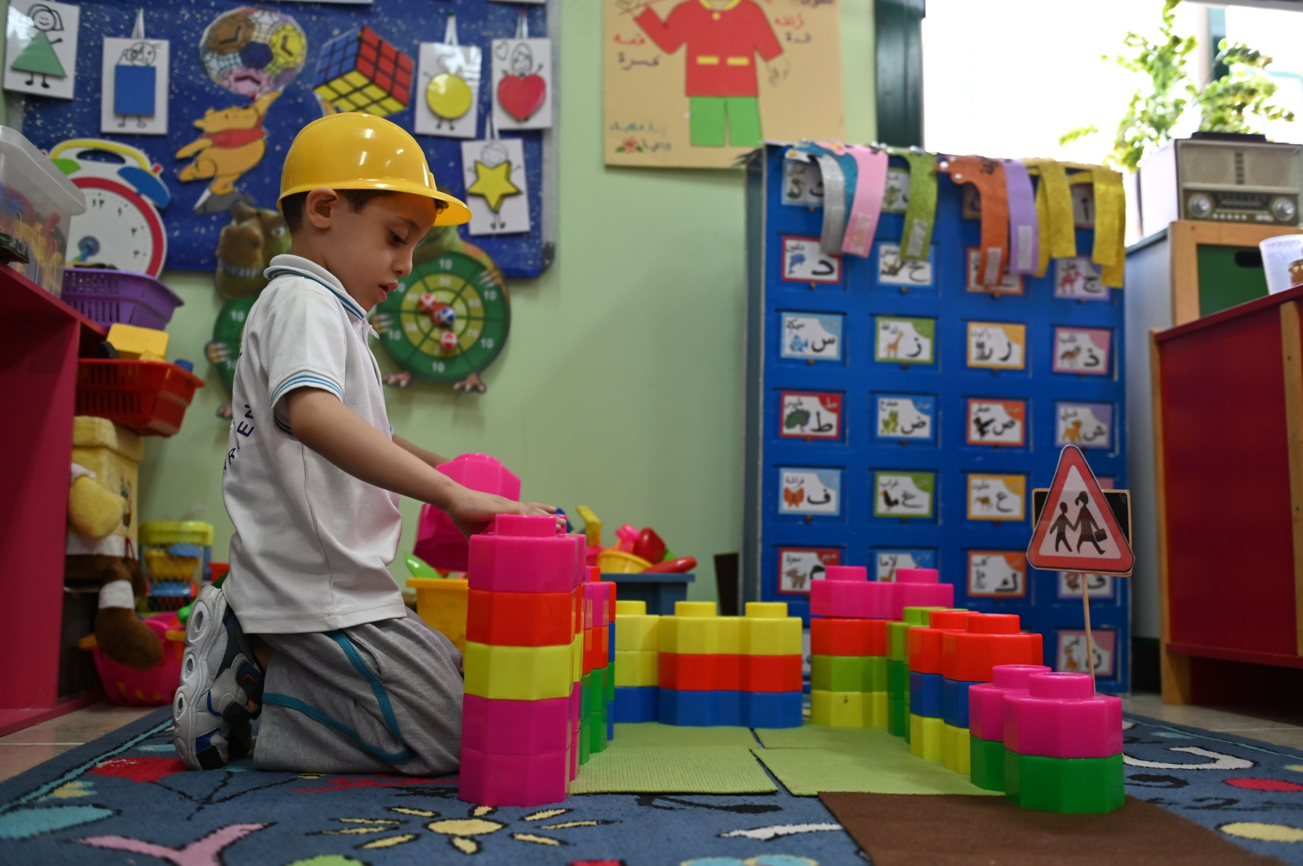
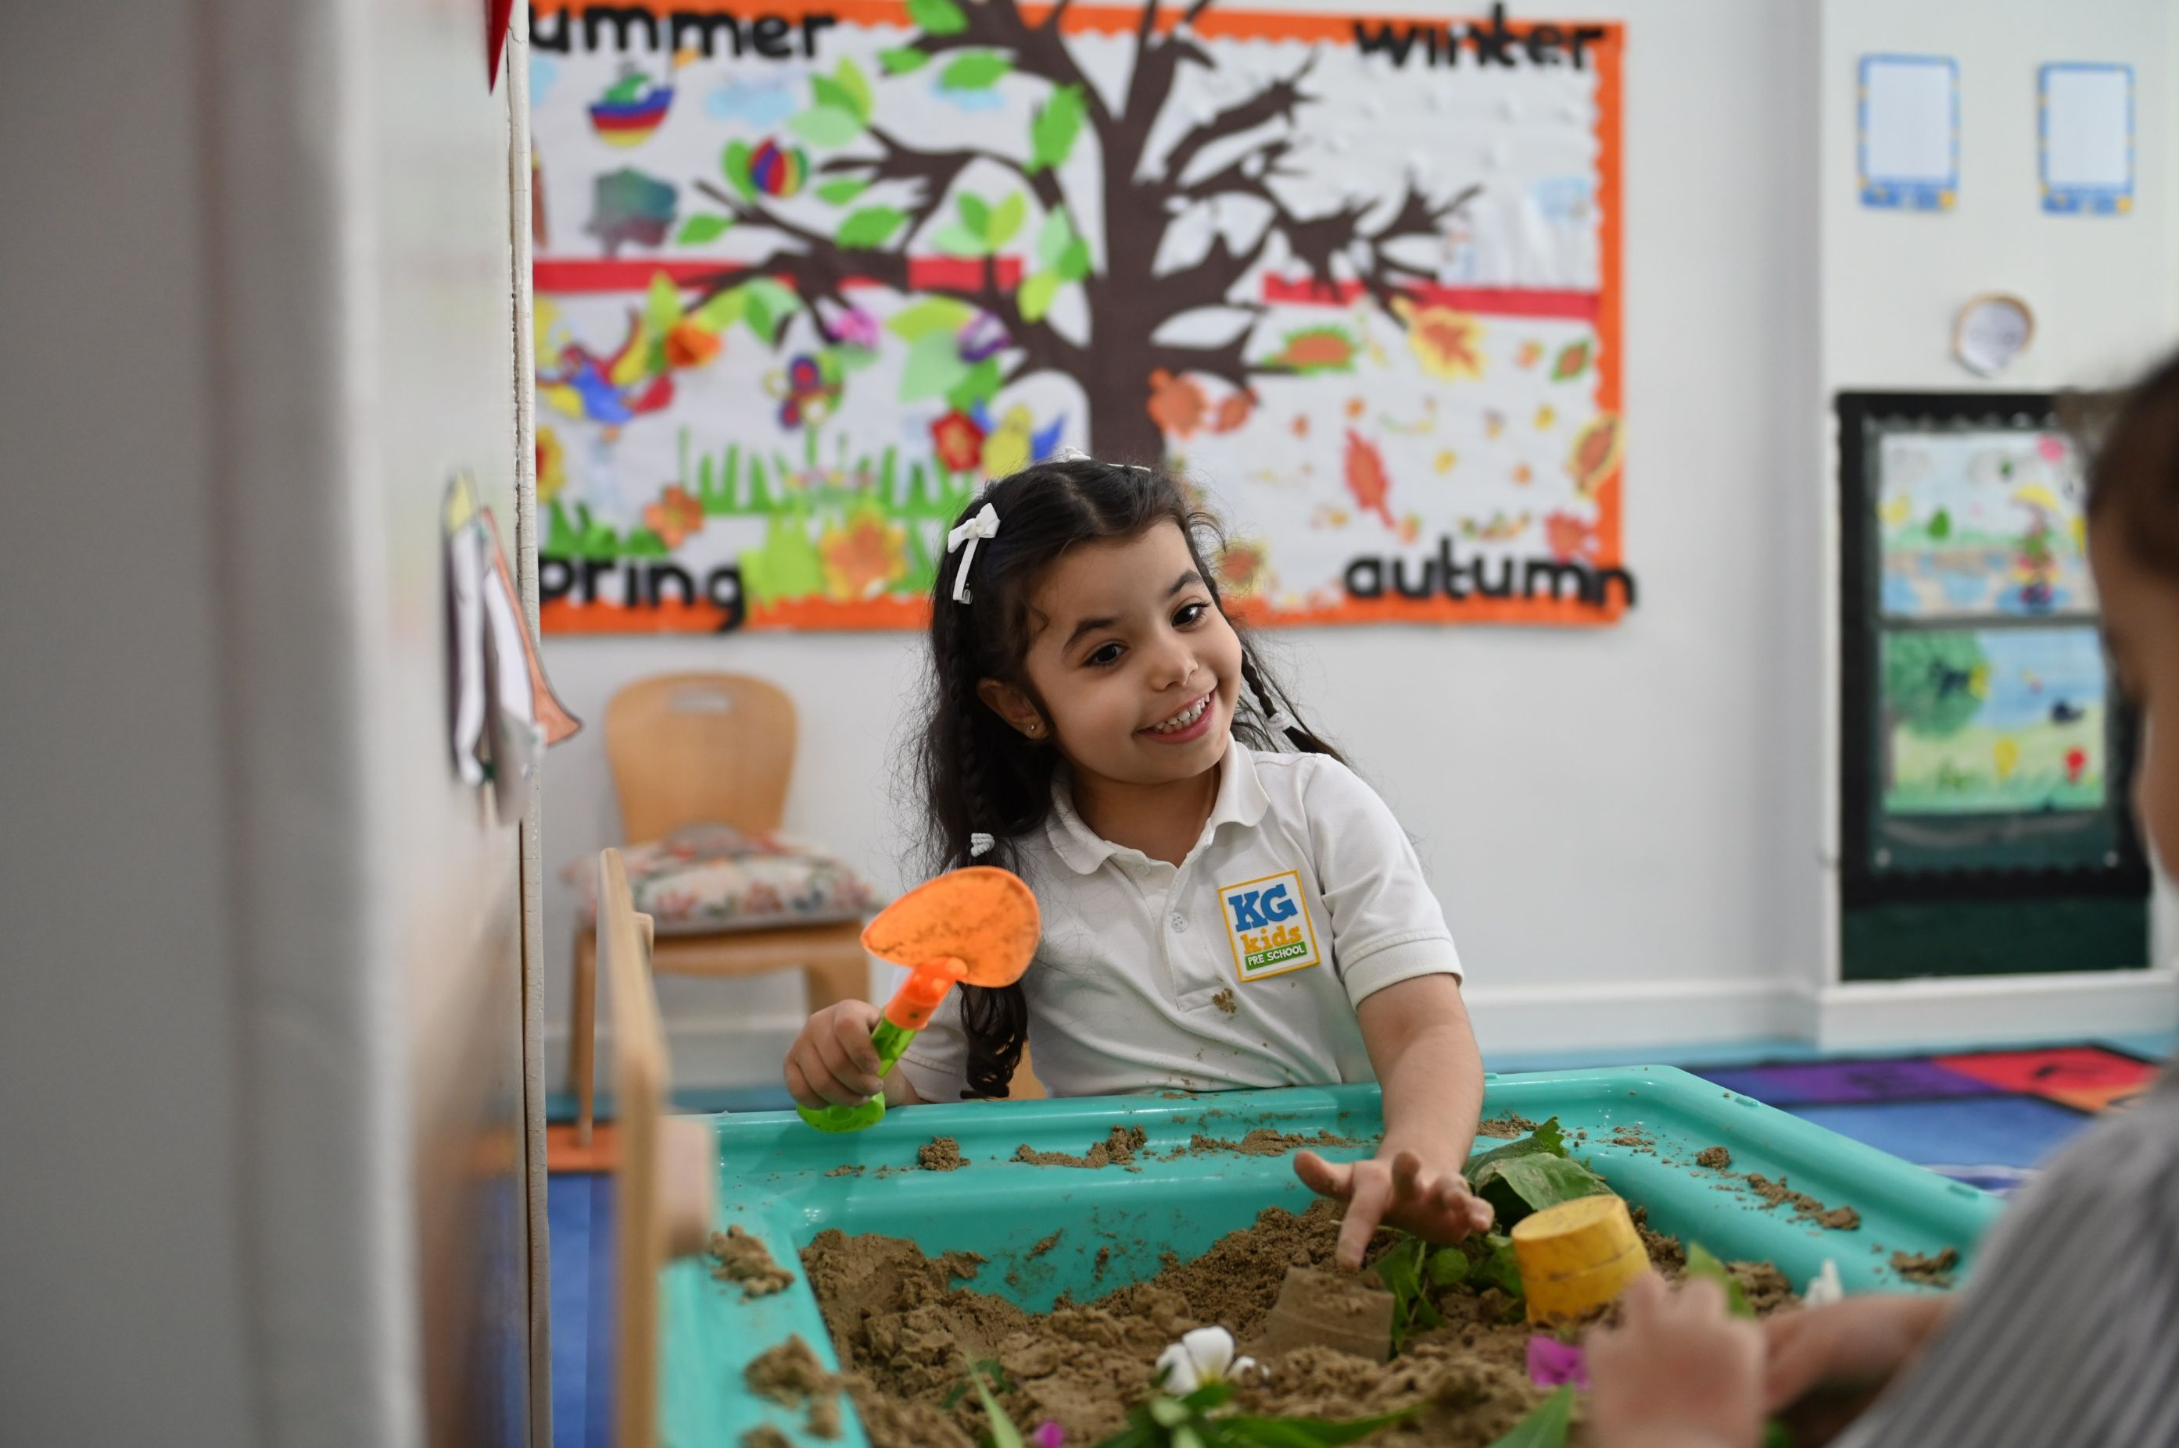
How do children grow?
Exploring and solving problems
Imagination and creativity
Learning different skills and knowledge
Cognitive Development

Slide 11
Children grow through play ..
Watch the video on Children grow through play
Notes:
A video

Slide 12
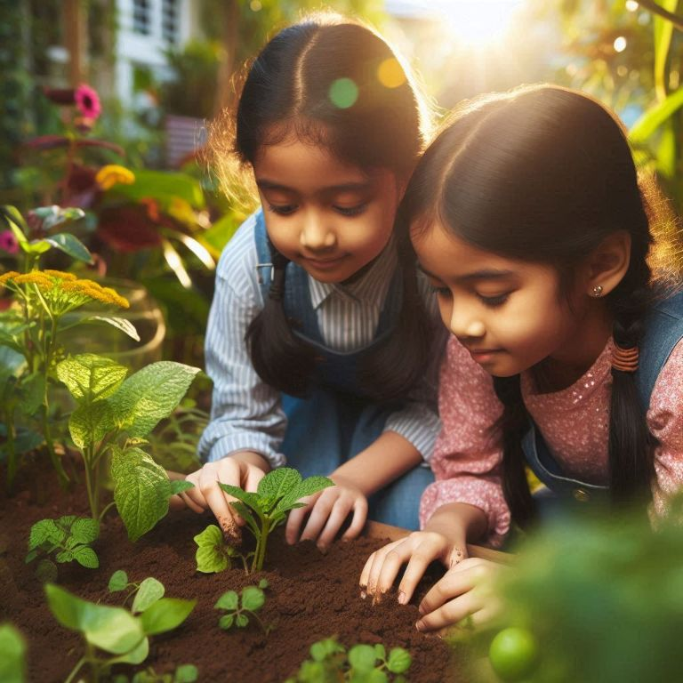
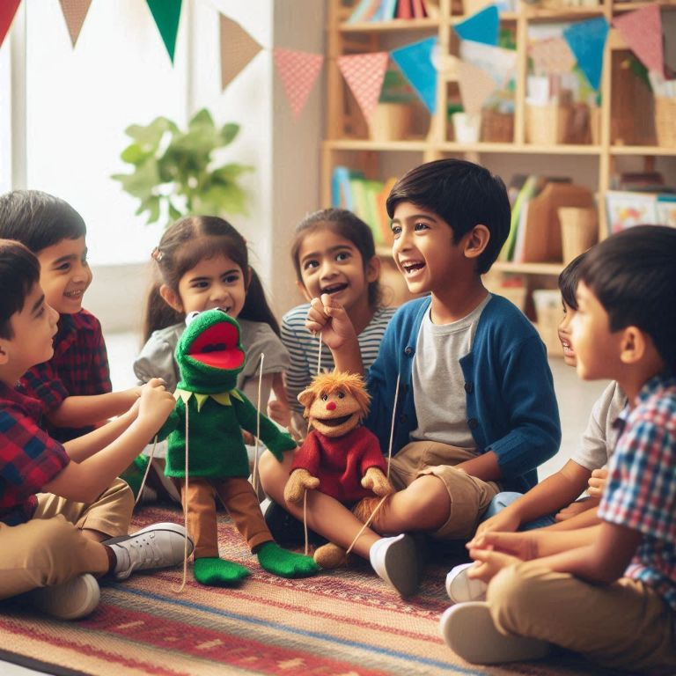
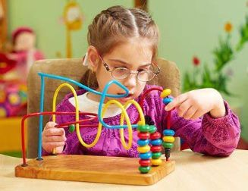
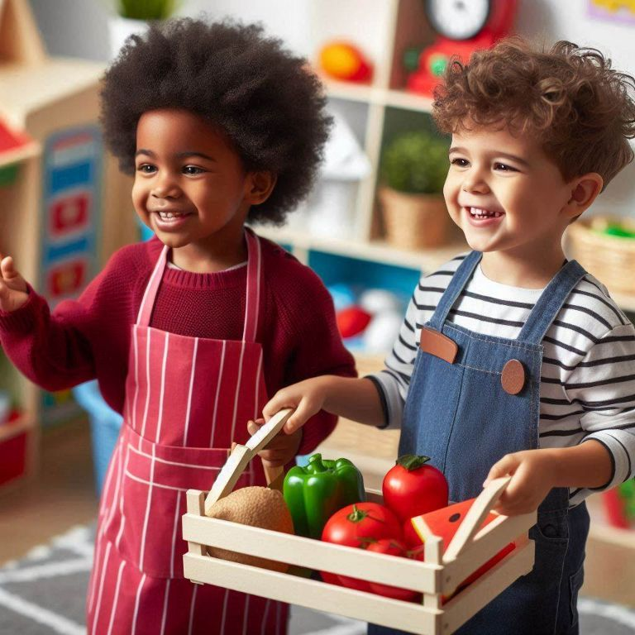
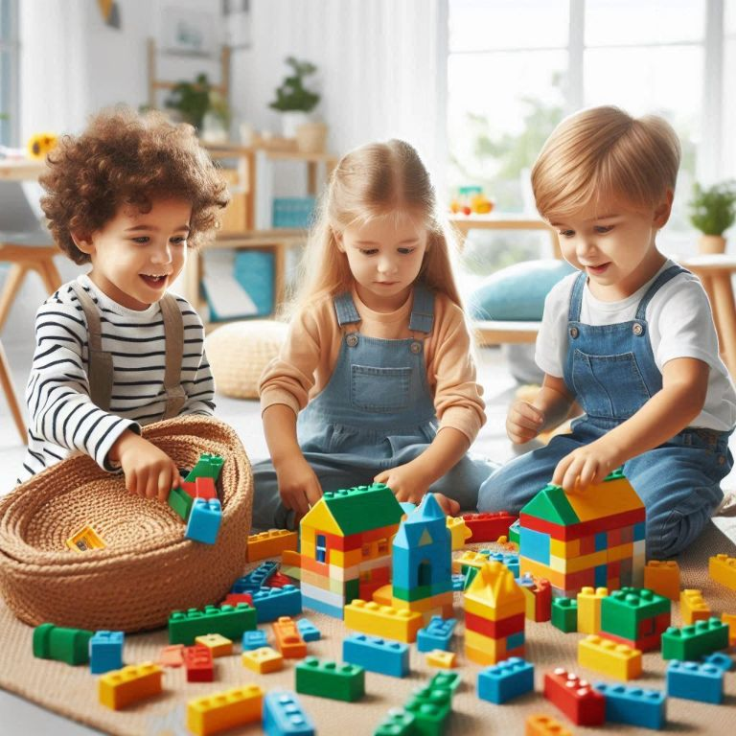
Children grow through play ..
Explore and discover
Express emotions
Solve problems
Build confidence
Develop social skills
Enhance creativity
Notes:
Explore and Discover: Play allows children to explore the world around them, ask questions, and satisfy their natural curiosity.
Solve Problems: Whether building with blocks or solving a puzzle, play helps children think critically and figure things out on their own.
Develop Social Skills: Playing with others teaches sharing, cooperation, and how to take turns, helping children build friendships.
Express Emotions: Through pretend play, art, or role-playing, children can express how they feel and make sense of their experiences.
Build Confidence: When children try new things and succeed, they feel proud, which builds their self-esteem and independence.
Enhance Creativity: Play encourages imagination, from creating stories to building their own worlds with toys, helping them think creatively.

Slide 13
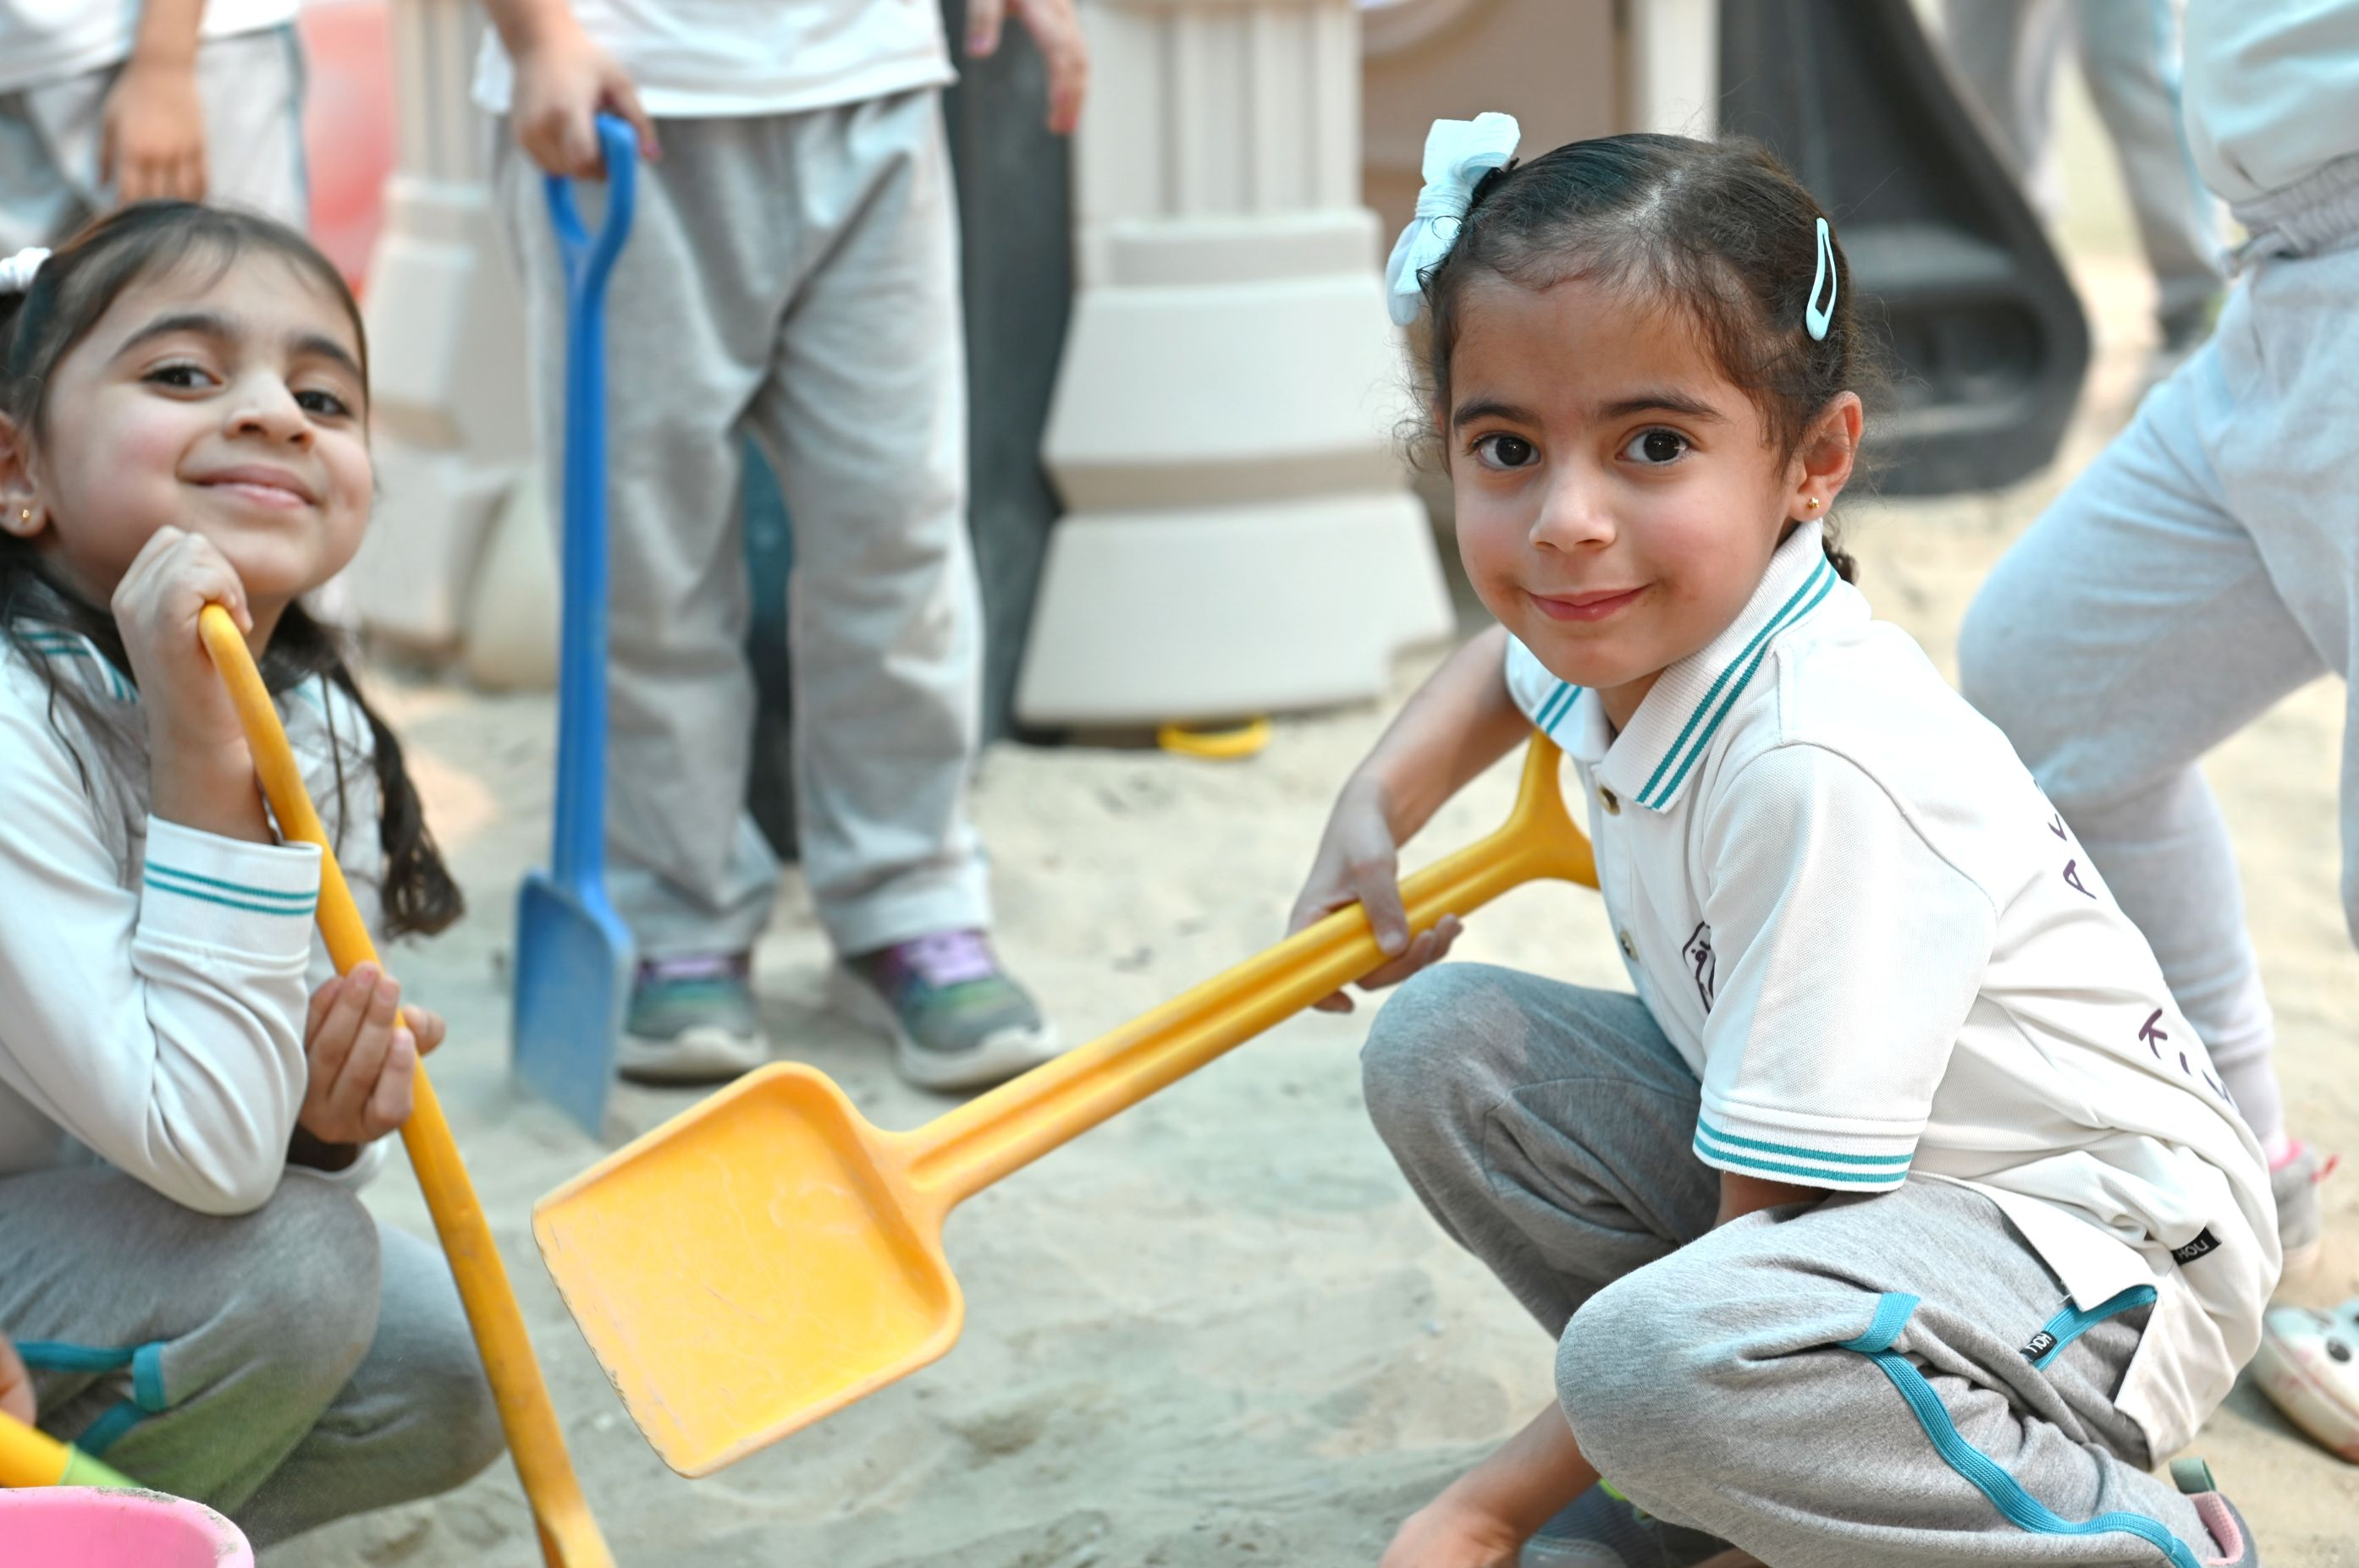
Through Kindergartens’ evaluations, we will focus on ..
Learning through PLAY
Notes:
Supports cognitive, physical, social, and emotional development.
Allows children to explore their world and learn problem-solving.
Promotes critical thinking skills.
Encourages creativity, imagination, and resilience.
Central to effective early childhood education and a key method of learning.

Slide 14
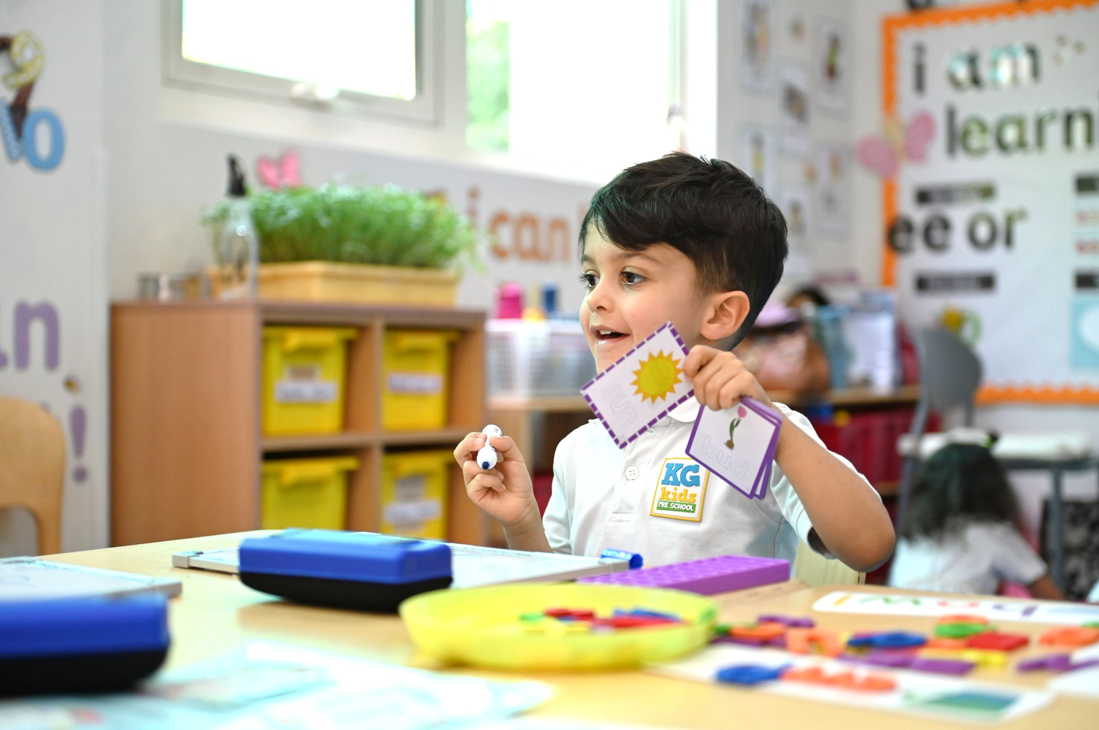
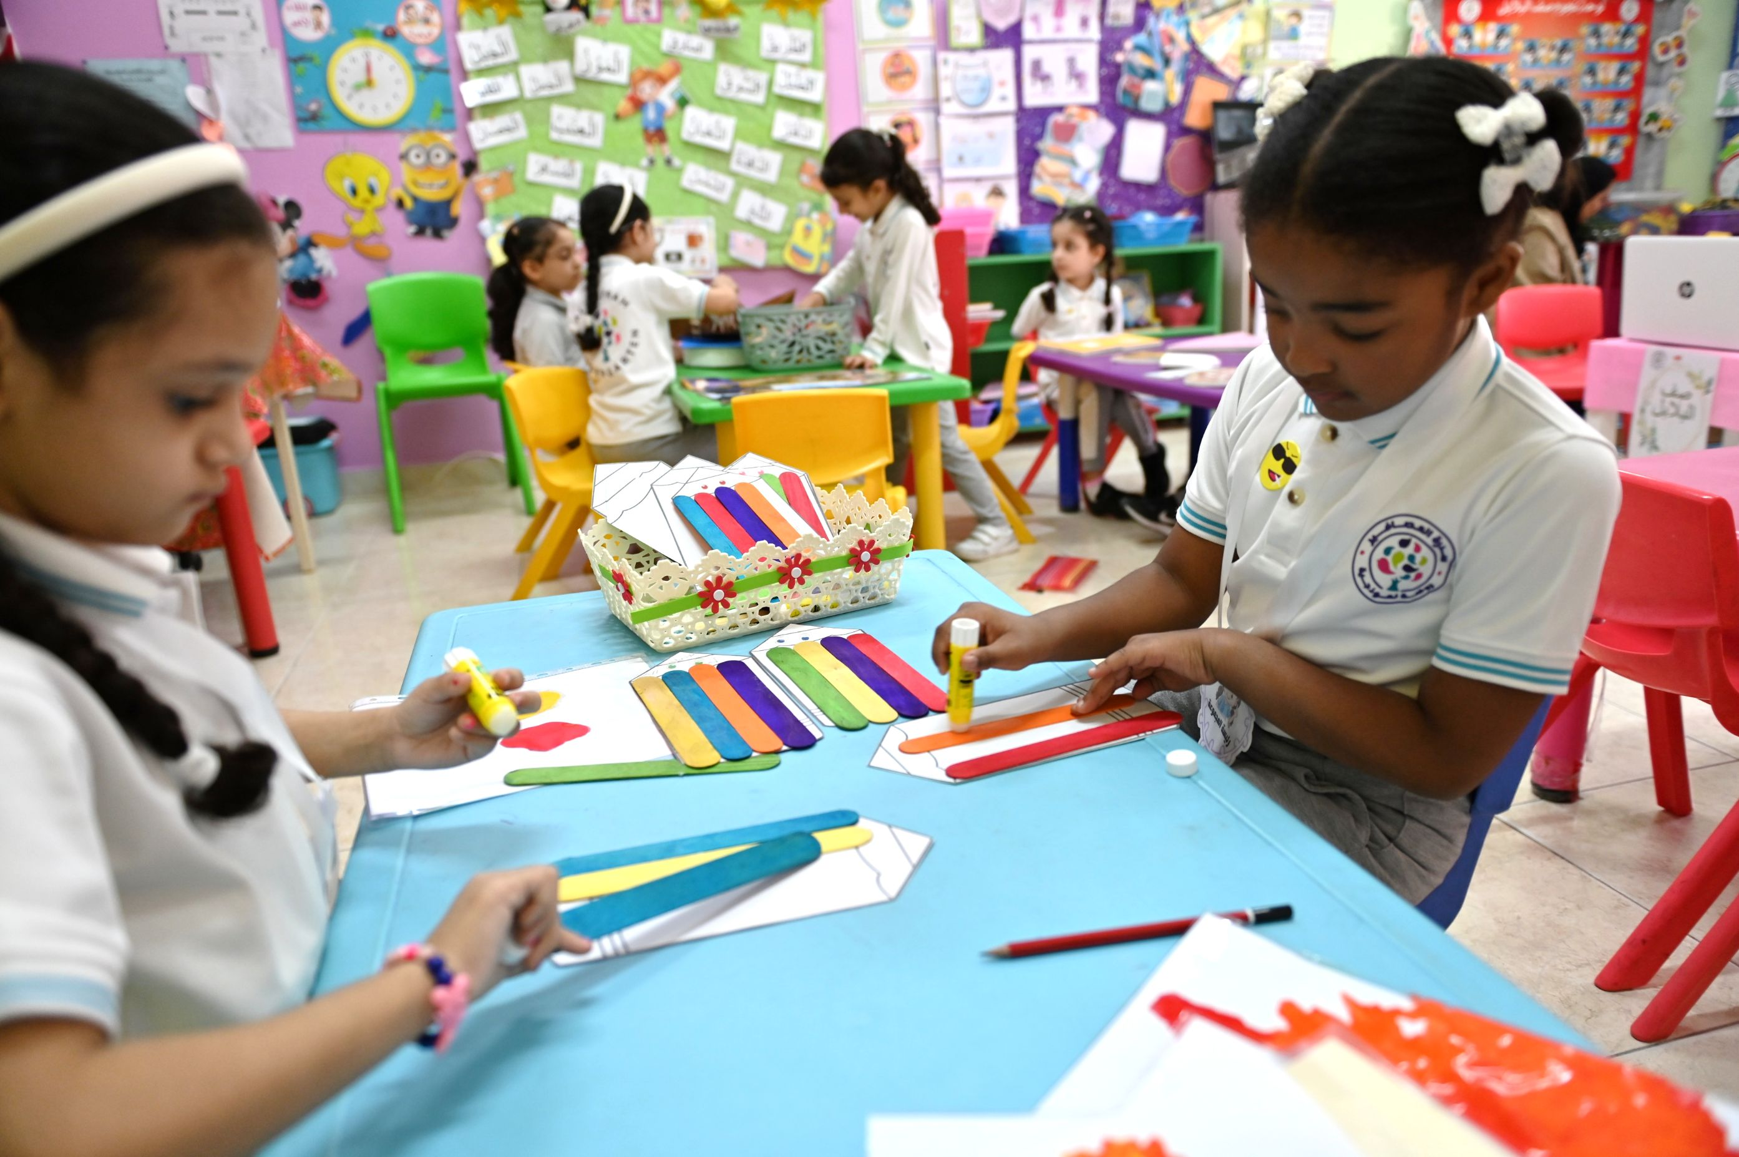
Through Kindergartens’ evaluations, we will focus on ..
Children at the center of learning and care
Notes:
Focus on nurturing overall development of children.
Recognizes each child as unique, with individual needs and interests.
Personalised learning experiences tailored to developmental levels.
Supportive environment that allows children to thrive.
Encourages growth at their own pace, based on ability and interests.

Slide 15
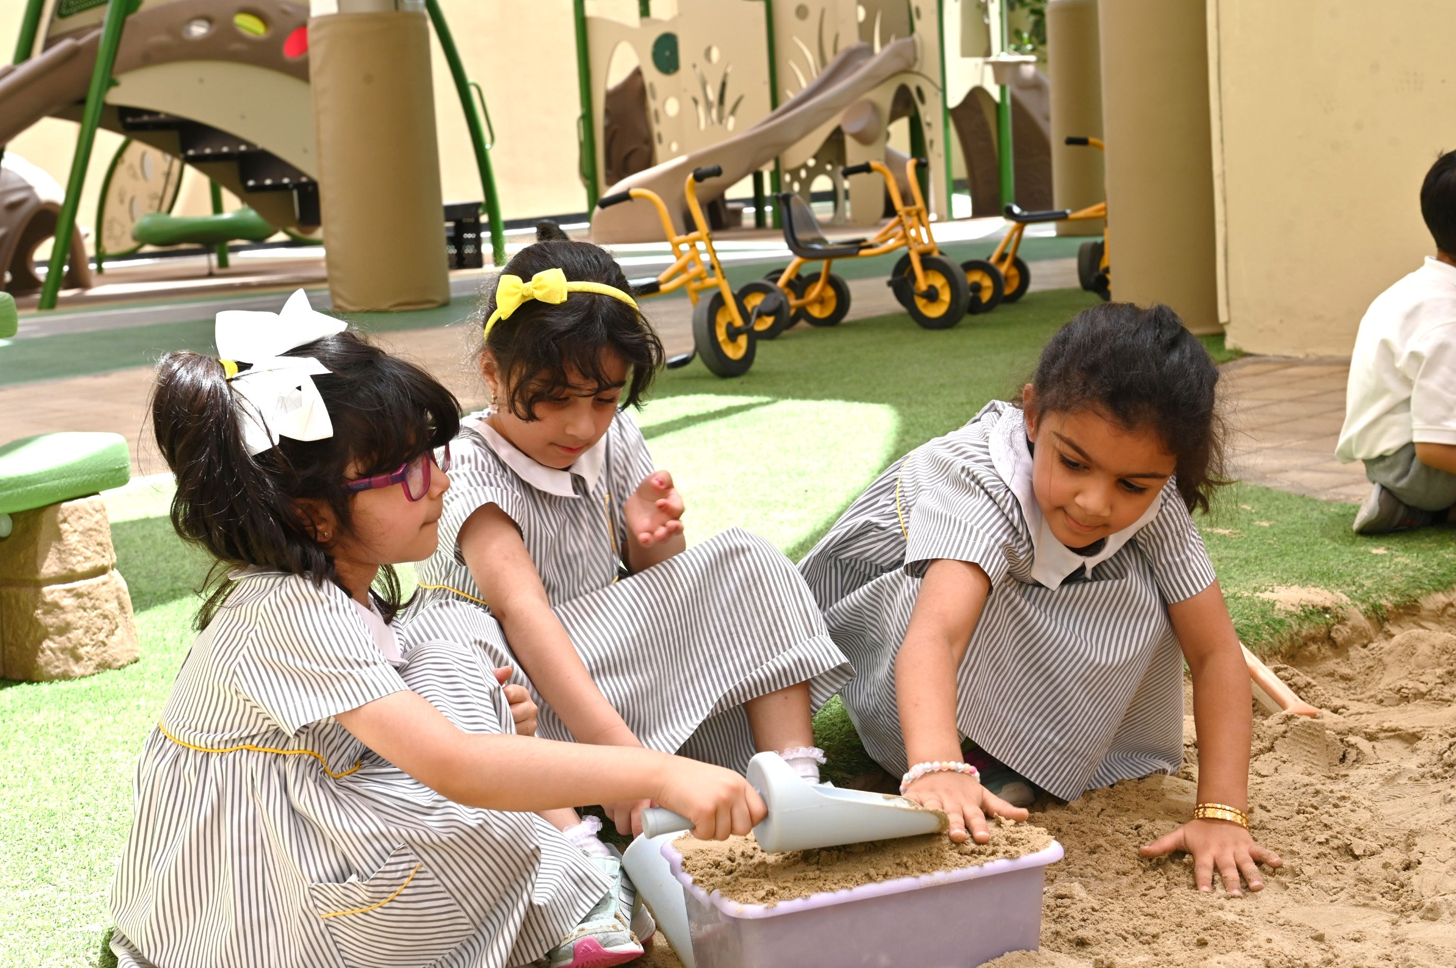
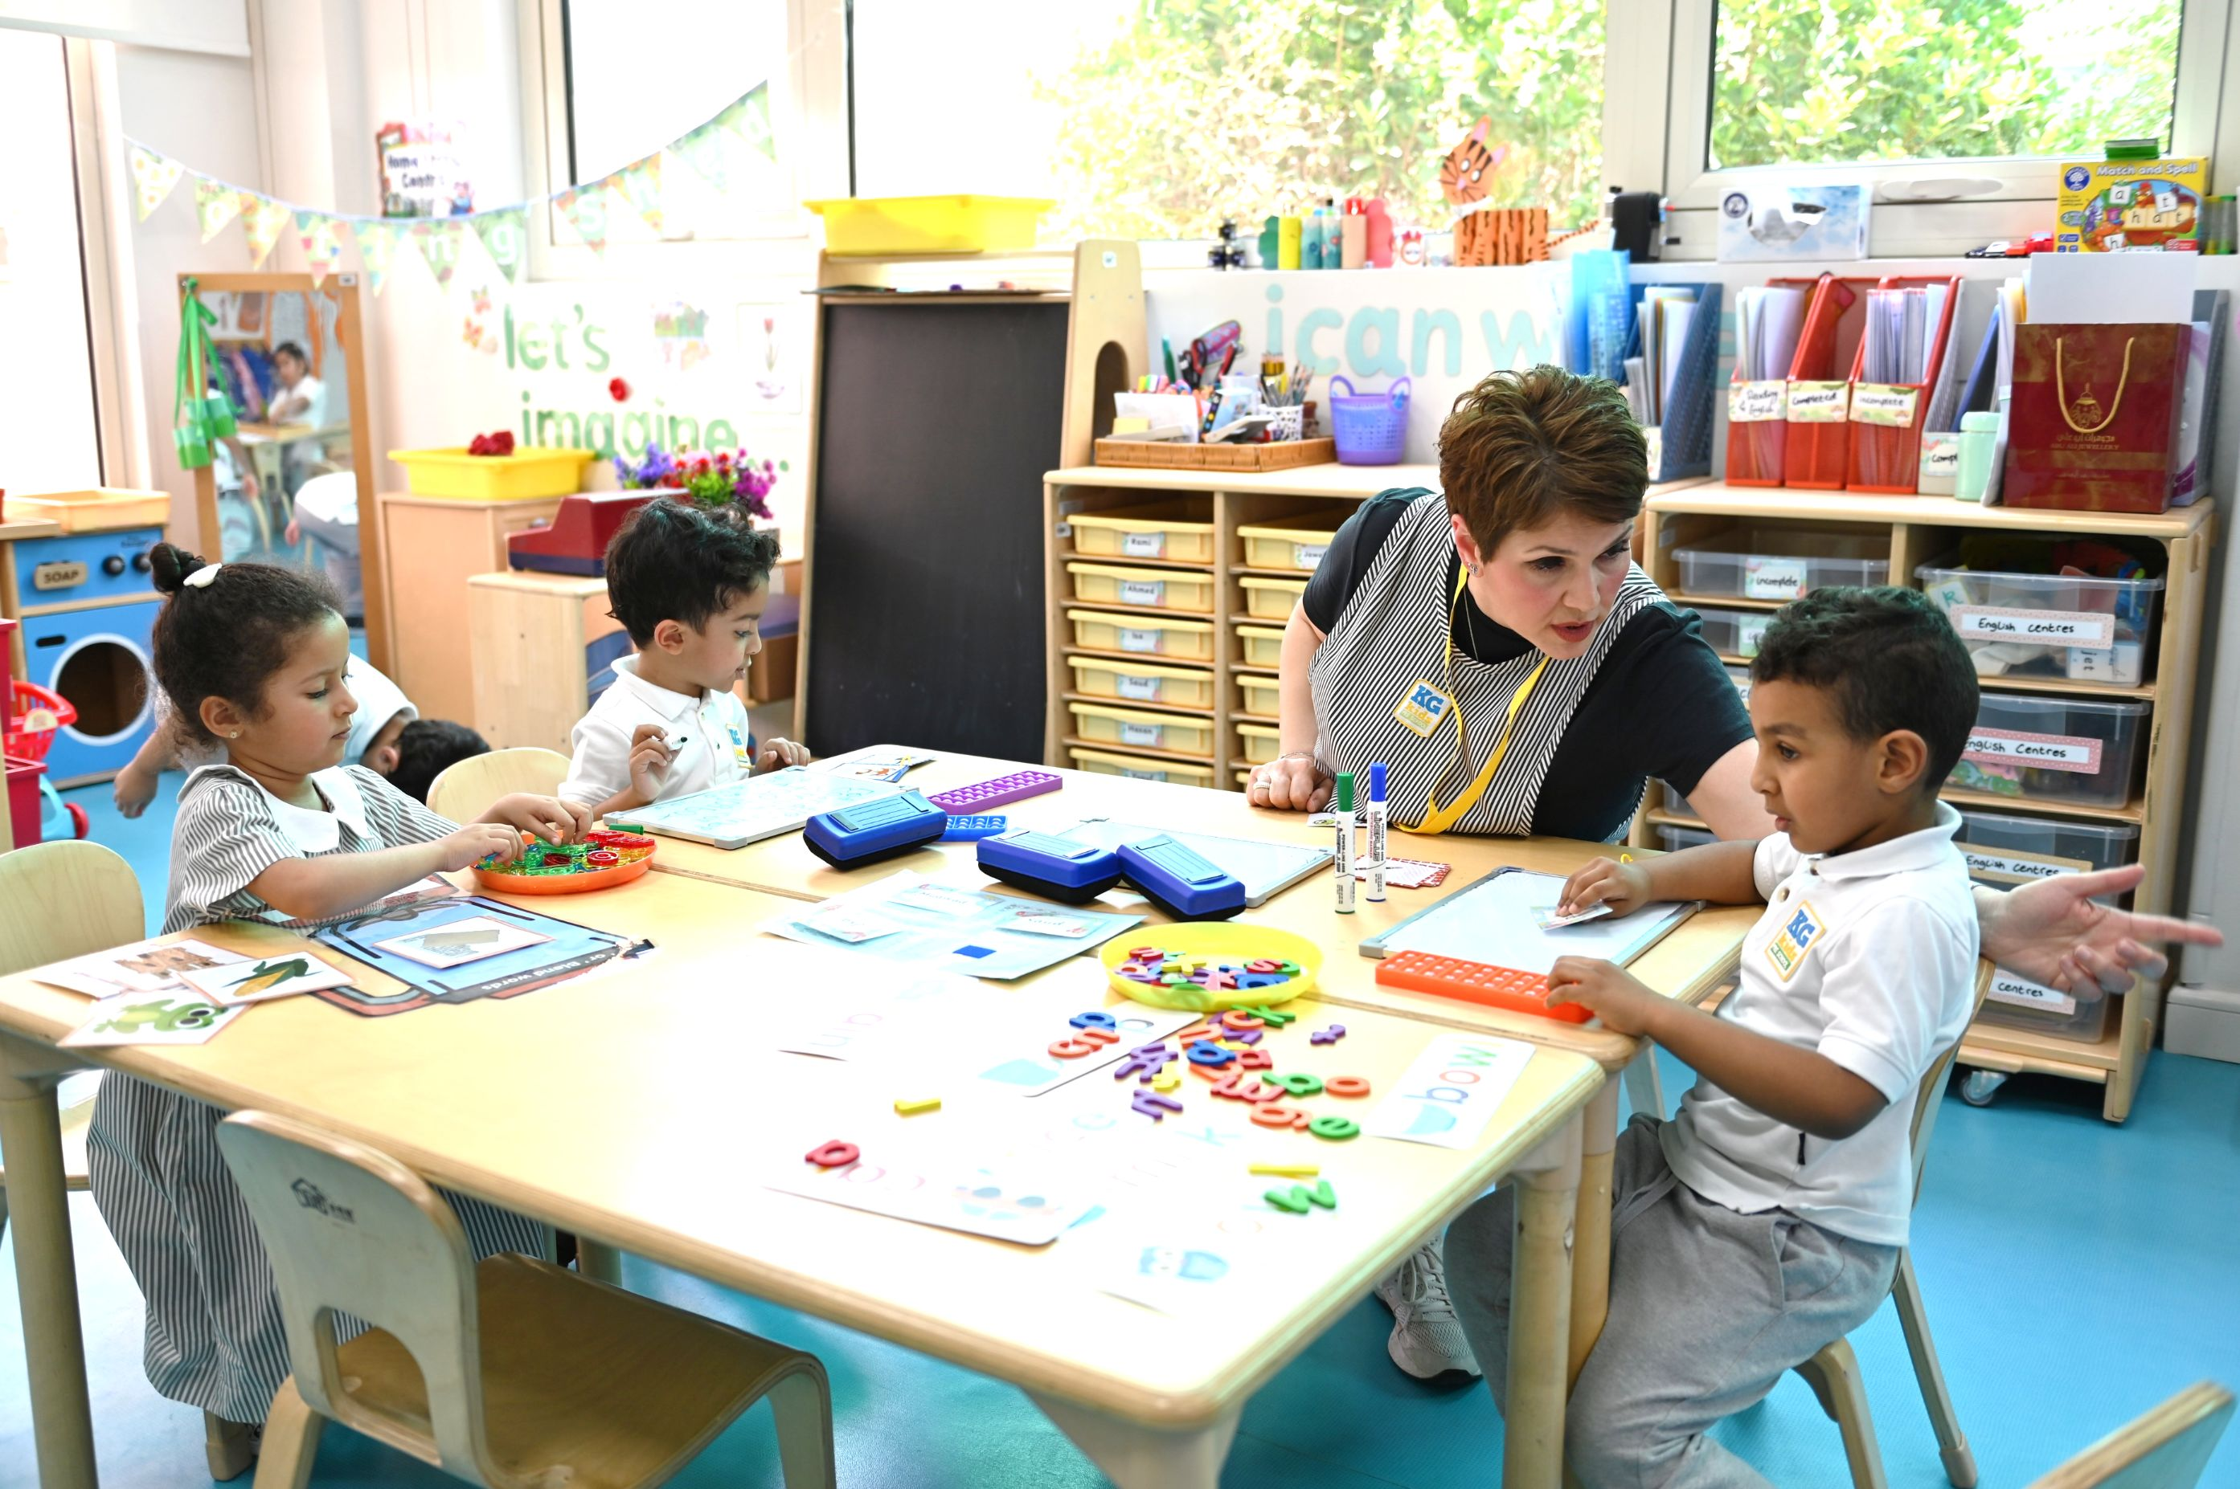
Through Kindergartens’ evaluations, we will focus on ..
Including family and the community
Notes:
Enriched by family and community involvement in activities and learning experiences.
All children are engaged and involved regardless of needs, conditions and backgrounds.
Fundamental for holistic development.
Safe, inclusive, and supportive atmosphere helps children feel valued and secure.

Slide 16
Kindergartens Areas of Evaluation
Aspect 1:
Children’s Growth and Development
1.1 Children's Social and Emotional Development
1.2 Children's Physical Development
Aspect 2:
Child Initiated Learning
2.1 Areas of Learning
2.2 Curriculum Experiences
Aspect3:
Leadership and Management
3.1 Leadership Effectiveness
3.2 Family and Community Engagement
1.3 Meeting Special Needs *

Slide 17



Thank you
bqa Bahrain
@bqa_bh
www.bqa.gov.bh

