Slide 1
Introduction to Children’s Learning Through Play For Parents

Slide 2
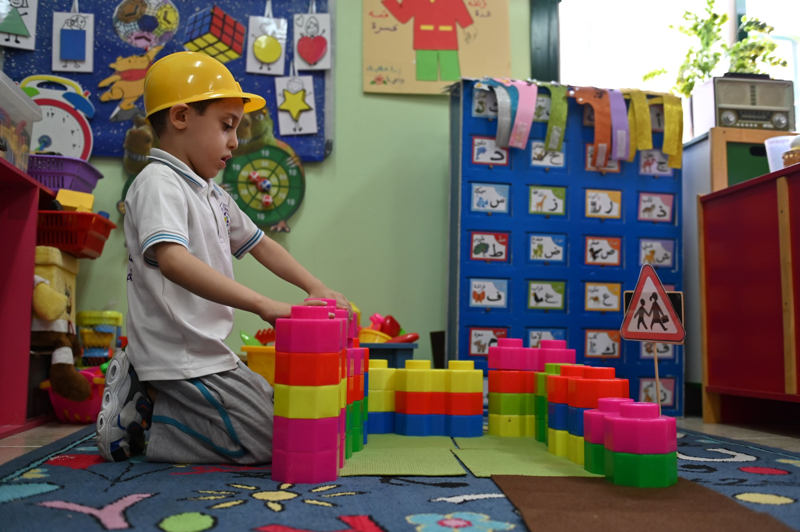
What do we mean when we say
Learning Through Play?

Slide 3
Learning Through Play
Watch the video on Learning Through Play
Notes:
A video

Slide 4
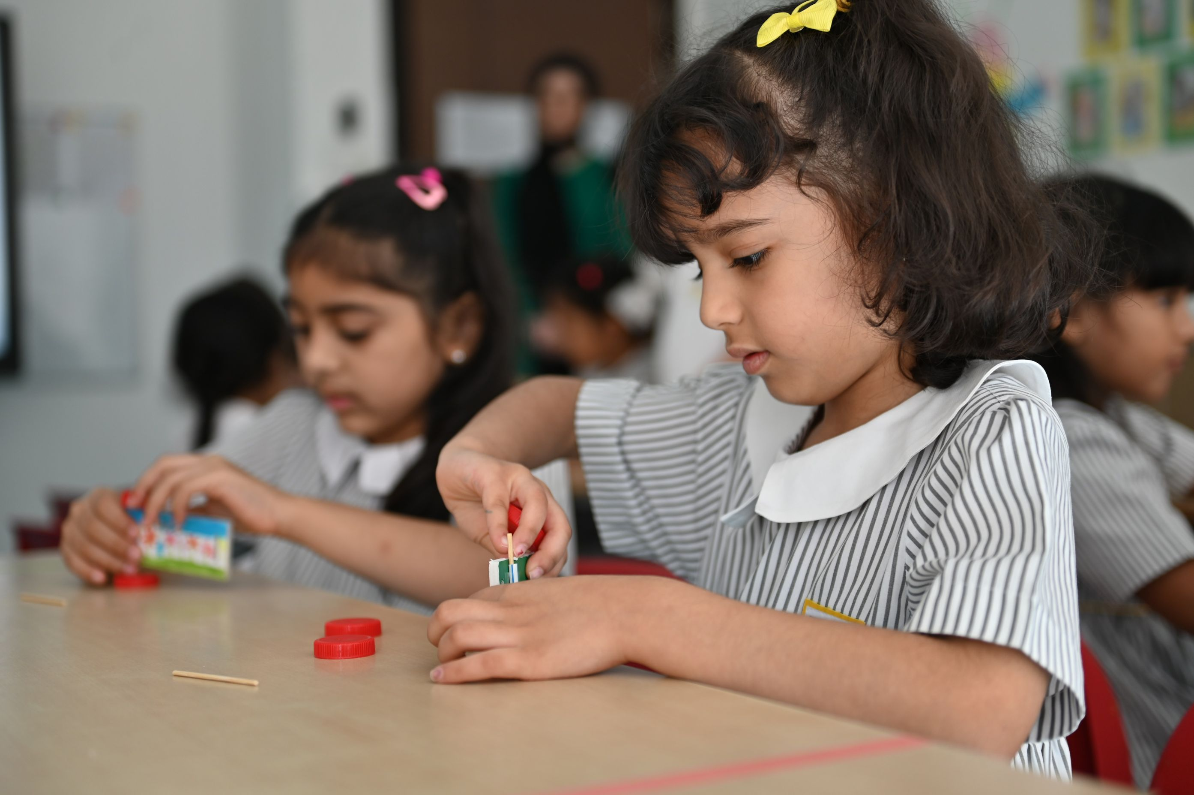
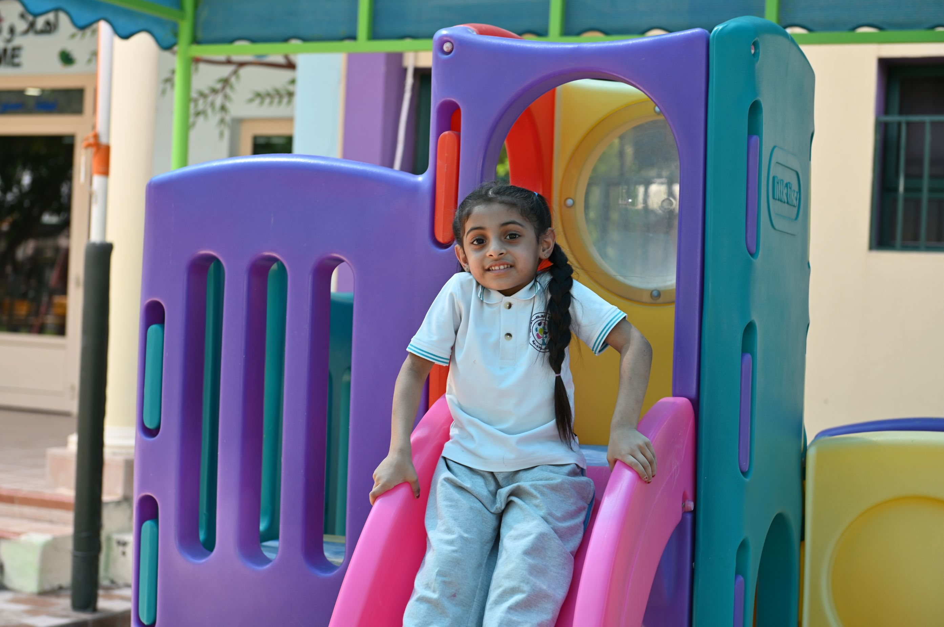
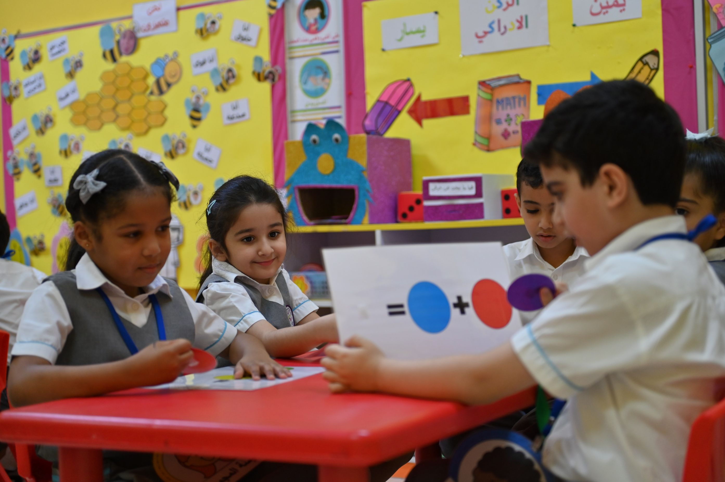
What is learning through play?
Learning through play means that the child learns new things - knowledge and skills - while playing.
Through play, children discover the world around them and learn important life skills in a fun and relaxing way, including problem-solving and communication skills.
It does not mean free play without purpose or planning, but rather refers to educational play activities carefully planned by the teacher to support the child’s growth and development through diverse experiences, matching their abilities and interests.

Slide 5
Why is learning through play important?
Notes:
A video

Slide 6
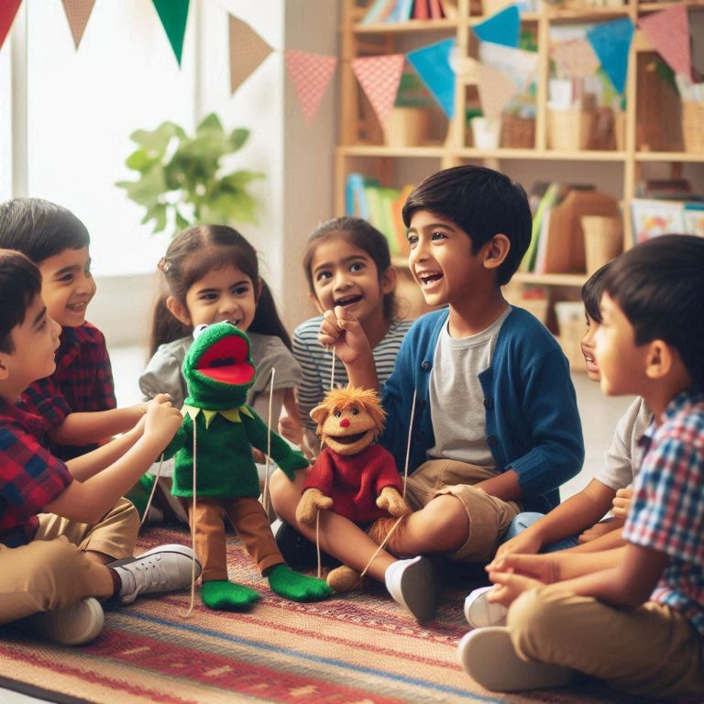
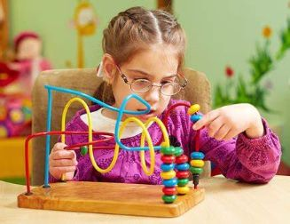
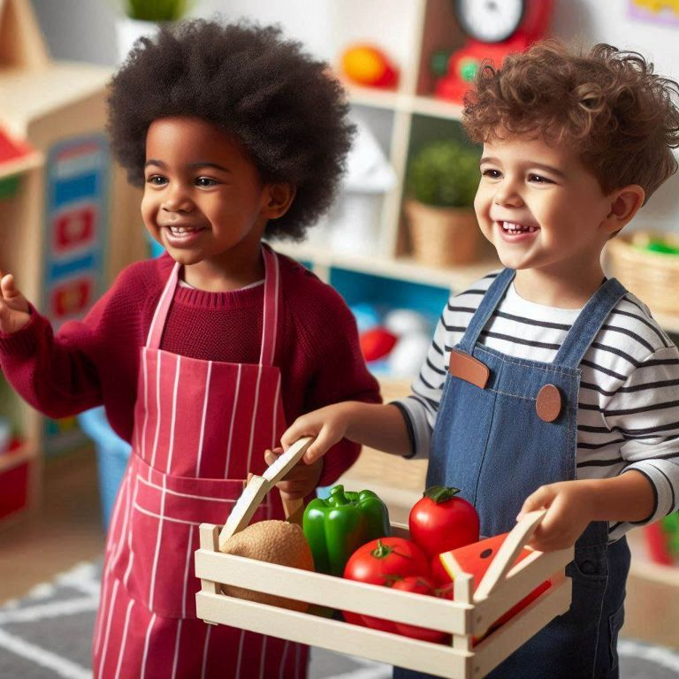
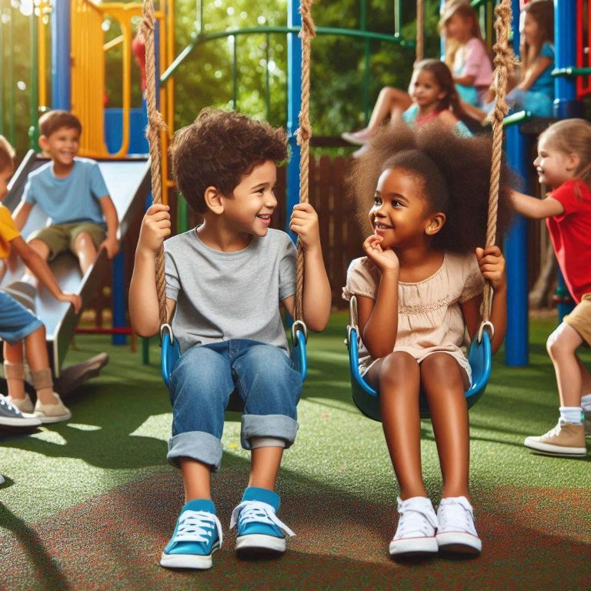
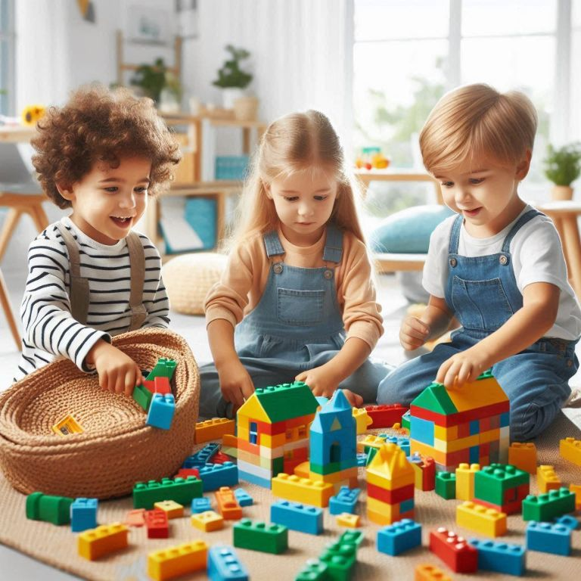
Through play, children ..
Explore and discover
Express emotions
Solve problems
Build confidence
Develop social skills
Enhance creativity
Notes:
Explore and Discover: Play allows children to explore the world around them, ask questions, and satisfy their natural curiosity.
Solve Problems: Whether building with blocks or solving a puzzle, play helps children think critically and figure things out on their own.
Develop Social Skills: Playing with others teaches sharing, cooperation, and how to take turns, helping children build friendships.
Express Emotions: Through pretend play, art, or role-playing, children can express how they feel and make sense of their experiences.
Build Confidence: When children try new things and succeed, they feel proud, which builds their self-esteem and independence.
Enhance Creativity: Play encourages imagination, from creating stories to building their own worlds with toys, helping them think creatively.

Slide 7
Learning through play in scientific research
Data from studies comparing the effect of play on children’s learning compared to children who learned in a traditional setting:
34% Development of cognitive skills such as memory and critical thinking
75% Show higher empathy and ability to resolve conflicts
30% language development and learned vocabulary
45% More likely to excel in reading, writing and math at school
40% Development in gross and fine motor skill
Notes:
References:
(Pediatrics Journal, 2018)
(Journal of Child Psychology and Psychiatry, 2020)
(NAEYC Research, 2019)
(Early Childhood Research Quarterly, 2017)
(Journal of Pediatrics, 2021).

Slide 8
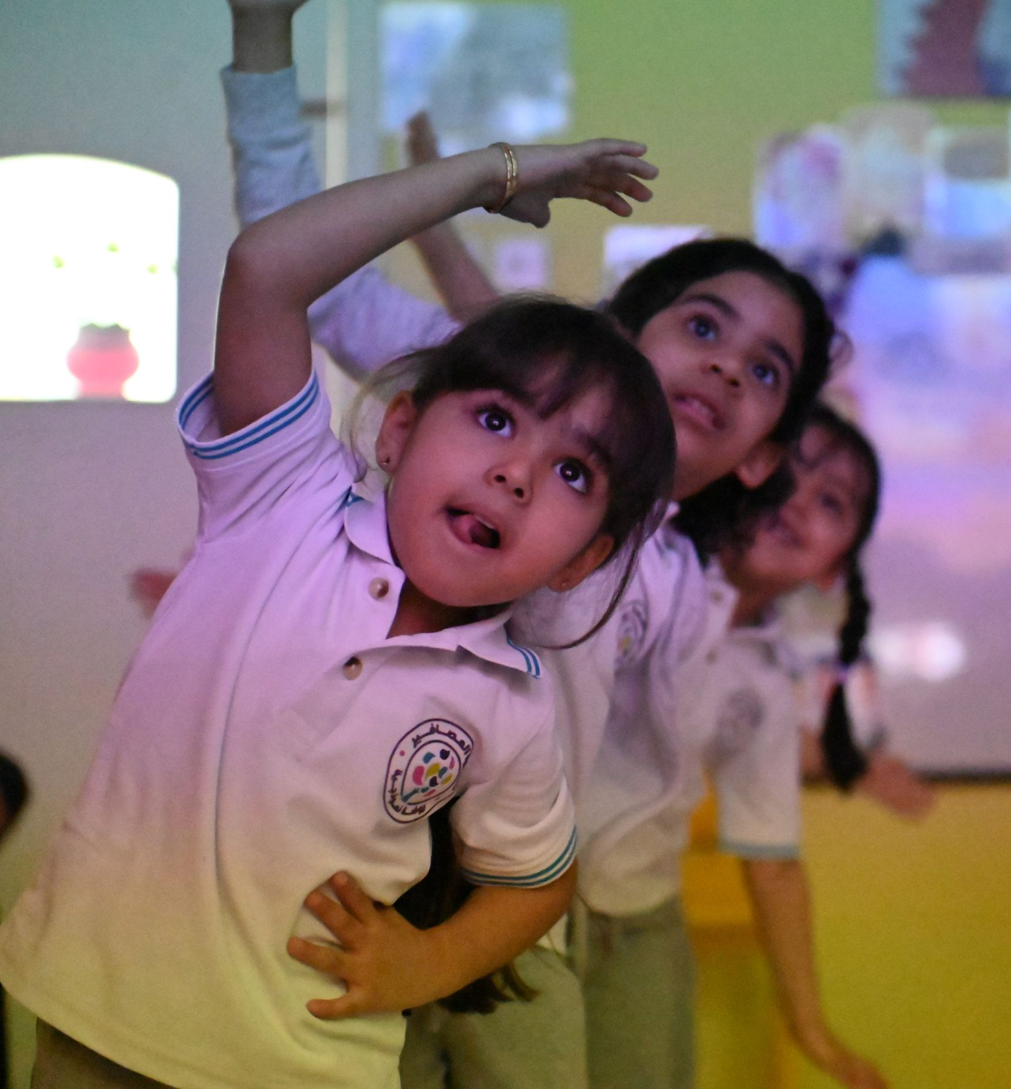
Types of learning through play
Free play: The child chooses what he/she wants to play with, such as blocks or painting
Guided play: The child plays specific games that help develop targeted knowledge and skills such as numbers and colors
Pretend play: The child plays roles such as a doctor or a salesman, which develops creativity and imagination
physical play: such as running or ball playing, help the child move and develop muscles

Slide 9
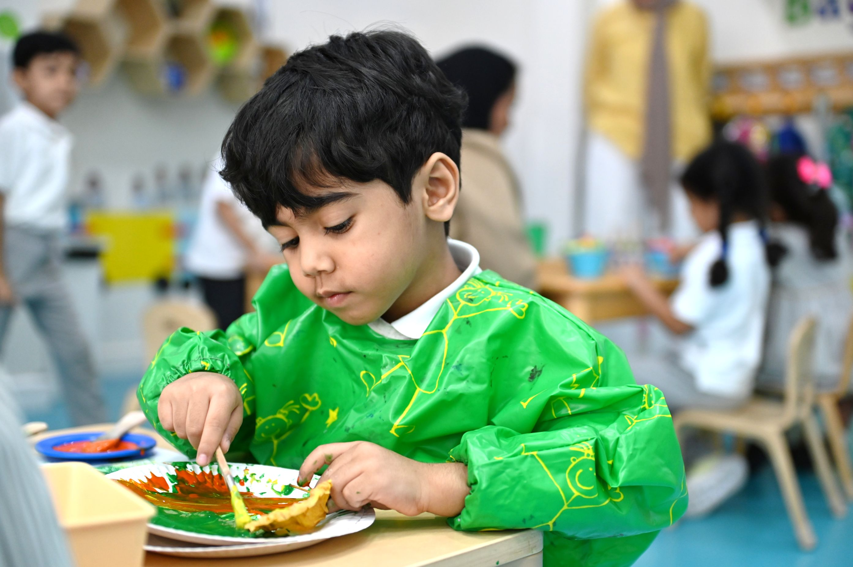
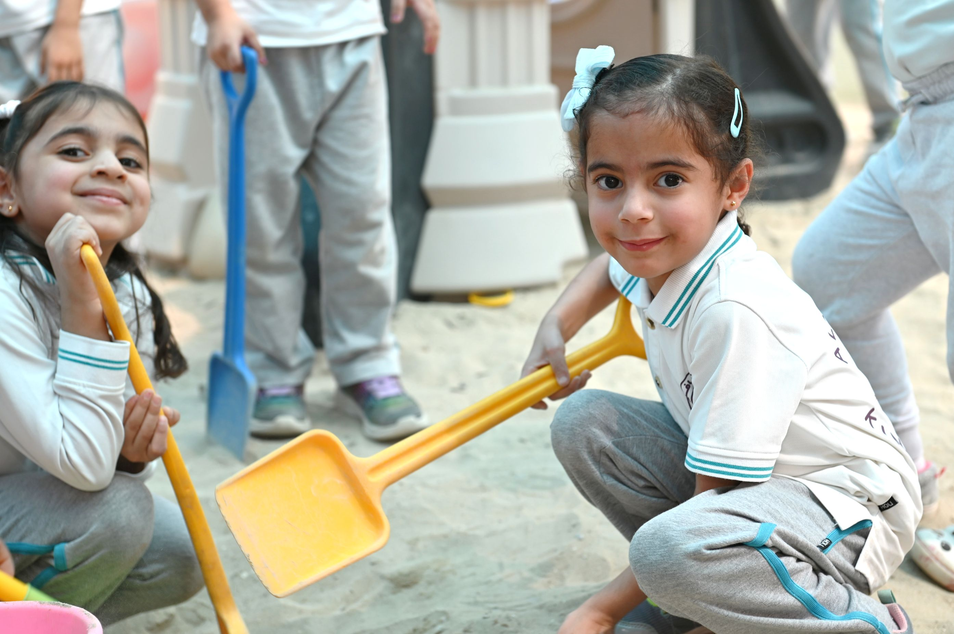
Through Kindergartens’ evaluations, we will focus on ..
Learning through PLAY
Notes:
Supports cognitive, physical, social, and emotional development.
Allows children to explore their world and learn problem-solving.
Promotes critical thinking skills.
Encourages creativity, imagination, and resilience.
Central to effective early childhood education and a key method of learning.

Slide 10
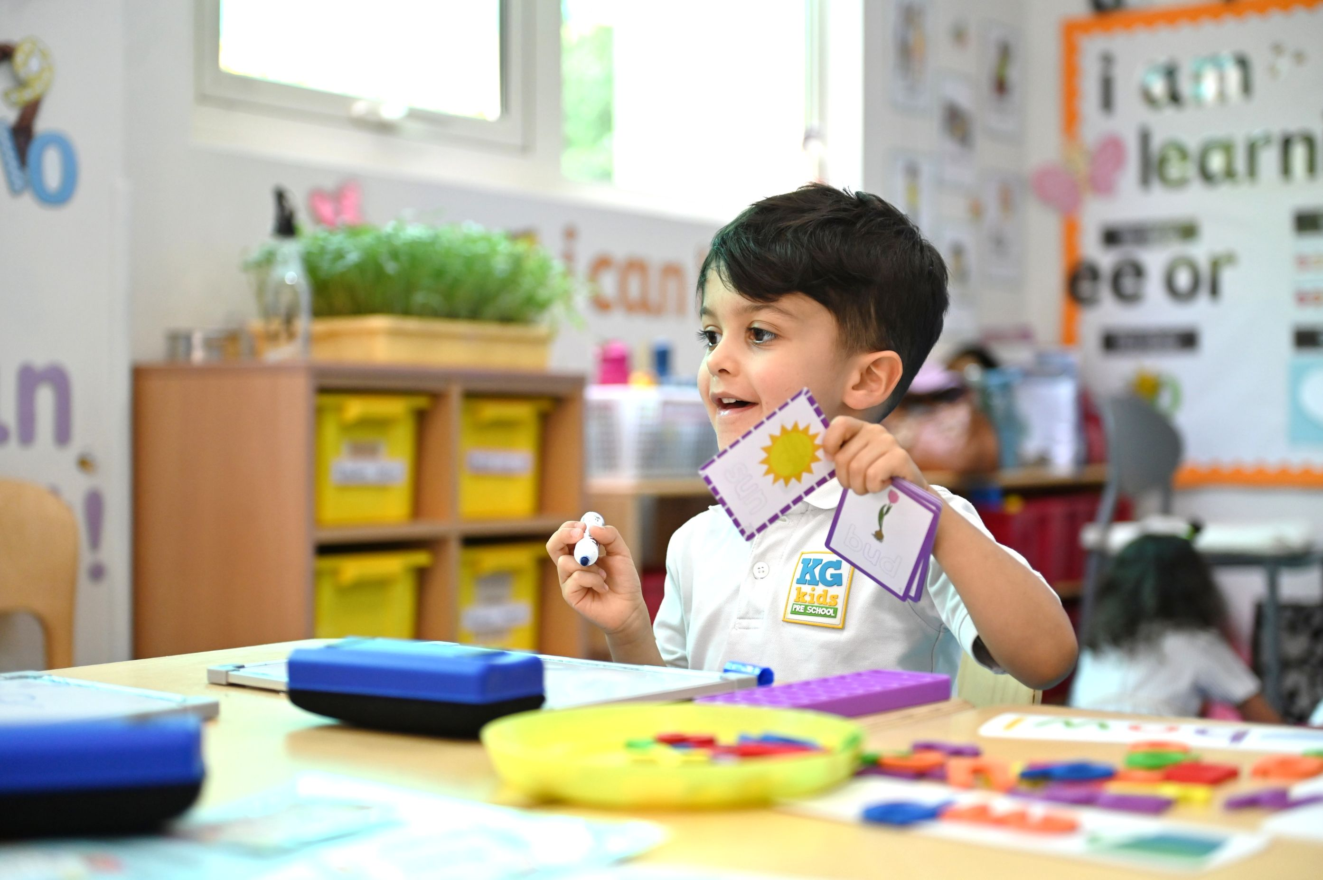
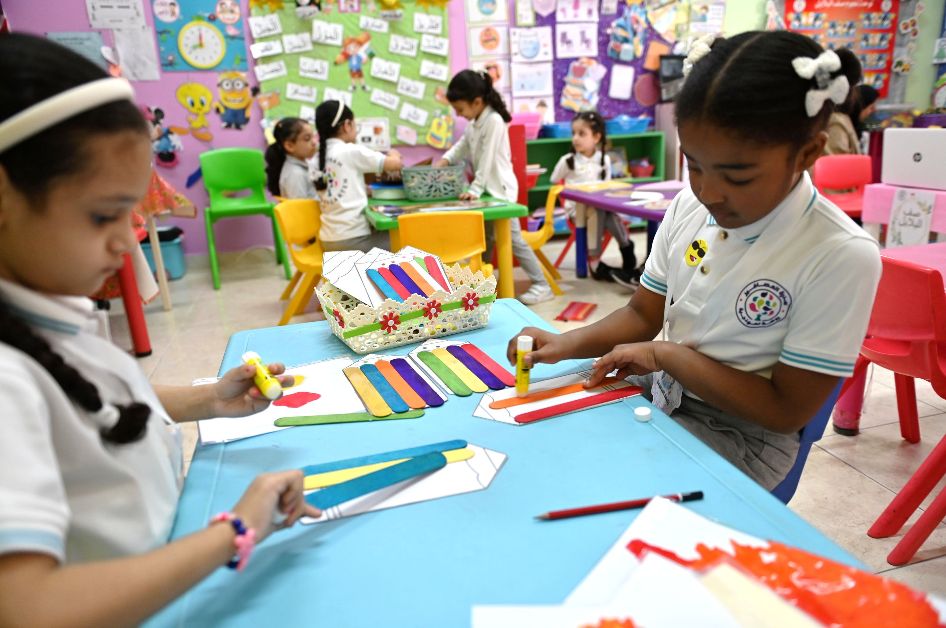
Through Kindergartens’ evaluations, we will focus on ..
Children at the center of learning and care
Notes:
Focus on nurturing overall development of children.
Recognizes each child as unique, with individual needs and interests.
Personalised learning experiences tailored to developmental levels.
Supportive environment that allows children to thrive.
Encourages growth at their own pace, based on ability and interests.

Slide 11
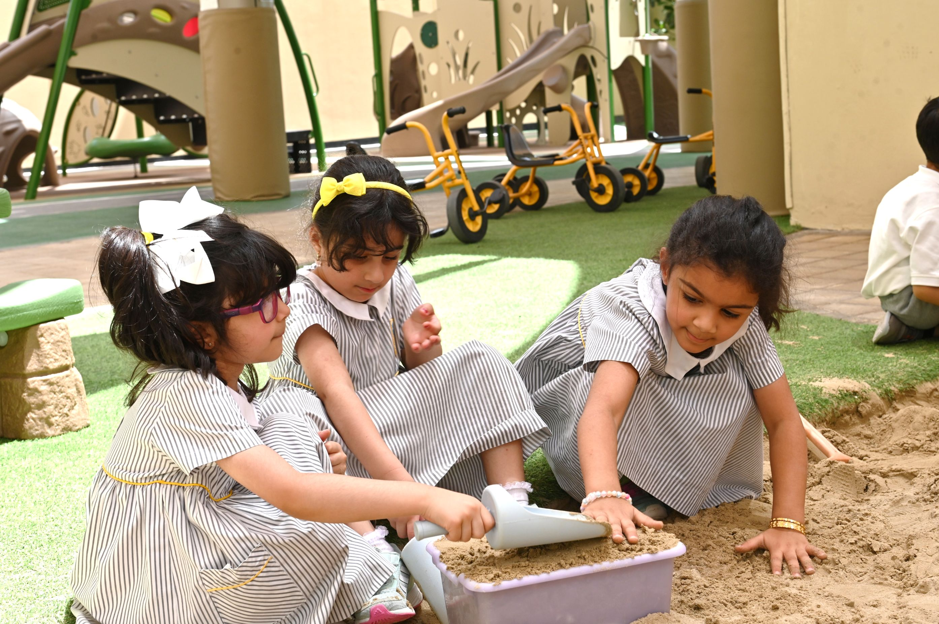
Through Kindergartens’ evaluations, we will focus on ..
Including family and the community
Notes:
Enriched by family and community involvement in activities and learning experiences.
All children are engaged and involved regardless of needs, conditions and backgrounds.
Fundamental for holistic development.
Safe, inclusive, and supportive atmosphere helps children feel valued and secure.

Slide 12
Family’s engagement in kindergartens
Watch the Video on Family Engagement
Notes:
A video

Slide 13
Kindergartens Areas of Evaluation
Aspect 1:
Children’s Growth and Development
1.1 Children's Social and Emotional Development
1.2 Children's Physical Development
Aspect 2:
Child Initiated Learning
2.1 Areas of Learning
2.2 Curriculum Experiences
Aspect3:
Leadership and Management
3.1 Leadership Effectiveness
3.2 Family and Community Engagement
1.3 Meeting Special Needs *

Slide 14
Thank you
bqa Bahrain
@bqa_bh
www.bqa.gov.bh

