Slide 1
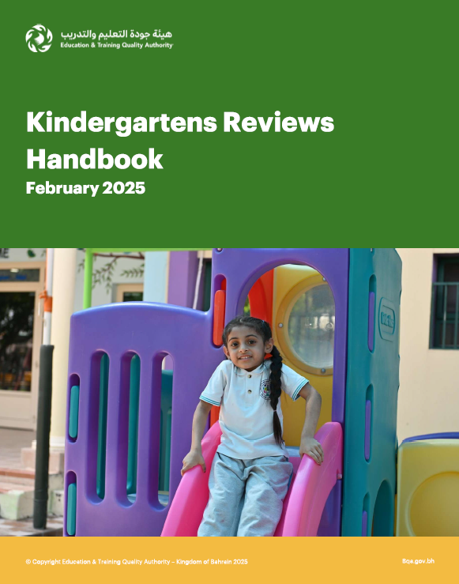
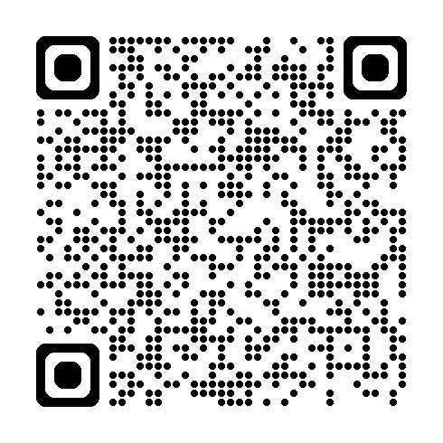
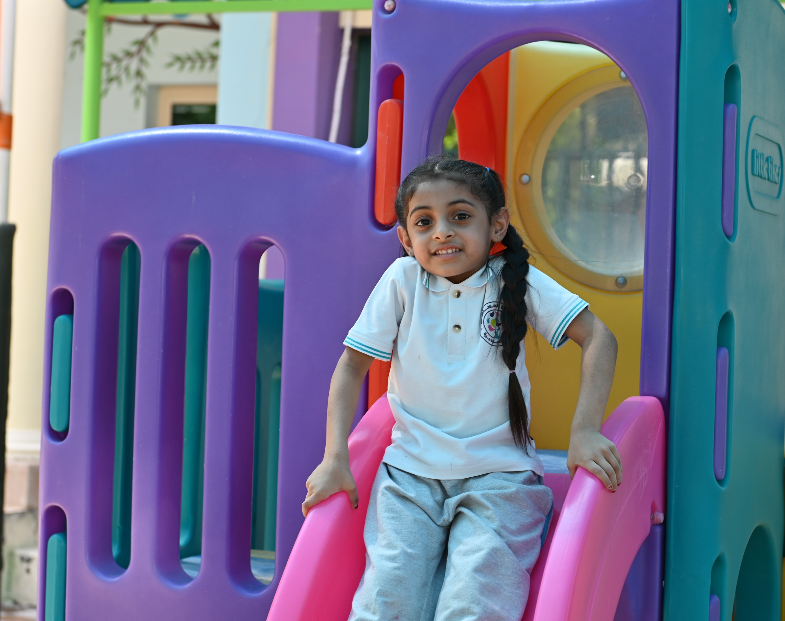
Who are we?
Kindergartens Areas of Evaluation
A government organisation. Our aim is to improve the quality of education in Bahrain. The Authority has three main tasks:
Review the performance of educational and training institutions
Manage the National Qualifications Framework (NQF)
Conduct National Examinations
Aspect 1: Children’s Growth and Development
Aspect 2:
Child Initiated Learning
Aspect 3: Leadership and Management
Kindergartens Reviews​
What is the Kindergartens review process? How does it help the KG improve?
It is an evaluation process for the quality of educational experiences provided for children by the kindergarten. The focus is on the child’s holistic development in early childhood, aiming to support KGs in improving their performance.
To access the Review Handbook please scan the code​
Why Evaluate Kindergartens?
Ensure children in Bahrain receive high-quality early childhood education.
Help improve kindergartens’ practices and support the sector in Bahrain.
What does the review team do during reviews?​
The review visit usually lasts for 2 days, during which the reviewers will:​
Highlight the importance of early childhood education.
What aspects will be focused on during the visit?
Communicate with children
Conduct​
interviews ​
Observe learning experiences
- Children grow and develop through PLAY
- The child is at the center of learning and care
- Family and the community engagement in learning experiences.
Scrutinise ​
documents
Attend Activities ​

Slide 2
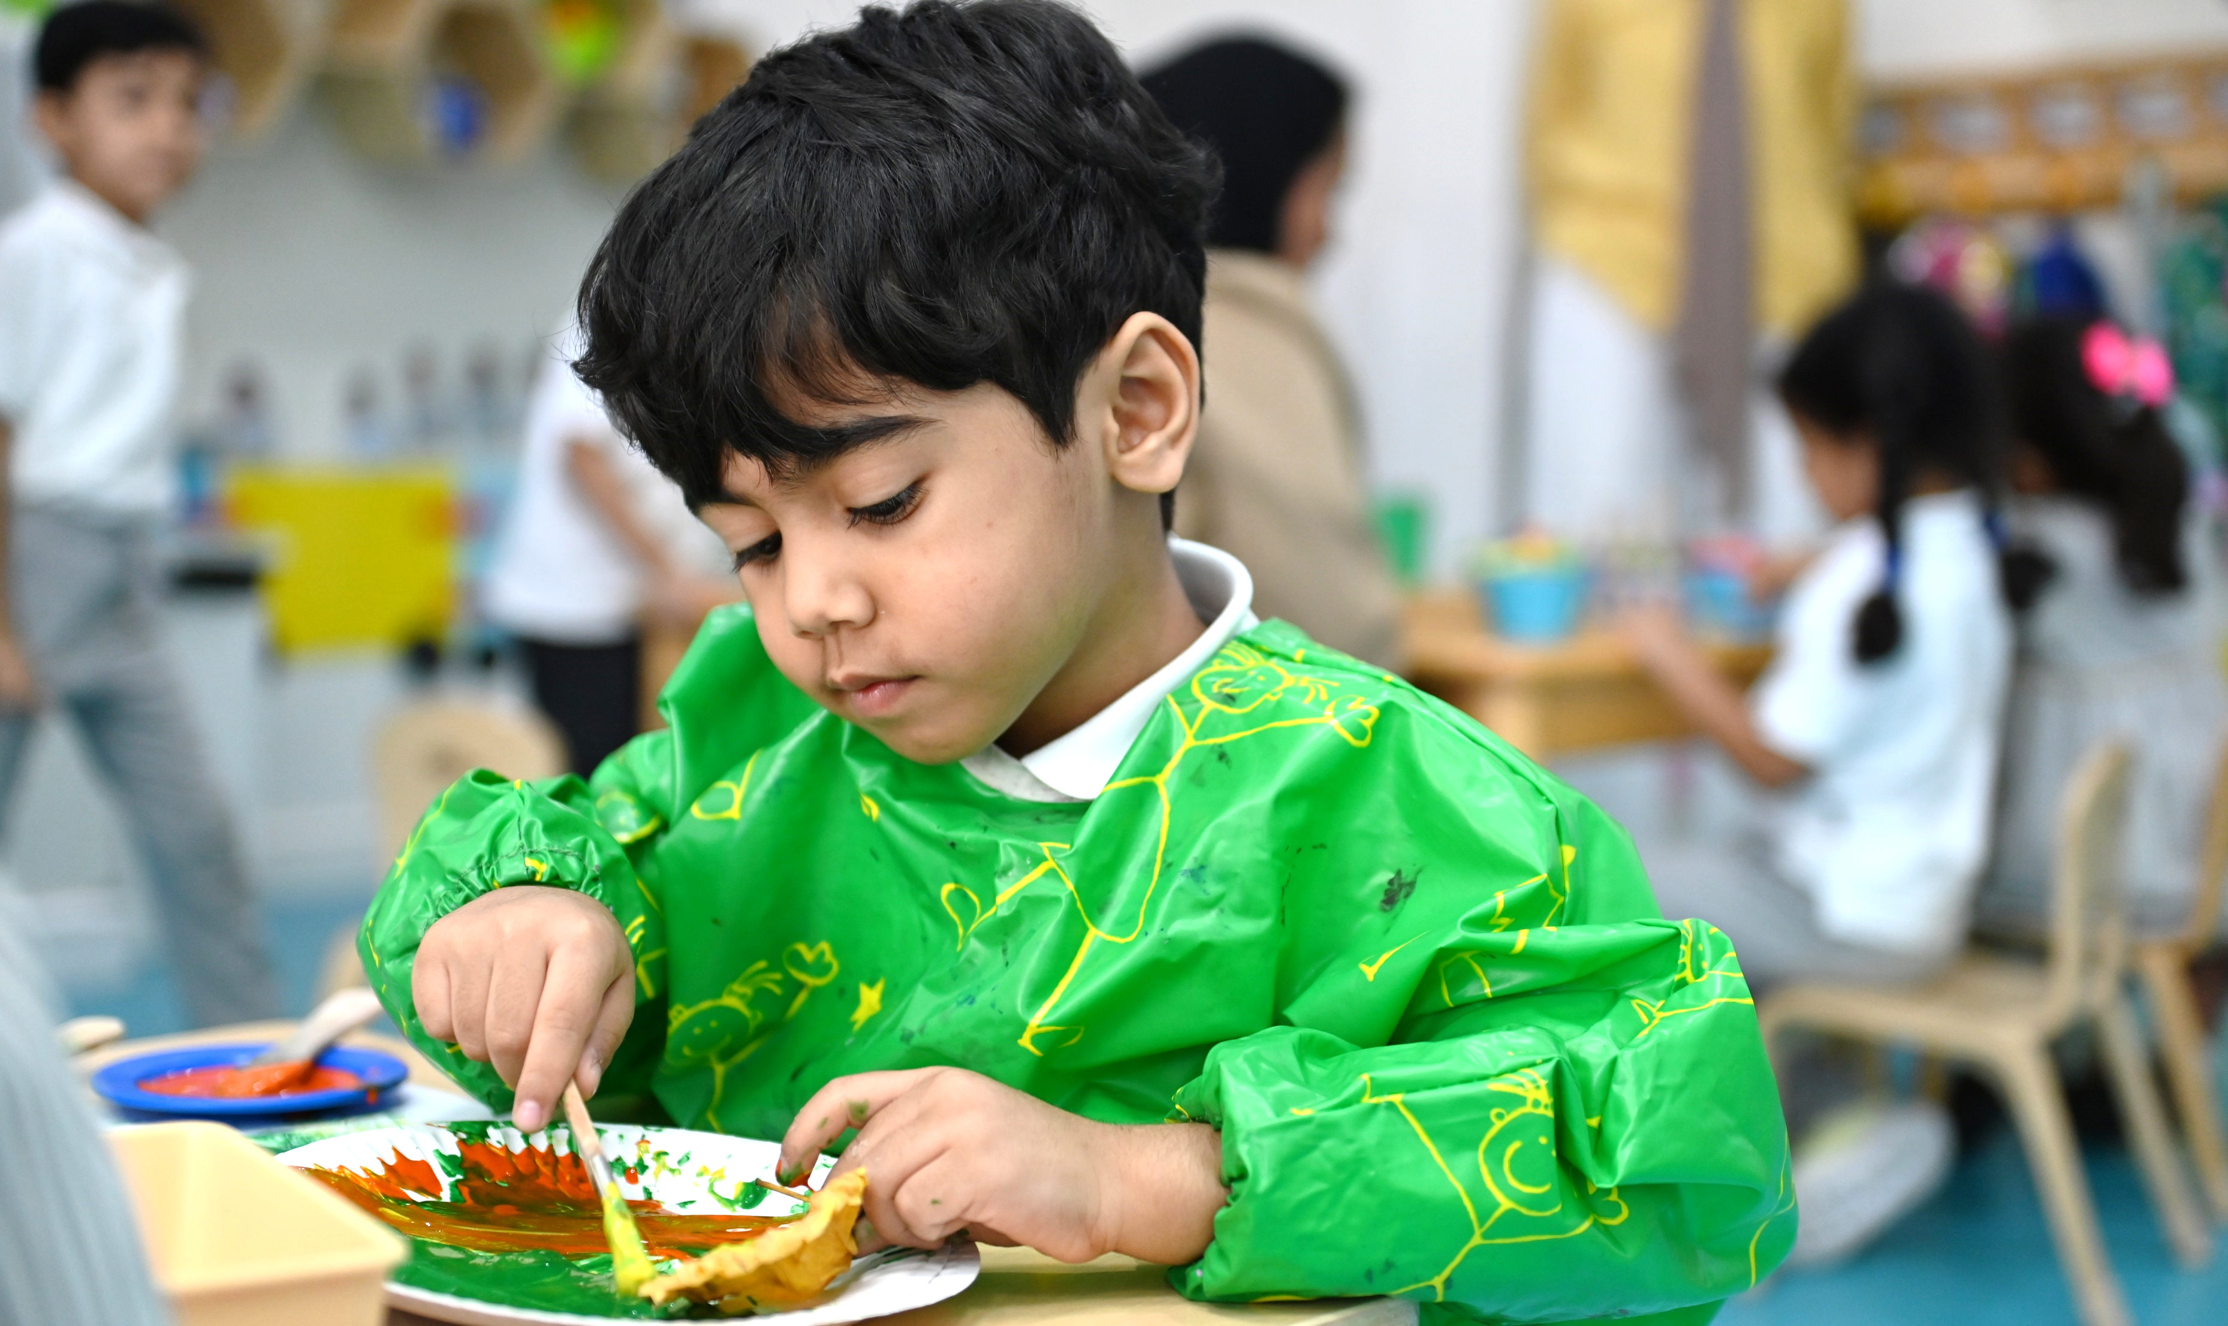
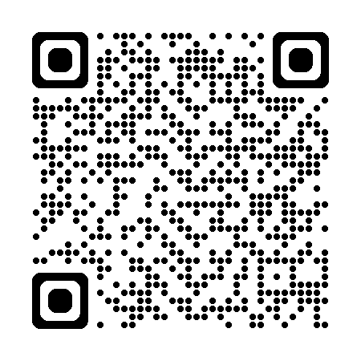
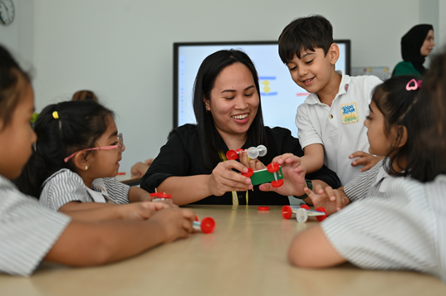
What happens after the evaluation process?​
For more information​
(BQA) Website​
Inform kindergarten leadership of the results​
Prepare a report on the review results and kindergarten’s performance.​
Publish the report on BQA website after endorsement
Parents role in the review process: ​
Parents can participate in the review process via: ​
Why focus on Play-Based Learning?
Through play, children ..
bqa_bh
Express emotions
Explore and discover
bqa.gov.bh
Meet review ​
team​
Fill Electronic ​
Questionnaire​
What are the characteristics of child development?
Build confidence
Develop social skills
Language and Communi-cation
Cognitive
Enhance creativity
Solve problems
Physical
Social and Emotional
To submit your inquiries and suggestions, contact us through info@bqa.gov.bh ​

