Slide 1

The Training Presentation for
‘Kindergartens Reviews’ in the Kingdom of
Bahrain
For Kindergartens Principals

Slide 2

What is Early Childhood Education (ECE)?

Slide 3
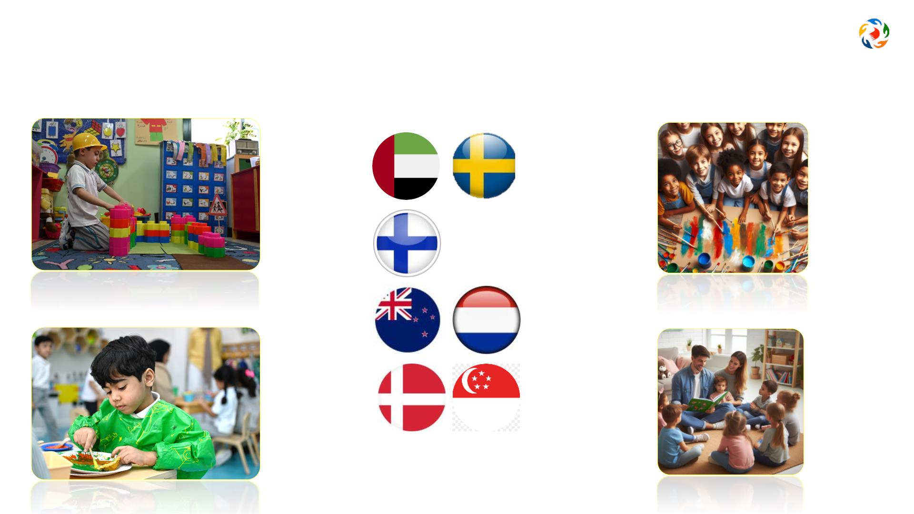
Benchmarks
Learning through PLAY
Focus on social and emotional growth
It’s all about the child
Incl
hips

Slide 4
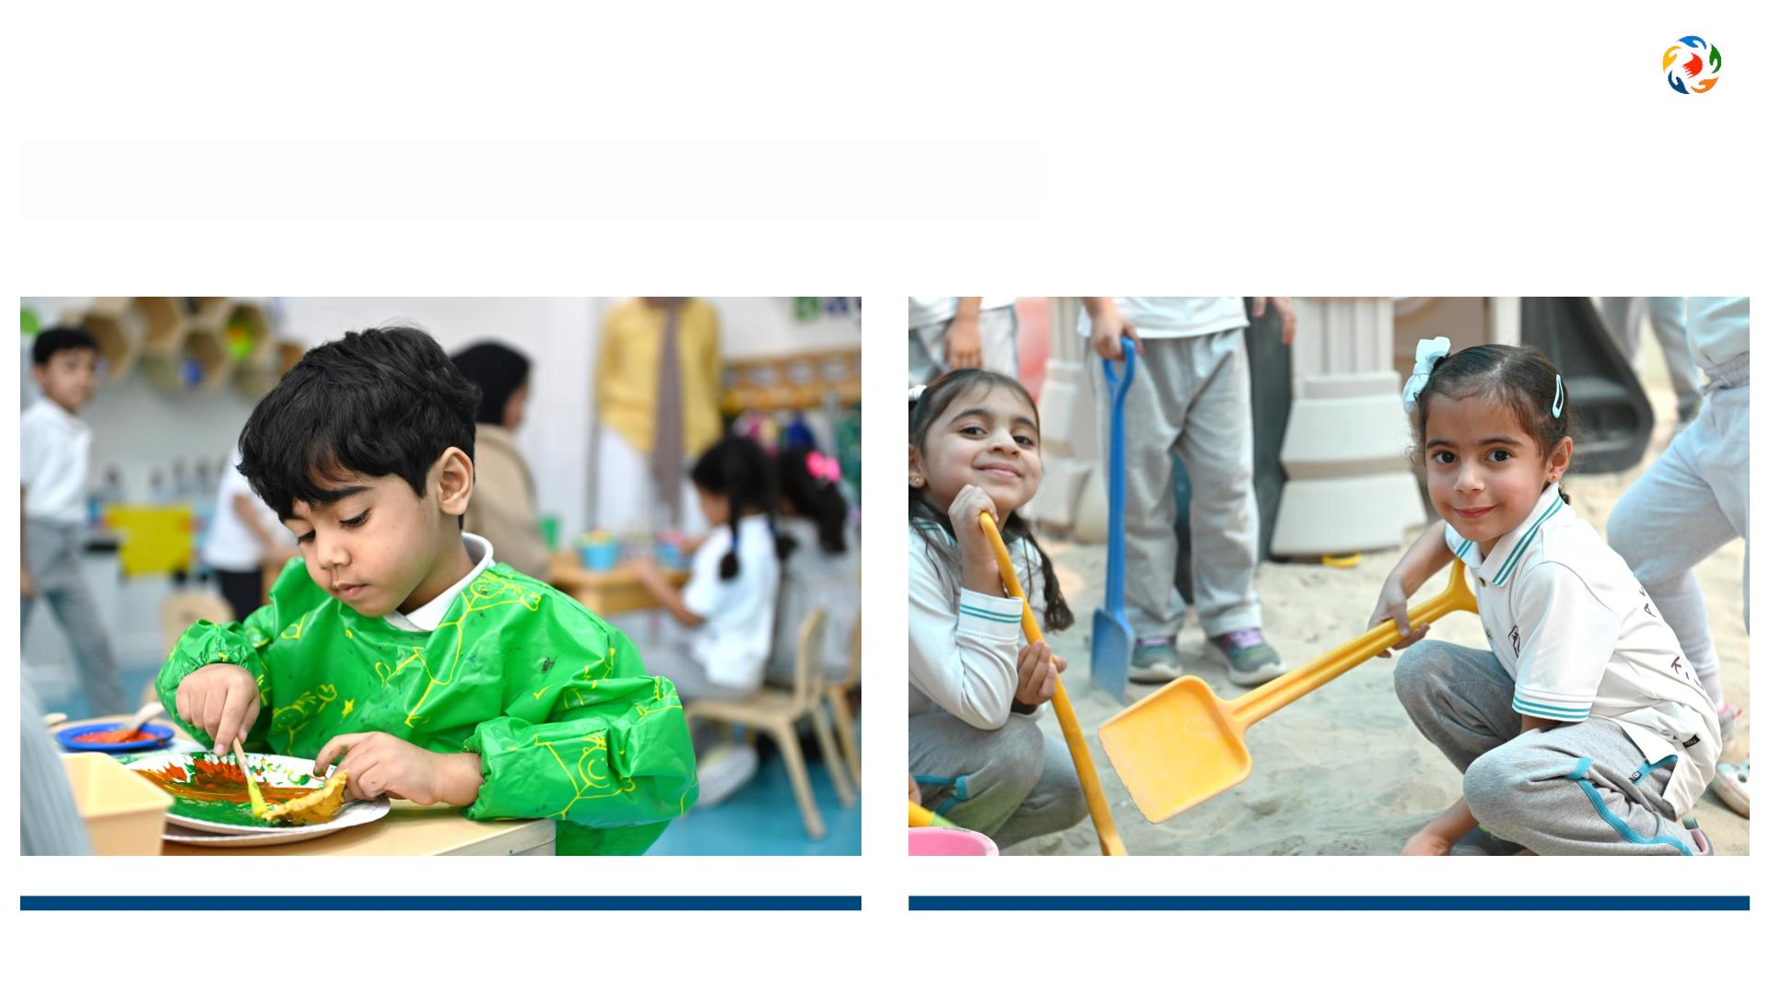
Pillars of Early Childhood Education
Centrality of Play

Slide 5
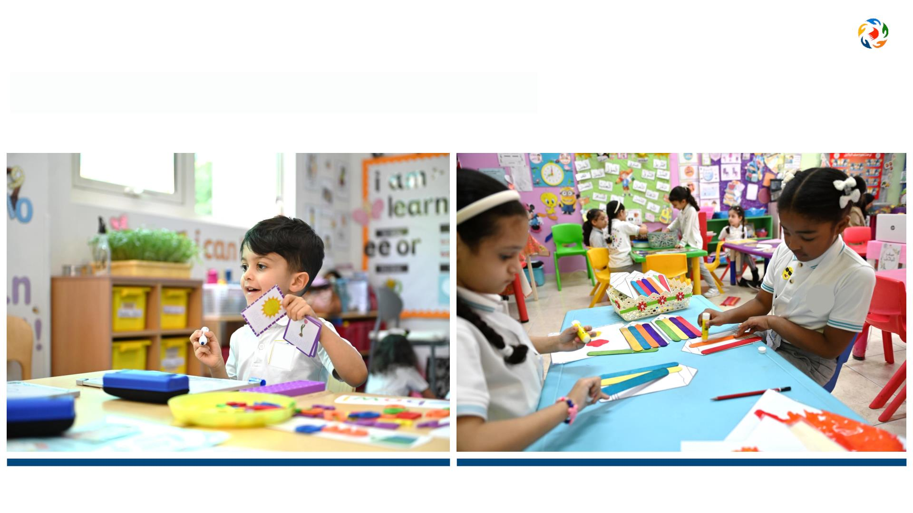
Pillars of Early Childhood Education
Holistic Development

Slide 6
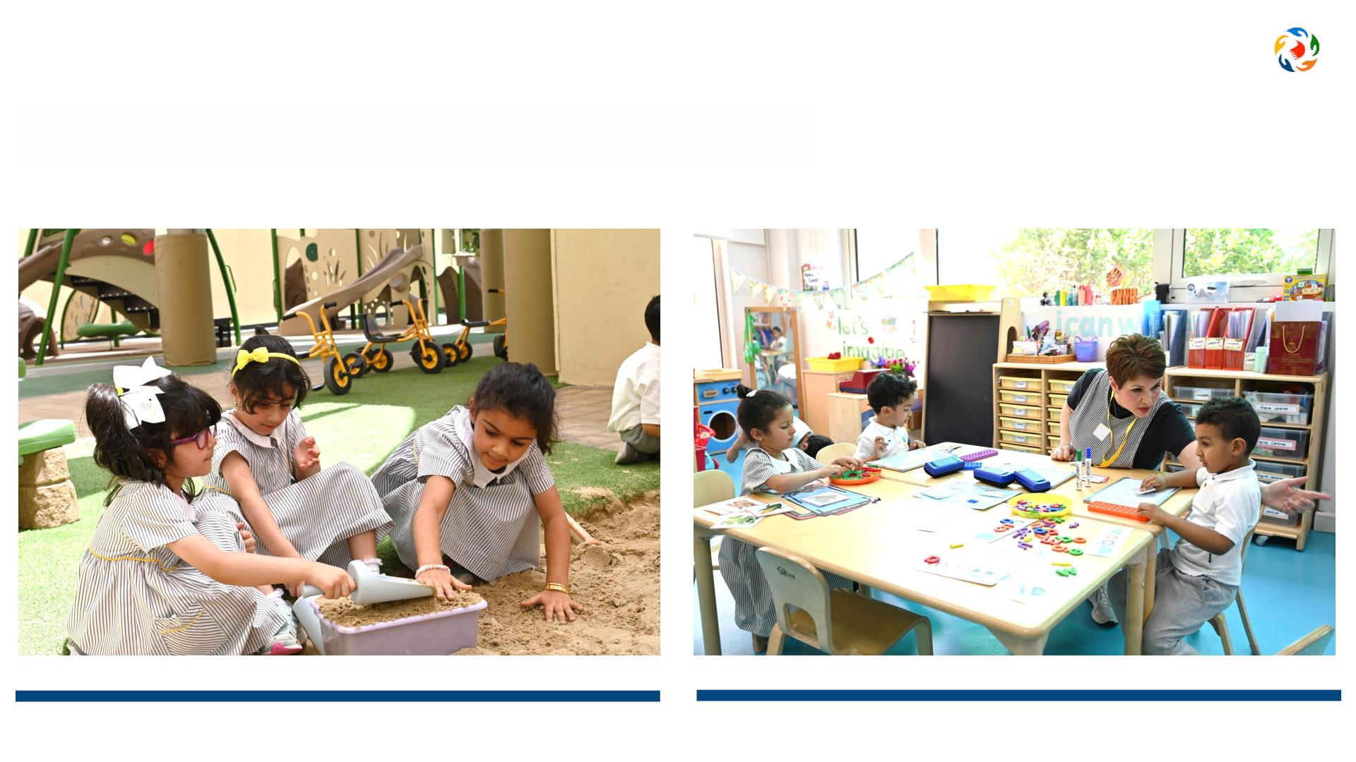
Pillars of Early Childhood Education
Nurturing and Inclusive Environment

Slide 7
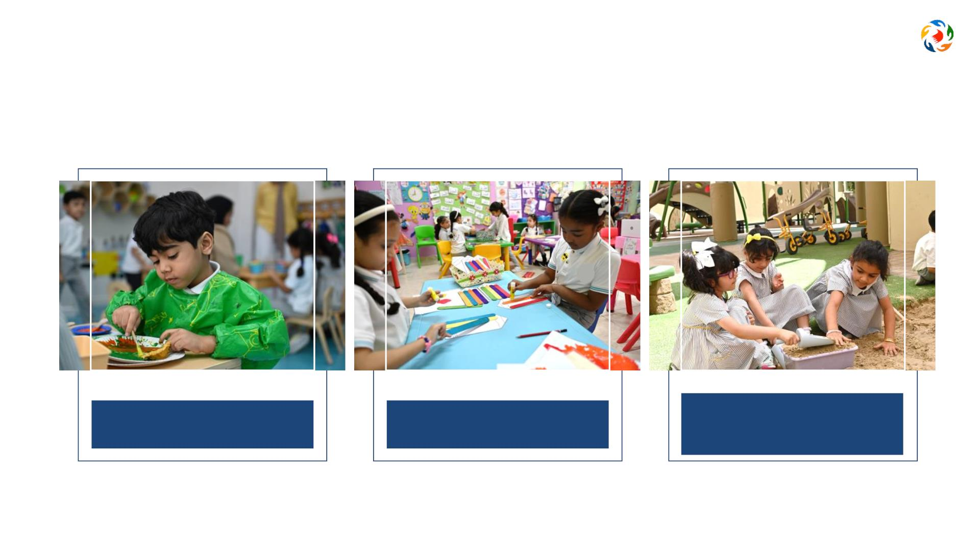
Activity 1
Reflect on your practices in the kindergarten, what types of activities foster the three pillars of ECE?
1
2
3
Centrality of Play
Holistic Development
Nurturing and Inclusive
Environment

Slide 8
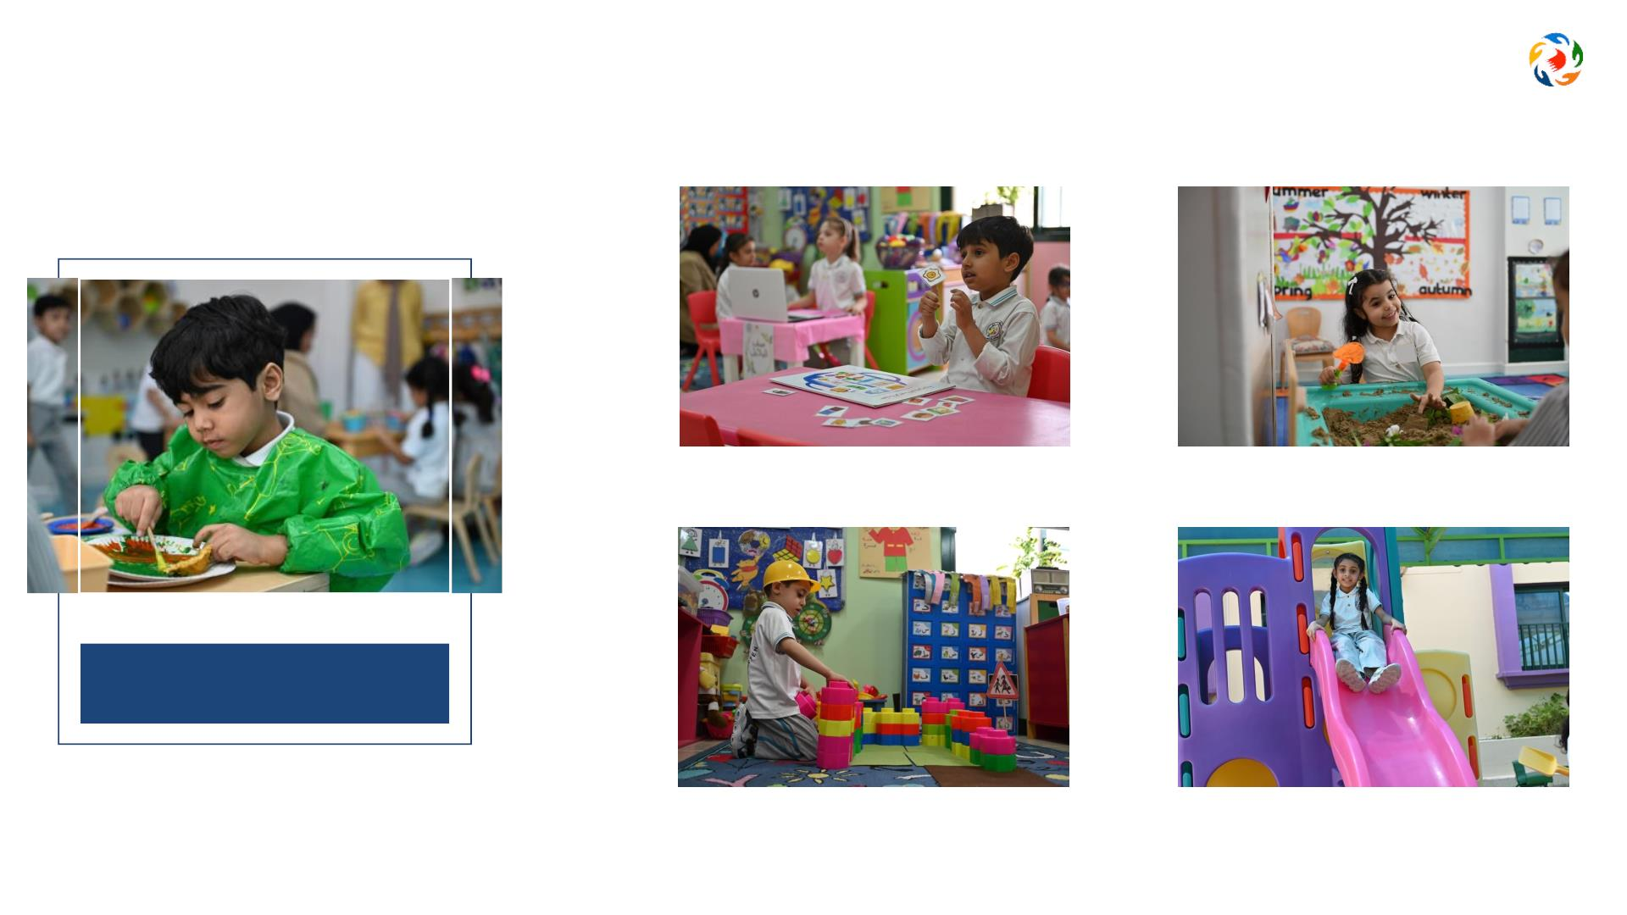
Activity 1
Sample of activities covering pillars of ECE
Matching pictures to sounds
Creating shapes with sand
1
Centrality of Play
Building blocks
Free outdoor play

Slide 9
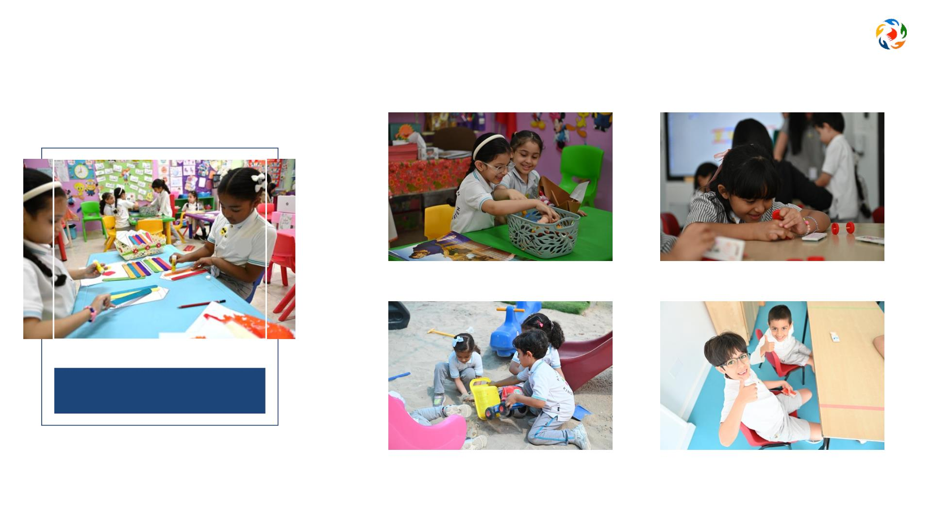
Activity 1
Sample of activities covering pillars of ECE
Pair activity
Assembling pieces to create shapes
2
Holistic Development
Outdoor group play
Express opinions and feelings

Slide 10
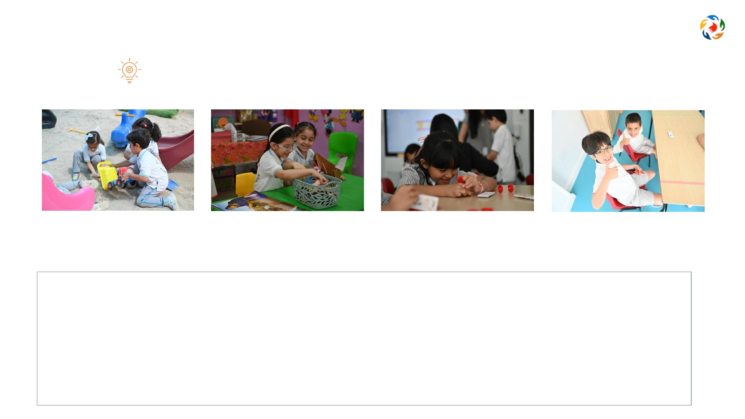
Activity 1
Reflect: How do these sample activities lead to ‘Holistic Development’?
Outdoor group play
Pair activity
Assembling pieces to
create shapes
Express opinions
and feelings
These sample activities all foster the development and progress of children in different aspects. While doing so, they
are developing fine and gross motor skills, they’re developing their social and communication skills while interacting
with others, they’re learning how to regulate their feelings and actions, they’re using their imagination through
exploring and developing their creativity, etc.
That is how these activities foster
Holistic Development

Slide 11
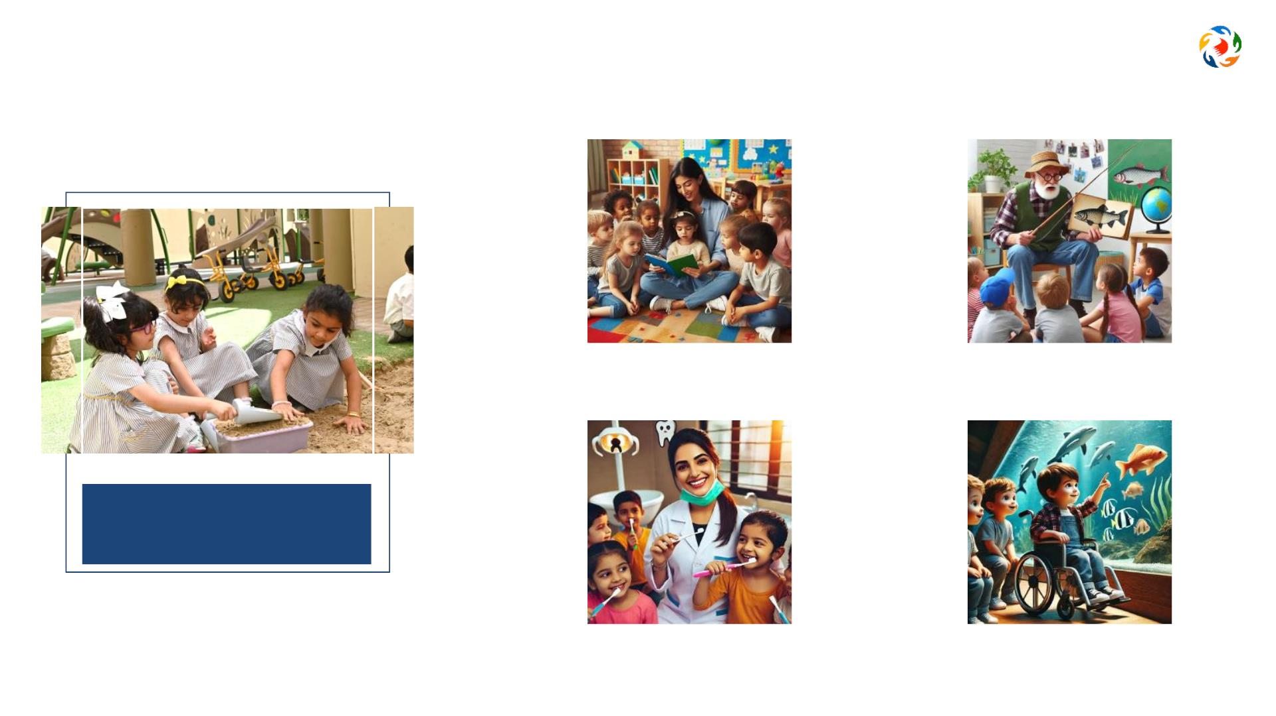
Activity 1
Sample of activities covering pillars of ECE
Story with mom
Grandad adventures
3
Nurturing and Inclusive
Environment
Dentist visit
A trip to the aquarium

Slide 12
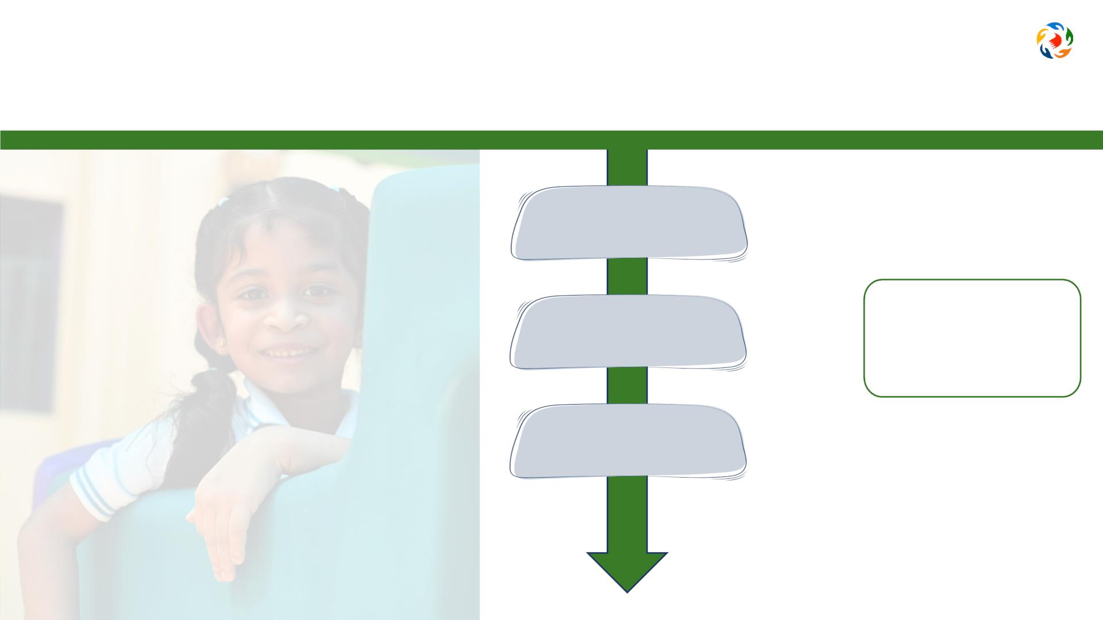
‘Kindergartens Reviews Framework’ components
Aspectsꢀ
=
Criteriaꢀ
Evaluation
Indicators

Slide 13
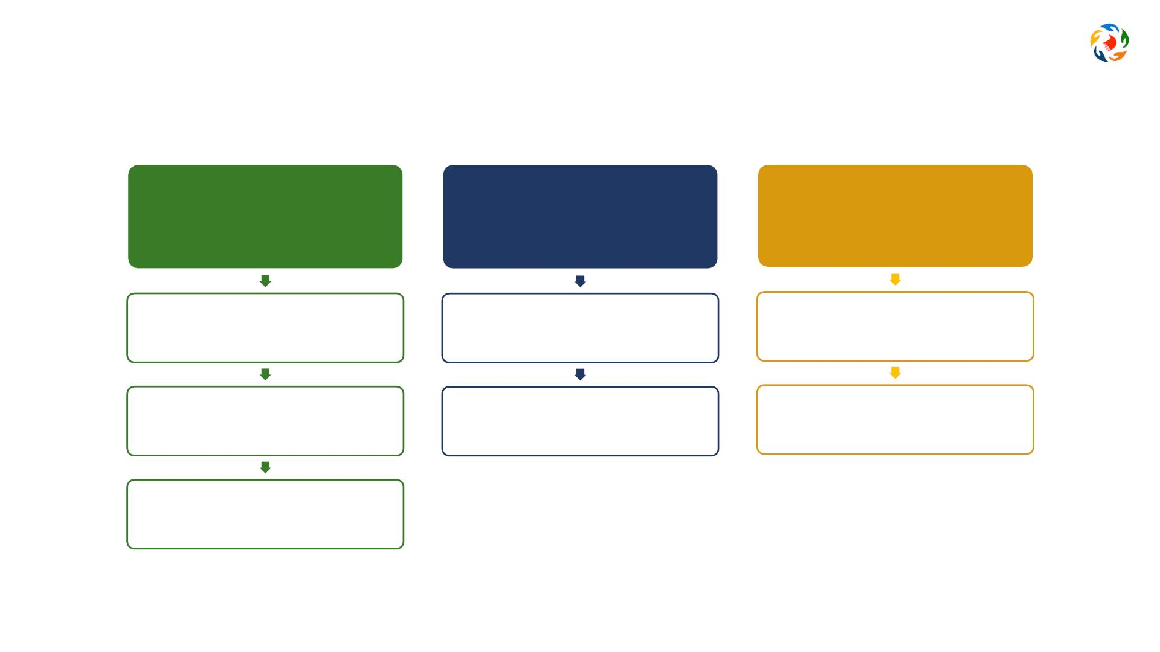
Kindergartens Reviews Framework
Aspect 1:
Aspect 2:
Aspect 3:
Children’s Growth and
Development
Child Initiated Learning
Leadership and
Management
1.1 Children's Social and
Emotional Development
3.1 Leadership
Effectiveness
2.1 Areas of Learning
1.2 Children's Physical
Development
3.2 Family and Community
Engagement
2.2 Curriculum Experiences
1.3 Meeting Special Needs
*

Slide 14
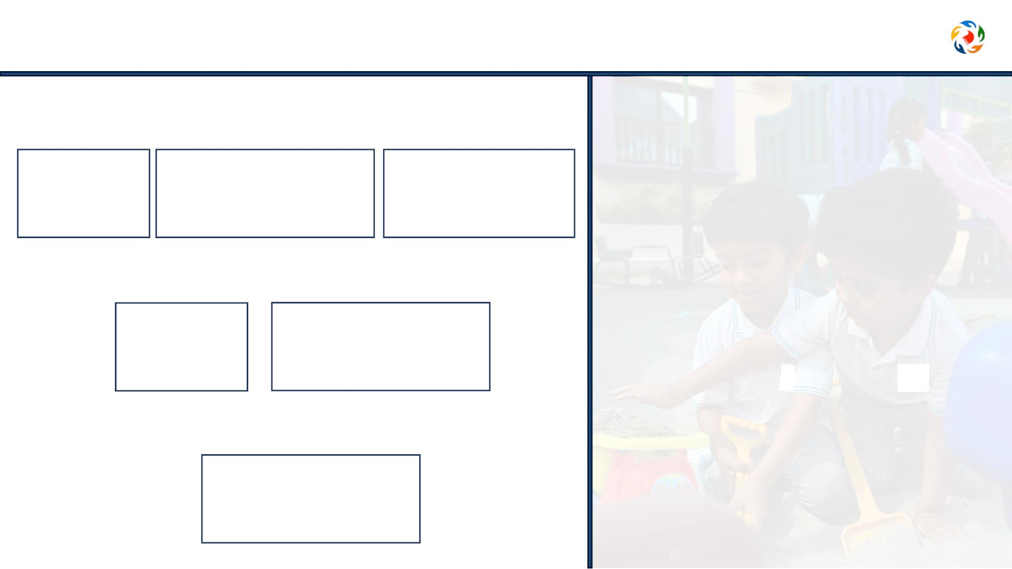
Aspect 1: Children's Growth and Development
1.1 Children’s Social and Emotional Development
1.1.2
Behavior and
Wellbeing
1.1.3
Communication
Skills
1.1.1
Social Skills
1.2 Children’s Physical Development
1.2.1
1.2.2
Motor Skills
Health and Selfcare
1.3 Meeting Special Needs *
1.3.1 Special Personal
Support

Slide 15
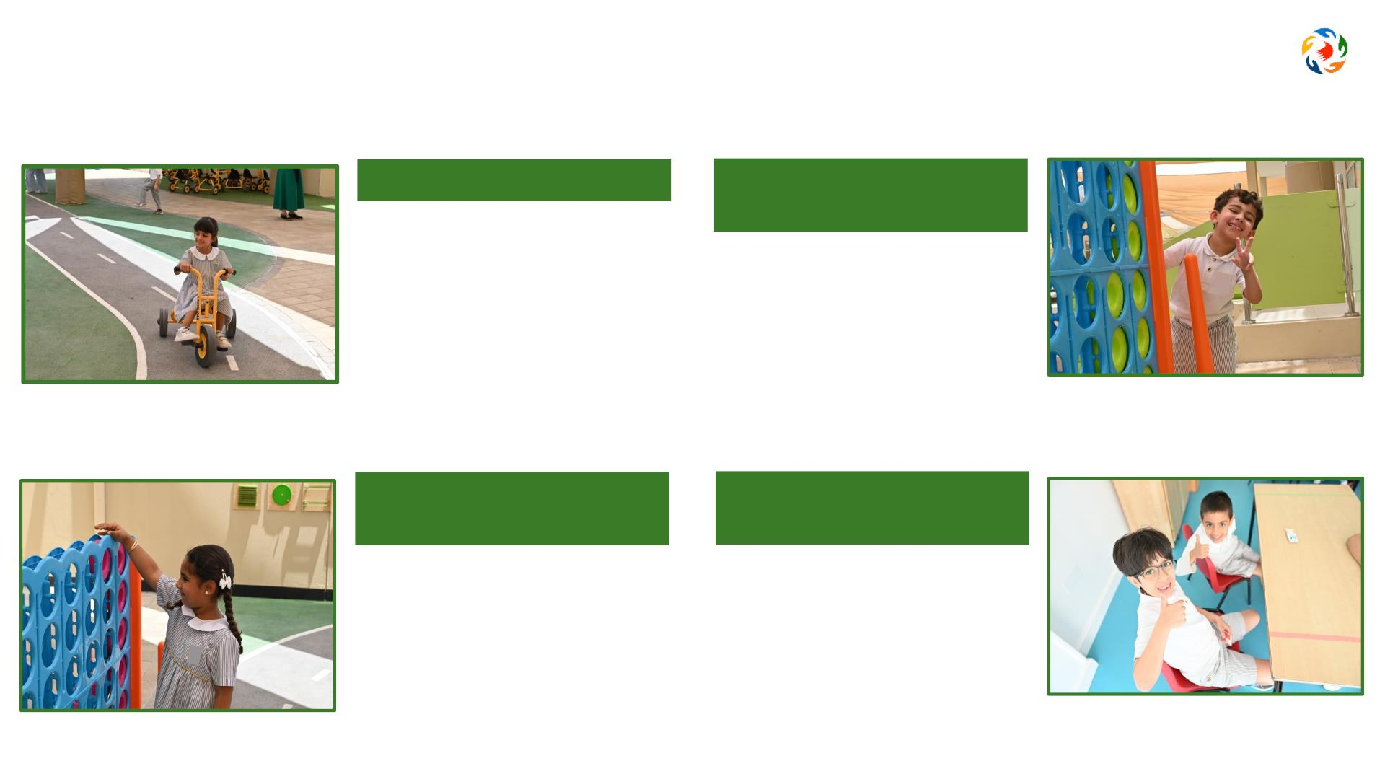
How do children grow?
Physical Development
Social and Emotional
Development
•
•
•
Developmentꢀofꢀgrossꢀmotorꢀskills
Developmentꢀofꢀfineꢀmotorꢀskills
•
•
Selfꢀawarenessꢀandꢀconfidenceꢀꢀ
Buildingꢀfriendshipsꢀandꢀplayingꢀ
togetherꢀ
Balanceꢀandꢀcoordinationꢀinꢀ
movement
•
Managingꢀfeelingsꢀandꢀshowingꢀ
positiveꢀbehaviourꢀ
Cognitive Development
Language and
Communication
•
•
•
Exploringꢀandꢀsolvingꢀproblemsꢀ
Imaginationꢀandꢀcreativityꢀ
•
•
Expressingꢀfeelingsꢀandꢀthoughts
Expressingꢀopinionꢀandꢀlisteningꢀ
activelyꢀ
Learningꢀdifferentꢀskillsꢀandꢀ
knowledgeꢀ
•
Participatingꢀandꢀengagingꢀwithꢀ
others

Slide 16

Quality communication and interactions

Slide 17

Children grow through play

Slide 18
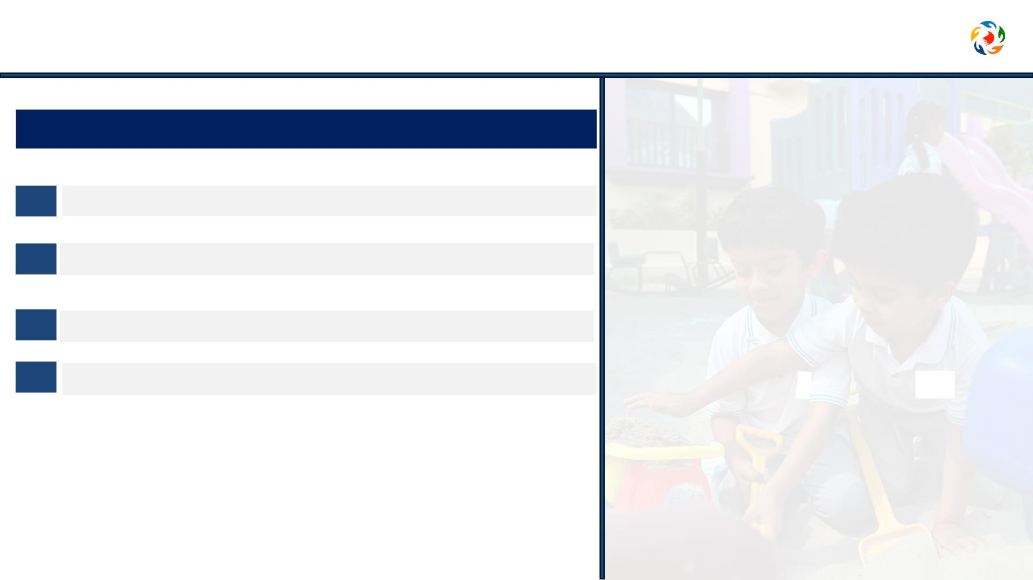
Aspect 1: Children's Growth and Development
Where to obtain data and evidence?
1
Observing & evaluating children’s participation & interaction
2 Analysing documents and procedures
3 Conducting interviews and surveys
4 Reviewing sample of children’s outcomes.

Slide 19
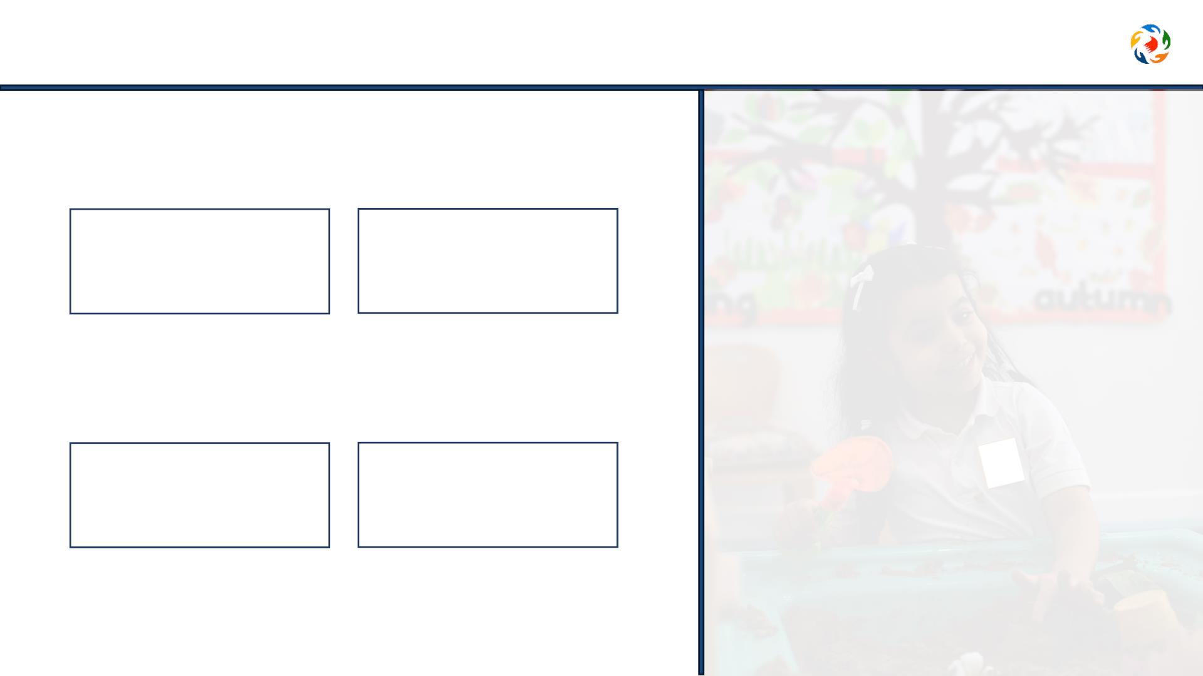
Aspect 2: Child Initiated Learning
2.1 Areas of Learning
2.1.1 Age-appropriate
Experiences
2.1.2
Managing Learning
Environment
2.2 Curriculum experiences
2.2.1
2.2.2
Acquiring Skills
Tracking Progress

Slide 20
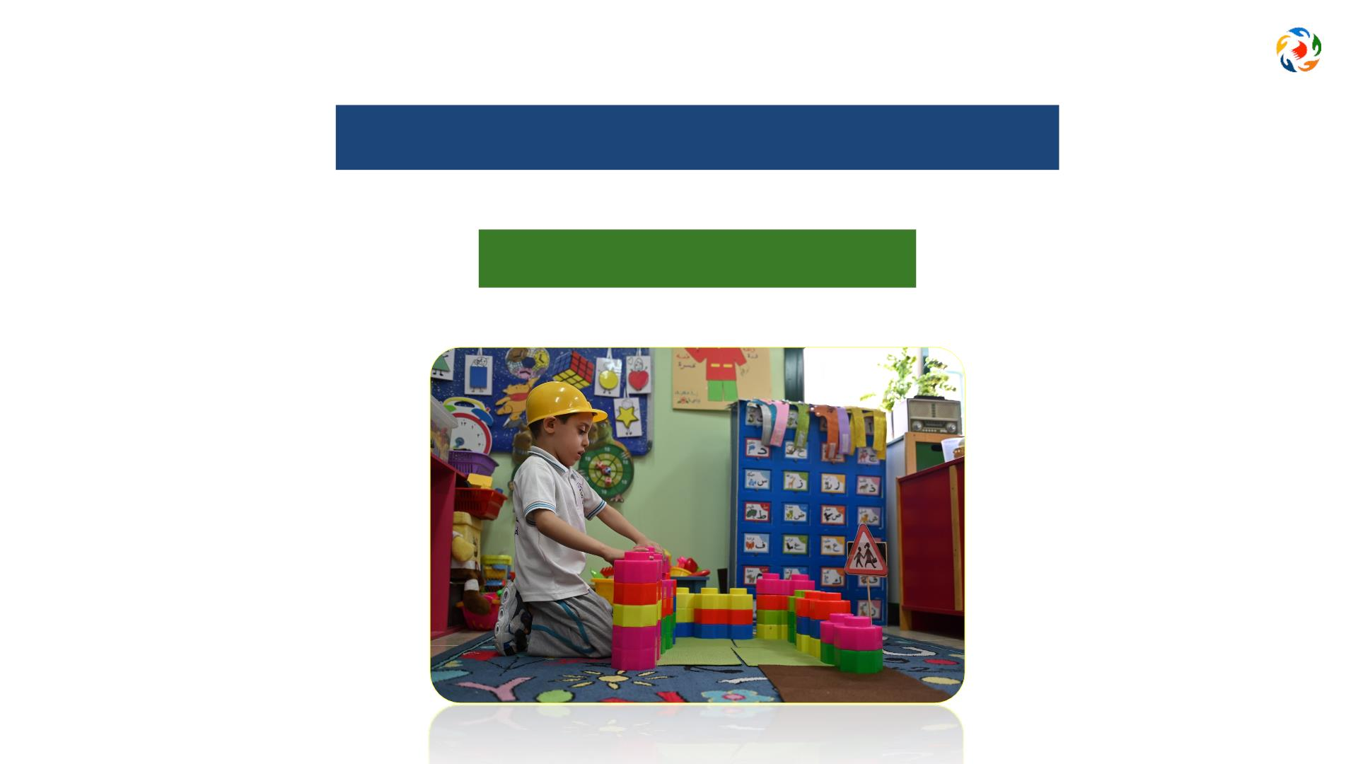
What do we mean when we say
Play Based Learning?

Slide 21

Play Based Learning

Slide 22
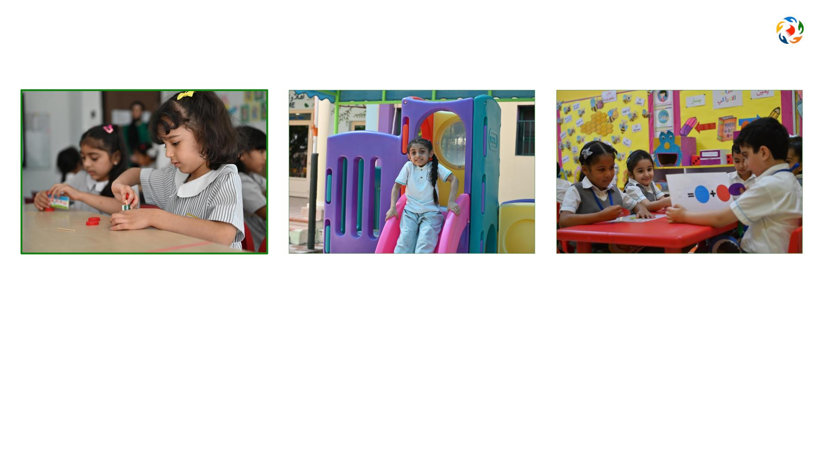
What is Play Based Learning?
Learning through play means
that the child learns new things -
knowledge and skills - while
playing.
Through play, children discover the
It does not mean free play without purpose
or planning, but rather refers to educational
play activities carefully planned by the
teacher to support the child’s growth and
development through diverse experiences,
matching their abilities and interests.
world around them and learn
important life skills in a fun and
relaxing way, including problem-
solving and communication skills.

Slide 23

Play in scientific research
Data from studies comparing the effect of play on children’s learning compared to children who learned in a
traditional setting:
34% Development of cognitive skills
75%
30% language development
Show higher empathy
such as memory and critical thinking
and ability to resolve conflicts
and learned vocabulary
45% More likely to excel in
40% Development in gross and
reading, writing and math at school
fine motor skill

Slide 24

Aspect 2: Child Initiated Learning
Where to obtain data and evidence?
• Observation of learning experiences
• Interaction with the children
• Evaluation of learning plans
• Assessing children’s outcomes.

Slide 25
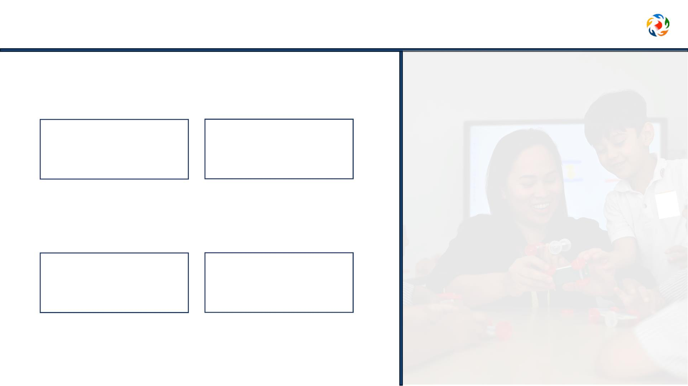
Aspect 3: Leadership and Management
3.1 Leadership effectiveness
3.1.1
3.1.2
Improvement Planning
Managing Resources
3.2 Family and Community Engagement
3.2.2
3.2.1
Family Involvement
Engagement with the
Community

Slide 26
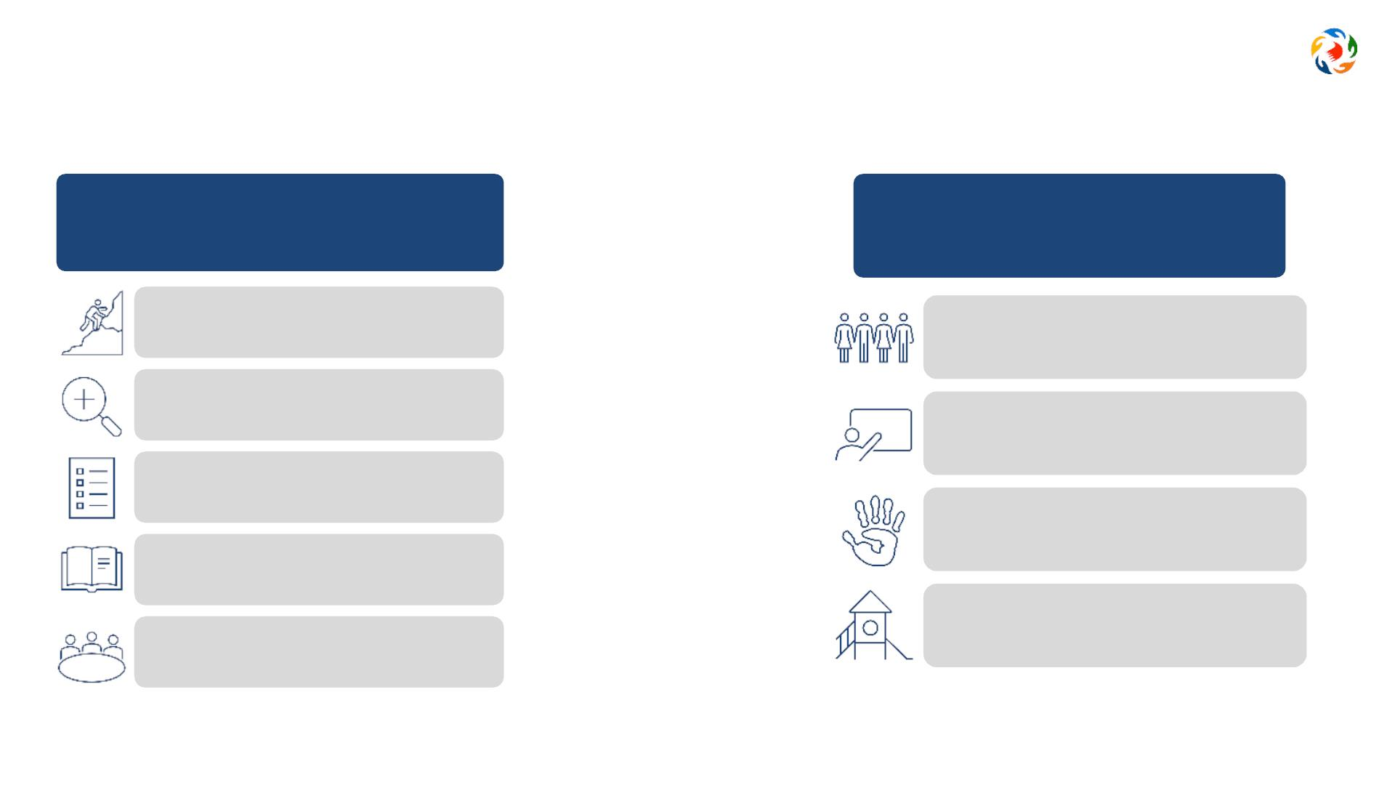
Aspect 3: Leadership and Management
3.1.1
3.1.2
Improvement Planning
Managing Resources
Clear vision
Suitability of staff
Staff development
Self-Evaluation to identify priorities
Improvement planning
Effectiveness of resources
Learning facilities
Curriculum implementation
Impact of governance *

Slide 27
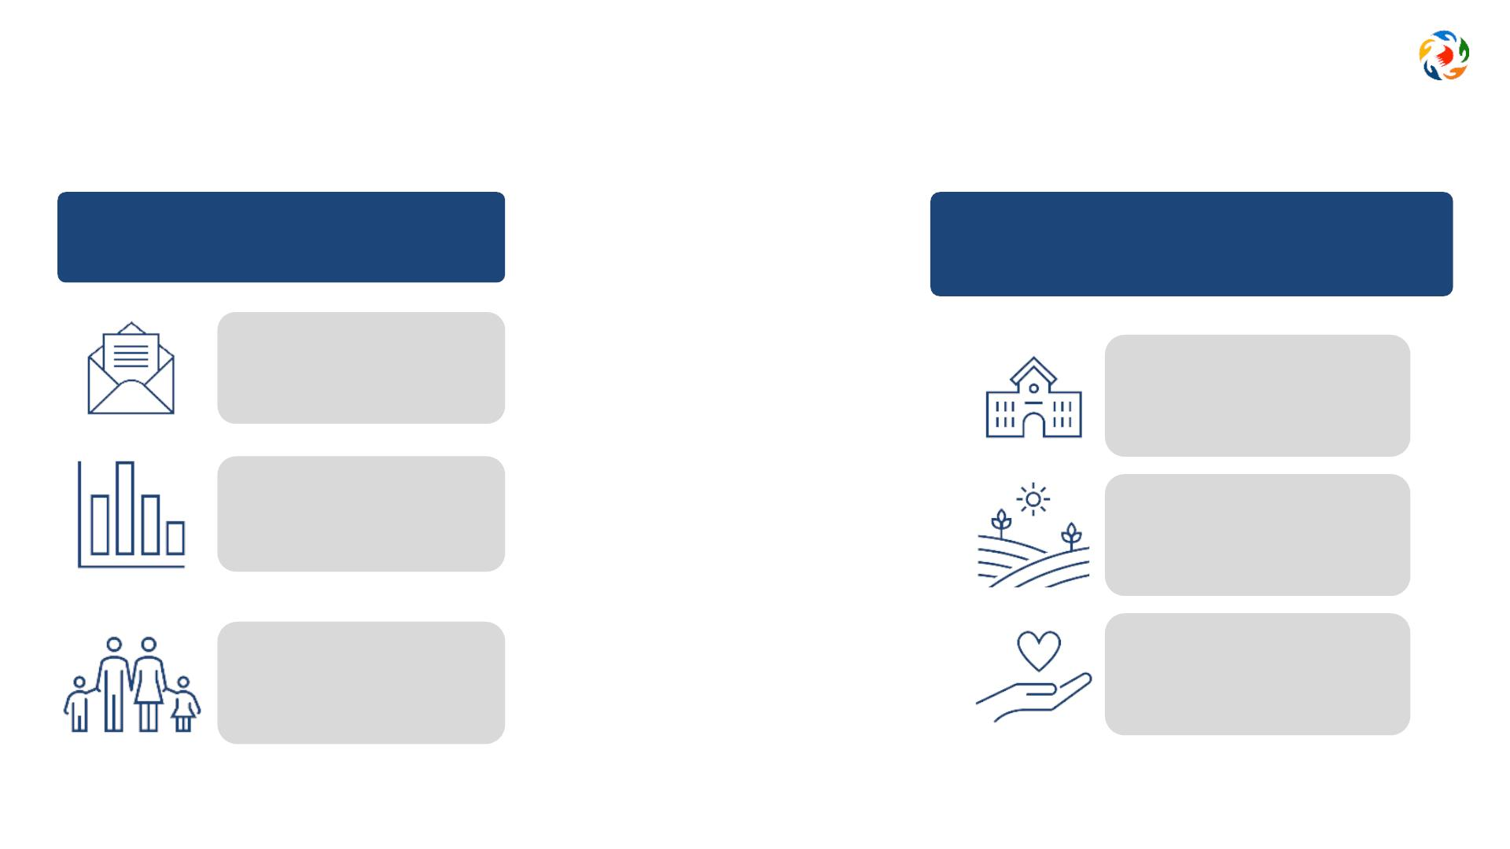
Aspect 3: Leadership and Management
3.2.1
3.2.2
Family Involvement
Engagement with the Community
Communicating
with parents
Next stage of
education
Progress updates
Enrich
experiences
Engagement in
activities
Sense of inclusion

Slide 28

Family’s engagement in kindergartens

Slide 29
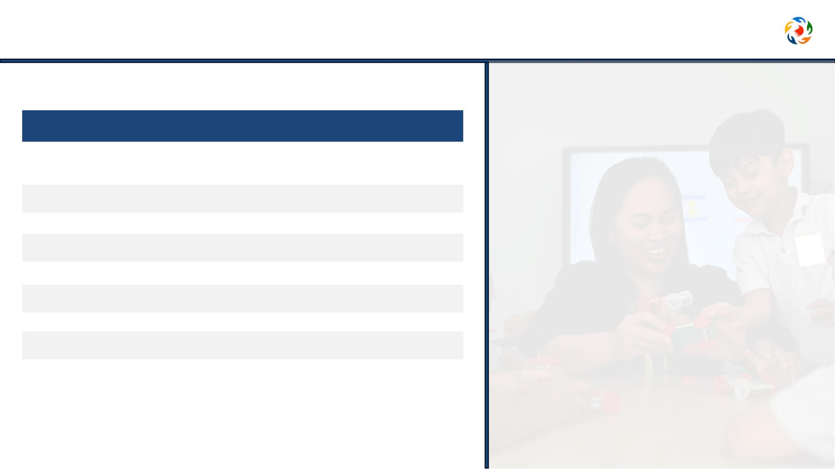
Aspect 3: Leadership and Management
Where to obtain data and evidence?
• Assess leadership awareness
• Analysis of plans
• Evaluate resources and facilities
• Interviews and document analysis.

Slide 30

Activity 2
Discuss in groups the diagram below, then answer the following questions:
ꢀ
Criteria
What is the name of the aspect (A) in the
diagram?
1
2
3
4
x
WhatꢀisꢀcriterionꢀXꢀinꢀaspectꢀ(A)?
Aspect
A
Suggestꢀsomeꢀactivitiesꢀthatꢀyouꢀwillꢀimplementꢀasꢀaꢀprincipalꢀtoꢀ
enhanceꢀcommunicationꢀandꢀengageꢀfamiliesꢀinꢀchildren'sꢀ
learningꢀexperiences.
Family and
Community
proposedꢀaꢀsetꢀofꢀnecessaryꢀtrainingꢀworkshopsꢀ
forꢀkindergartenꢀteachersꢀinꢀgeneral.
Engagement

Slide 31

Activity 2
Discuss in groups the diagram below, then answer the following questions:
ꢀ
Leadership
effectiveness
1
2
3
4
Leadership and Management
Leadership
and
Management
Leadership effectiveness
Playꢀdayꢀwithꢀmom,ꢀreadingꢀaꢀstoryꢀwithꢀgrandpa,ꢀfootballꢀwithꢀ
dad,ꢀaꢀtripꢀtoꢀtheꢀcastleꢀwithꢀmyꢀgrandma,ꢀmyꢀfavoriteꢀdishꢀwithꢀ
myꢀsister...ꢀEtc.
Family and
Community
Applyingꢀplay-basedꢀlearningꢀ–ꢀdevelopingꢀchildren’sꢀ
communicationꢀskillsꢀ–ꢀcharacteristicsꢀofꢀchildren’sꢀ
developmentꢀ–ꢀinteractiveꢀlearningꢀenvironmentꢀ–ꢀetc.
Engagement

Slide 32
kindergartensꢀreviewsꢀprocessꢀandꢀprocedures

Slide 33

kindergartens reviews process and procedures
Stage 1
Pre Review
• Kindergarten uploads the needed documents in the HUB at the
specified time
Self Evaluation Form (SEF) - plans – timetables - staff deployment list
2 weeks
pre-review
• Kindergarten receives review notification letter (review dates - name of
Lead)
• Parents’ Questionnaire (PQ)
Week of the
review
• Lead calls on Sunday
• Reviewers analyse kindergarten’s documents and prepare for the
review.
(Sunday)

Slide 34

kindergartens reviews process and procedures
• Observe kindergarten activities and children’s
experiences
Stage 2
During the review
• Scrutinise children’s outcomes and kindergartens
documents
• Discuss with the KG staff and parents
• Engage in conversations with children
Quality assurance
manager (QAM) visits
the KG to ensure the
quality of review
procedures
• Ensure availability, suitability and effectiveness of resources
• Provide Final Feedback to KG leadership.

Slide 35

kindergartens reviews process and procedures
• BQA Sends review draft report (Maximum of 4 weeks)
Stage 3
Post review
procedures
• KG comments on factual information in the draft report and shares
it with BQA (within 5 days)
• KG submits an action plans to implement the given
recommendations and share it with BQA (within 4 weeks)
No judgments
Review Reports
• The review report is shared via BQA website after Cabinet
endorsement

Slide 36
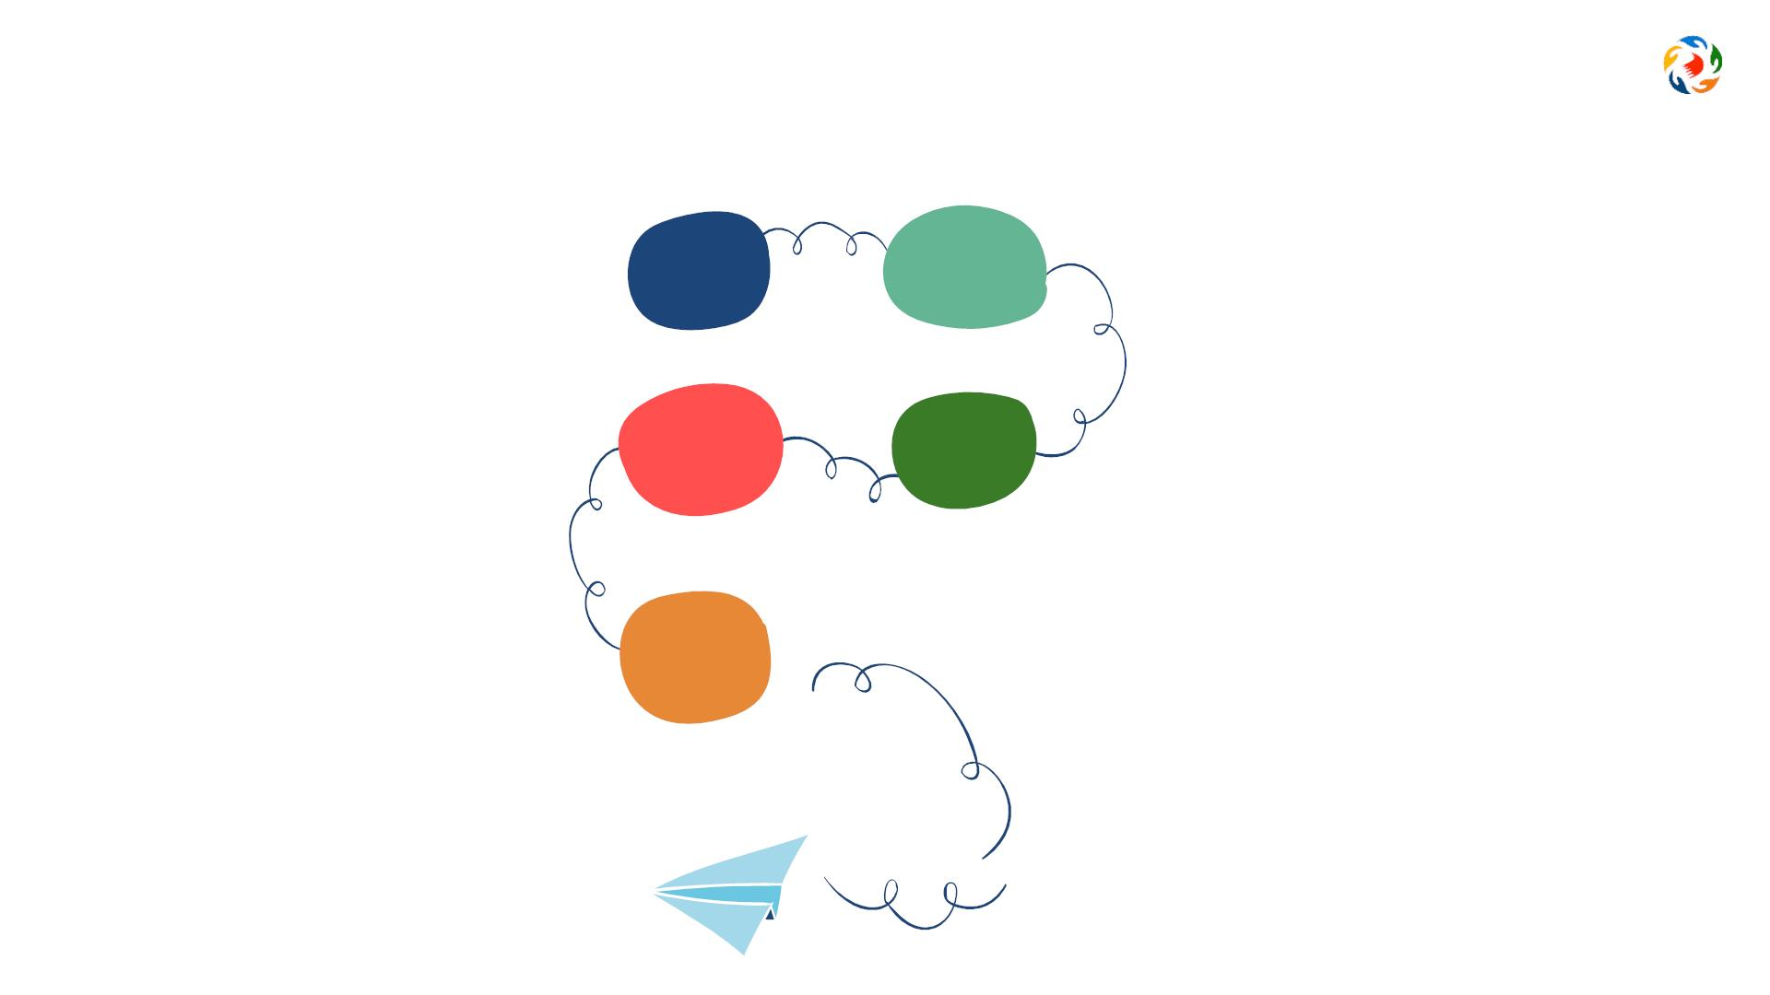
Suggested procedures to fill the SEF
1) Forming a
Self-Evaluation team
1
2
2) Planning
according to
Framework aspects
4) Critical look to evaluate
strengths and areas for
development in every
aspect
4 3
3) Collecting data and
information for every
criteria of every aspect
5
5) Filling the
Self-Evaluation Form
Upload it to the HUB

Slide 37

Common mistakes in filling the SEF
Done individually
Lack of examples
Extreme brevity or
verbosity
Unrealistic writing
Descriptive writing

Slide 38
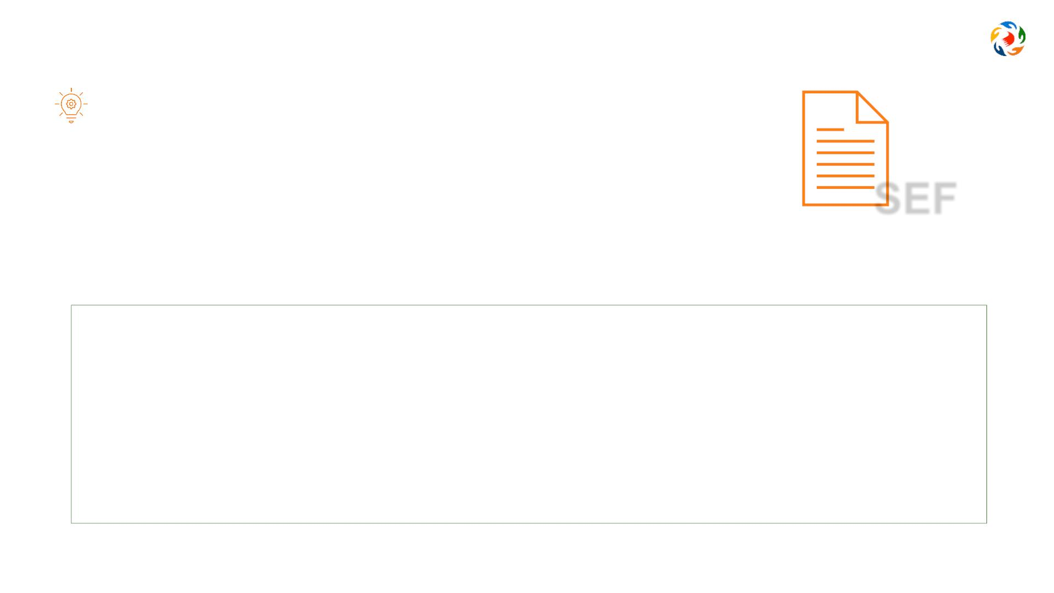
Activity 3
Reflect: What are they key positives and areas for development in …
Aspect 1: Children's Growth and Development
SEF
1.1 Children’s Social and Emotional Development
1.1.1 Social Skills (Engagement in activities, interaction with others, showing confidence,
cooperating and building friendships).
1.1.2 Behavior and Wellbeing (Sense of self and identity, Self regulation, resolve conflicts
and show positive values, develop empathy, sense of safety).
1.1.3 Communication Skills (Self expression thoughts and feelings, active listening, follow
instructions, and engage in conversations).

Slide 39

Thank you
www.bqa.gov.bh
bqa Bahrain
@bqa_bh

