Slide 1
The Training Presentation for ‘Kindergartens Reviews’ in the Kingdom of Bahrain For Kindergartens Principals

Slide 2
What is Early Childhood Education (ECE)?
Click here to view the video
Notes:
A video introducing ECE

Slide 3
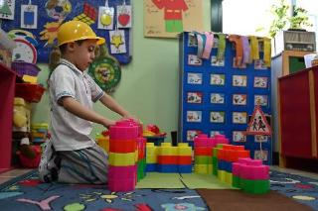
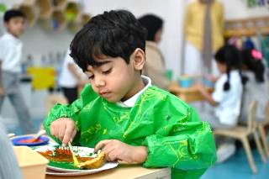
Benchmarks
Learning through PLAY
Focus on social and emotional growth
It’s all about the child
Inclusion and partnerships
Notes:
Explain: Leading countries in quality education share similar core approaches to early years education, all centred on children and their holistic development. These approaches prioritise learning through play, exploration, and meaningful interactions. Fundamental to this is a strong focus on children’s social and emotional development, supported by a collaborative partnership with families and communities. Such systems actively promote inclusive practices, ensuring all children are valued and supported, regardless of their diverse needs and backgrounds.

Slide 4
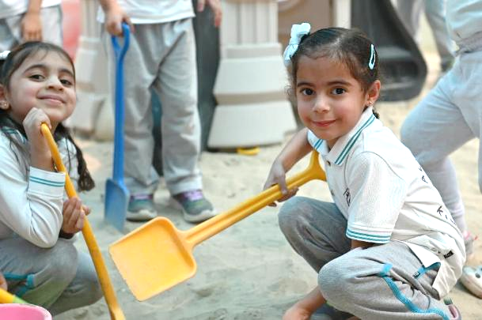
Pillars of Early Childhood Education
Centrality of Play
Notes:
Share, explain and discuss:
From the video, we understand these are the pillars of ECE:
Centrality of play:
Supports cognitive, physical, social, and emotional development.
Allows children to explore their world and learn problem-solving.
Promotes critical thinking skills.
Encourages creativity, imagination and resilience.
Central to effective early childhood education and a key method of learning.

Slide 5
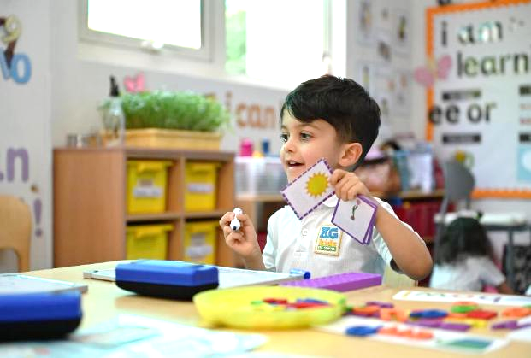
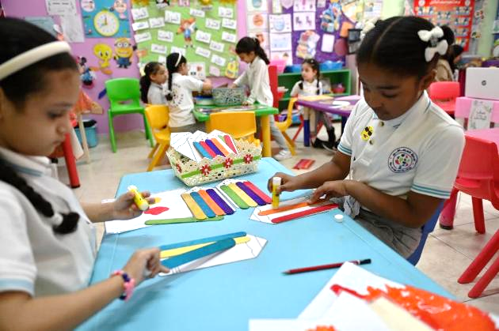
Pillars of Early Childhood Education
Holistic Development
Notes:
Share, explain and discuss:
Holistic development:
Focus on nurturing overall development of children.
Recognises each child as unique, with individual needs and interests.
Personalised learning experiences tailored to developmental levels.
Supportive environment that allows children to thrive.
Encourages growth at their own pace, based on ability and interests.

Slide 6
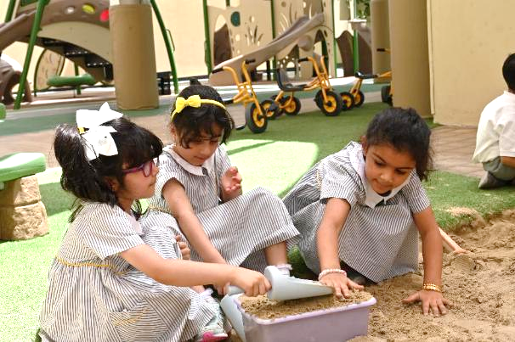
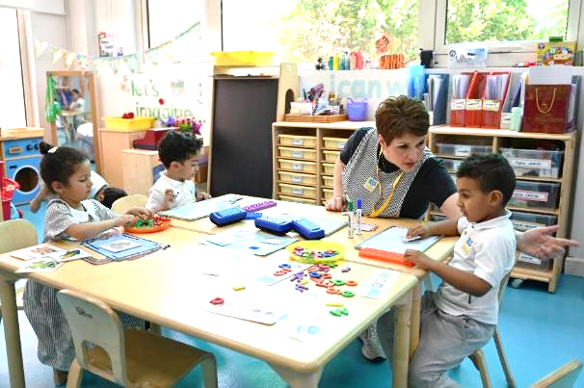
Pillars of Early Childhood Education
Nurturing and Inclusive Environment
Notes:
Share, explain and discuss:
Nurturing and Inclusive Environment:
Enriched by family and community involvement in activities and learning experiences.
All children are engaged and involved regardless of needs, conditions and backgrounds.
Fundamental for holistic development.
Safe, inclusive, and supportive atmosphere helps children feel valued and secure.
Enhances cognitive, emotional, and social growth through play, exploration, and learning.

Slide 7
Activity 1
Centrality of Play
2
Holistic Development
Nurturing and Inclusive
Environment
1
3
Reflect on your practices in the kindergarten, what types of activities foster the three pillars of ECE?
Notes:
Give the principals 15 minutes to reflect on their practices and discuss what types of activities that foster the three pillars?
They will need flipcharts , A3 papers, markers.

Slide 8
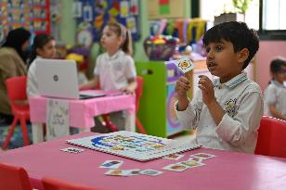
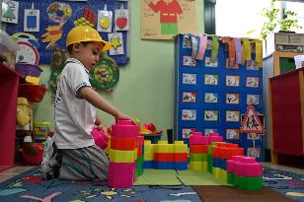
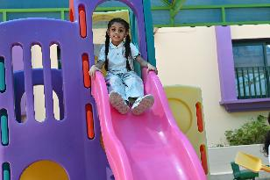
Activity 1
Sample of activities covering pillars of ECE
Matching pictures to sounds
Creating shapes with sand
1
Centrality of Play
Building blocks
Free outdoor play
Notes:
Sample answer – please note many other examples (that include children learning and growing through play) are correct
Please provide the principals chances to present their examples before showing the answer
Discuss the examples – how do they cover the pillar?

Slide 9
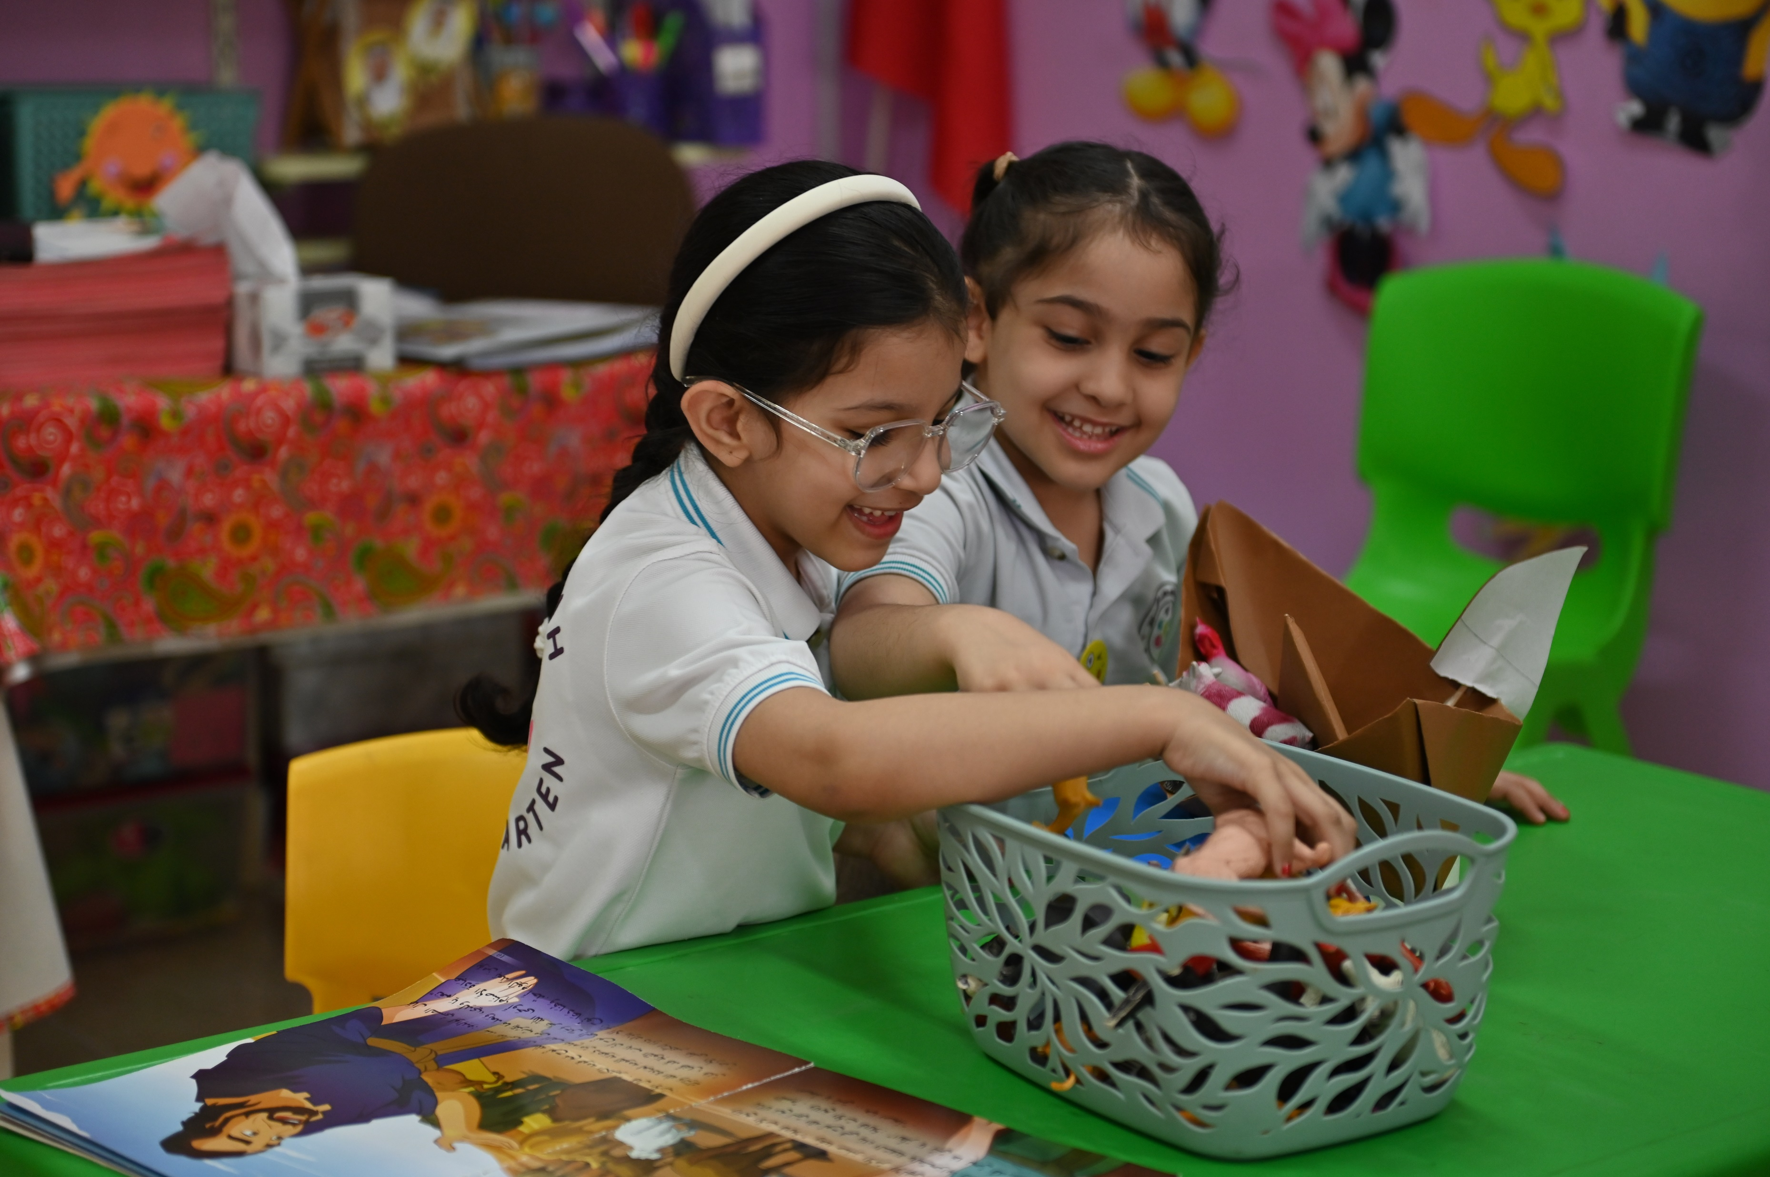
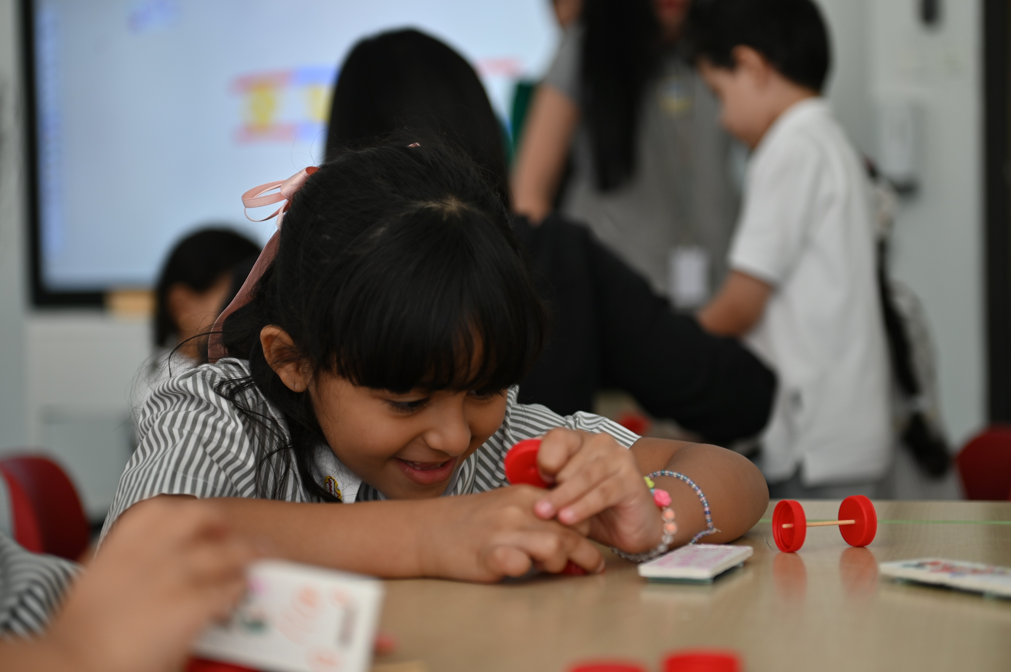
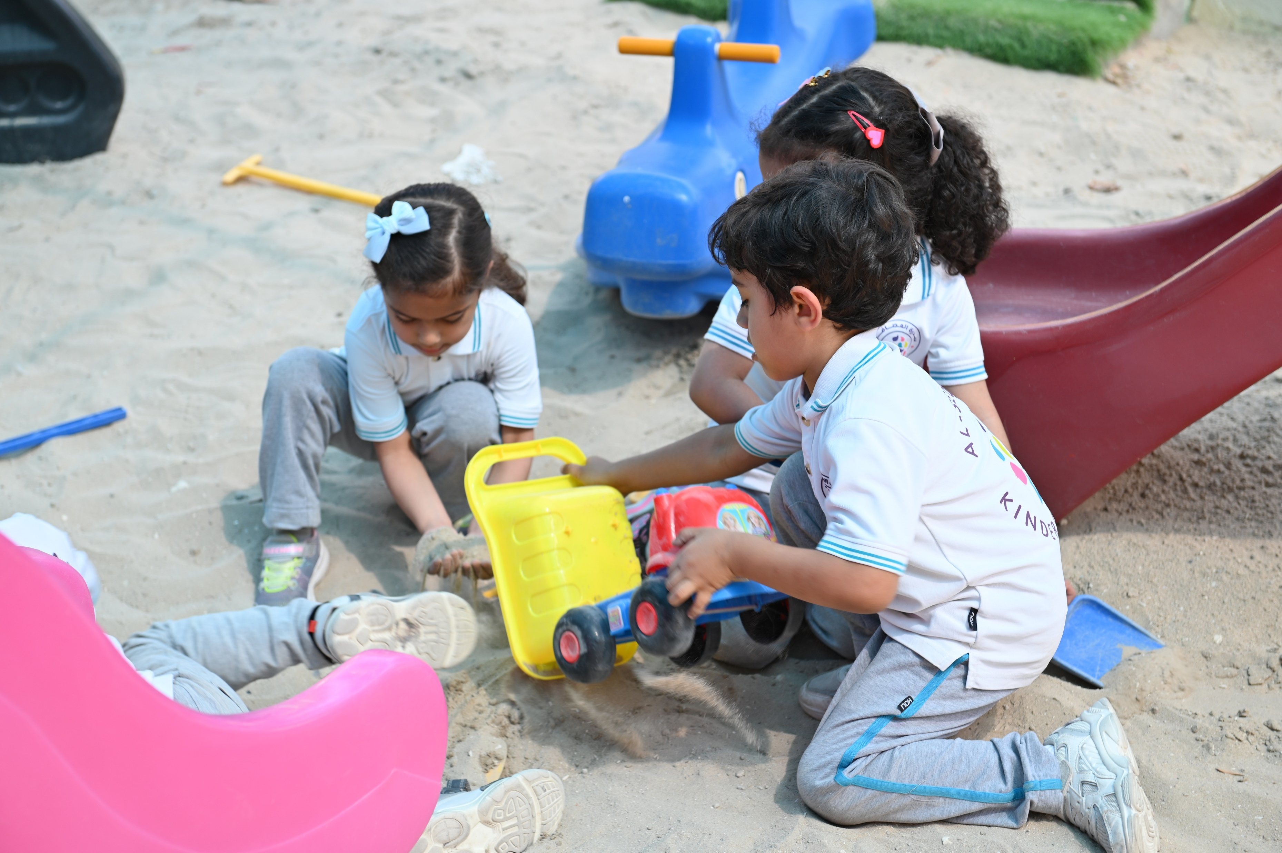
Activity 1
Sample of activities covering pillars of ECE
Pair activity
Assembling pieces to create shapes
2
Holistic Development
Outdoor group play
Express opinions and feelings
Notes:
Sample answer – please note many other examples of activities (that include children growing and progressing in skills and concepts) are correct
Please provide the principals chances to present their examples before showing the answer
After showing the answer click on the next slide

Slide 10
Activity 1
Reflect: How do these sample activities lead to ‘Holistic Development’?
Outdoor group play
Pair activity
Assembling pieces to
create shapes
Express opinions
and feelings
These sample activities all foster the development and progress of children in different aspects. While doing so, they are developing fine and gross motor skills, they’re developing their social and communication skills while interacting with others, they’re learning how to regulate their feelings and actions, they’re using their imagination through exploring and developing their creativity, etc.
That is how these activities foster
Holistic Development
Notes:
Give the principals few minutes to reflect and think about the term “Holistic Development”
Then show and discuss the answer

Slide 11
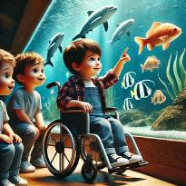
Activity 1
Sample of activities covering pillars of ECE
Story with mom
Grandad adventures
3
Nurturing and Inclusive
Environment
Dentist visit
A trip to the aquarium
Notes:
Sample answer – please note many other examples of activities (that include family and community members participation – trips and inclusivity) are correct
Please provide the principals chances to present their examples before showing the answer
Discuss the examples – how do they cover the pillar?

Slide 12
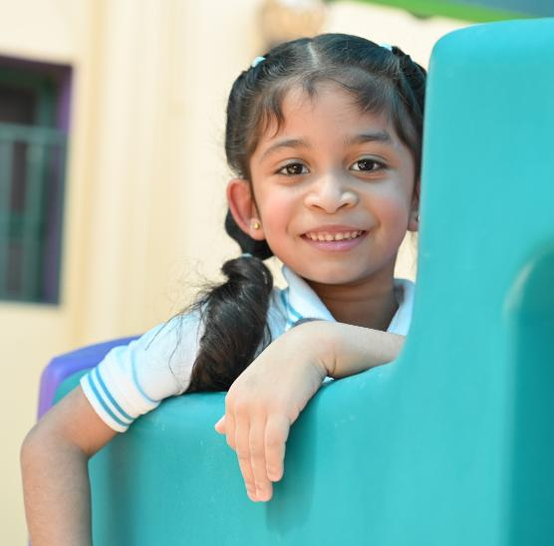
‘Kindergartens Reviews Framework’ components
Aspects
=
Evaluation
Criteria
Indicators
Notes:
Explain:
Aspect: Representing the core areas of Kindergartens’ practices.
- Criteria: Representing the focus areas in each aspect and upon which the aspect is evaluated.
- Indicator: Explaining the key elements that the criteria focus on.

Slide 13
Kindergartens Reviews Framework
Aspect 1:
Children’s Growth and Development
1.1 Children's Social and Emotional Development
1.2 Children's Physical Development
Aspect 2:
Child Initiated Learning
2.1 Areas of Learning
2.2 Curriculum Experiences
Aspect 3:
Leadership and Management
3.1 Leadership Effectiveness
3.2 Family and Community Engagement
1.3 Meeting Special Needs *
Notes:
Share, explain and discuss

Slide 14
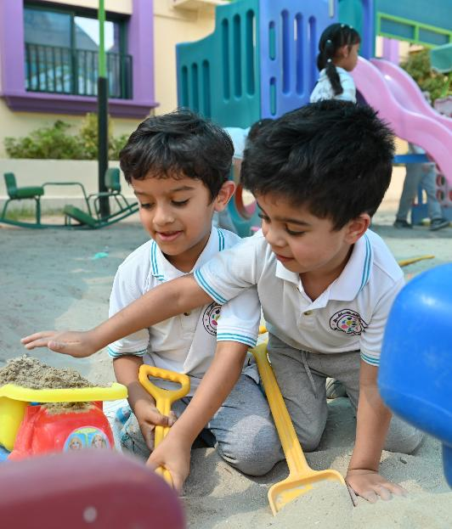
Aspect 1: Children's Growth and Development
1.1 Children’s Social and Emotional Development
1.1.2
Behavior and
Wellbeing
1.1.3
Communication Skills
1.1.1
Social Skills
1.2 Children’s Physical Development
1.2.1
Motor Skills
1.2.2
Health and Selfcare
1.3 Meeting Special Needs *
1.3.1 Special Personal Support
Notes:
Share, explain and discuss:
1.1.1 Social Skills (Engagement in activities, interaction with others, showing confidence, cooperating and building friendships).
1.1.2 Behavior and Wellbeing (Sense of self and identity, Self regulation, resolve conflicts and show positive values, develop empathy, sense of safety).
1.1.3 Communication Skills (Self expression thoughts and feelings, active listening, follow instructions, and engage in conversations).
1.2.1 Motor Skills (Development of Fine and Gross Motor skills, that includes developing hand/feet and eye coordination).
1.2.2 Health and selfcare (How children take care of themselves and make healthy choices, such as good hygiene practices, healthy eating habits and physical activity).
1.3.1 Special personal support (Identifying potential special needs and supporting children with special needs, children with health conditions and disabilities, providing needed accommodation and engagement in KG activities).

Slide 15
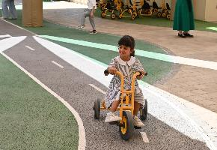
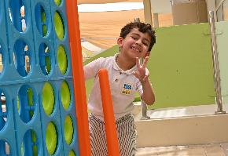
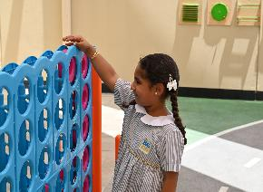
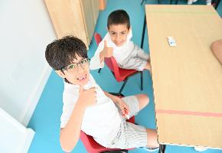
How do children grow?
Physical Development
Social and Emotional Development
Development of gross motor skills
Self awareness and confidence
Development of fine motor skills
Building friendships and playing together
Balance and coordination in movement
Managing feelings and showing positive behaviour
Cognitive Development
Language and Communication
Exploring and solving problems
Expressing feelings and thoughts
Imagination and creativity
Expressing opinion and listening actively
Learning different skills and knowledge
Participating and engaging with others
Notes:
Share, explain and discuss what is offered in kindergarten to support every area of child development

Slide 16
Quality communication and interactions
Click here to view the video
Notes:
A video explaining Quality Communication and Interactions

Slide 17
Children grow through play
Click here to view the video
Notes:
Share, explain and discuss
A video explaining how children grow holistically through play

Slide 18
Aspect 1: Children's Growth and Development
Where to obtain data and evidence?
1
Observing & evaluating children’s participation & interaction
2
Analysing documents and procedures
3
Conducting interviews and surveys
4
Reviewing sample of children’s outcomes.
Notes:
Share, explain and discuss

Slide 19
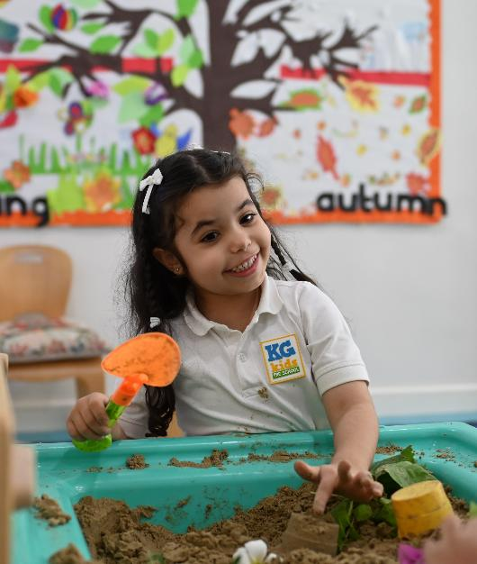
Aspect 2: Child Initiated Learning
2.1 Areas of Learning
2.1.1 Age-appropriate Experiences
2.1.2
Managing Learning Environment
2.2 Curriculum experiences
2.2.1
Acquiring Skills
2.2.2
Tracking Progress
Notes:
Share, explain and discuss:
2.1.1 Age-appropriate experiences (Active Play Based Learning – sensory learning - Investigative Learning - cooperative Learning - fostering creativity, problem solving and imagination through open ended activities and regular access to outdoor learning time).
2.1.2 Managing learning environment (Management of participation and engagement – utilization of learning time and resources – clarity of instructions – children’s motivation and love for learning – Teacher- child positive rapport).
2.2.1 Acquiring skills (Progress in language acquisition, numeracy skills, ICT skills and general knowledge, understanding the world to (life skills – citizenship – inclusivity), based on curriculum experiences).
2.2.2 Tracking progress (Holistic curriculum approach - Continuous evaluation – child observations and photos documentation - Progress Portfolios - support and feedback provided).

Slide 20
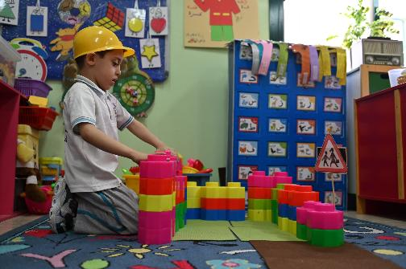
What do we mean when we say
Play Based Learning?
Notes:
Give principals few minutes to discuss the term

Slide 21
Play Based Learning
Click here to view the video
Notes:
A video explaining play-based learning

Slide 22
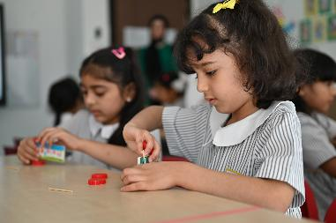
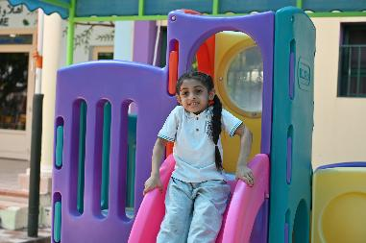
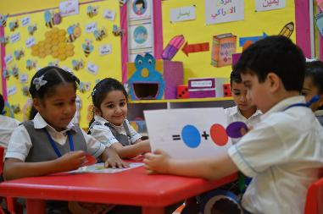
What is Play Based Learning?
Learning through play means that the child learns new things - knowledge and skills - while playing.
Through play, children discover the world around them and learn important life skills in a fun and relaxing way, including problem-solving and communication skills.
It does not mean free play without purpose or planning, but rather refers to educational play activities carefully planned by the teacher to support the child’s growth and development through diverse experiences, matching their abilities and interests.
Notes:
Share, explain and discuss

Slide 23
Play in scientific research
Data from studies comparing the effect of play on children’s learning compared to children who learned in a traditional setting:
34% Development of cognitive skills such as memory and critical thinking
75% Show higher empathy and ability to resolve conflicts
30% language development and learned vocabulary
45% More likely to excel in reading, writing and math at school
40% Development in gross and fine motor skill
Notes:
References:
(Pediatrics Journal, 2018)
(Journal of Child Psychology and Psychiatry, 2020)
(NAEYC Research, 2019)
(Early Childhood Research Quarterly, 2017)
(Journal of Pediatrics, 2021).

Slide 24
Aspect 2: Child Initiated Learning
Where to obtain data and evidence?
Observation of learning experiences
Interaction with the children
Evaluation of learning plans
Assessing children’s outcomes.
Notes:
Share, explain and discuss
((for more information on Aspect 2, you may refer to Kindergartens Teachers Training ppt))

Slide 25
Aspect 3: Leadership and Management
3.1 Leadership effectiveness
3.1.1
Improvement Planning
3.1.2
Managing Resources
3.2 Family and Community Engagement
3.2.2
Engagement with the Community
3.2.1
Family Involvement
Notes:
Share, explain and discuss
3.1.1 Improvement Planning (Work with clear vision - self evaluation to identify priorities - improvement planning – implementation of the curriculum- impact of governance).
3.1.2 managing resources (Suitability of human resources - staff development – availability and suitability of learning resources and facilities).
3.2.1 Family involvement (parents’ communication – informing progress – Family’s engagement in KG activities).
3.2.2 Engagement with the community (to prepare for next stage of education and enrich children’s experiences and sense of inclusion).

Slide 26
Aspect 3: Leadership and Management
3.1.1
Improvement Planning
Clear vision
Self-Evaluation to identify priorities
Improvement planning
Curriculum implementation
Impact of governance *
3.1.2
Managing Resources
Suitability of staff
Staff development
Effectiveness of resources
Learning facilities
3.1 Leadership effectiveness
Notes:
Share, explain and discuss
3.1.1 Improvement Planning
Evaluates kindergarten’s clear vision guiding direction and decision-making.
Assesses self-evaluation process to identify strengths and areas for improvement.
Focus on curriculum implementation and identified priorities.
Impact of governance on leadership support and quality education.
3.1.2 Managing Resources
Evaluates suitability of human and learning resources.
Ensures staff qualifications and skills meet children’s needs.
Professional development opportunities and feedback for staff growth.
Assesses learning resources and facilities for safety and appropriateness to create an optimal learning environment.

Slide 27
Aspect 3: Leadership and Management
3.2.1
Family Involvement
Communicating with parents
Progress updates
Engagement in activities
3.2.2
Engagement with the Community
Next stage of education
Enrich experiences
Sense of inclusion
3.2 Family and Community
Engagement
Notes:
3.2.1 Family Involvement
Evaluates effectiveness in engaging parents in children’s education.
Focuses on communication to keep parents informed on progress and development.
Addresses parents' suggestions and concerns.
Involve family in learning activities and events.
Bridges gap between home and kindergarten, creating a consistent learning environment.
Reinforces positive attitudes and supports children's social, emotional, and overall development.
3.2.2 Engagement with the Community
Assesses collaboration with community organisations and resources.
Focus on transitions from home to Primary stage.
Enriches children's experiences through community involvement (e.g., visits to libraries, museums).
Provides real-world learning experiences by inviting professionals (e.g., artists, police officers).
Broadens children's horizons, supports inclusion, and enhances holistic development.

Slide 28
Family’s engagement in kindergartens
Click here to view the video
Notes:
A video on family engagement

Slide 29
Aspect 3: Leadership and Management
Where to obtain data and evidence?
Assess leadership awareness
Analysis of plans
Evaluate resources and facilities
Interviews and document analysis.
Notes:
Share, explain and discuss

Slide 30
Activity 2
Discuss in groups the diagram below, then answer the following questions:
Criteria
x
What is the name of the aspect (A) in the diagram?
1
What is criterion X in aspect (A)?
2
Aspect A
Suggest some activities that you will implement as a principal to enhance communication and engage families in children's learning experiences.
3
Family and Community
Engagement
proposed a set of necessary training workshops for kindergarten teachers in general.
4
Notes:
In groups, discusses the aspect and answers questions related to it Resources: A3 papers, pens Set aside 10 minutes to do the activity Set aside time for principals to share and discuss their answers, before presenting the model answer

Slide 31
Activity 2
Discuss in groups the diagram below, then answer the following questions:
Leadership effectiveness
Leadership and Management
1
Leadership effectiveness
Leadership and Management
2
Play day with mom, reading a story with grandpa, football with dad, a trip to the castle with my grandma, my favorite dish with my sister... Etc.
3
Family and Community
Engagement
Applying play-based learning – developing children’s communication skills – characteristics of children’s development – interactive learning environment – etc.
4
Notes:
share and discuss the sample answer Please note Q3 and Q4 (examples only) – other examples can be applicable

Slide 32
kindergartens reviews process and procedures

Slide 33
kindergartens reviews process and procedures
Stage 1
Pre Review
Kindergarten uploads the needed documents in the HUB at the specified time
Self Evaluation Form (SEF) - plans – timetables - staff deployment list
2 weeks
pre-review
Kindergarten receives review notification letter (review dates - name of Lead)
Parents’ Questionnaire (PQ)
Week of the review
(Sunday)
Lead calls on Sunday
Reviewers analyse kindergarten’s documents and prepare for the review.
Notes:
Share, explain and discuss

Slide 34
kindergartens reviews process and procedures
Stage 2
During the review
Observe kindergarten activities and children’s experiences
Scrutinise children’s outcomes and kindergartens documents
Discuss with the KG staff and parents
Quality assurance manager (QAM) visits the KG to ensure the quality of review procedures
Engage in conversations with children
Ensure availability, suitability and effectiveness of resources
Provide Final Feedback to KG leadership.
Notes:
Share, explain and discuss

Slide 35
kindergartens reviews process and procedures
Stage 3
Post review procedures
BQA Sends review draft report (Maximum of 4 weeks)
KG comments on factual information in the draft report and shares it with BQA (within 5 days)
No judgments
Review Reports
KG submits an action plans to implement the given recommendations and share it with BQA (within 4 weeks)
The review report is shared via BQA website after Cabinet endorsement
Notes:
Share, explain and discuss

Slide 36
Suggested procedures to fill the SEF
2) Planning according to Framework aspects
2
1
Step
1) Forming a
Self-Evaluation team
Step
3
4
4) Critical look to evaluate strengths and areas for development in every aspect
Step
Step
3) Collecting data and information for every criteria of every aspect
5
Step
Step
5) Filling the
Self-Evaluation Form
Step
Upload it to the HUB
Notes:
Take a few minutes to reflect and discuss what steps are needed to fill the self-assessment form View and discuss the answer

Slide 37
Common mistakes in filling the SEF
Lack of examples
Done individually
Extreme brevity or verbosity
Unrealistic writing
Descriptive writing
Notes:
Share, explain and discuss

Slide 38
Aspect 1: Children's Growth and Development
Activity 3
Reflect: What are they key positives and areas for development in …
SEF
1.1 Children’s Social and Emotional Development
1.1.1 Social Skills (Engagement in activities, interaction with others, showing confidence, cooperating and building friendships).
1.1.2 Behavior and Wellbeing (Sense of self and identity, Self regulation, resolve conflicts and show positive values, develop empathy, sense of safety).
1.1.3 Communication Skills (Self expression thoughts and feelings, active listening, follow instructions, and engage in conversations).
Notes:
Allocate 15 minutes for principals to reflect on their practices in the kindergarten for the first aspect – the first criteria (children’s social and emotional development)
Remind principals that they should cover all indicators of the criteria (1.1.1 – 1.1.2 – 1.1.3) from positive and areas for development
Remind principals that this process should be done collaboratively in the kindergarten to fill out the self-evaluation form
Note: There is no model answer for this activity, as each kindergarten is unique in its self-evaluation – Support principals as they attempt to write down the positive points and those that need development

Slide 39
Thank you
bqa Bahrain
@bqa_bh
www.bqa.gov.bh

